Slide 1
Obtaining Adjustable Regularization for Free via Iterate Averaging
Jingfeng Wu, Vladimir Braverman, Lin F. Yang
Johns Hopkins University & UCLA
June 2020

Slide 2
Searching optimal hyperparameter
ML/Opt problem
Main loss
Hyperparameter
Regularization
GD/SGD
Learning rate/step size
Notes:
Ridge regression, LASSO, Weight decay for deep neural networks
Typical way: re-running the optimizer

Slide 3
Re-running the optimizer is expensive! ☹
A single round of training takes about 3 days.
Almost a year to try a hundred different hyperparameters.
ResNet-50 + ImageNet + 8 GPUs
Can we obtain adjustable regularization for free?

Slide 4
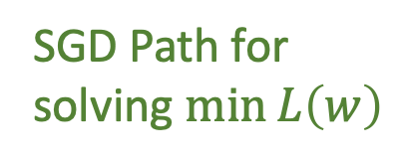

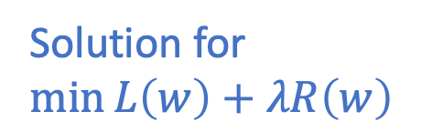
Iterate averaging => regularization (Neu et al.)
Contour of $L(w)$
Solution for
$$\min{L\left(w\right)+λR\left(w\right)}$$
SGD Path for
solving $\min{L\left(w\right)}$
Geometric
averaging

Slide 5
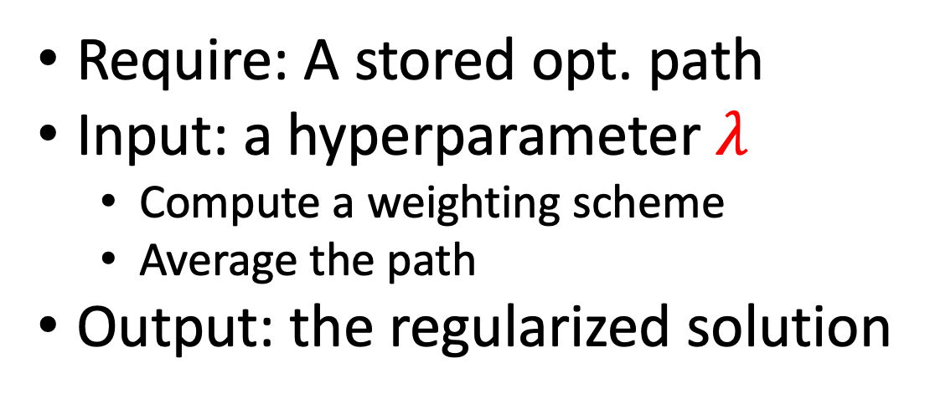
Iterate averaging protocol
Require: A stored opt. path
Input: a hyperparameter $λ$
Compute a weighting scheme
Average the path
Output: the regularized solution
Iterate averaging is cheap ☺
But Neu et al.’s result is limited ☹

Slide 6
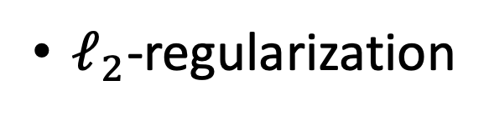
Formally, Neu et al. shows
Linear regression
$ℓ_{2}$-regularization
GD/SGD path
Geometric averaging
solves

Slide 7
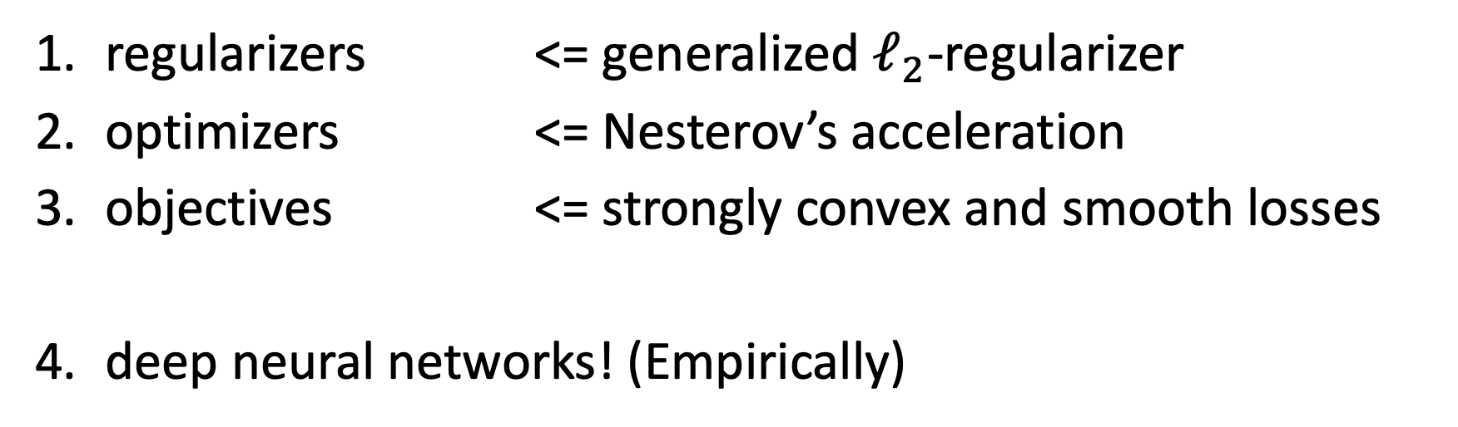
Our contributions: ☺ ☺ ☺ ☺
Iterate averaging works for more general
regularizers <= generalized $ℓ_{2}$-regularizer
optimizers <= Nesterov’s acceleration
objectives <= strongly convex and smooth losses
deep neural networks! (Empirically)

Slide 8
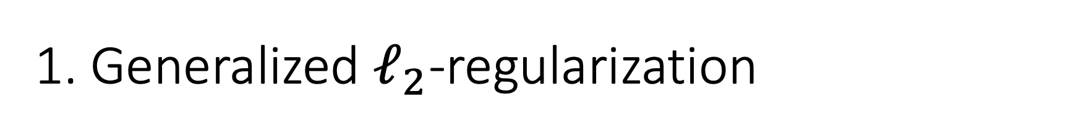
1. Generalized $ℓ_{2}$-regularization
Use a preconditioned GD/SGD path instead!
solves
Notes:
Mahalanobis distance

Slide 9
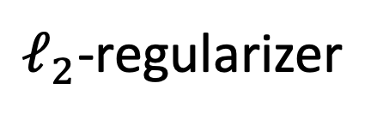
2. Nesterov’s acceleration
Weighting scheme
where
solves
$ℓ_{2}$-regularizer

Slide 10
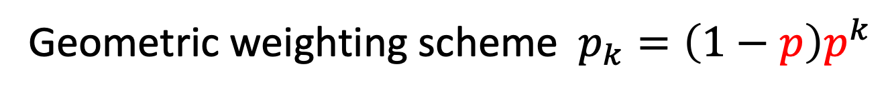
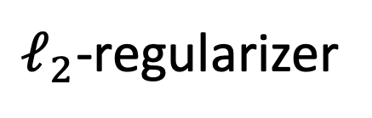
3. Strongly convex and smooth objectives
Yes! But only approximately…
Geometric weighting scheme $p_{k}=\left(1−p\right)p^{k}$
$ℓ_{2}$-regularizer

Slide 11
4. Deep neural networks ☺
A single
GPU K80
Iterate averaging is effective and efficient!

Slide 12
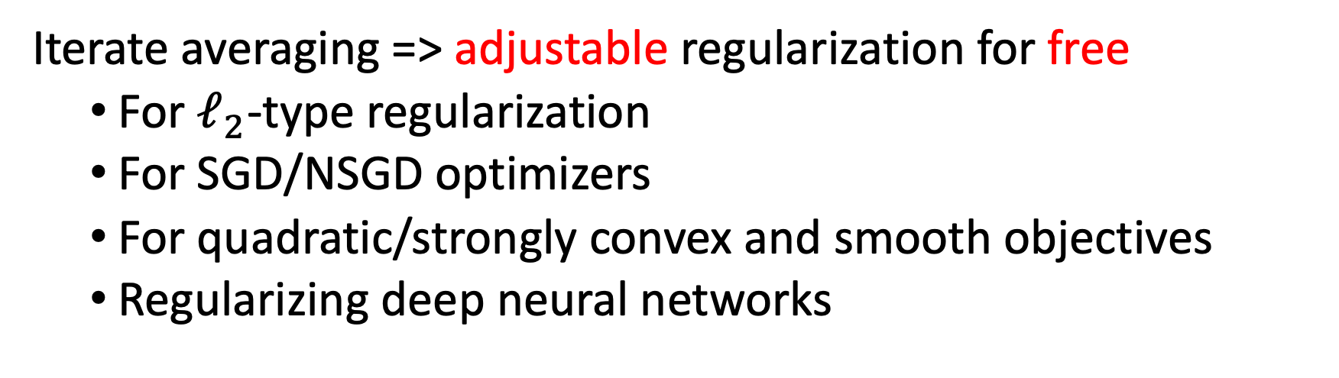
Take Home
Iterate averaging => adjustable regularization for free
For $ℓ_{2}$-type regularization
For SGD/NSGD optimizers
For quadratic/strongly convex and smooth objectives
Regularizing deep neural networks
Join our poster session for more details!

