Slide 1
Database Design Animal Health & Adoption Management System
Yunan Shao

Slide 2
Main Concepts
This is an imaginary database I created based on my AED final project.
Main design ideas focus on workflow of work requests.
Different from JAVA Objects, tables can not present the inheritance of a class which means the stage of a work request need more than one table to represent.

Slide 3
Problem Statement
More Families have kept pets or plan to have pets but not all of them have paid enough attention to their pets’ health.
Taking pets to the clinic is inconvenient sometimes, it could waste time if there are not big problems.
Adoption is always a better option than buying a pet and can be done in a more convenient way.
Homeless animals can cause potential transmitted diseases and need to be rescued in time.

Slide 4
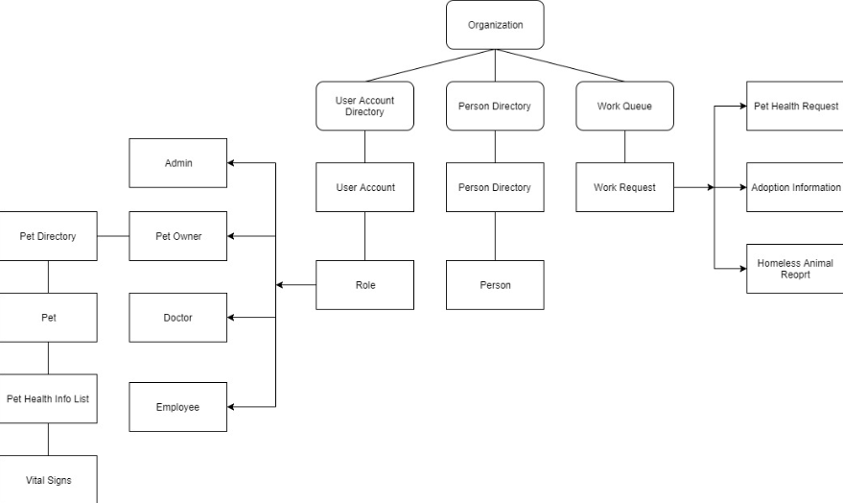
Object Model in JAVA

Slide 5
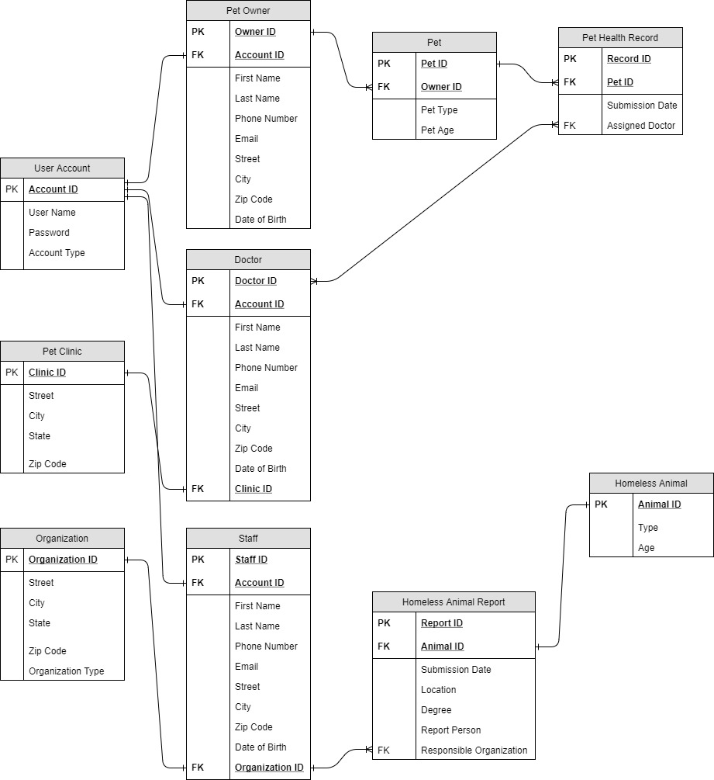
ER Diagram Before

Slide 6
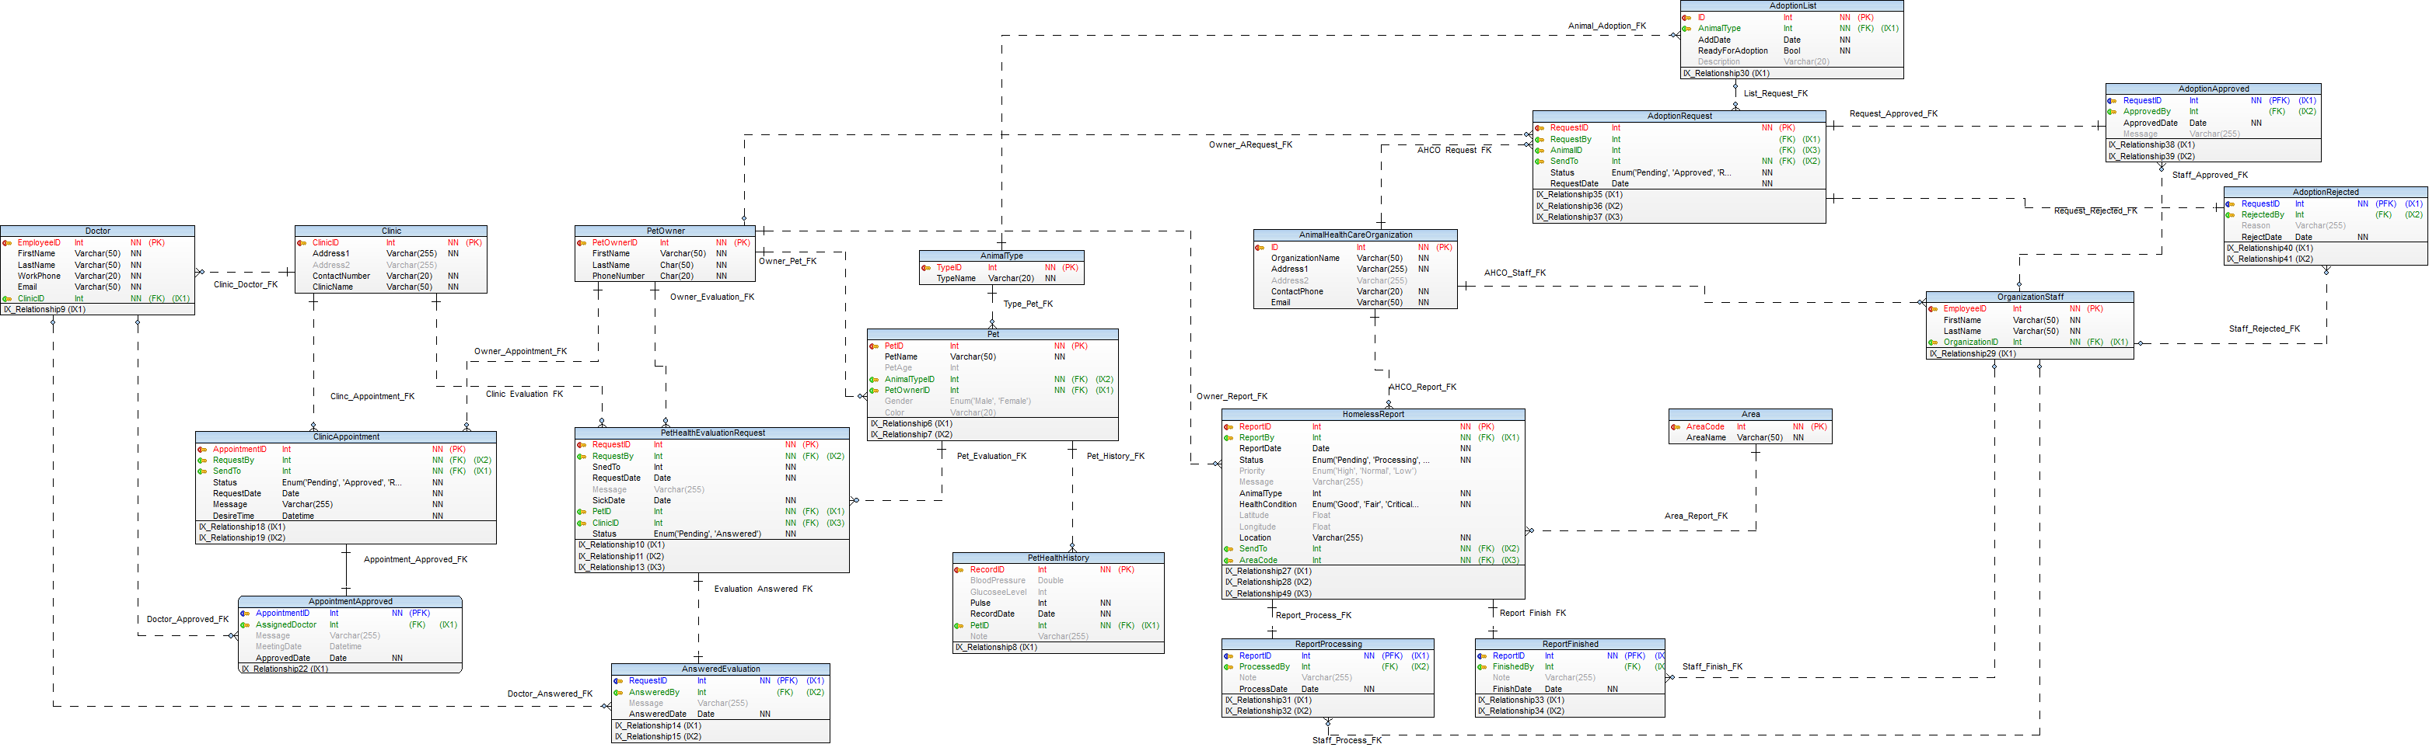
Final ER Diagram

Slide 7
Final ER Diagram
Main changes
Add tables for different status of table with additional information.
Problems: Trigger does not take parameters and the attributes in middle table are not in the main table.
Workaround: Make those attributes nullable and execute trigger first to insure the uniqueness.
Or create temporary table to fire the trigger.

Slide 8
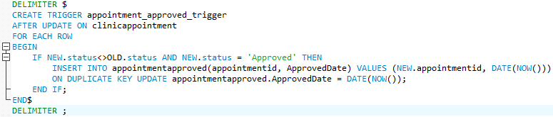
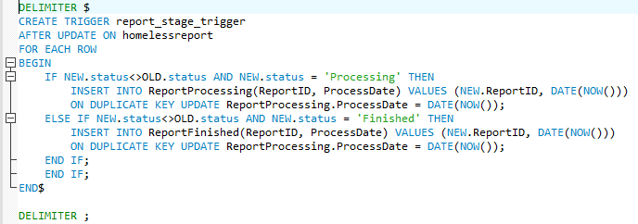
Triggers

Slide 9
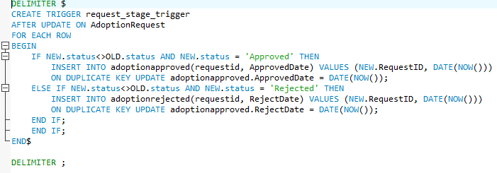
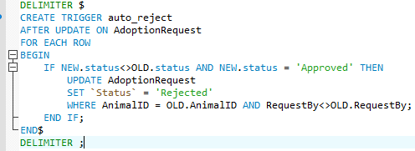
Triggers cont.
All triggers are set for work requests (appointments, adoption requests, etc.) to insert a unique record into sub tables presenting the different stage or function as a receipt for the original request.

Slide 10
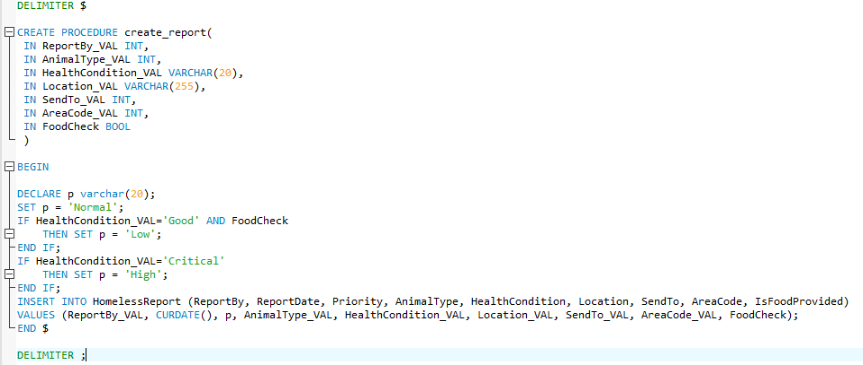
Procedure-Report Priority Determinant
Because the priority is depend on multiple attributes when a user submit a report. I use procedure to insert on the report table in order to make the priority can be automatically set by the database.

Slide 11
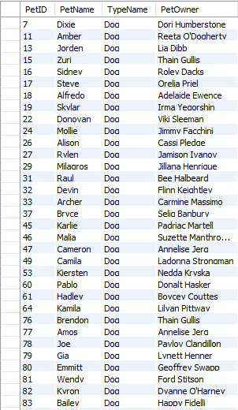

Views

Slide 12


Slide 13
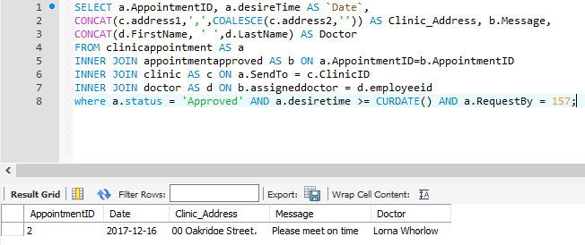
Basic Functions
Finding appointments with doctor in the future

Slide 14
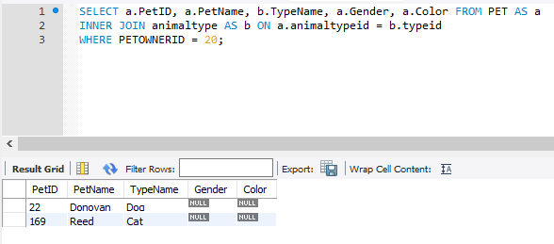
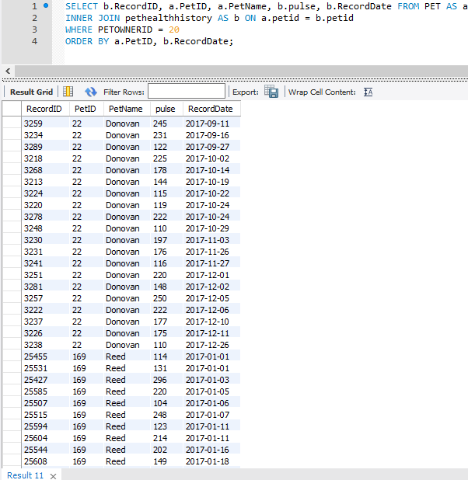
Pet Management
All pets owned by one person.
All health record ordered by date for each pet.

Slide 15
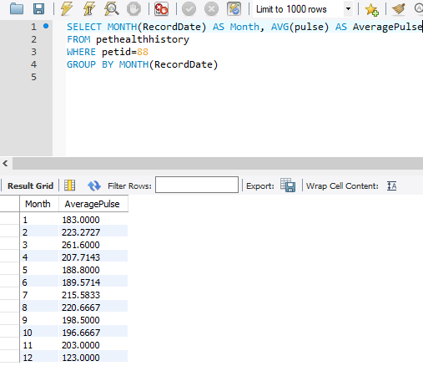
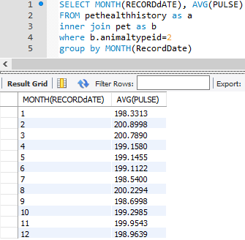
Pet Health
Overall monthly average for comparison
Individual monthly average

Slide 16
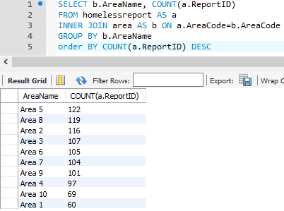
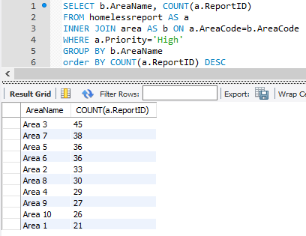
Homeless Report
Total number of report for each area. Get the idea of potential transmitted disease might take place.
Total number of report for each area by priority. Predict which area need more employee and need to be paid more attention.

