Slide 1
LDA*&Sys-TM(1)
Qingfeng Yao

Slide 2
Guideline
LDA*:
A Robust and Large-scale Topic Modeling System
Sys-TM:
A Fast and General Topic Modeling System

Slide 3
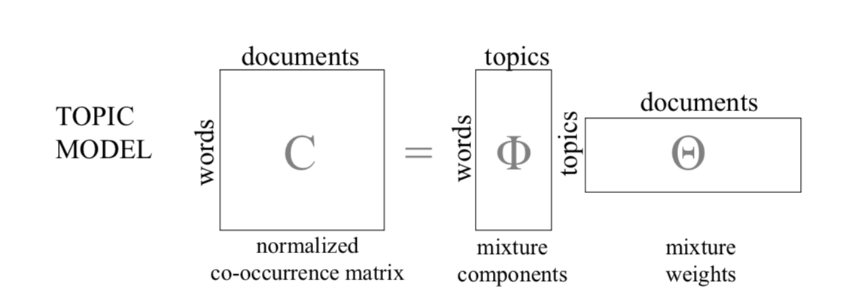
Topic Model

Slide 4
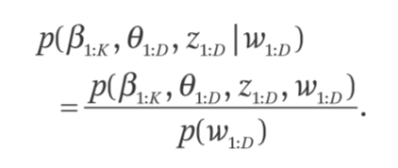
Topic Model
analyze the words of the original texts to discover the themes that run through them,
how those themes are connected to each other, and how they change over time.

Slide 5
Guideline
LDA
Sampler Selection

Slide 6
Guideline
Sys-TM:
Topic Model Revised
LDA*:
Distributed Setting & Asymmetric Parameter Server

Slide 7


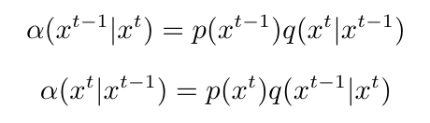
Review
Detailed Balance Condition
MCMC

Slide 8

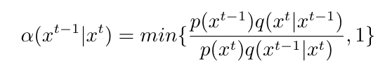
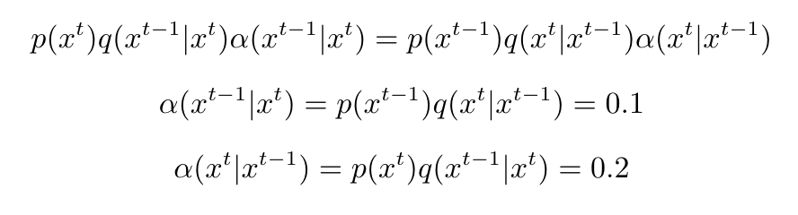
Review
MCMC: the proposal distributions
MH:

Slide 9
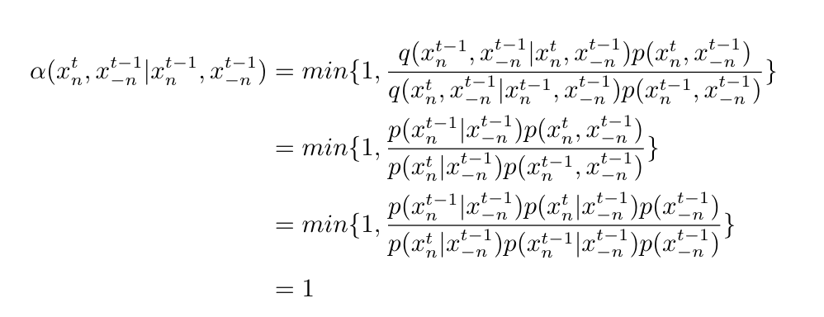
Review
Gibbs: the posterior conditionals for each of the random variables
the proposal distributions for Gibbs sampling are the posterior conditionals

Slide 10
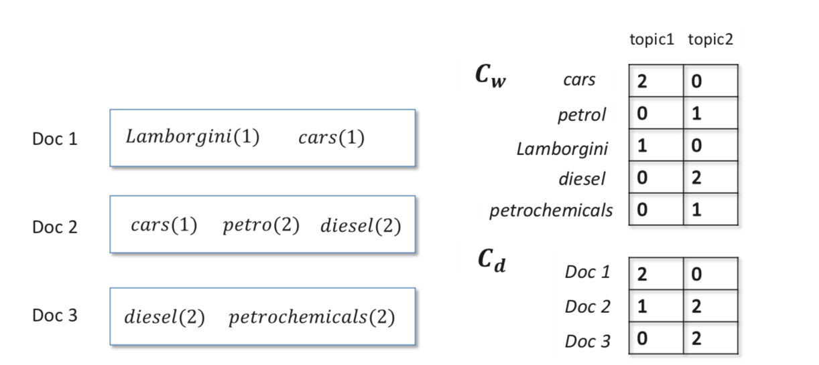

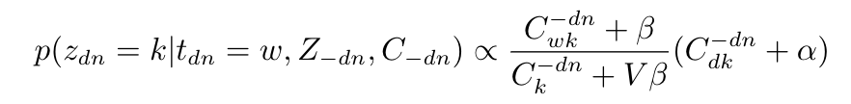
Review

Slide 11
Guideline
LDA
Sampler Selection

Slide 12
LDA
LDA models each document as random mixtures over latent topics
each document d is represented as K-dim topic distribution θd which follows a Dirichlet prior α, while each topic k is a V -dim word distribution φk which follows a Dirichlet prior β.

Slide 13
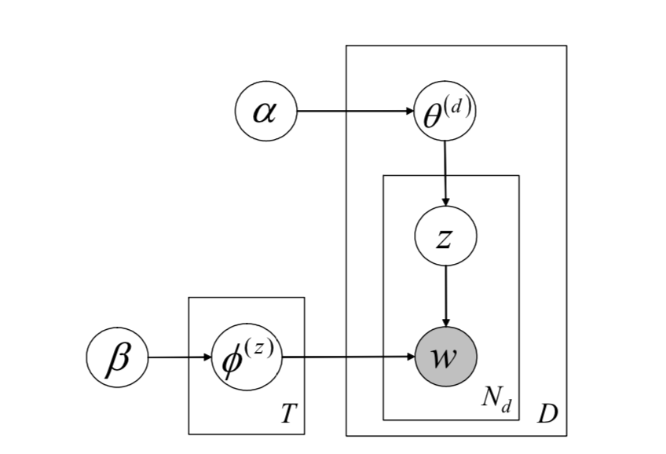
LDA

Slide 14
Sampler Selection
Sparsity-Aware (SA) Samplers: skip those with zero Cdk or Cwk
AliasLDA
F+LDA
Metropolis-Hastings (MH) Samplers: scale to a large number of topics
LightLDA
WarpLDA

Slide 15
System Tradeoff
SA samplers: when K, Ld, and Lw are smaller
MH samplers: otherwise

Slide 16
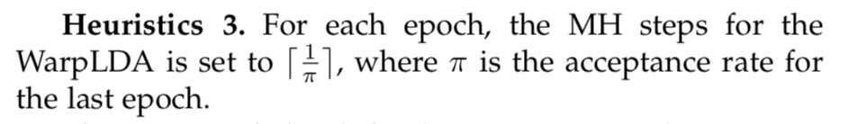
Hybrid Sampler
based on F+LDA and WarpLDA
F+LDA and WarpLDA always dominate others
can cleverly choose an efficient sampler with the tradeoff
how to decide which document is long enough or word is common enough to “qualify” for WarpLDA
S is a threshold value that depends on the implementation and properties of the dataset
how to balance an MH sampler and an SA sampler, which have different convergence speeds

Slide 17
Guideline
Sys-TM:
Topic Model Revised
LDA*:
Distributed Setting & Asymmetric Parameter Server

Slide 18
Sys-TM
Besides LDA, we focus on three other popular topic models, STM, TOT and CTM. We study how to apply state-of-the-art samplers of LDA to them
summarize two rules for applying SA and MH samplers to topic models, respectively
STM, TOT and CTM are revised based on the proposed rules

Slide 19


The Rules of Applying SA and MH Samplers
two rules
In order to apply SA sampler (F+LDA), we need to guarantee the computation independence between different topics
For MH sampler (WarpLDA), it has to draw samples from two proposal distributions qdoc and qword. We only need to guarantee that qdoc is independent of words and qword is independent of documents

Slide 20
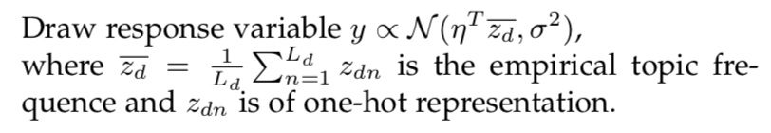
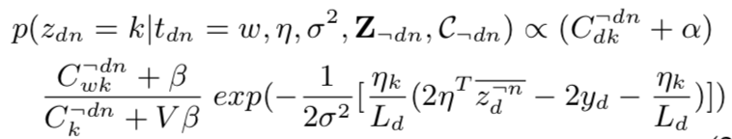
STM
Supervised Topic Model
adds a response variable to each document
the difference of generating one document between STM and LDA is that STM needs to draw one response variable y from a normal distribution after drawing all words of this document

Slide 21
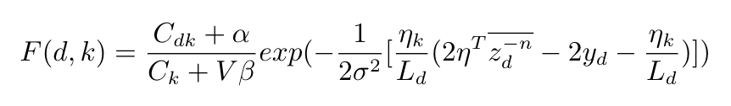


STM

Slide 22
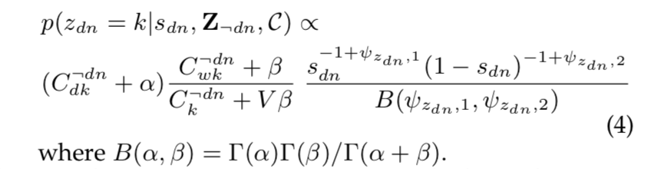
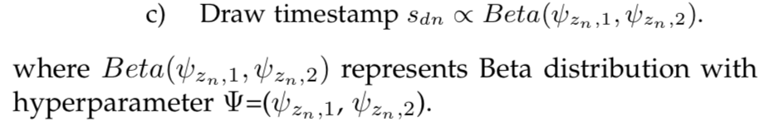
TOT
Topics over Time model
discovering topic evolution over time
assumes a continuous distribution over time associated with each topic
topics are responsible for generating both observed timestamps and words

Slide 23
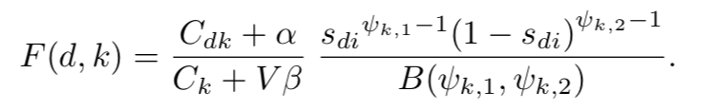

TOT

Slide 24
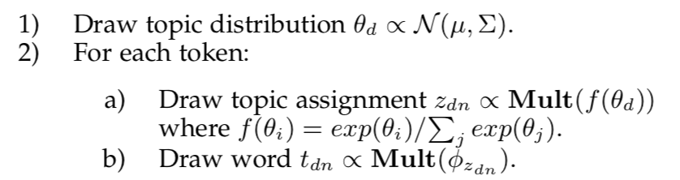
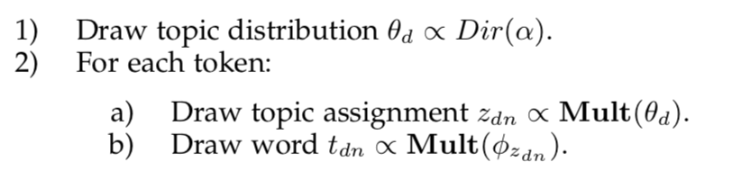
CTM
Correlated Topic Model
captures the correlation between topics by adopting logistic normal distribution for topic distribution

Slide 25
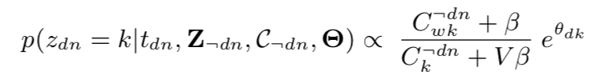
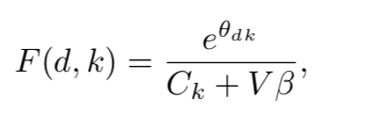
CTM

Slide 26
THANK YOU!

