Slide 1
Report
------
2018.11.28

Slide 2
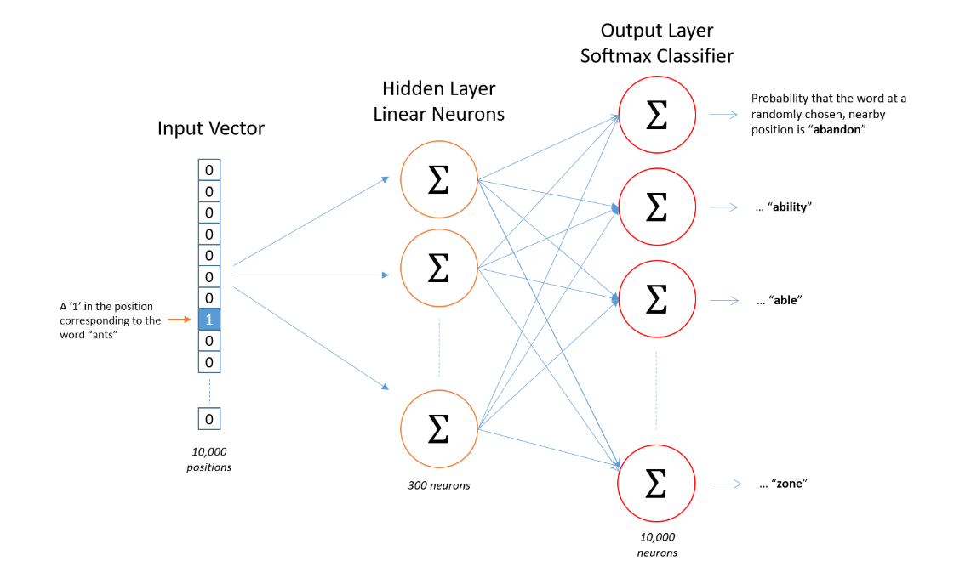

Skip gram

Slide 3
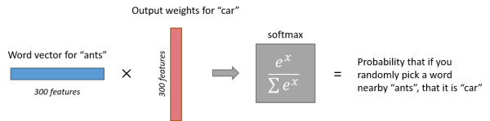

Slide 4
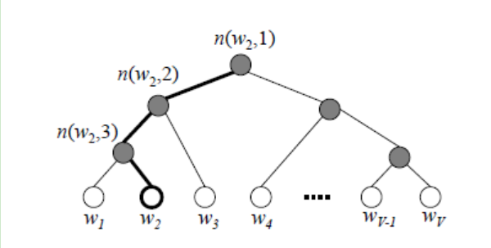
huffman tree in Hierarchical Softmax

Slide 5
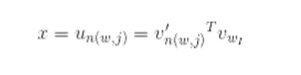




负采样

Slide 6
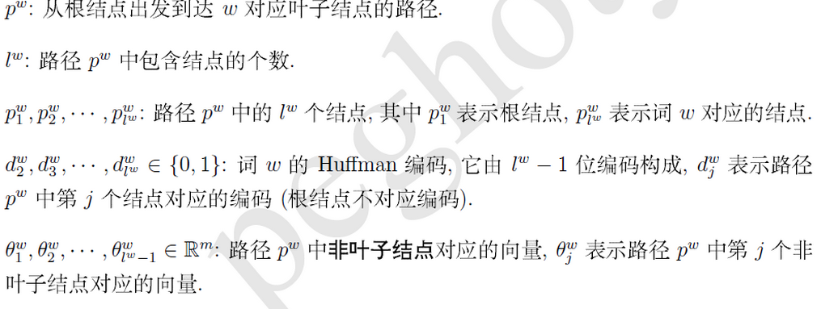

Slide 7



Calculation of model Gradient
Sigmoid Function
Log-likelihood Function(对数似然函数)of w
Gradient(梯度) of x _{w}

