Slide 1
Report
------
2018.11.21

Slide 2
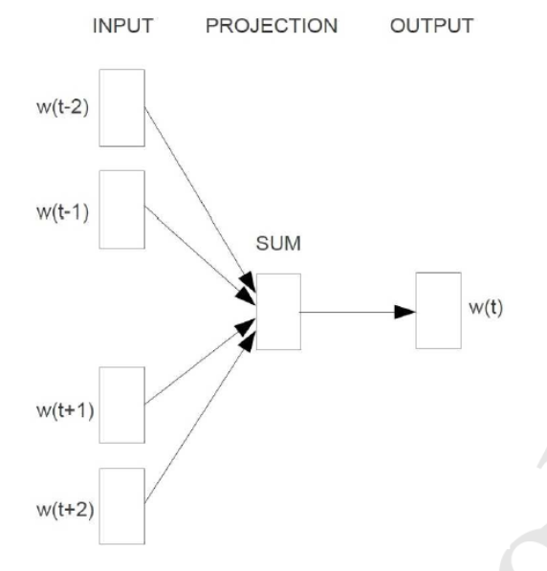
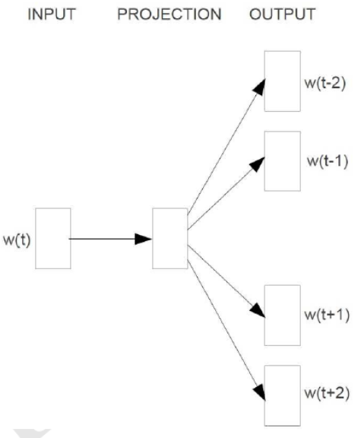
CBOW model & Skip-gram model
CBOW Model
Skip-gram Model

Slide 3

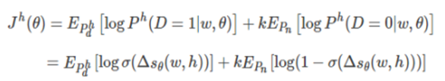
Skip-gram 词向量训练
噪声对比估计

Slide 4
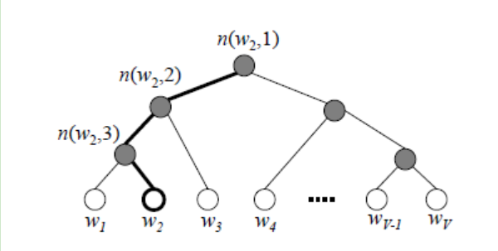
huffman tree in Hierarchical Softmax

Slide 5



Calculation of model Gradient
Sigmoid Function
Log-likelihood Function(对数似然函数)of w
Gradient(梯度) of x _{w}

Slide 6
