Slide 1

How to Write and Publish
Research Papers for the Premier Forums in Knowledge & Data Engineering
Xindong Wu
Department of Computer Science
University of Vermont
USA;
合肥工业大学计算机应用长江学者讲座教授
xwu@cs.uvm.edu
www.cs.uvm.edu/~xwu
Notes:
What are those notes used for?

Slide 2
Contents
  Some TKDE and ICDM statistics
  Scientific writing and paper structure
  What to know and how to write a top-quality paper
    A promising topic
    A convincing case
    In-depth analysis of empirical results
    The most important part: the introduction
  How to publish at ICDM and TKDE
  Paper reviewing and its feedback
  Summary of take-home messages

Slide 3

Focused Areas in
Knowledge & Data Engineering
Data Mining
  Knowledge Discovery in Databases (KDD)
  Intelligent Data Analysis
Database Systems
  Data Management
  Data Engineering
Knowledge Engineering
  Semantic Web
  Knowledge-Based Systems
  Soft Computing

Slide 4

Major Forums in Data Mining
Conferences (conference publications are extremely important in Computer Science):
  The birth of data mining/KDD: 1989 IJCAI Workshop on Knowledge Discovery in Databases
    1991-1994 Workshops on Knowledge Discovery in Databases
  1995 – date: International Conferences on Knowledge Discovery in Databases and Data Mining (KDD)
  2001 – date: IEEE ICDM and SIAM-DM (SDM)
  Several regional conferences, incl. PAKDD (since 1997) & PKDD (since 1997)
Journals (top journals vs high-impact journals):
  Data Mining and Knowledge Discovery (DMKD, since 1997)
  Knowledge and Information Systems (KAIS, since 1999)
  IEEE Transactions on Knowledge and Data Engineering (TKDE)
  Many others, incl. TPAMI, ML, IDA, …

Slide 5
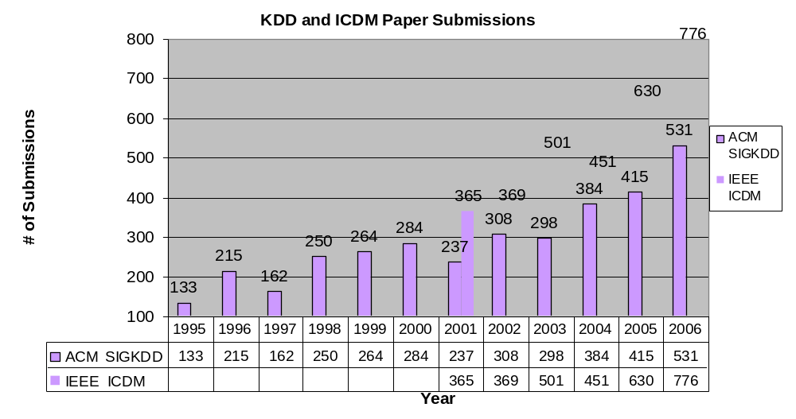
ACM KDD vs. IEEE ICDM
USTC, January 9, 2007

Slide 6
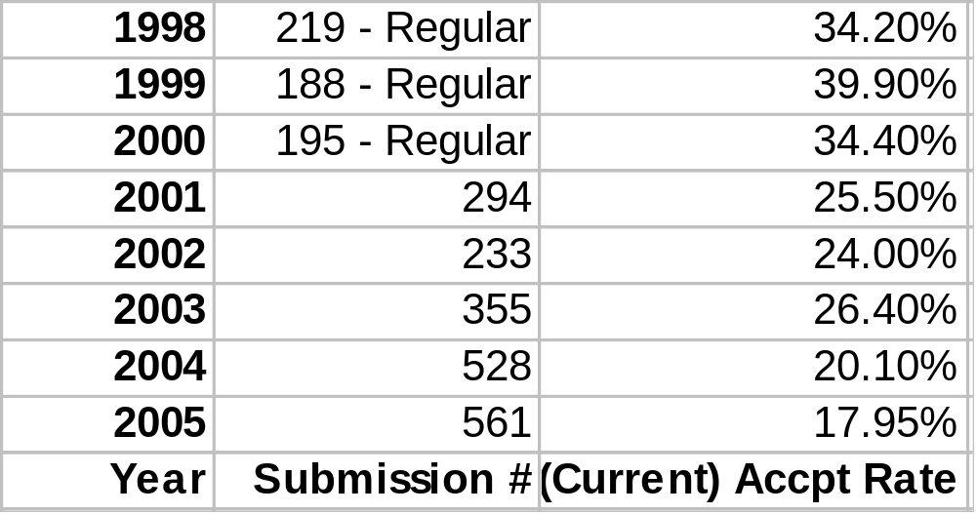
TKDE Submission Numbers and Acceptance Rates

Slide 7
Contents
  Some TKDE and ICDM statistics
  Scientific writing and paper structure
  What to know and how to write a top-quality paper
    A promising topic
    A convincing case
    In-depth analysis of empirical results
    The most important part: the introduction
  How to publish at ICDM and TKDE
  Paper reviewing and its feedback
  Summary of take-home messages

Slide 8
Why Write a Scientific Paper
Advance knowledge in your research field with evidence
Explain your ideas and make them accessible to others
Two key components in a research paper:
  An explicit claim on your contribution on a research problem
  Evidence to support your claim
Your contribution can possibly be a refutation of a hypothesis on the research problem
[Take-Home Message #1] It is NOT enough to design yet another technique or system without convincing evaluation.

Slide 9
What to Claim for a Scientific Paper
Your technique solves a problem for the first time
Your technique performs better, in one or more of the following dimensions [Alan Bundy, How-To Guides, homepages.inf.ed.ac.uk/bundy/howtos/writingGuide.html], than its rivals:
  Behaviour: X has a higher success rate then Y or produces better quality outputs, e.g. shorter,easier to understand, more similar to human outputs, etc.
  Coverage: X is applicable to a wider range of examples than Y
  Efficiency: X is faster or uses less space than Y
  Useability: Users find X easier to use than its rivals.
[Take-Home Message #2] You should avoid claiming too many dimensions, but one or two with in-depth evidence.

Slide 10
Typical Structure of a Research Paper (1)
Title: Catchy and indicative of your research contribution
  ICDM Data Mining on ICDM Paper Submissions: The shorter a paper title, the better its acceptance chance (less possibility for being incremental work)
Abstract: A summary of the research problem, your claim, and the evidence
Introduction: Motivation, a re-statement of the abstract information, significance, an outline of the rest of the paper
Related work:
  A critical review on the rival approaches that supports the motivation
  How to differentiate existing work with your own creative contributions.

Slide 11
Research Paper Structure (2)
Problem statement and algorithm design: Explain your ideas in detail
Evaluation: Evidence to support the claim of your research contribution
  Unless you can provide proofs for a theoretical paper on theorems, experimental results are always expected
Conclusion: A summary of the research contribution, a discussion on its significance, and a mention of future work.

Slide 12
Contents
  Some TKDE and ICDM statistics
  Scientific writing and paper structure
  What to know and how to write a top-quality paper
    A promising topic
    A convincing case
    In-depth analysis of empirical results
    The most important part: the introduction
  How to publish at ICDM and TKDE
  Paper reviewing and its feedback
  Summary of take-home messages

Slide 13
What to Know Before You Write
Assess the audience: To whom are you writing? Why will they be reading your writing?
Assess the purpose: What should the reader take away?
Read other people’s writing from the forums that you are targeting
  Language skills and the writing style are always important
  A paper published in one top journal can easily get rejected by another top journal – community difference or cultural difference
[Take-Home Message #3] Know your enemy: Check who are on the program committee or editorial board, and cite their relevant work with due credit
Follow the rules – length limits, formatting standards etc.

Slide 14
How to Write a Top-Quality Paper
[Take-Home Message #4] Choose a promising topic
  10 Challenging Problems in Data Mining Research (presented by Qiang Yang & Xindong Wu at ICDM ’05) http://www.cs.uvm.edu/~icdm/
Present a convincing case
Provide in-depth analysis of empirical results
Spend more time on the introduction.

Slide 15
How to Present a Convincing Case
What exactly is the problem being solved?
How are your ideas significant (to justify a paper)?
  Some ideas are so simple that have been used many times w/o being published
Is all related work referenced and reviewed?
Are the comparative studies with previous work convincing?
Has your system been implemented and used, and if so what did it demonstrate from the real world (for you and the reader to learn)?

Slide 16
In-Depth Analysis of Empirical Results
Enough details for your experiment settings (so that other researchers can verify and improve your results)
What were the alternatives considered at various points of your experiments? Why and how have you made the choices for your experiments?
[Take-Home Message #5] Are the experimental results consistent and conclusive?
Can you fine-tune some key parameters to get better or worse results? If so, use figures and tables to show their impacts on your system performances
How do the experimental results correspond to the motivation of the paper?
What have you found surprising and tried to avoid in these experiments? How generally applicable are these lessons?

Slide 17
The Most Important Part of Your Paper: the Introduction
The 1/3 – 2/3 Rule from a reviewer’s perspective:
  1/3 time to read your introduction and make a decision
  Remaining 2/3 time to find evidence for the decision
[Take-Home Message #6] A good introduction with a good motivation is half of your success!
What to cover in the introduction
  The research problem
  The motivation of your research on the research problem
  The claim of your contribution
  A summary of your evidence to support your claim
  The significance of your contribution
  An outline of the rest of the paper.

Slide 18
Contents
  Some TKDE and ICDM statistics
  Scientific writing and paper structure
  What to know and how to write a top-quality paper
    A promising topic
    A convincing case
    In-depth analysis of empirical results
    The most important part: the introduction
  How to publish at ICDM and TKDE
  Paper reviewing and its feedback
  Summary of take-home messages

Slide 19
How to Publish at ICDM and TKDE (1)
ICDM and TKDE both look for significant technological contributions
ICDM and TKDE are both very tough, expecting best results in their respective research field
[Take-Home Message #7] Reading and citing relevant papers from the premier forums (incl. ICDM/KDD and TKDE) is a must
A possible way to publish in both ICDM/KDD and TKDE:
  Submit to ICDM/KDD to get (quick) feedback
  Expand and submit to TKDE if positive feedback from ICDM/KDD, with at least 30% new material.

Slide 20
How to Publish at ICDM and TKDE (2)
How about application papers?
  Application papers are always invited, but innovations are necessary. A case of an innovative application must be presented, for the ICDM/TKDE audience.
How about data analysis w/o large volumes of data?
  Experiments on large databases are not always required, but generally expected
  Reasons on why not large data sets should be explained.
Most important of all: the uniqueness of your research in the field!
  You work has to be (1) technically sound, (2) relevant, (3) original, (4) significant, and (5) well clarified.

Slide 21
Contents
  Some TKDE and ICDM statistics
  Scientific writing and paper structure
  What to know and how to write a top-quality paper
    A promising topic
    A convincing case
    In-depth analysis of empirical results
    The most important part: the introduction
  How to publish at ICDM and TKDE
  Paper reviewing and its feedback
  Summary of take-home messages

Slide 22
The Review Process
TKDE
  EiC: Assign papers to AEs, and handle inconsistency between the AE and reviewers
  AE: Solicit reviewers, and coordinate the review process
ICDM
  PC Chairs: Assign papers to Vice Chairs and PC members
  Vice Chairs: Resolve conflicting reviews and make paper acceptance recommendations
  PC members: reviewers.

Slide 23
How to Deal with Feedback (1)
How to deal with Handling Editors
  Be polite, but to the point
  Ask for a change, if a clearly biased or unfair case.
How to deal with conflicting review reports
  For journal submissions
    Try every effort to address every concern
    [Take-Home Message #8] Provide a point-by-point statement of changes
    Use other reviewers’ comments to disagree with the negative ones
  For conference submissions
    Rebut if you think you have a reasonable chance to win – Nothing to lose
    Get senior authors involved in the rebuttal.

Slide 24
How to Deal with Feedback (2)
How to deal with “arrogant” and “ignorant” reviewers
  If there is no chance to win them over, provide a gentle statement for the “unreasonable” criticisms that you are not addressing
  You should still try and resolve some of their comments
  Your attitude towards the reviewers’ comments is important – all reviewers will read your statement of changes, and an accommodating approach is useful.
Critical reviews are always expected from first-rate journals and conferences – Don’t get emotional with negative comments
[Take-Home Message #9] Be accommodating and persistent in journal submissions & good luck! !

Slide 25
Contents
Some TKDE and ICDM statistics
Scientific writing and paper structure
What to know and how to write a top-quality paper
  A promising topic
  A convincing case
  In-depth analysis of empirical results
  The most important part: the introduction
How to publish at ICDM and TKDE
Paper reviewing and its feedback
Summary of take-home messages

Slide 26
Summary of Take-Home Messages
It is NOT enough to design yet another technique or system without convincing evaluation
You should avoid claiming too many dimensions, but one or two with in-depth evidence
Know your enemy: Check who are on the program committee or editorial board, and cite their relevant work with due credit
Choose a promising topic
Are the experimental results consistent and conclusive?
A good introduction with a good motivation is half of your success!
Reading and citing relevant papers from the premier forums is a must
Provide a point-by-point statement of changes (when dealing with journal feedback)
Be accommodating and persistent in journal submissions.

