Slide 1
LDA*&Sys-TM(2)
Qingfeng Yao

Slide 2
Guideline
Motivation
Details
Architecture
Topic Modeling Framework
Experiment
Tradeoff
Hybrid Sampler
Sys-TM

Slide 3
Motivation
Abundance of systems are designed for LDA, including LightLDA , YahooLDA . However, none of these systems is designed to deal with diversity and skewness of workloads
This diversity and skewness of input corpus cause different systems to slow down on different datasets we are trying to support. Worse, there are no studies of this tradeoff available so far
None of existing systems is designed to deal with LDA variants

Slide 4
Diversity and Skewness of Workloads
Documents of very different types such as web corpus, user behaviors logs, and social network posts, therefore, the length of documents varies
The word frequency follows a power law distribution which some words are orders of magnitude more frequent than others

Slide 5
Sys-TM
Efficiently support a variety of topic models with the consideration of the diversity and skewness of workloads
A Fast and General Topic Modeling System
provide a unified topic modeling framework by integrating the hybrid sampler
Sys-TM is equipped with a user-friendly programming interface to allow user developing new high-performance topic models flexibly

Slide 6
Guideline
Details
Architecture
Topic Modeling Framework

Slide 7
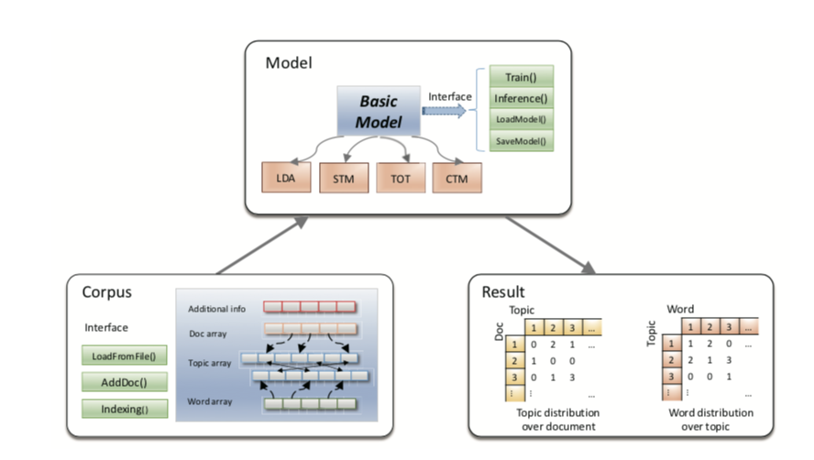
Architecture

Slide 8
Architecture
consist of three components
Corpus: a set of documents which contains a number of tokens
Inside a Corpus, each document and each token have an unique integer identifier, and everything is stored with those integer IDs
documents can be further labeled with additional information such as timestamps or category IDs
Model: record a set of parameters and topic-word counters that can be used to inference new corpus
A customized topic model can be instantiated by implementing the interfaces with its own model parameters and inference algorithms
the Train and Inference methods are implemented with high performance hybrid samplers
Result

Slide 9
Topic Modeling Framework
follow the computation architecture in expectation maximization (EM) algorithm
consider that most of topic models do sampling from a posterior distribution and then estimate parameters
contain sampling step and estimating step
sample a value from a posterior distribution
estimate parameters with sampled values
the estimating step can be omitted if there are no parameters to be estimated, like LDA and CTM

Slide 10
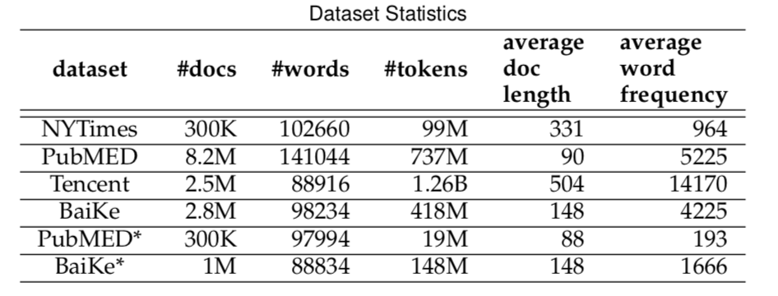
Datasets
1、BaiKe is a dataset with many long documents as well as many short documents.
2、NYTimes and PubMED are public datasets.
3、Randomly sample 300K documents from PubMED and 1M documents from Baike,
and generate two small datasets, PubMED* and Baike*.

Slide 11
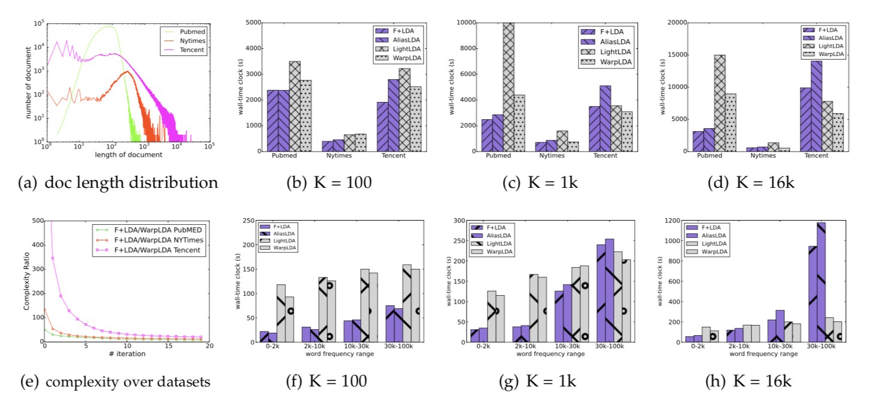
Datasets

Slide 12
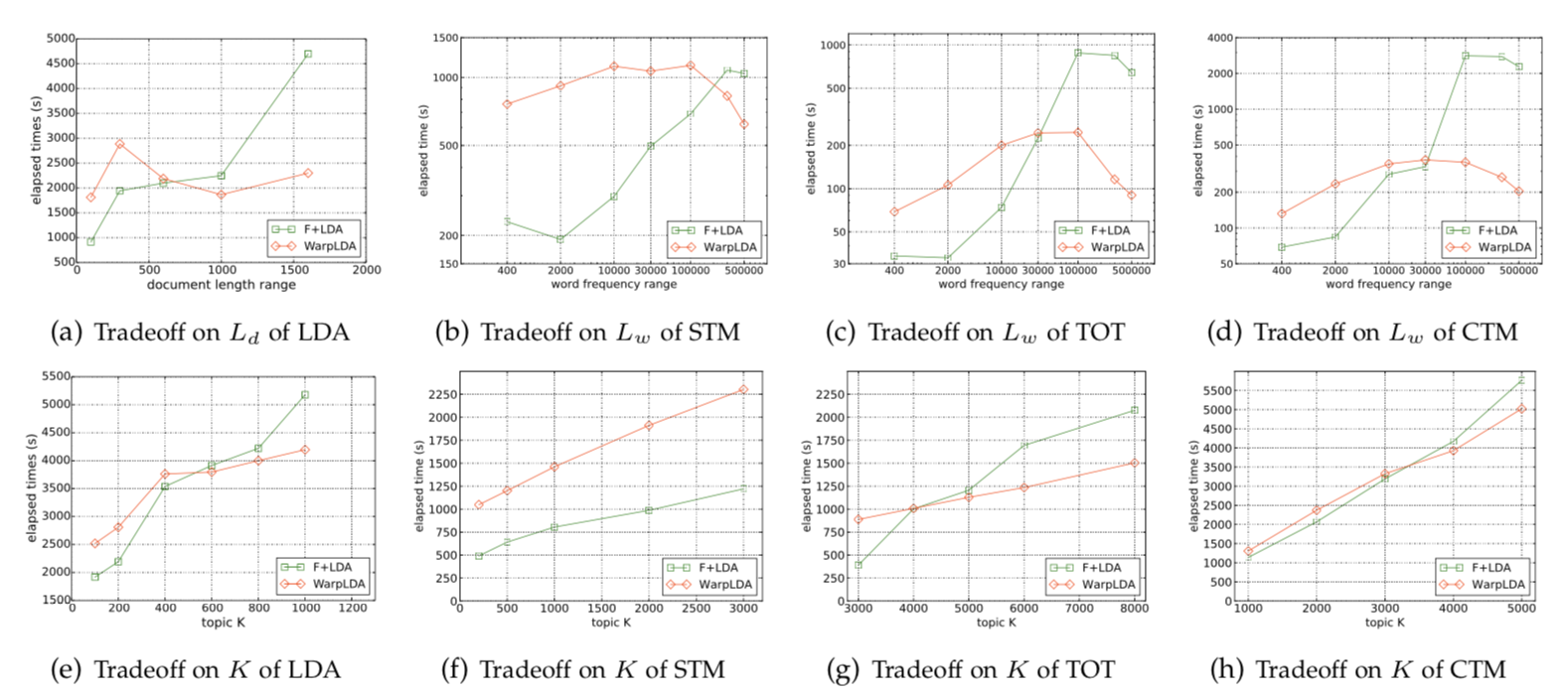
Tradeoff

Slide 13
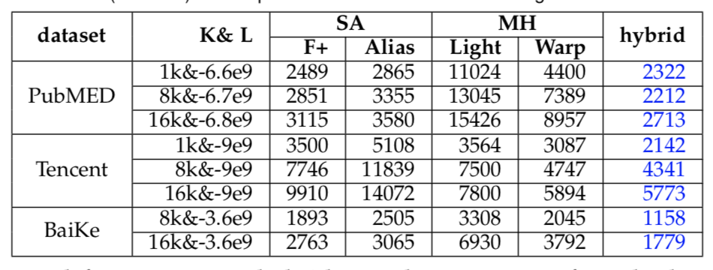
Hybrid Sampler

Slide 14
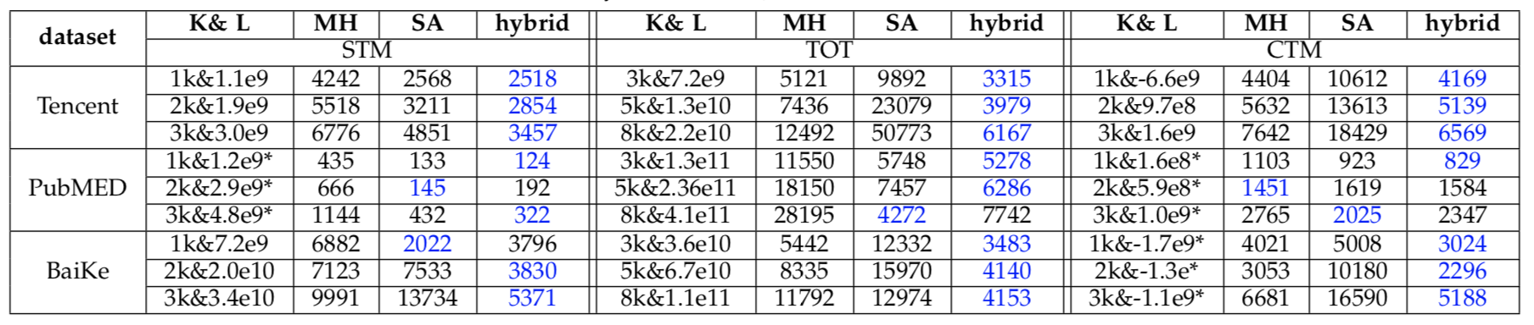
Hybrid Sampler

Slide 15
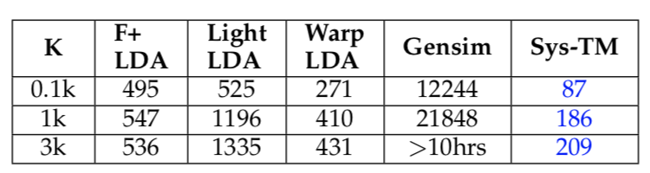
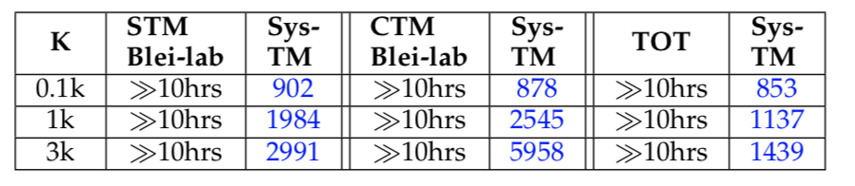
Sys-TM

Slide 16
THANK YOU!

