Slide 1
Query Knowledge Graph via Ranking Given Examples
BY 高世成

Slide 2
Abstract:
Motivation
Problem description
Related work
Problem definition
Potential functions (5)
Experiment Plan
Data set
Future work
Data processing
code framework

Slide 3
Motivation:
Inside knowledge graph hides the information that we need for further purpose.
Though there is a query language SPARQL served as a query approach, sometimes people just can’t organize the inner logic which covers the demand in a clear way but giving examples.
So a query by example approach is needed.
EXAMPLE: potential crime or criminal

Slide 4
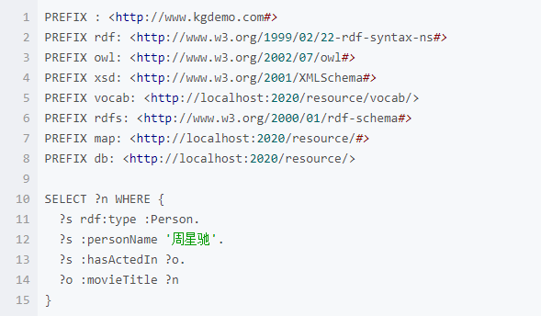
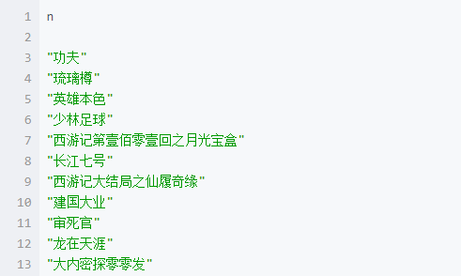
Motivation:
所有周星驰参演过的电影

Slide 5
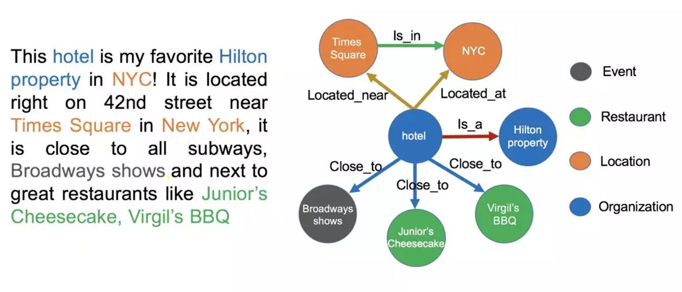
Motivation:

Slide 6
Problem description:
In our model, we provide positive examples from the set of ground truth and negative examples outside.
If we want to know the demand from the given examples, the attributes that the examples associated to should get more attention.
We should first rank the attributes to get the ones that people really care about.
Then query the knowledge base using these attributes.

Slide 7
Problem description:
All the entities
Expected return set
Negative examples
Positive examples

Slide 8
Related work:
Query Understanding via Entity Attribute Identification
Query to entity link engine
Using MRF
Query language, linked entity, attribute →graph G
Using word embedding to describe the distance of query word to attribute and entity
A Markov Random Field Model for Term Dependencies
MRF
Baseline

Slide 9
Problem definition:
We organize Graph G which is under Marcov property using these examples and the attribute for ranking.
For each attribute, we could build a Graph to calculate the score of it using an approach of MRF(marcov random field).

Slide 10
Problem definition:
a
n
Different relation edge in Graph G：
attribute-positive example
attribute-negative example
negative example-positive example
p1
p2
p3
Graph G

Slide 11
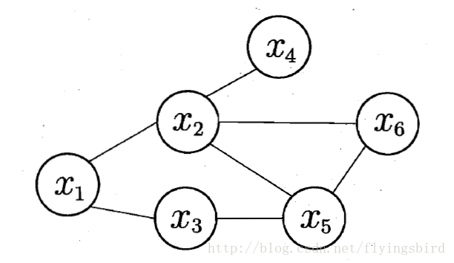

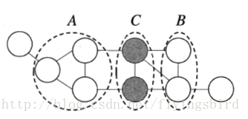
Problem definition:
About MRF:
Q：图上的一个团
Z：规范化因子

Slide 12
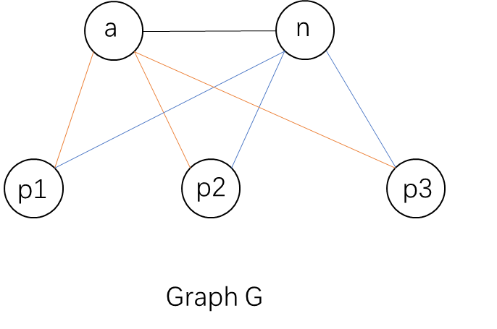
Potential functions:
With Graph G, how to design the potential function?
The clique: should we go with the maximal clique or just a plain one; (maximal clique)
The pattern: for edge with different vertex type, how to describe the need in a potential function; (two patterns, three patterns)

Slide 13

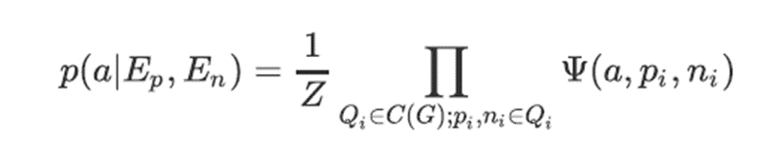
Potential functions:

Slide 14
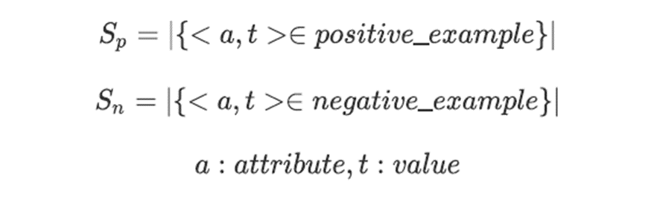
Potential functions:

Slide 15
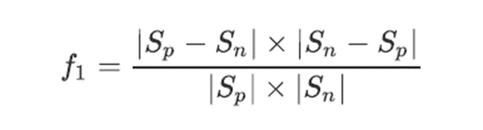
Potential functions A:
Sp
Sn
Idea:
2 pattern
Attribute-entity
Positive-negative
Distance(f1) & importance(f2) & proportion(f2)
Importance factor

Slide 16

Potential functions B:
Sp
Sn
Idea:
2 pattern
Attribute-entity
Positive-negative
Distance & importance & proportion

Slide 17
Potential functions C:
Sp
Sn
Idea:
2 pattern
Attribute-entity
Positive-negative
Distance & importance & proportion

Slide 18
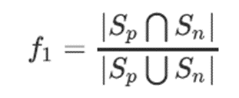
Potential functions D:
Sp
Sn
Idea:
2 pattern
Attribute-entity
Positive-negative
Distance & proportion & importance

Slide 19
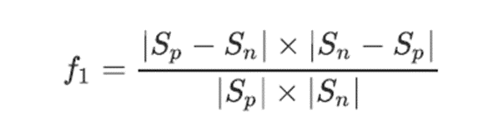


Potential functions E:
Idea:
3 pattern
Attribute-positive entity
Attribute-negative entity
Positive-negative
Distance & proportion (& importance?)
Sp
Sn

Slide 20

Potential functions:
线性组合：
非线性组合：

Slide 21
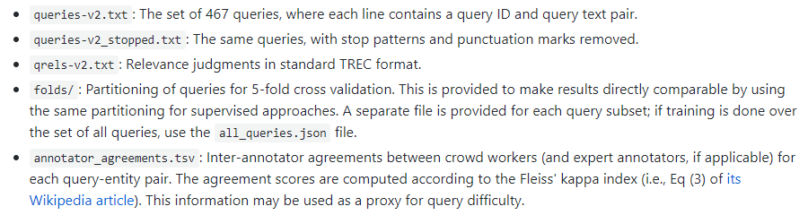
Data Set:
DBpedia collection v2:

Slide 22
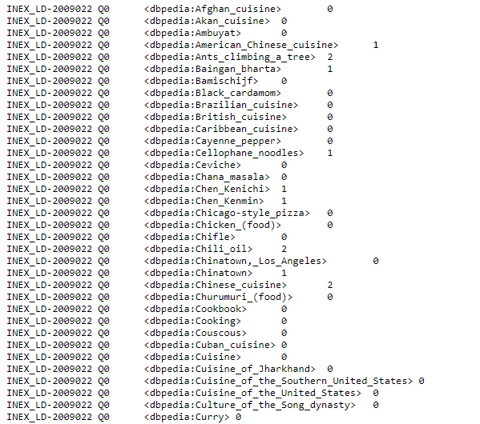
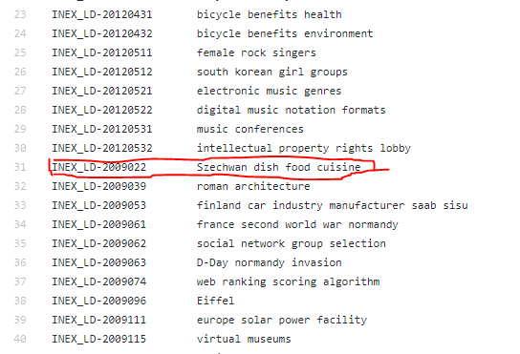
Data Set:

Slide 23
Future Plan:
Data processing:
Divide into positive and negative according to labels(0, 1, 2)
Csv format
Code framework:
Java
Load to memory
SparQL endpoint (slow but required)
MRF computation organization

Slide 24
Q&A

