Slide 1
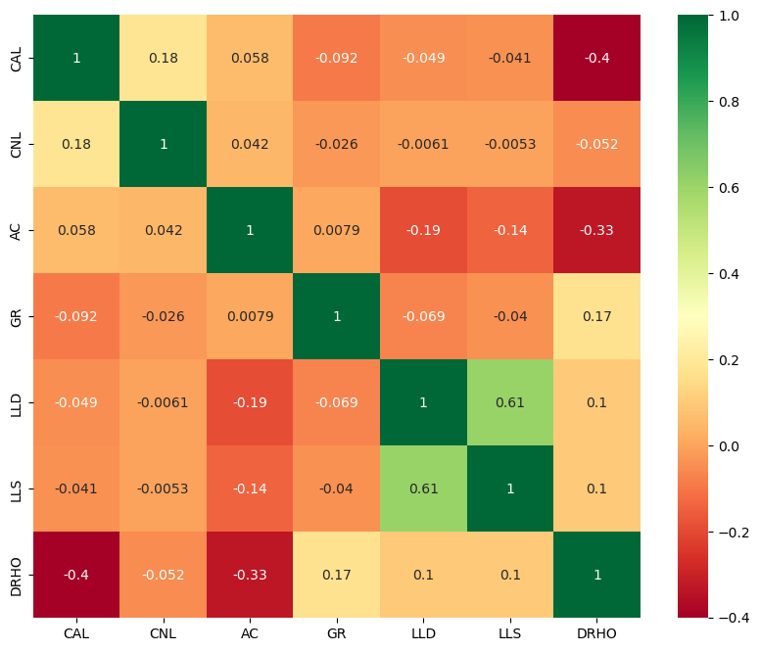
相关性分析

Slide 2
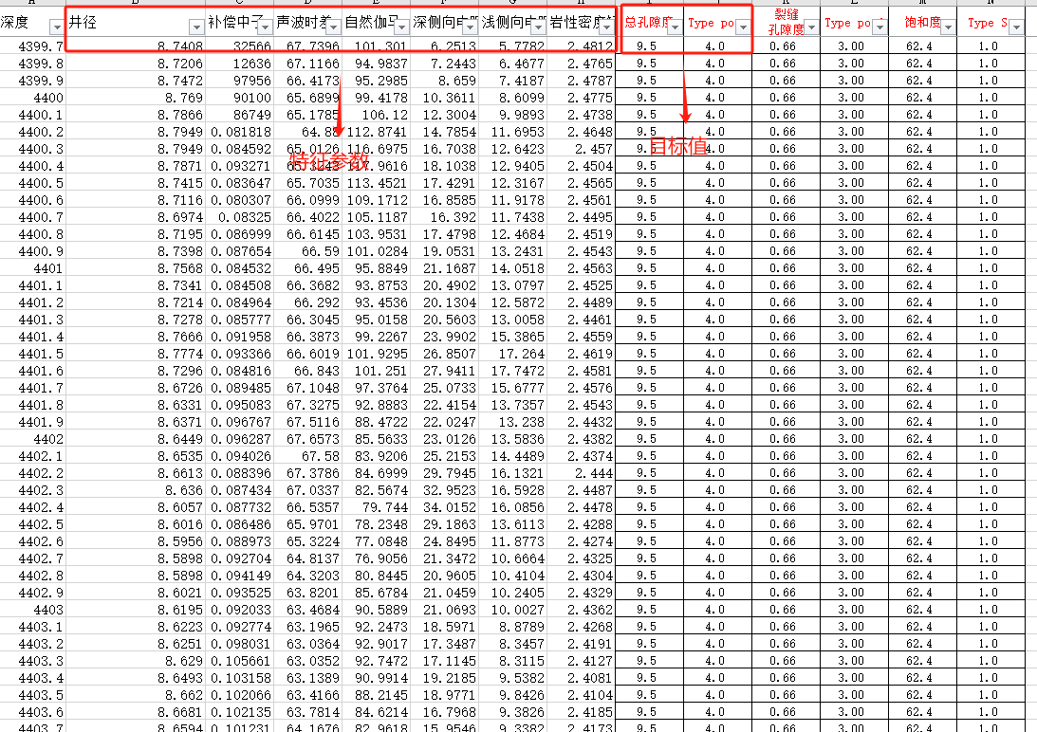
总孔隙度预测
总孔隙度为0-10%，分为5类，步长为2%。
RF，XGBoost和Catboost效果都还可以，重要性分析我都做了，你们可以分析后决定用哪一个

Slide 3
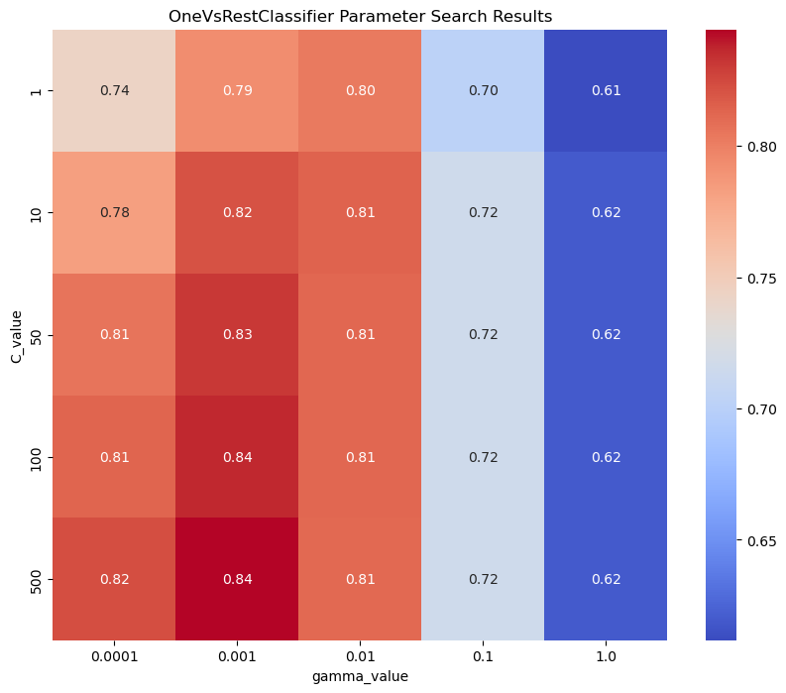
Best parameters: C=500.0, gamma=0.001
train set accurate:0.9673929840828311
test set accurate: 0.5714285714285714
test set precision:0.44223132948945876
test set recall:0.49912445278298934
test set f1:0.4635480794345083

Slide 4
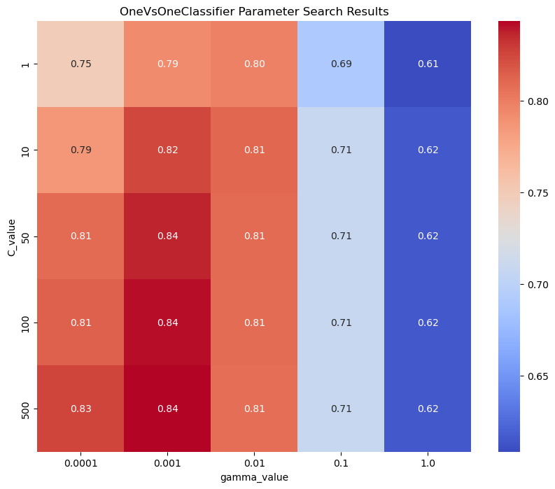
Best parameters: C=500.0, gamma=0.001
train set accurate: 0.971256374594344
test set accurate: 0.6173469387755102
test set precision: 0.5010131053071847
test set recall: 0.5438086303939962
test set f1: 0.49772082836135567

Slide 5
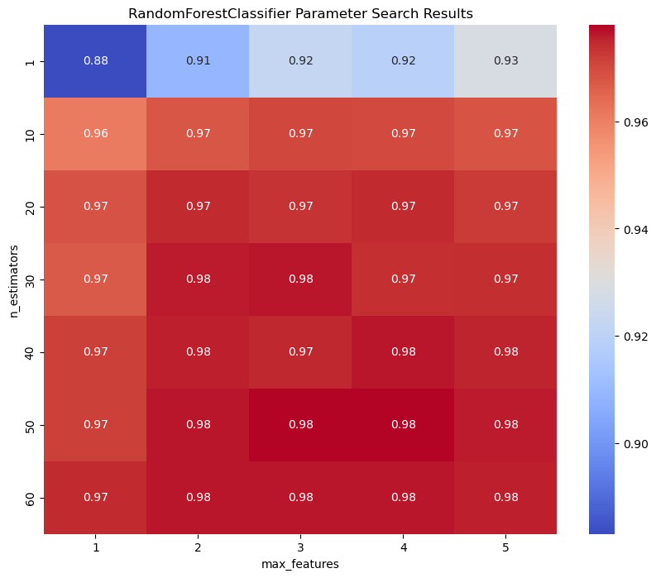
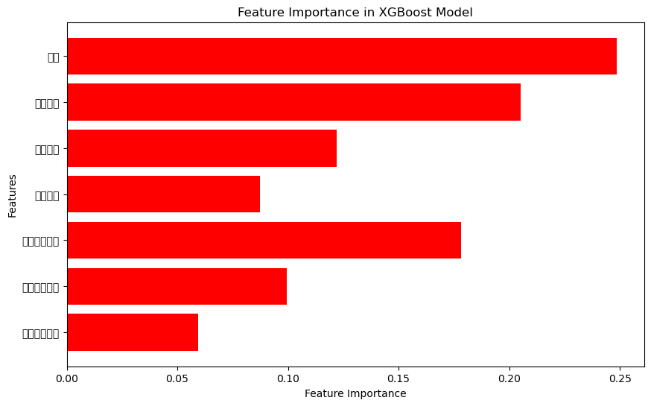
Best parameters: n_estimators=50.0, max_features=3.0
train set accurate: 0.9995363931386184
test set accurate: 0.7908163265306123
test set precision: 0.8425407925407926
test set recall: 0.7297435897435898
test set f1: 0.7251634458120152
井径
补偿中子
Features
声波时差
自然伽马
深侧向电阻率
浅侧向电阻率
岩性密度矫正

Slide 6
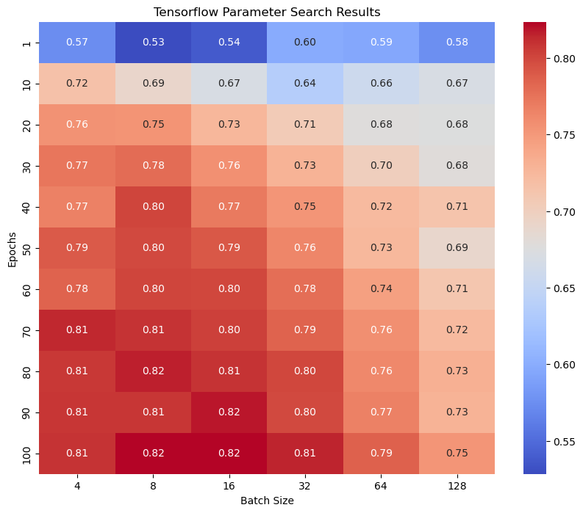
Epochs: 80, Batch Size: 4, Average Accuracy: 0.806673002243042
train set accurate: 0.8116
test set accurate: 0.6020
test set precision: : 0.5394
test set recall: 0.5989
test set f1: 0.5648

Slide 7
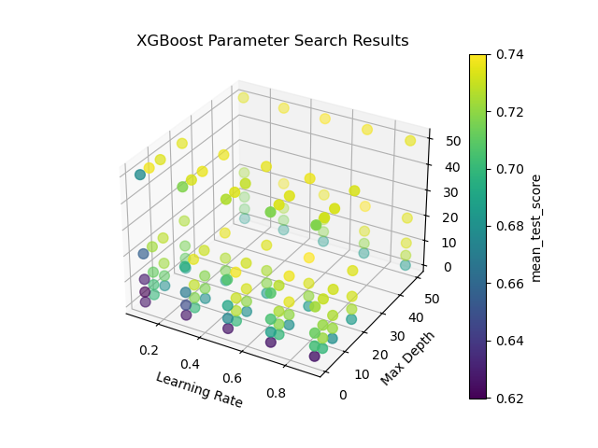
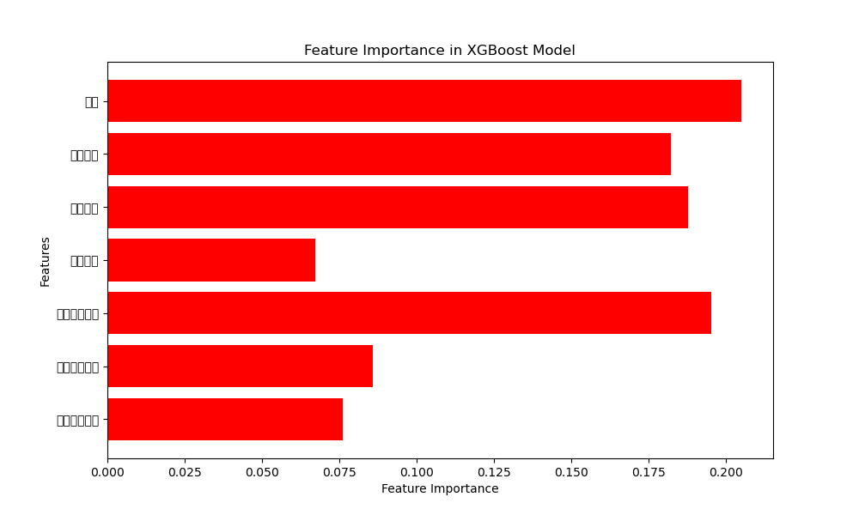
learning_rate': 0.7, 'max_depth': 50,'n_estimators': 20
train set accurate: 0.9142327306444136
test set accurate: 0.7857142857142857
test set precision: 0.8552053140096618
test set recall: 0.7405827505827507
test set f1: 0.7536131851190029
井径
补偿中子
Features
声波时差
自然伽马
深侧向电阻率
浅侧向电阻率
岩性密度矫正

Slide 8
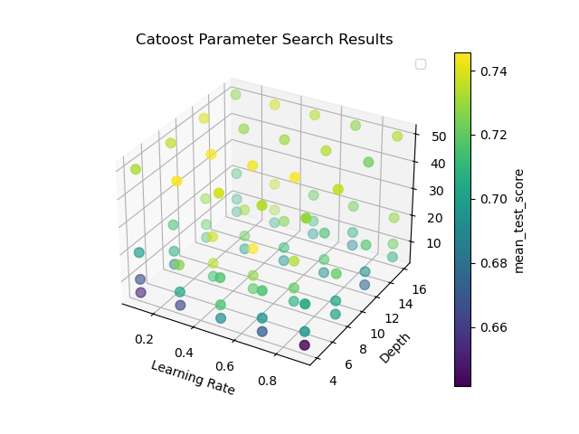
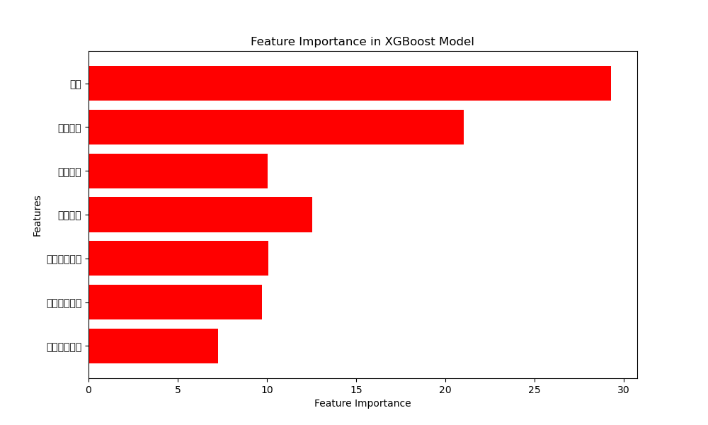
depth': 8, 'iterations': 20, 'learning_rate': 0.5
train set accurate: 0.9800649049605934
test set accurate: 0.7959183673469388
test set precision: 0.8483374774511236
test set recall: 0.7574171357098187
test set f1: 0.7749177770818281
井径
补偿中子
Features
声波时差
自然伽马
深侧向电阻率
浅侧向电阻率
岩性密度矫正

Slide 9
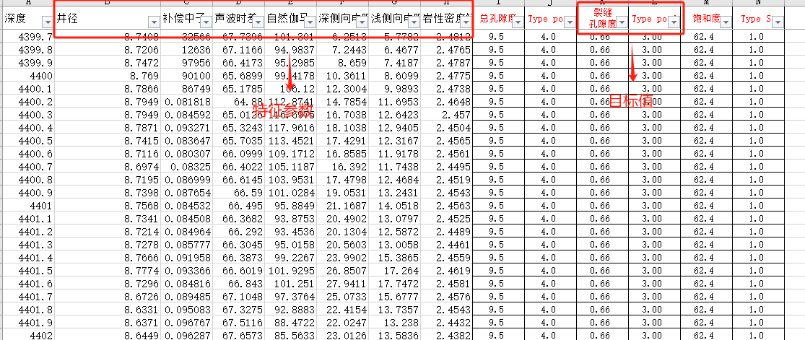
裂缝孔隙度预测
裂缝孔隙度为0-1%，分为5类，步长为0.2%。
RF效果较好，重要性分析我做了

Slide 10
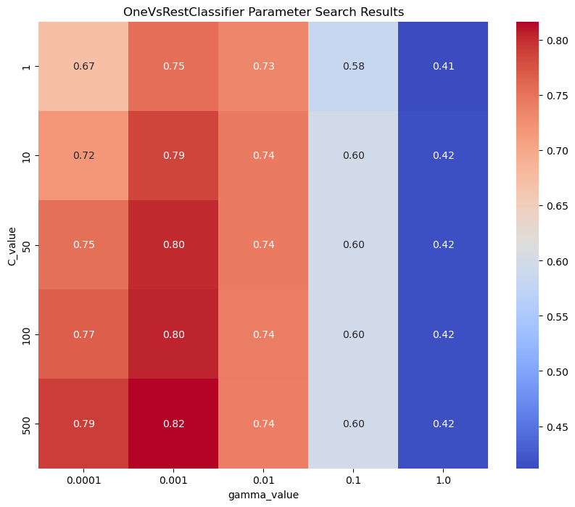
Best parameters: C=500.0, gamma=0.001
train set accurate: 0.971124150710315
test set accurate: 0.7111111111111111
test set precision: 0.7232749634905318
test set recall: 0.6748568586881281
test set f1: 0.6858334826054124

Slide 11
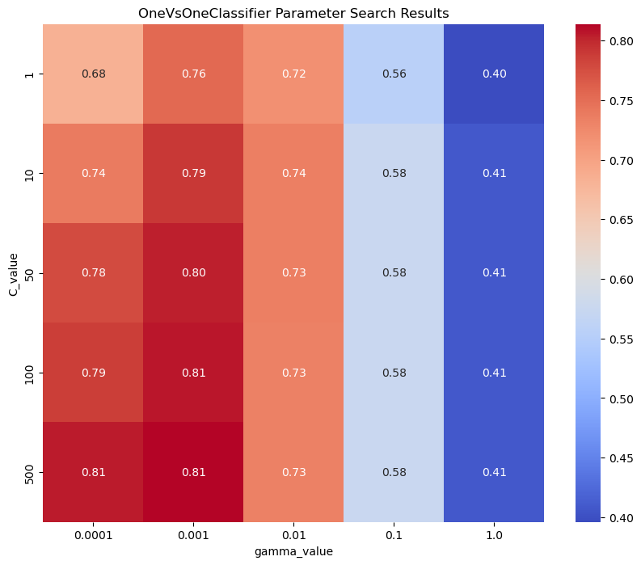
Best parameters: C=500.0, gamma=0.001
train set accurate: 0.9777640518838789
test set accurate: 0.7222222222222222
test set precision: 0.7497595770681685
test set recall: 0.686621564570481
test set f1: 0.6996247209982769

Slide 12
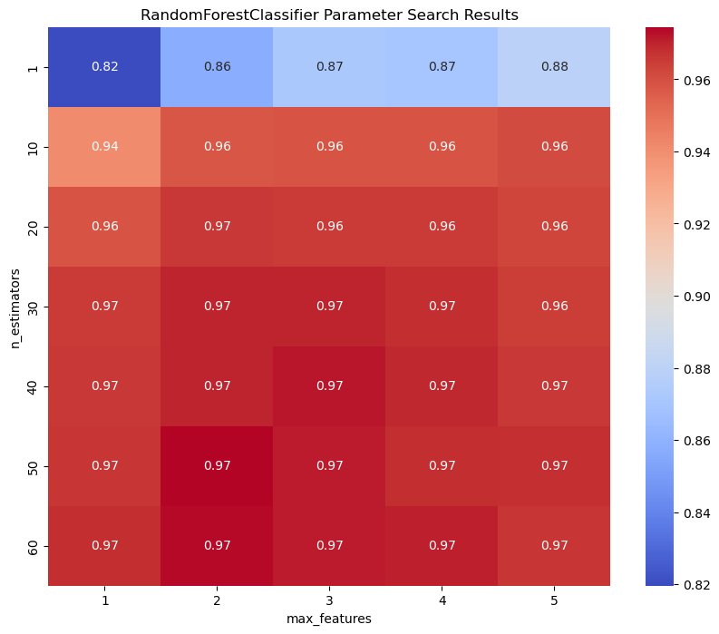
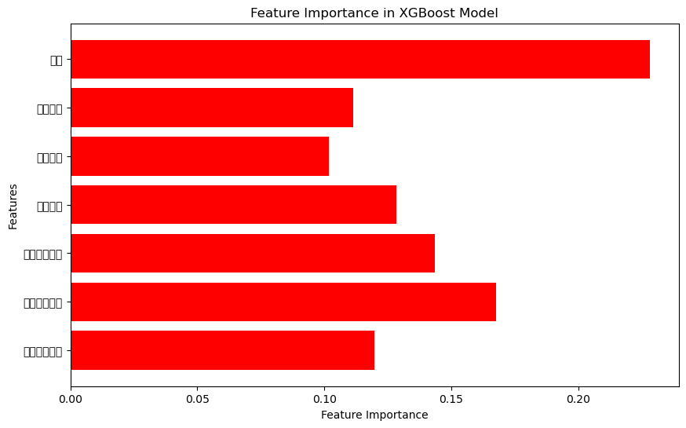
Best parameters: n_estimators=50.0, max_features=2.0
train set accurate: 0.9989190858554663
test set accurate: 0.89444444
test set precision: 0.9144481605351171
test set recall: 0.8795147420147421
test set f1: 0.8890281258702311
井径
补偿中子
Features
声波时差
自然伽马
深侧向电阻率
浅侧向电阻率
岩性密度矫正

Slide 13
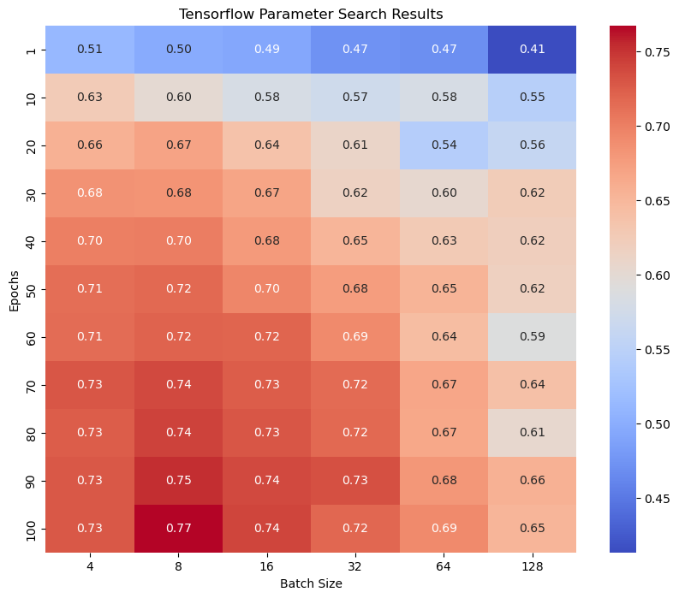
Epochs: 40, Batch Size: 4, Average Accuracy: 0.700898
train set accurate: 0.7648
test set accurate: 0.6611
test set precision: 0.6514
test set recall: 0.6194
test set f1: 0.6186

Slide 14
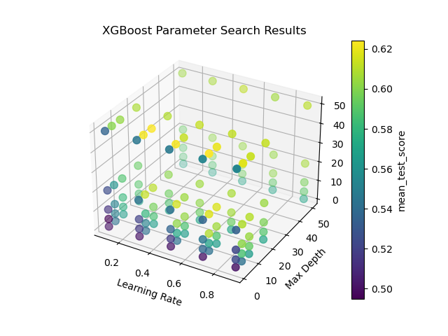
learning_rate': 0.7, 'max_depth': 5,'n_estimators’: 50
train set accurate: 0.8295243977764052
test set accurate: 0.75
test set precision: 0.7355889724310777
test set recall: 0.7394745589946828
test set f1: 0.7341580041580041

Slide 15
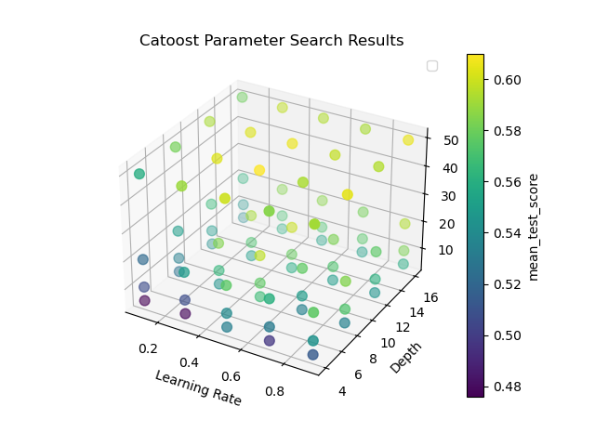
depth': 8, 'iterations’: 50, 'learning_rate': 0.5
train set accurate: 0.98888888
test set accurate: 0.883333333
test set precision: 0.9040131578947369
test set recall: 0.8611323
test set f1: 0.8718468

