Slide 1
Time Series Distance Metrics
Oscar Torreno - @oscartorreno

Slide 2
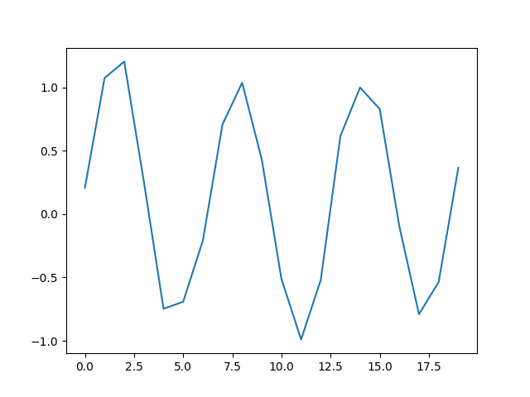
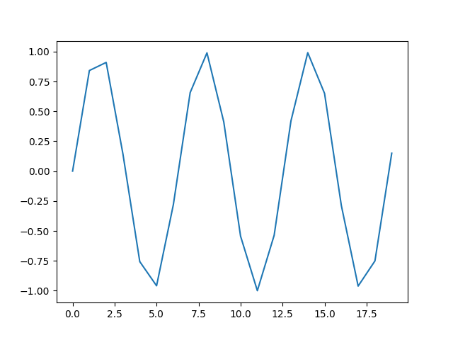
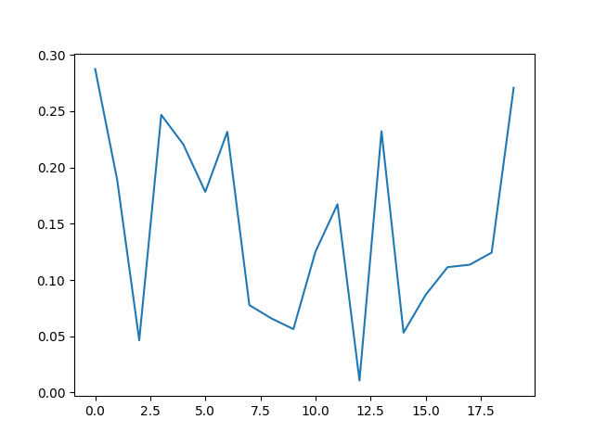
Why do we need distance metrics?

Slide 3
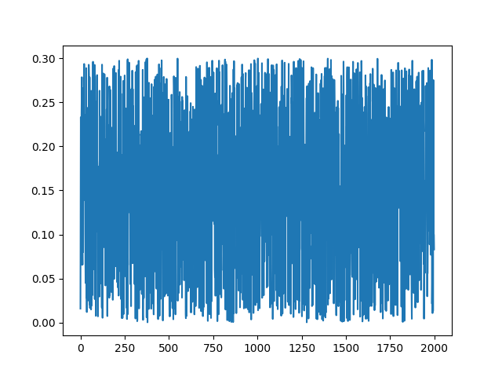
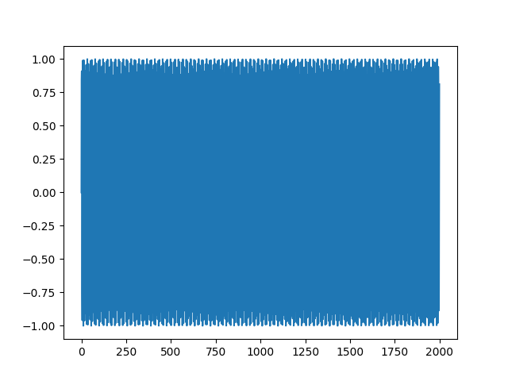
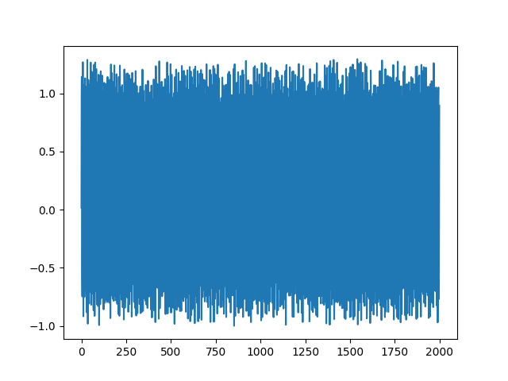
Why do we need distance metrics?

Slide 4
Why do we need distance metrics?

Slide 5
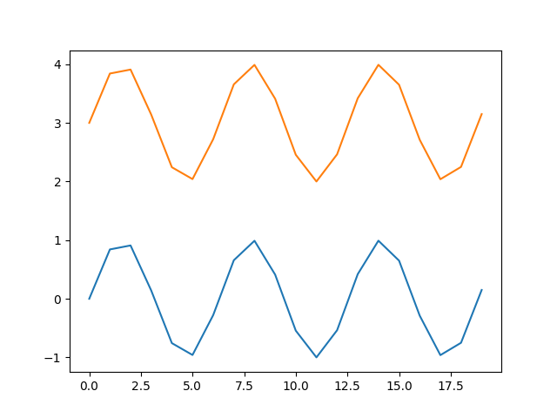
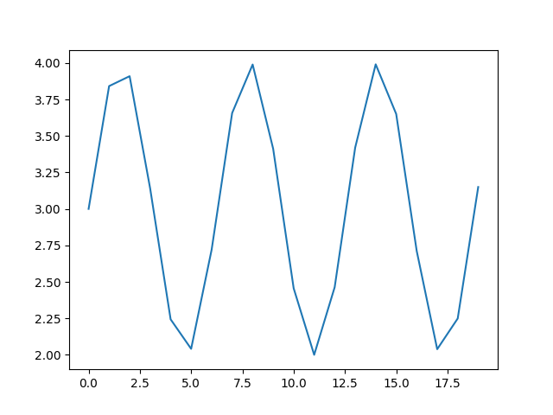
Important consideration
Normalize your data! (if you are interested in the shape)

Slide 6
Hierarchies

Slide 7
Clustering
Cluster 1
Cluster 2
Cluster 3

Slide 8
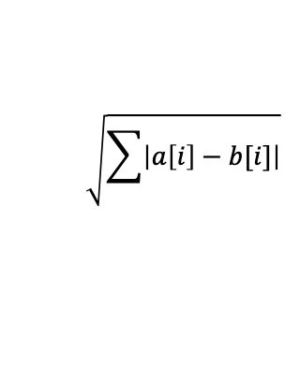
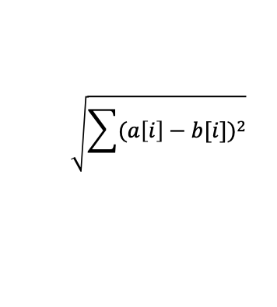
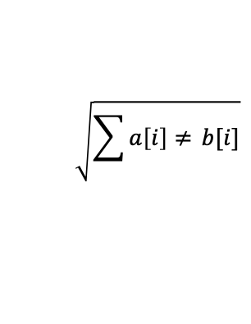
(Some) Existing distance metrics
$$\sqrt{\sum{{(a\left[i\right]−b[i])}^{2}}}$$
Euclidean
Manhattan
Hamming
DTW (Dynamic Time Warping)
SBD (Shape-Based Distance)
$$\sqrt{\sum{\left|a\left[i\right]−b[i]\right|}}$$
$$\sqrt{\sum{a\left[i\right]≠ }b[i]}$$

Slide 9
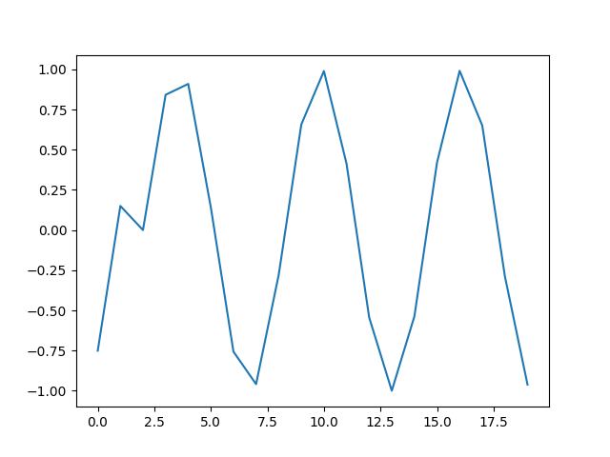
Euclidean, Manhattan, Hamming
Fast, but…

Slide 10
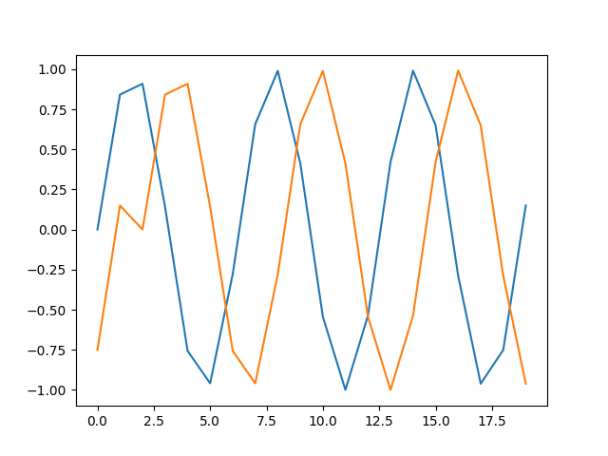
Euclidean, Manhattan, Hamming
Fast, but…
Euclidean: 5.0283
Manhattan: 20.0203
Hamming: 20.0

Slide 11
DTW
Slower, but…
DTW: 2.2225

Slide 12
DTW

Slide 13
DTW
w = 2

Slide 14
SBD
Normalizes the input data
Calculates the max value of the cross correlation between the input sequences. The result is 1 – such max value

Slide 15
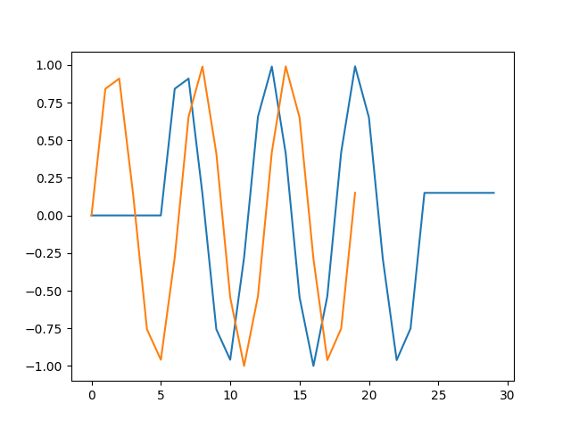
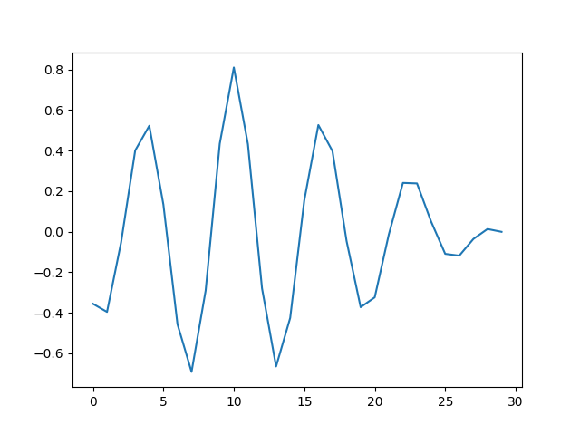
SBD – cross-correlation
Amplitude
Correlation

Slide 16
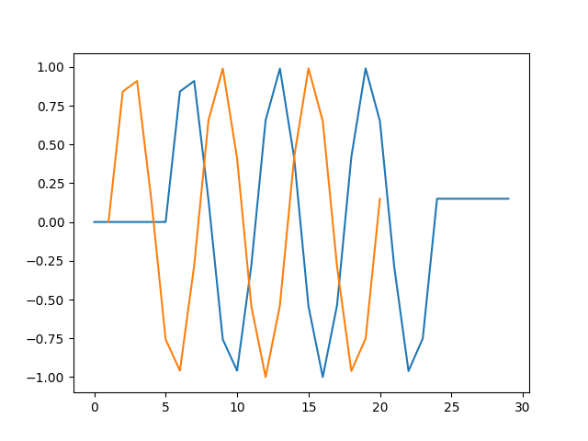
SBD – cross-correlation
Amplitude
Correlation

Slide 17
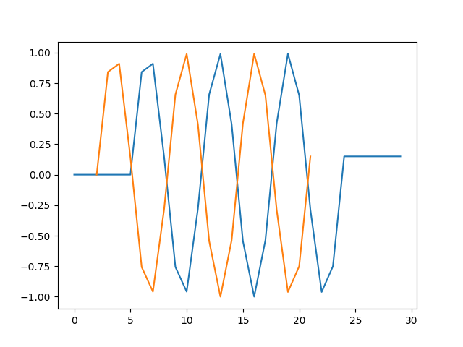
SBD – cross-correlation
Amplitude
Correlation

Slide 18
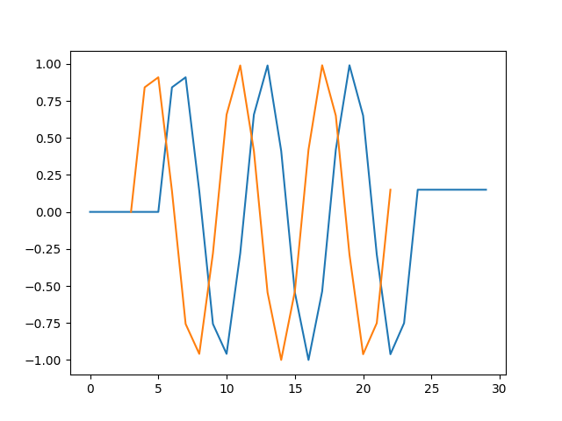
SBD – cross-correlation
Amplitude
Correlation

Slide 19
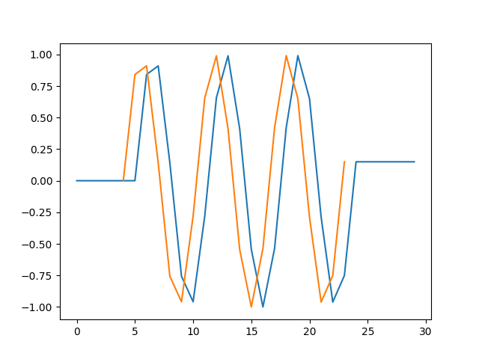
SBD – cross-correlation
Amplitude
Correlation

Slide 20
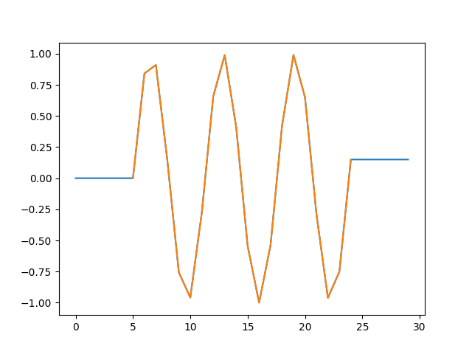
SBD – cross-correlation
Amplitude
Correlation

Slide 21
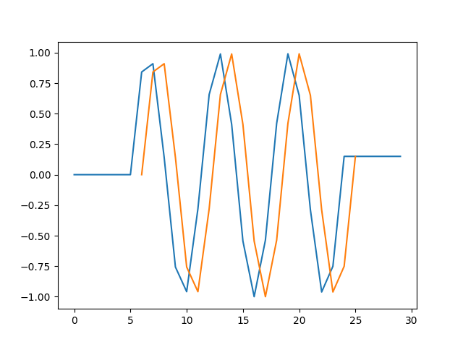
SBD – cross-correlation
Amplitude
Correlation

Slide 22
SBD
Slower, but…
SBD: 0.0625

Slide 23
In summary – same data & different metrics
Euclidean: 5.0283
Manhattan: 20.0203
Hamming: 20.0
DTW: 2.2225
SBD: 0.0625

Slide 24
Pros & cons of existing metrics
Euclidean, Manhattan, Hamming
Fast
Not so accurate
DTW
Slow
Accurate
SBD
Slower than Euclidean, manhattan and hamming
Better accuracy than DTW

Slide 25
Thanks for your attention
Any question?
Oscar Torreno - @oscartorreno
oscar.torreno@shapelets.io
https://shapelets.io

