Slide 1




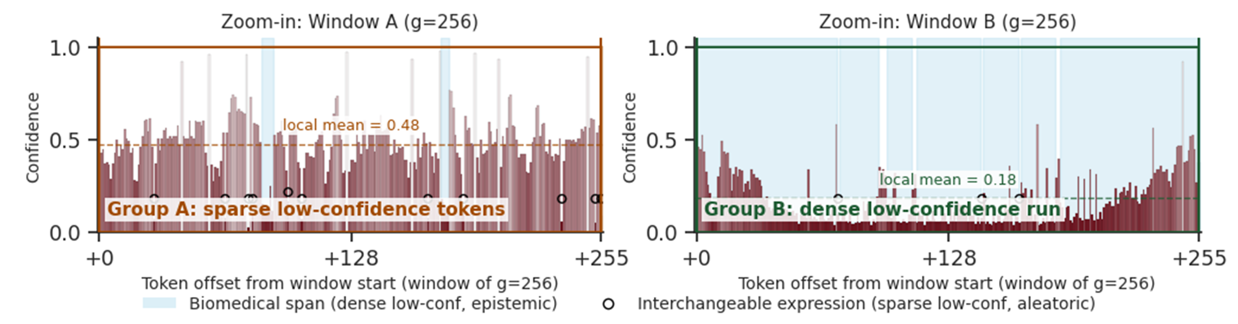
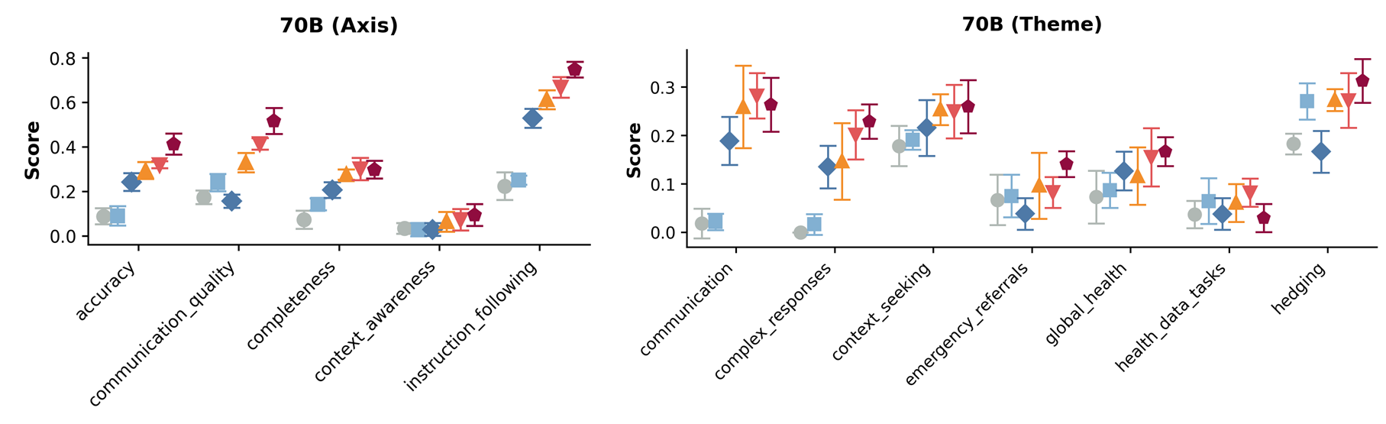
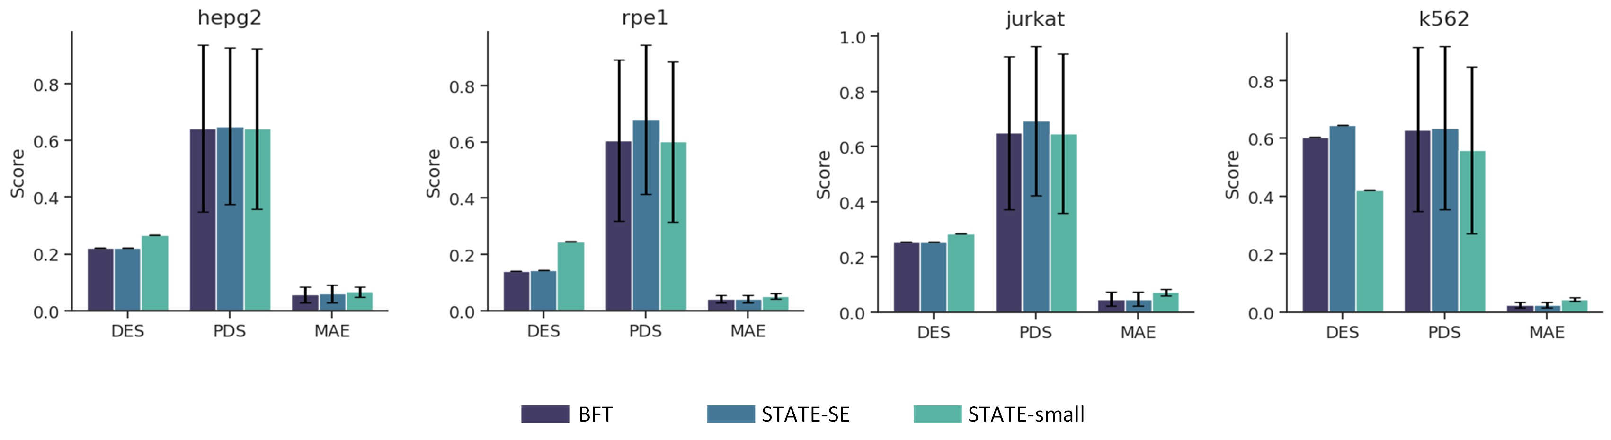
Aligning LLMs with Biomedical Knowledge
using Balanced Fine-Tuning
Zhenchao Tang*¹, Fang Wang*†¹, Haohuai He¹, Jiale Zhou¹, Tianxu Lv¹, Jun Zhu¹, Shouzhi Chen¹, Minghao Yang¹,
Yu Wang¹, Jiayang Wu¹, Yidong Song², Yaokun Li³, Jiehui Huang⁴, Jun Zhou⁵, Bing He¹, Jianhua Yao†¹
¹Tencent AI for Life Sciences Lab ²Nankai University ³Sun Yat-sen University
⁴The Hong Kong University of Science and Technology ⁵Tsinghua University
*Equal contribution †Correspondence: avonwanghit@gmail.com, jianhua.yao@gmail.com
NeurIPS 2026 arxiv.org/abs/2511.21075
Project and code: shapsider.github.io/BFT
1 Problem & challenges
3 How Balanced Fine-Tuning works
4 Experimental results
Biomedical AI must learn unfamiliar gene names and how biological processes work. Confidence-weighted fine-tuning (DFT) gives less emphasis to hard-to-predict words and can overlook difficult passages. Later training receives limited feedback, making this first learning stage important.
BFT compares how hard each piece of text is to predict with the surrounding passage. It then gives more attention to training examples containing difficult passages.
We compare standard fine-tuning (SFT), DFT and BFT under matched settings, then add correct-answer feedback training (GRPO).
Look within an answer
Look across examples
Predicting how cells respond to chemicals
Observation: difficult words occur in groups
Predict gene activity: up, down or unchanged
Feedback training on 45 cell lines, testing on 5
Model predictions on medical articles, using nearby text
Read a word together with nearby text.
Keep more attention on difficult biomedical passages.
Find the hardest passage in each example.
Give harder examples more attention, within a limit.
↓
↓
Learn difficult biomedical knowledge
while limiting the influence of isolated outliers.
1. Compare a word with its surroundings
+13.4 percentage points over SFT
+4.0 points after feedback training
Share of biomedical terms / expert-marked concepts (%)
DFT gives less emphasis to every hard-to-predict word. BFT first checks the surrounding passage. A word inside an equally difficult biomedical passage retains more learning signal than it would under DFT.
The two BFT parts help separately. SFT and DFT decline after feedback training. BFT’s advantage over Gemini-2.5-Flash is not statistically clear.
Context | DFT | BFT
One difficult word, easy surroundings | Reduces its contribution | Keeps its emphasis low
Many difficult words, difficult surroundings | Reduces their contribution | Restores more learning signal
Turning gene descriptions into useful numbers
BFT writes gene descriptions. A text encoder converts them into numbers used to predict gene properties and group cells.
Groups of difficult words contain many biomedical concepts. Expert annotations support this pattern, while chat and math texts show little change in biomedical-term share. This suggests knowledge gaps, although prediction difficulty does not directly measure what the model knows.
2. Give harder examples more attention
BFT finds the hardest local passage in each training example. Examples containing harder passages receive more emphasis. This extra emphasis is limited so that a difficult example cannot receive an unbounded weight.
Which difficult content should training retain?
3. Combine both decisions while learning
Cell-response prediction accuracy, same training settings
The first decision controls which words influence learning inside a response. The second controls how much the whole response contributes. Together, they focus training on difficult biomedical content while limiting isolated outliers.
Average gene prediction score: BFT 0.829 vs GenePT 0.802. GenePT remains higher on Lys4. Both use the same text encoder, while the descriptions come from different sources.
Grouping cells by type (higher scores are better)
We test both decisions under matched settings: 48,503 training examples and two passes through the same data.
Method | ARI | AMI | ASW
scGPT | 0.26 | 0.32 | 0.039
GenePT | 0.30 | 0.46 | 0.041
SFT | 0.12 | 0.25 | 0.021
BFT | 0.34 | 0.58 | 0.061
HealthBench Hard (70B) & GeneAgent
Keeping grouped difficult content gives 0.674 accuracy, compared with 0.571 for keeping the same amount of randomly chosen content. BFT uses gradual emphasis rather than a fixed keep-or-discard rule.
Predicting responses in single cells
2 Motivation
A difficult word should be interpreted in context. A whole difficult passage may contain important biomedical knowledge that the model needs to learn. BFT therefore makes two connected decisions: which words should influence learning, and which training examples deserve more attention.
BFT improves medical scores across three model sizes and has the best overall GeneAgent text-overlap score among the aligned open-weight models. Error bars show variation across repeated answers.
Comparable to standard STATE inputs on four datasets. BFT writes profiles without training on these datasets, while the downstream STATE prediction model is still trained.
Notes:
Scientific source: supplied camera-ready neurips_2026_arxiv.tex and original Figures 1b, 2a and 5; native plain-language method schematic, https://arxiv.org/abs/2511.21075. Method explanation paraphrases Section 3 in plain language. No displayed equations. Words are an accessible shorthand for scored text tokens. Local-relative token weighting and bounded weakest-region sample weighting remain the actual method. Both signals are detached; implementation details are in the paper. The qualitative context table describes the paper's sparse/dense regimes, without claiming all uncertain content is epistemic. Diagnostic chart labels: Medical articles = PMC, Expert concepts = CRAFT, Chat = UltraChat, Math = NuminaMath. Values and all four native charts and the cell-type table preserve the paper's data. Retention is size-matched; Full BFT uses continuous weights. VCWorld before/after feedback training is GRPO under the shared setup. Gemini comparison is exploratory and non-significant. The gene score is AUC, mean over six tasks. Cell grouping uses ARI/AMI/ASW. Profile text source and construction differ from GenePT despite a matched encoder. Only profile generation is zero-shot for perturbation datasets. Original medical error bars show decoding variation, not training-seed variation. Poster retains the official 36x24 inch landscape template and author-supplied Tencent and Tencent AI for Life Sciences Lab logos. Official template folder: https://drive.google.com/drive/u/1/folders/16tSJGJryd7NgQCBblaKxTfXLZXDIJJrt. Upload specifications: https://wiki.eventhosts.cc/en/reference/posteruploads.

