Slide 1

SRM TRP ENGINEERING COLLEGE
(Approved by AICTE, New Delhi & Affiliated to Anna University, Chennai)
DEPARTMENT OF INFORMATION TECHNOLOGY
Academic Year 2026 – 2027 (Odd Semester) • Course: IT25301 Web Technology Laboratory
MINI PROJECT PRESENTATION
ELECTRICITY BILL CALCULATOR
An Automated Web Application for Slab-Tiered Tariff Calculation, Real-Time Billing Breakdown & Utility History Tracking
PROJECT TEAM MEMBERS
SHAPTHAGIRI G (Reg. No: 814725205105)
RENGESH M (Reg. No: 814725205088)
SAI SARAN N (Reg. No: 814725205096)
Degree & Branch: B.Tech – Information Technology (II Year)
PROJECT SUPERVISION & DEPARTMENT
Faculty In-Charge & Project Guide:
Mrs. C. MANONMANI, M.E., (Ph.D.)
Assistant Professor, Department of Artificial Intelligence & Data Science
Head of the Department:
Dr. S. SABEETHA SARASWATHI, M.Tech., Ph.D.
Associate Professor & Head, Department of Information Technology

Slide 2
CONTEXT & OBJECTIVES | SRM TRP ENGINEERING COLLEGE
02 / 08
Project Overview, Problem Statement & Objectives
Addressing manual calculation errors and billing obscurity with a modern client-side web utility
CHALLENGES IN CONVENTIONAL BILLING
01
Automated Calculation
Automatically computes consumed units (Units = Current − Previous) and strictly enforces validation to reject negative or inverted readings.
02
Slab-Tiered Engine
Accurately partitions consumed units across progressive domestic tariff slabs (₹1.50, ₹2.50, ₹4.00, ₹6.00) without retroactive penalty.
Prone to Human Error: Manual subtraction of meter readings often leads to incorrect billing disputes.
Complex Progressive Tariffs: Consumers struggle to verify slab-tiered calculations on physical bills.
Zero Pre-Bill Transparency: Consumers receive physical bills weeks later, leaving no means for mid-cycle tracking.
THE PROPOSED WEB SOLUTION
03
Transparent Invoicing
Generates detailed itemized bills displaying consumption per slab, applicable rate, subtotal, and print-ready bill receipt using CSS print media.
04
Persistent History
Saves past calculations to browser LocalStorage, allowing consumers to review previous consumption records, audit past bills, or clear records on demand.
Instantaneous Calculation: Computes units and slab breakdowns dynamically in < 5 ms.
Zero Server Installation: 100% client-side HTML5/CSS3/JavaScript execution with zero maintenance cost.
Offline History & Printing: Persistent LocalStorage tracking and one-click printable formal invoices.
Department of Information Technology, SRM TRP Engineering College • Academic Year 2026-27 (Odd Semester)
IT25301 - Web Technology Lab

Slide 3
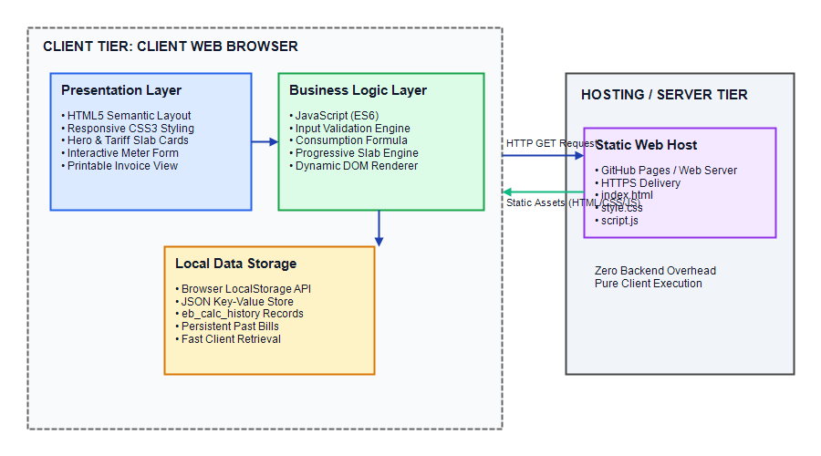
ARCHITECTURE & STACK | SRM TRP ENGINEERING COLLEGE
03 / 08
System Architecture & Technology Stack
Three-tier client-side architecture delivering responsive performance and persistent utility storage
1. PRESENTATION LAYER (HTML5 + CSS3)
HTML5 Semantic Structure: Clean semantic elements (<header>, <section>, <form>, <table>) ensuring high accessibility.
Modern CSS3 Layout: CSS Flexbox/Grid responsive system, CSS variables, and @media print stylesheet.
2. BUSINESS LOGIC ENGINE (JAVASCRIPT ES6+)
Input Validation & Sanitization: Rejects negative values, non-numeric strings, and inverted meter conditions.
Progressive Slab Algorithm: Dynamic loop iterating through configured tariff tiers with immediate breakdown.
3. STORAGE & PLATFORM COMPATIBILITY
HTML5 LocalStorage: Stores past bill records as serialized JSON. Retains data across sessions with zero server costs.
Cross-Platform Execution: Works seamlessly on all browsers (Google Chrome, MS Edge, Firefox, Safari) and mobile displays.
Figure 3.1: 3-Tier Client-Side Web Application Architecture
Department of Information Technology, SRM TRP Engineering College • Academic Year 2026-27 (Odd Semester)
IT25301 - Web Technology Lab

Slide 4
TARIFF & MATH MODEL | SRM TRP ENGINEERING COLLEGE
04 / 08
Progressive Tariff Slabs & Mathematical Model
Exact mathematical formulas, non-retroactive tiered logic, and verified benchmark calculations
CORE MATHEMATICAL FORMULATIONS
1. Electricity Units Consumed (U):
U = Reading_current − Reading_previous (where R_curr ≥ R_prev ≥ 0)
2. Progressive Slab Total Charge (Total Bill):
Total Bill = ∑ (Units in Slab_i × Rate_i) for i = 1 to k
*Tariffs are non-retroactive: each tier charges only the units falling within its span.
EXAMPLE 1: LOW DOMESTIC CONSUMPTION (80 UNITS)
• Slab 1 (80 units @ ₹1.50): 80 × 1.50 = ₹120.00
• Total Payable: ₹120.00 (Single slab tier applied)
EXAMPLE 2: TYPICAL HOUSEHOLD CONSUMPTION (250 UNITS)
• Slab 1 (100 u @ ₹1.50): ₹150.00 | Slab 2 (100 u @ ₹2.50): ₹250.00
• Slab 3 (50 u @ ₹4.00): ₹200.00
• Total Payable: ₹600.00 (150 + 250 + 200 = ₹600.00 across 3 tiers)
OFFICIAL DOMESTIC TARIFF SLABS
• Slab 1 (0 – 100 Units): ₹1.50 / unit (Lifeline domestic allowance)
• Slab 2 (101 – 200 Units): ₹2.50 / unit (Domestic baseline consumption)
• Slab 3 (201 – 300 Units): ₹4.00 / unit (Standard domestic consumption)
• Slab 4 (Above 300 Units): ₹6.00 / unit (High energy consumption tier)
EXAMPLE 3: HEAVY CONSUMPTION (450 UNITS)
• Slab 1: ₹150.00 | Slab 2: ₹250.00 | Slab 3: ₹400.00
• Slab 4 (150 u @ ₹6.00): ₹900.00
• Total Payable: ₹1,700.00 (150 + 250 + 400 + 900 = ₹1,700.00 across all 4 tiers)
Department of Information Technology, SRM TRP Engineering College • Academic Year 2026-27 (Odd Semester)
IT25301 - Web Technology Lab

Slide 5
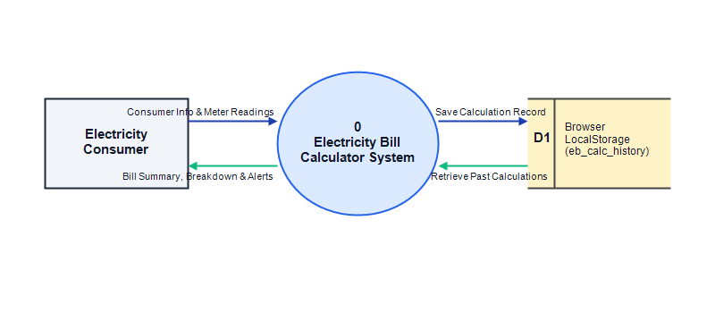
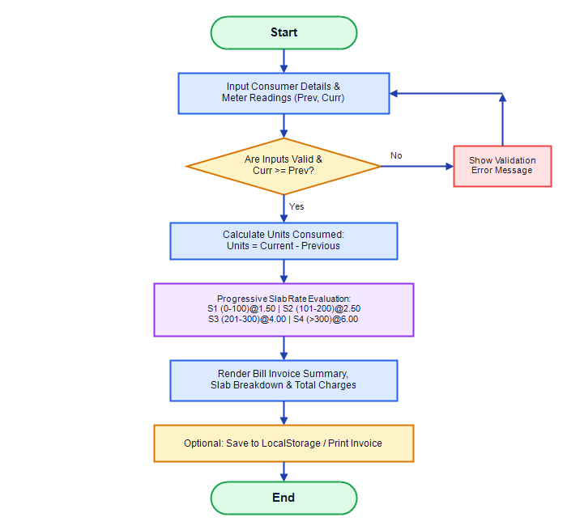
DESIGN & WORKFLOWS | SRM TRP ENGINEERING COLLEGE
05 / 08
System Design & Data Flow Modeling
Data flow architecture from user input acquisition to dynamic invoice calculation and persistence
Figure 3.3: Data Flow Diagram (Level 0 Context Diagram)
DATA FLOW OVERVIEW (LEVEL 0 CONTEXT)
External Entity: Consumer submits previous and current readings.
Core Processing: Validates input, calculates units, and evaluates progressive slab tiers.
Data Stores: Appends calculation records to browser LocalStorage for review.
Figure 3.5: End-to-End System Calculation & Workflow Logic
Department of Information Technology, SRM TRP Engineering College • Academic Year 2026-27 (Odd Semester)
IT25301 - Web Technology Lab

Slide 6
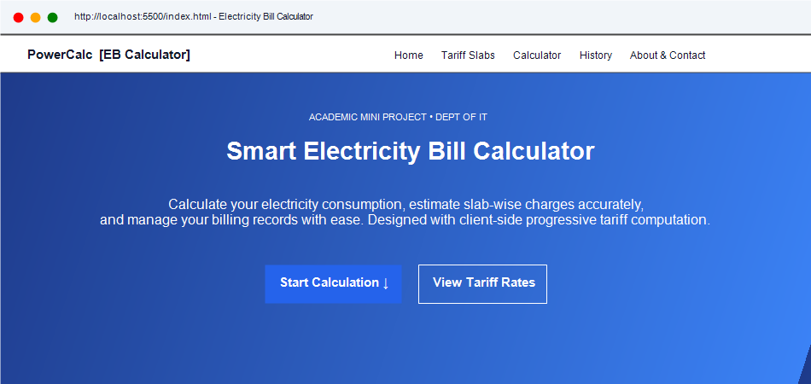
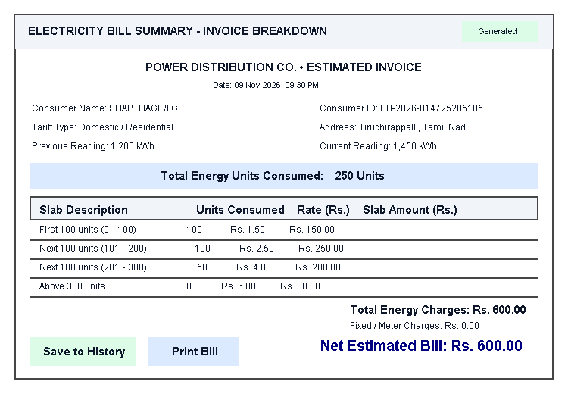
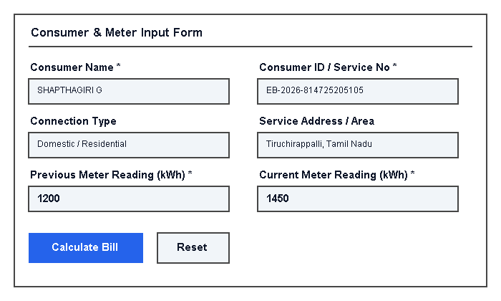
APPLICATION UI | SRM TRP ENGINEERING COLLEGE
06 / 08
Application UI Showcase & Interactive Modules
Visual walkthrough of the responsive home page, tariff table, input form, and instant bill breakdown
Figure 4.2: Navigation Header, Hero Section & Domestic Tariffs
Figure 4.5: Generated Bill Invoice with Slab-by-Slab Cost Breakdown
KEY USER INTERFACE HIGHLIGHTS
Instant Feedback: Full bill rendered immediately upon form submit without page reload.
Itemized Transparency: Clear breakdown table showing consumed units in each slab and rate applied.
Figure 4.4: Meter Reading Input Form with Real-Time Validation
Department of Information Technology, SRM TRP Engineering College • Academic Year 2026-27 (Odd Semester)
IT25301 - Web Technology Lab

Slide 7
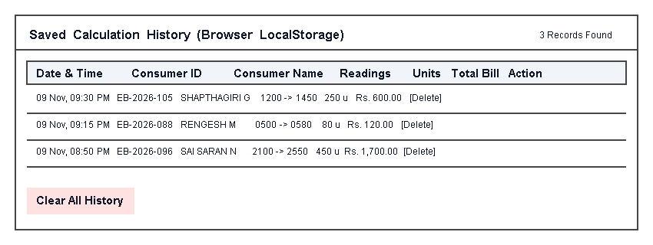
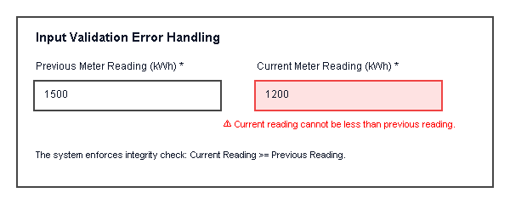
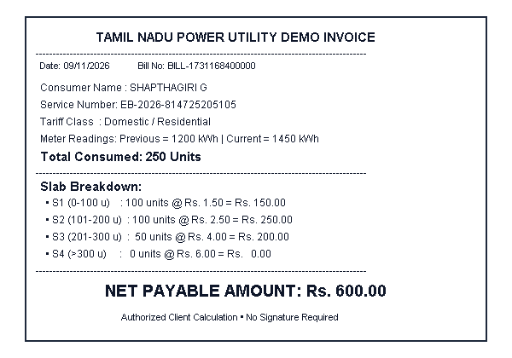
ADVANCED FEATURES | SRM TRP ENGINEERING COLLEGE
07 / 08
History Tracking, Validation & Print Invoice
Ensuring data integrity through strict input constraints, offline persistence, and print formatting
Figure 4.8: Input Validation Alert (Current Reading < Previous Reading)
Figure 4.6: Client-Side Persistent History Table (HTML5 LocalStorage)
LOCALSTORAGE PERSISTENCE CAPABILITY
Structured Records: Stores timestamp, readings, consumed units, and total bill in browser cache.
Session Independent: Data remains available across browser restarts and offline states.
Figure 4.7: Print-Ready Invoice via CSS @media print Stylesheet
Department of Information Technology, SRM TRP Engineering College • Academic Year 2026-27 (Odd Semester)
IT25301 - Web Technology Lab

Slide 8
TESTING & CONCLUSION | SRM TRP ENGINEERING COLLEGE
08 / 08
Testing Matrix, Future Scope & Conclusion
100% verification pass rate, system scalability roadmap, and final project outcomes
VERIFICATION & TESTING SUMMARY [20 / 20 TEST CASES PASSED (100%)]
Unit Testing: Verified differential unit computation, input boundary checking, and individual slab rate calculations.
Boundary Value Testing: Tested exact threshold transitions at 0, 100, 200, and 300 units with 100% mathematical consistency.
Negative & Error Testing: Rejected non-numeric strings, negative meter values, and current < previous inputs gracefully.
Cross-Browser Verification: Flawless layout and script execution on Google Chrome, Microsoft Edge, Firefox, and Safari.
FUTURE ENHANCEMENT ROADMAP
IoT Smart Meter Integration: Automated telemetry ingestion via ESP32 / Wi-Fi optical pulse counter.
Cloud Backend & Multi-User DB: Centralized database (Node.js / MongoDB) with consumer authentication.
Integrated Payment Gateway: Direct bill settlement supporting UPI, NetBanking, and credit/debit cards.
Predictive Energy Analytics: Machine learning forecasting to alert households before crossing into higher slabs.
PERFORMANCE & SYSTEM EFFICIENCY
Computation Latency: < 5 ms execution time (instantaneous client response).
Storage Footprint: < 50 KB local browser cache overhead.
Zero Server Cost: Completely static client-side operation with 100% offline uptime.
CONCLUSION
The Electricity Bill Calculator successfully delivers a lightweight, dependable, and transparent utility solution. By automating differential meter calculations and enforcing progressive slab tariffs, the application eliminates manual errors, clarifies utility billing for everyday consumers, and provides persistent historical records with zero operational cost.
Department of Information Technology, SRM TRP Engineering College • Academic Year 2026-27 (Odd Semester)
IT25301 - Web Technology Lab

