Slide 1
Electronic Lab Notebook ELN
Shaghayegh(Shaq)
Hosseini
May14^{h} 2014

Slide 2
How to find best vendor?
Google
Review on Journal of the Association for Laboratory

Slide 3
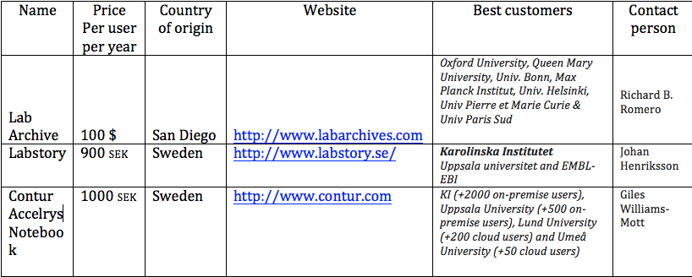
Google

Slide 4
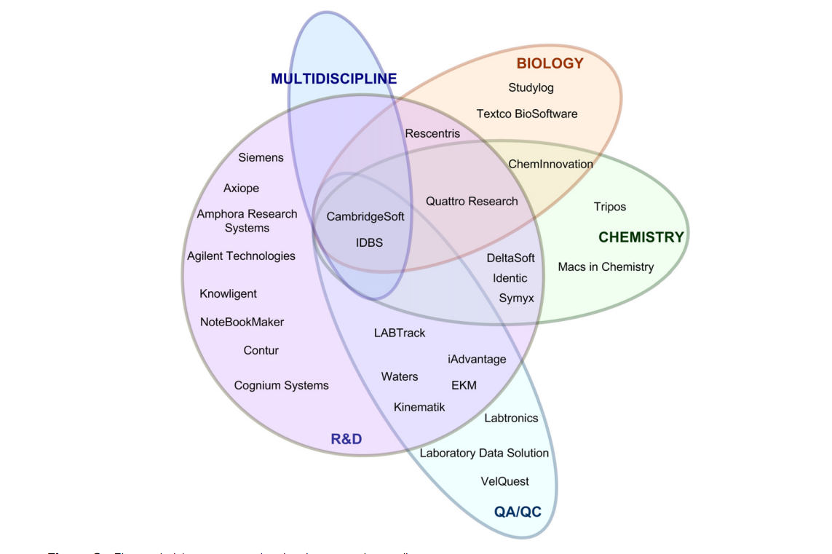
ELN primary market audience
Journal of Laboratory Automation 2011 16: 90
Michael Rubacha, Anil K. Rattan,* and Stephen C. Hosselet

Slide 5
Cambridge soft IBDS
What type of notebook you are currently using?
What type of data you intend to store?
How many users you will have?
quattro-research
Flyer
your inputs
Chem Innovation
Mac and windows platform

