Slide 1
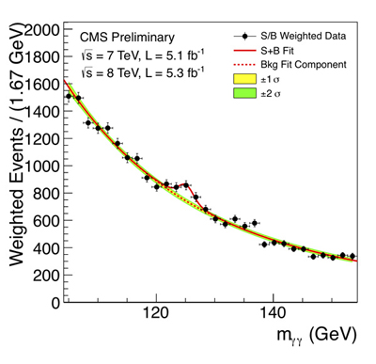
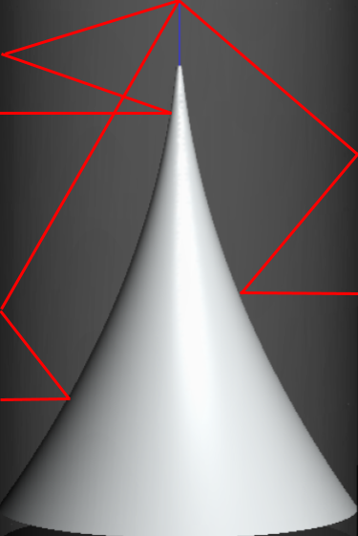
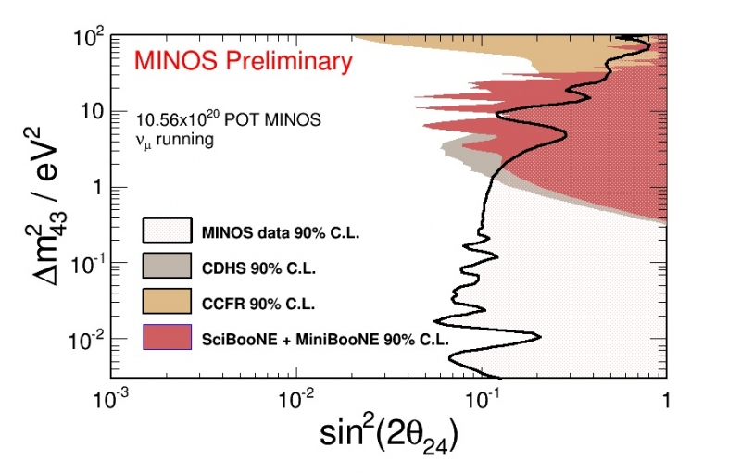

FERMILAB-SLIDES-24-0185-STUDENT
Refinement and Modeling of a Blackbody-Based Calibration Method in the InfraBREAD Detector
Shardul Rao, University of Minnesota | Supervised by Dr. Stefan Knirck
Axions and How BREAD Detects Them
The axion is a hypothetical particle proposed by Frank Wilczek and Steven Weinberg as a consequence of the Peccei-Quinn mechanism, which can explain why the strong interaction simultaneously preserves charge and parity symmetry.¹ Due to their properties, axion-like particles make promising dark matter candidates. Under some theoretical models, axion-like particles can convert directly to photons in the presence of a magnetic field.²
The Broadband Reflector Experiment for Axion Detection (BREAD) searches for this axion-to-photon conversion³. These converted photons are emitted normal to the inner cylindrical surface, reflected off of the parabolic reflector, reflected again off of the inner cylindrical surface, and focused to a single point. InfraBREAD specifically detects converted infrared photons using a superconducting nanowire single-photon detector (SNSPD).
Body text – Helvetica / Arial Regular 40pt / Black
This template is to be used as a guide when designing your poster. The layout can be rearranged and elements can be resized within the columns. Overall design should follow this grid with 1 inch gutter and margin.
A cutaway view of the BREAD reflector, which is a parabolic reflector cut in half about its central axis and revolved around another, perpendicular axis. Any photon emitted normal to the inner cylindrical surface gets focused to a singular point after two reflections.
Blackbody Calibration Idea
Caption Text – Helvetica / Arial Bold 24pt Blue
Citations
[1]
This area is designated for logos
Leave a minimum of 1” clear space above the footer.
Caption Text – Helvetica / Arial Bold 24pt Blue

