Slide 1
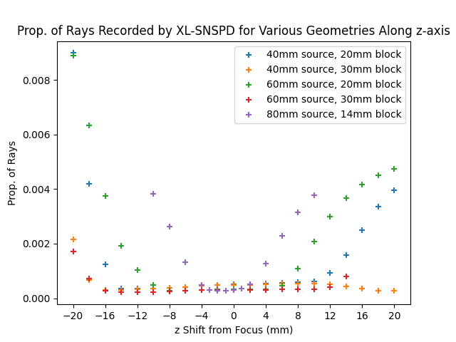
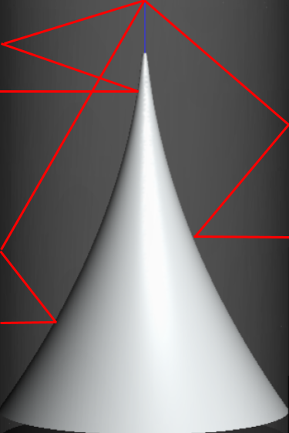
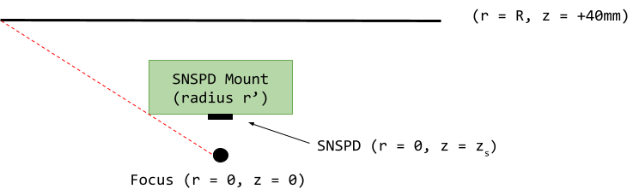
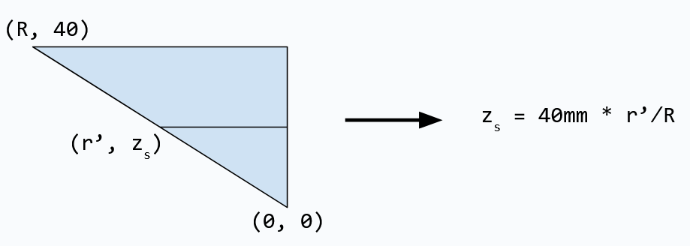

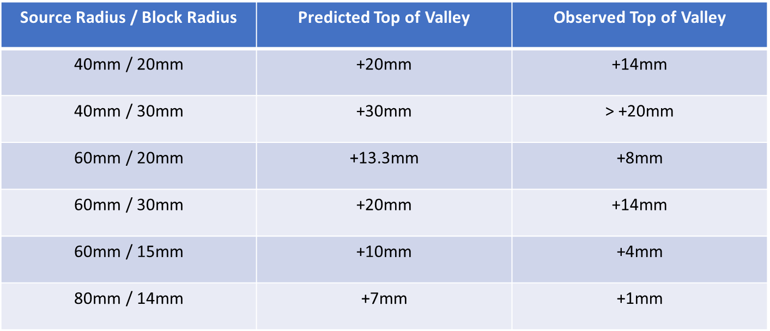
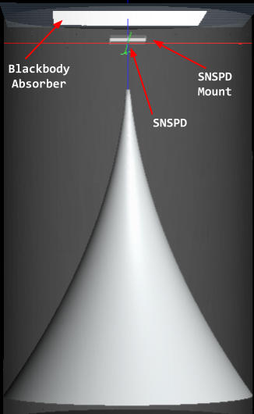
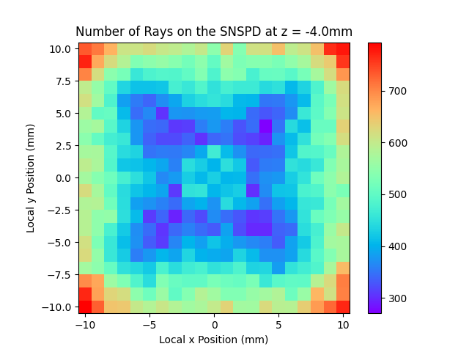
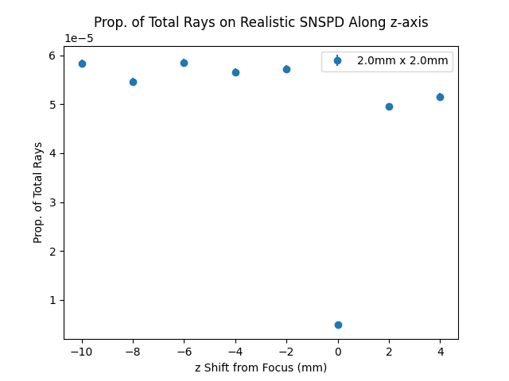
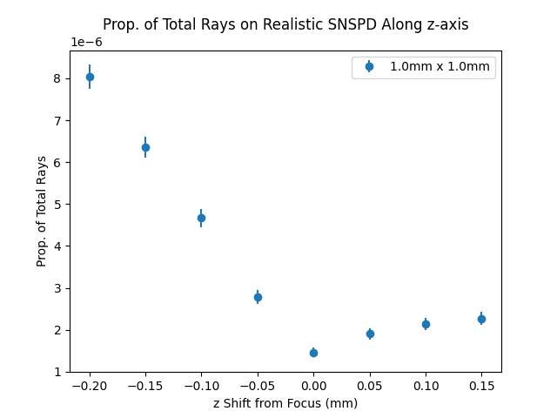
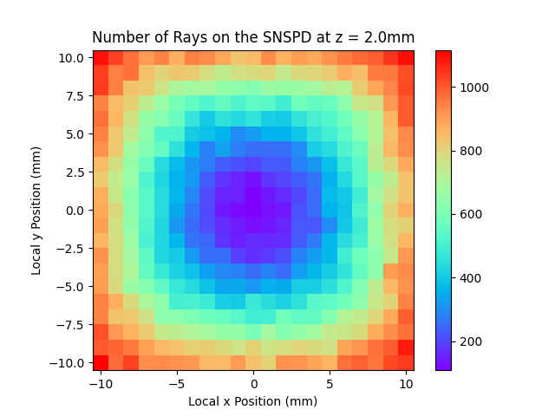



FERMILAB-SLIDES-24-0185-STUDENT
Refinement and Modeling of a Blackbody-Based Calibration Method in the InfraBREAD Detector
Shardul Rao, University of Minnesota | Supervised by Dr. Stefan Knirck
Axions and How BREAD Detects Them
Varying the Size of the Absorber and Mount
The axion is a hypothetical particle first proposed in the 1970s to resolve the strong CP problem¹
Due to their properties, axion-like particles are a well-motivated dark matter candidate⁵
The Broadband Reflector Experiment for Axion Detection (BREAD) searches for axion-to-photon conversion in a magnetic field⁶
These converted photons are reflected, focused, and detected by a superconducting nanowire single photon detector (SNSPD)
The effect of the radius of the blackbody absorber and SNSPD mount were investigated using an unphysically large SNSPD. A minimum was not consistently observed at the focus, but a valley is seen.
Modeling the Size of the Valley
Prediction of z Position of Top of Valley
A cutaway view of the BREAD reflector. Any photon emitted normal to the inner cylindrical surface gets focused to a singular point after two reflections.
Observation
Calibrating SNSPD Using Blackbody Radiation
Data supports revised prediction of (Top of Valley) = (Predicted Top) – 6mm
Realistic Scale Simulations
Throw the old model out; calibration expectation confirmed to within 50 microns!
Left: Due to uneven thermal contraction when the detector is cooled to ~0.1K, the true focal spot of the detector may move slightly.
Right: Example 2D plots of the number of rays recorded by the SNSPD at two different detector positions.
Citations
[1] R. D. Peccei and H. R. Quinn, “CP conservation in the presence of pseudoparticles,” Phys. Rev. Lett. 38, 1440–1443 (1977).
[2] R. D. Peccei and H. R. Quinn, “Constraints imposed by CP conservation in the presence of pseudoparticles,” Phys. Rev. D 16, 1791–1797 (1977).
[3] S. Weinberg, “A new light boson?” Phys. Rev. Lett. 40, 223–226 (1978).
[4] F. Wilczek, “Problem of Strong P and T Invariance in the Presence of Instantons,” Phys. Rev. Lett. 40, 279–282 (1978).
[5] M. Dine, W. Fischler, and M. Srednicki, “A simple solution to the strong CP problem with a harmless axion,” Physics Letters B 104, 199–202 (1981).
[6] S. Knirck, et.al. (BREAD Collaboration), “First results from a broadband search for dark photon dark matter in the 44 to 52 μeV range with a coaxial dish antenna,” Phys. Rev. Lett. 132, 131004 (2024).
This manuscript has been authored by Fermi Research Alliance, LLC under Contract No. DE-AC02-07CH11359 with the U.S. Department of Energy, Office of Science, Office of High Energy Physics. This work was supported in part by the U.S. Department of Energy, Office of Science, Office of Workforce Development for Teachers and Scientists (WDTS) under the Science Undergraduate Laboratory Internships Program (SULI).
Caption Text – Helvetica / Arial Bold 24pt Blue

