Slide 1
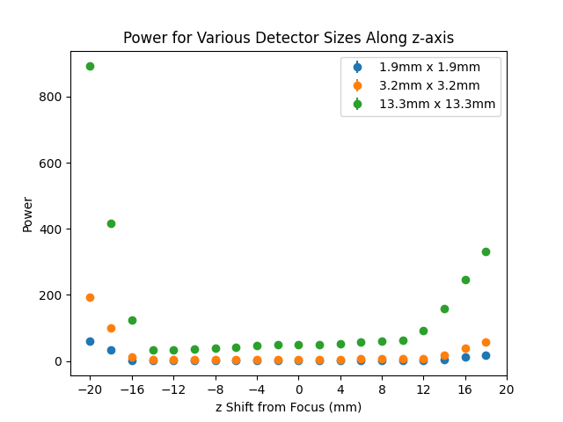
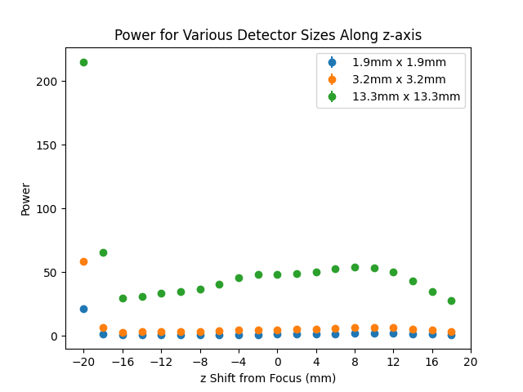
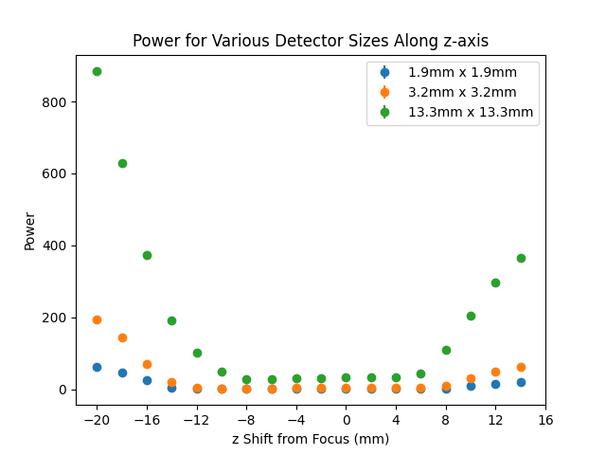
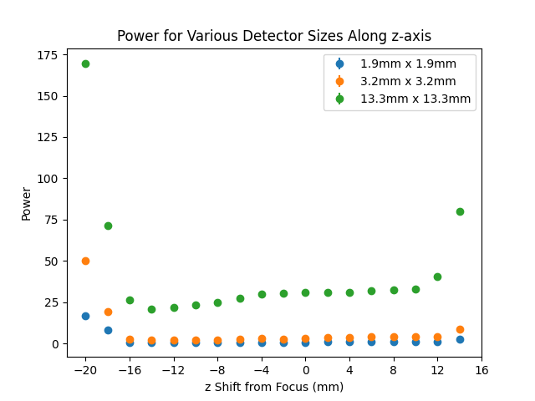
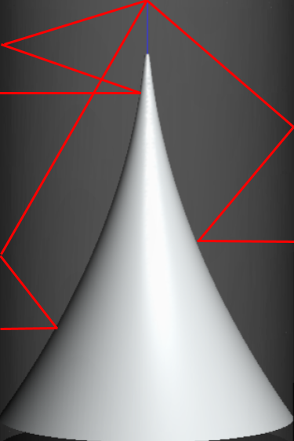
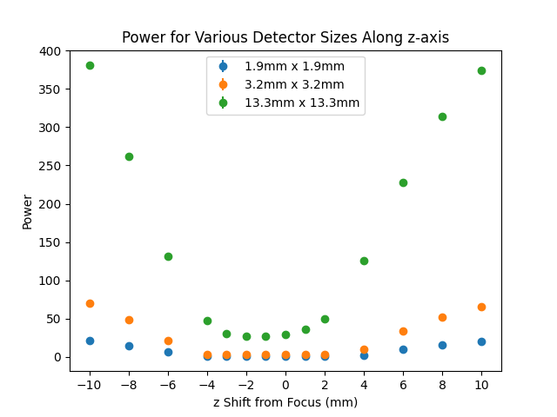
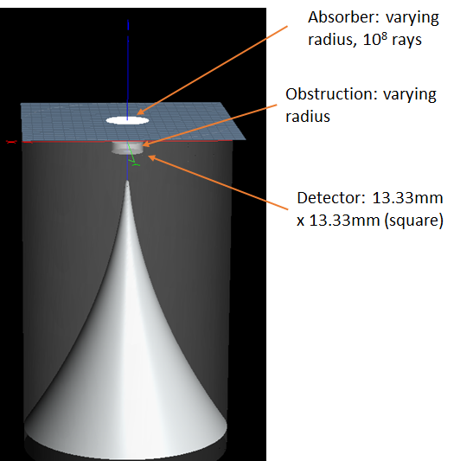
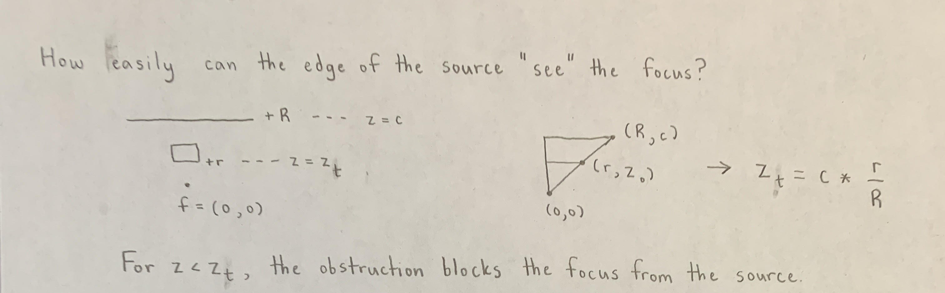
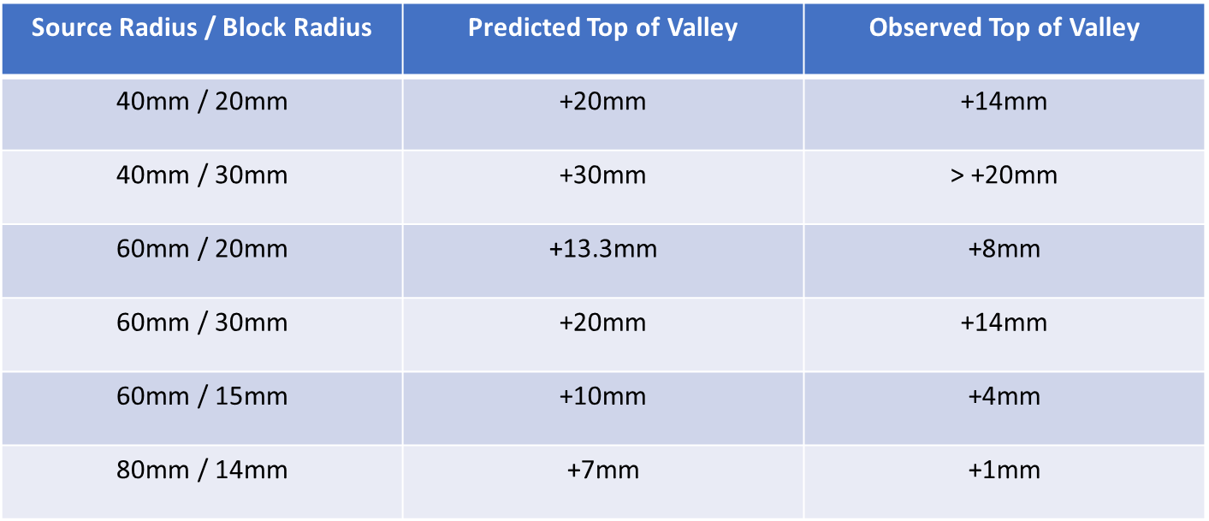


FERMILAB-SLIDES-24-0185-STUDENT
Refinement and Modeling of a Blackbody-Based Calibration Method in the InfraBREAD Detector
Shardul Rao, University of Minnesota | Supervised by Dr. Stefan Knirck
Axions and How BREAD Detects Them
Varying the Size of the Source and Block
The axion is a hypothetical particle proposed by Frank Wilczek and Steven Weinberg as a consequence of the Peccei-Quinn mechanism, which can explain why the strong interaction simultaneously preserves charge and parity symmetry.¹ Due to their properties, axion-like particles make promising dark matter candidates. Under some theoretical models, axion-like particles can convert directly to photons in the presence of a magnetic field.²
The Broadband Reflector Experiment for Axion Detection (BREAD) searches for this axion-to-photon conversion.³ These converted photons are emitted normal to the inner cylindrical surface, reflected off of the parabolic reflector, reflected again off of the inner cylindrical surface, and focused to a single point. InfraBREAD specifically detects converted infrared photons using a superconducting nanowire single-photon detector (SNSPD).
40 mm radius source, 20mm radius block
40 mm radius source, 30mm radius block
A cutaway view of the BREAD reflector, which is a parabolic reflector cut in half about its central axis and revolved around another, perpendicular axis. Any photon emitted normal to the inner cylindrical surface gets focused to a singular point after two reflections.
60 mm radius source, 20mm radius block
60 mm radius source, 30mm radius block
Calibrating SNSPD Using Blackbody Radiation
80 mm radius source, 14mm radius block
Due to uneven thermal contraction when the detector is cooled to ~0.1K, the true focal spot of the detector may move slightly.
A “hot” absorber (~10 K) emits blackbody radiation into the reflector cavity. The SNSPD sits beneath a mount, which blocks blackbody radiation from above from passing through it.
Our initial expectation is that the focus should be exactly at location of minimum blackbody photon counts.
Modeling the Size of the Valley
Prediction
Observation
I’m going to make this into a nice digital image
Data supports revised prediction of (Top of Valley) = (Predicted Top) – 6mm
Citations
This manuscript has been authored by Fermi Research Alliance, LLC under Contract No. DE-AC02-07CH11359 with the U.S. Department of Energy, Office of Science, Office of High Energy Physics. This work was supported in part by the U.S. Department of Energy, Office of Science, Office of Workforce Development for Teachers and Scientists (WDTS) under the Science Undergraduate Laboratory Internships Program (SULI).
Caption Text – Helvetica / Arial Bold 24pt Blue

