Slide 1
KPI 2018 – Assessment Report for LAND PARCEL DATA IN SMALLWORLD
Nik Mohd Fadhil Bin Nik Mohd Kamil
Mapping & Analysis Unit, GIS Distribution Project | 24 Dec 2018

Slide 2
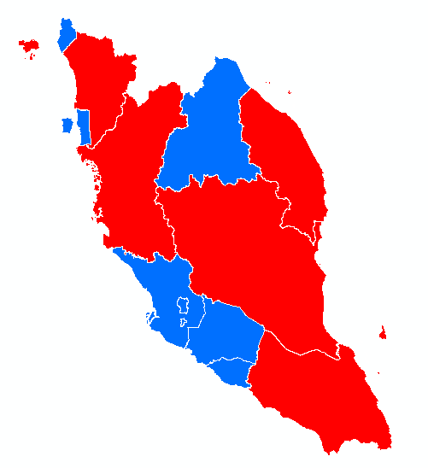
STATUS LAND PARCEL (NDCDB) UPDATED IN SW
No | State | Date
1 | Kuala Lumpur | 2/2/2018
2 | Putrajaya | 2/2/2018
3 | Selangor | 20/2/2018
4 | Negeri Sembilan | 31/1/2017
5 | Pulau Pinang | 8/8/2018
6 | Kelantan | 29/8/2018
7 | Melaka | 14/9/2018
8 | Perlis | 21/12/2018
9 | Kedah | 2/1/2019
10 | Johor | 2/1/2019
11 | Terengganu | 2/1/2019
12 | Pahang | 4/3/2019
13 | Perak | 4/3/2019

