Slide 1
KPI 2018 REQUIREMENT STUDY FOR GIS DATA ANALYTIC Distribution Network Master Plan(DNMP)
Nik Mohd Fadhil Bin Nik Mohd Kamil
Mapping & Analysis Unit, GIS Distribution Project | 27 Dec 2018

Slide 2
TABLE OF CONTENT
No | CONTENT | SLIDE NO
1 | OBJECTIVES | 3
2 | OFFICIAL MEETING CONDUCTED | 4
3 | REFERENCES | 5
4 | FINDINGS | 6
5 | WAY FORWARDS | 31

Slide 3
#1 OBJECTIVES
No | OBJECTIVE
1 | To study existing DNMP template and related documents
2 | To gather user requirement for GIS use in DNMP
3 | To get way forwards of GIS use in DNMP

Slide 4
#2 OFFICIAL MEETING CONDUCTED
Date | Attendance
24 July 2018 @ TNB Banda Kaba | Nik Mohd Fadhil Bin Nik Mohd Kamil (GIS D) Mapping & Analysis Technician (GIS D) Hasliana Binti Mohamad (GIS D) Mohd Saiful Anuar bin Mohd Rapheal (GIS D) Rozana binti Romainor (GIS D) Mohamad Izham b. Pazarizal (Cheras) Zulhairi Wan Mat (Cheras) Muhammad Izzat b. Mukhtar (Cheras) Aizat b. Noor Azmi (Petaling Jaya) Mohamad Izham b. Pazarizal (Cheras) Idawati binti Muhammad Sam (Rawang)

Slide 5
#3 REFERENCES
No | SOURCE
1 | Distribution Network Master PlanTemplate (Asset Management Dept.)
2 | Distribution Planners Handbook (Asset Management Dept.)
3 | Prosedur `DNMP 22kV and below’ (ENGR-750-73)
4 | Prosedur `DNMP 33kV and below’ (ENGR-750-74)
5 | Distribution Planners Handbook (Asset Management Dept.)

Slide 6
#4 FINDINGS

Slide 7
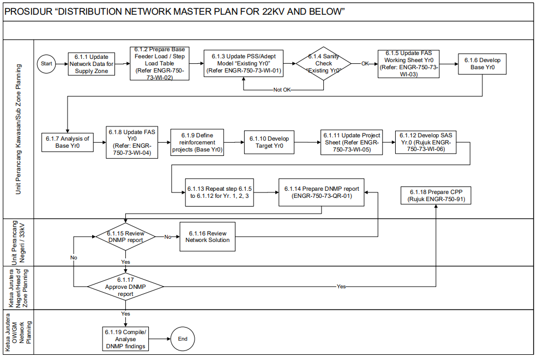

Slide 8
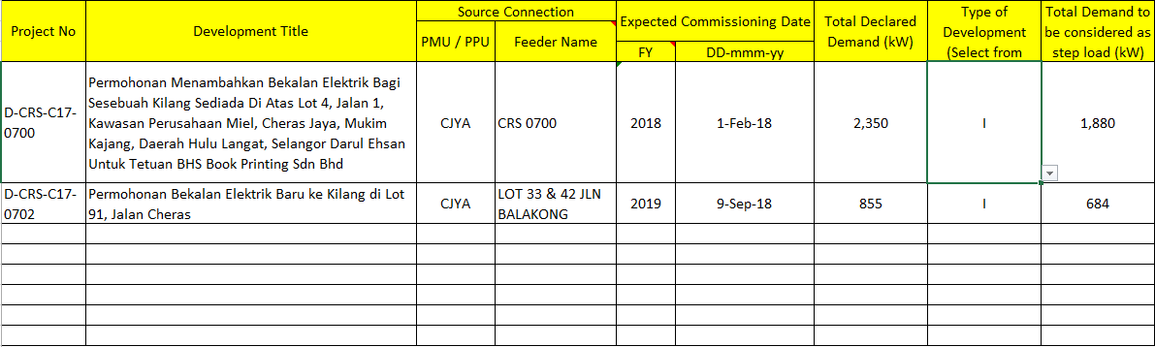
DNMP > STEP LOAD
Data-data boleh diperolehi
Daripada Lite Editor GIS
Data-data boleh diperolehi
Daripada Lite Editor GIS
Data-data boleh diperolehi daripada Desktop GIS

Slide 9
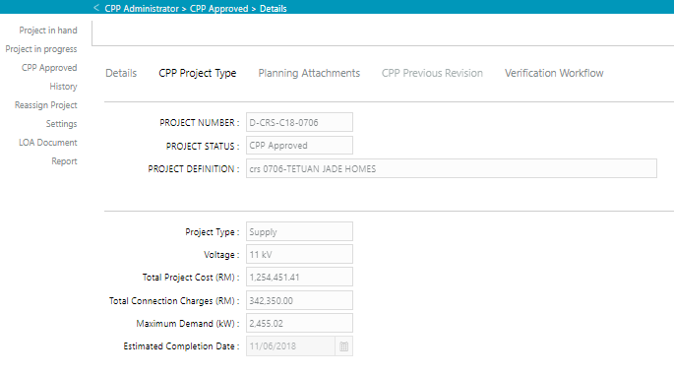
DNMP > STEP LOAD INPUT DATA DARIPADA GIS (LITE EDITOR)

Slide 10
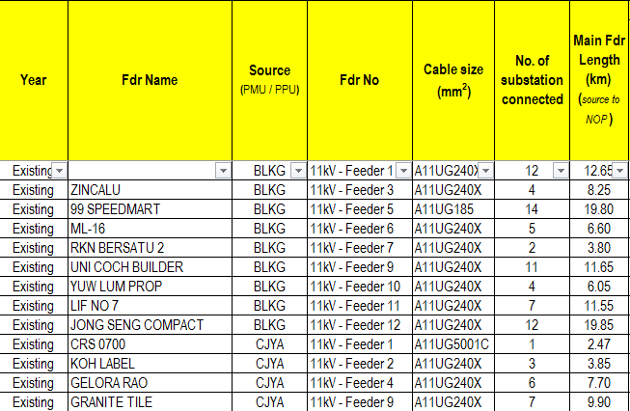
DNMP > FAS WORKING

Slide 11
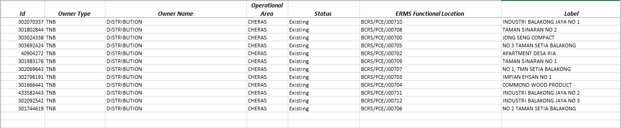
DNMP > FAS WORKING INPUT DATA DARIPADA GIS (SMALLWORLD)

Slide 12
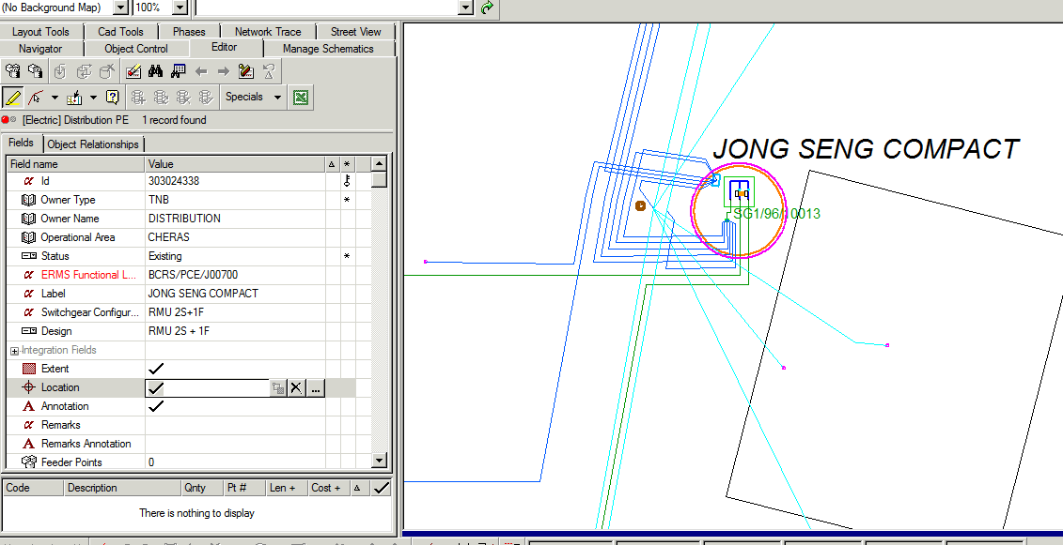
DNMP > FAS WORKING INPUT DATA DARIPADA GIS (SMALLWORLD)
2
1

Slide 13
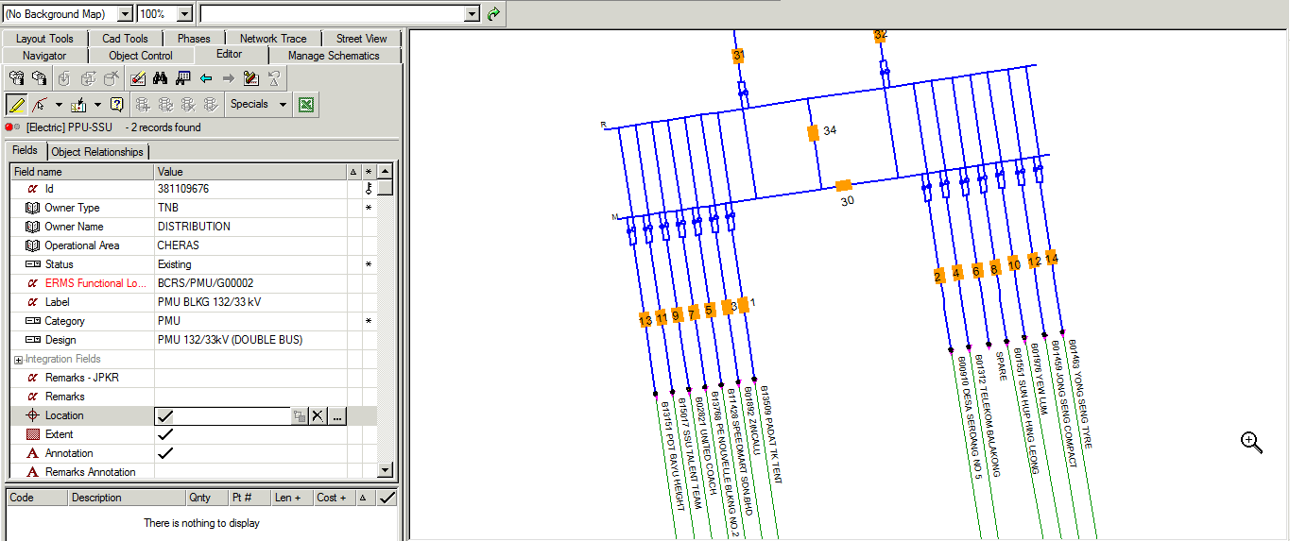
3
4

Slide 14
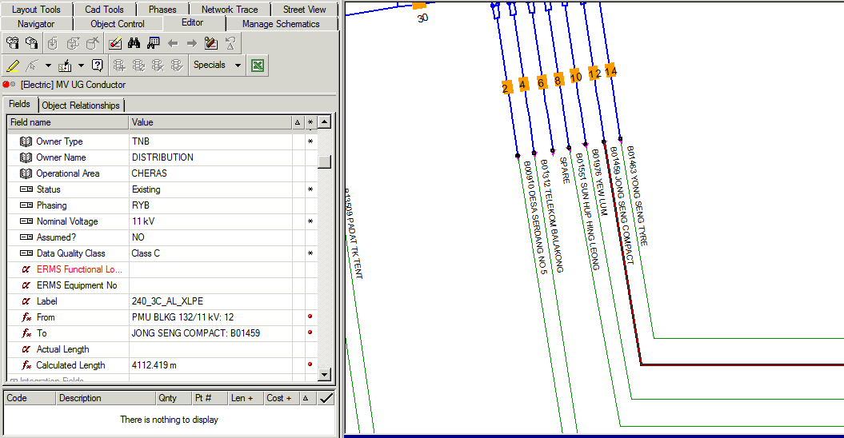
5
6

Slide 15
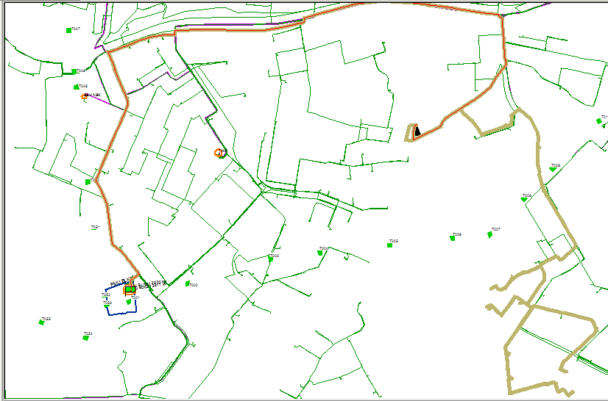

Slide 16
#5 WAY FORWARDS

Slide 17
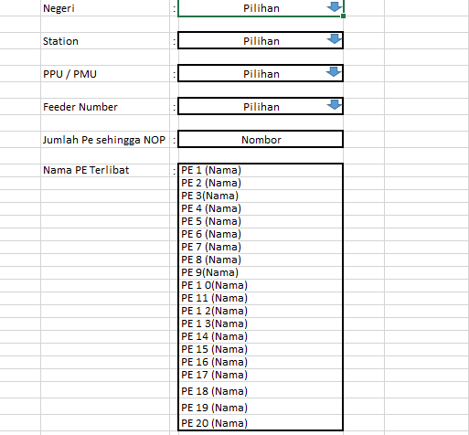
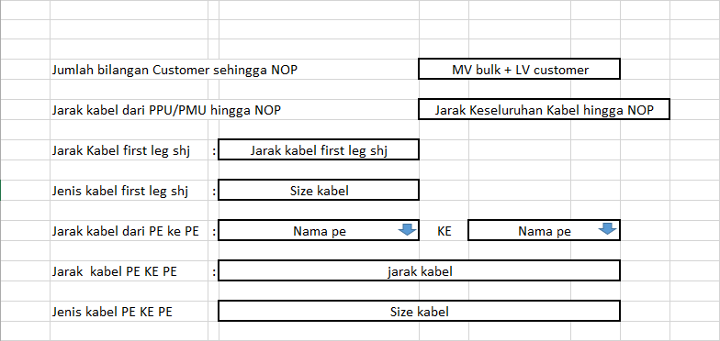
DNMP > CADANGAN PENAMBAHBAIKAN BAGI INPUT DATA DARIpada gis

Slide 18
