Slide 1
KPI 2018 REQUIREMENT STUDY FOR GIS DATA ANALYTIC Distribution Project Evaluation Template (dPET)
Nik Mohd Fadhil Bin Nik Mohd Kamil
Mapping & Analysis Unit, GIS Distribution Project | 24 Dec 2018

Slide 2
TABLE OF CONTENT
No | CONTENT | SLIDE NO
1 | OBJECTIVES | 3
2 | OFFICIAL MEETING CONDUCTED | 4
3 | REFERENCES | 5
4 | FINDINGS | 6
5 | WAY FORWARDS | 31

Slide 3
#1 OBJECTIVES
No | OBJECTIVE
1 | To study existing dPET template and related documents
2 | To gather user requirement for GIS use in dPET
3 | To get way forwards of GIS use in dPET

Slide 4
#2 OFFICIAL MEETING CONDUCTED
Date | Attendance
24 July 2018 @ TNB Banda Kaba | Nik Mohd Fadhil Bin Nik Mohd Kamil (GIS D) Mapping & Analysis Technician (GIS D) Hasliana Binti Mohamad (GIS D) Mohd Saiful Anuar bin Mohd Rapheal (GIS D) Rozana binti Romainor (GIS D) Mohamad Izham b. Pazarizal (Cheras) Zulhairi Wan Mat (Cheras) Muhammad Izzat b. Mukhtar (Cheras) Aizat b. Noor Azmi (Petaling Jaya) Mohamad Izham b. Pazarizal (Cheras) Idawati binti Muhammad Sam (Rawang)

Slide 5
#3 REFERENCES
No | SOURCE
1 | Distribution Project Evaluation Template (Asset Management Dept.)
2 | Distribution Planners Handbook (Asset Management Dept.)
3 | Penggunaan Template Penilaian Projek (dPET) dalam Proses Perancangan dan Penilaian Projek Pembaikan Sistem Bahagian Pembahagian TNB – Bil. A39/2012
4 | 33kV Distribution Network Master Plan Process Flow
5 | Prosedur Perancangan Projek Sistem 33KV Dan Penubuhan PPU (ENGR-750-57)
6 | Prosedur Pengurusaan Kehilangan Tenaga Teknikal (ENGR-750-83)

Slide 6
#4 FINDINGS

Slide 7
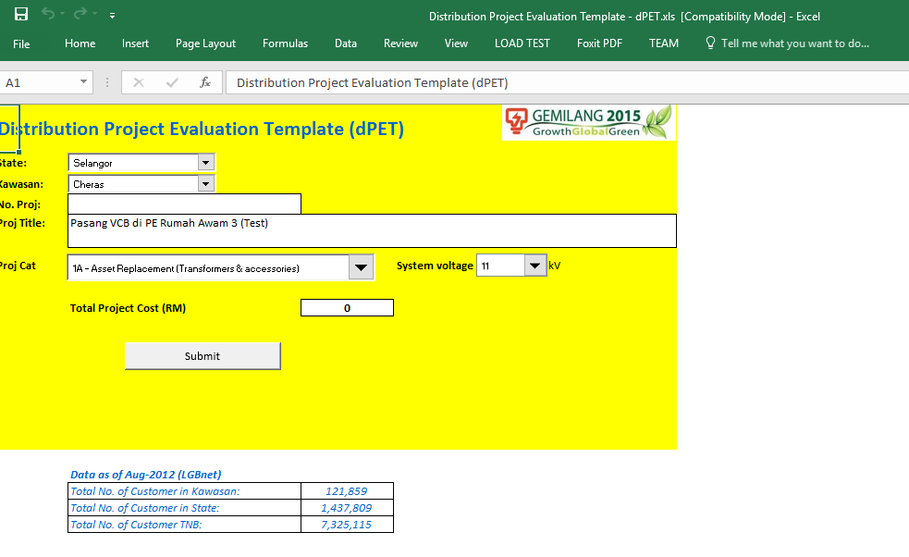

Slide 8
CB No | FL | EQ NO | Outgoing or Incoming? | Total PE connected | DA? (Yes or No)
CB 1 | XXXXXX | YYYYYYY | Incoming | No | Yes
CB 2 | XXXXXX | YYYYYYY | Incoming | No | Yes
CB 3 | XXXXXX | YYYYYYY | Outgoing | Yes | No
CB 4 | XXXXXX | YYYYYYY | Outgoing | Yes | Yes
CB 5 | XXXXXX | YYYYYYY | Outgoing | Yes | No
1A
Peak MD - ILMAS
Query by EQ No & FL
Supply Area - need to check Mr Lau
Manufacture Year (dPET), Commissioned Data (GIS)
1B
Query by FL & EQ of No CB
DA (PE fully SCADA controlled by RCC) - Manually, need to discuss with DA on ERMS data
Manufacture Year (dPET), Commissioned Data (GIS)
Supply Area - need to check Mr Lau
MV Bulk Customers Connected (GIS) without MD, next Data Model need to considered Consumption
Demand Contribution Profile - calculate based on Tariff

Slide 9
1C
Query by EQ No & FL of RMU
Network Type (GIS)
Total nos of PE connected to feeder (GIS tracing, 1st leg, calculate no of PE connected up to off point)
DA (PE fully SCADA controlled by RCC) - Manually, need to discuss with DA on ERMS data
Total Feeder Peak MD (ILMAS)
Manufacture Year (dPET), Commissioned Data (GIS)
Supply Area - need to check Mr Lau
MV Bulk Customers Connected (GIS) without MD, next Data Model need to considered Consumption
Demand Contribution Profile - calculate based on Tariff

Slide 10
1D
Query based on FL No to FL No (Section to Section)
Total nos of PE connected to feeder (GIS tracing, 1st leg, calculate no of PE connected up to off point)
DA (PE fully SCADA controlled by RCC) - Manually, need to discuss with DA on ERMS data
Total Feeder Peak MD (ILMAS)
Replaced Asset Selection (IUG or ABC) - GIS to determine
Original Year Installed (of Replaced asset) - GIS can’t provide data
Supply Area - need to check Mr Lau
MV Bulk Customers Connected (GIS) without MD, next Data Model need to considered Consumption
Demand Contribution Profile - calculate based on Tariff
System Performance Data - LGBNET
Technical Losses - Adept

Slide 11
1E
Total Feeder length - GIS (PPU to off point)
Total line length (km) to be replaced in this project - Query based on FL No to FL No
Total nos of Auto-Recloser on the line (Feeder) - GIS (trace by feeder)
Nos of Auto-Recloser fully SCADA controlled by RCC - Manually, need to discuss with DA on ERMS data
Total Feeder Peak MD - ILMAS
Original Year Installed - GIS can’t provide data
Supply Area - need to check Mr Lau
MV Bulk Customers Connected from Feeder - GIS without MD, next Data Model need to considered Consumption
Demand Contribution Profile - calculate based on Tariff
System Performance Data - LGBNET
No of Breakdown experience in last 12 months - LGBNET

Slide 12
2A
Type 1
Feeder Peak MD - ILMAS Spur Section Peak MD - User key-in
User need to inform FL for spur S/S. GIS need to trace by section from tee-off point.
No of PE connected - GIS
Nos of PE fully SCADA controlled by RCC - Manually, need to discuss with DA on ERMS data
Supply Area - need to check Mr Lau
No. of MV Bulk Customer - GIS (To trace by section from tee-off point).
Total MD of MD Bulk Customer - BCRM
Demand Contribution Profile - GIS (To trace by section from tee-off point)
Technical Losses - Adept
Type 2
Feeder Peak MD - ILMAS Spur Section Peak MD - User key-in
User need to inform FL for spur S/S. GIS need to trace by section from tee-off point.
No of PE connected - GIS
Nos of PE fully SCADA controlled by RCC - Manually, need to discuss with DA on ERMS data
Supply Area - need to check Mr Lau
No. of MV Bulk Customer - GIS (To trace by section from tee-off point).
Total MD of MD Bulk Customer - BCRM
Demand Contribution Profile - GIS (To trace by section from tee-off point)
Technical Losses - Adept

Slide 13
2B
Type 1
Feeder Peak MD - ILMAS
(n-1) element contingency scenario - DNMP
Supply Area - need to check Mr Lau
No of PE connected - GIS
Nos of PE fully SCADA controlled by RCC - Manually, need to discuss with DA on ERMS data
No. of MV Bulk Customer - GIS (To trace by section from tee-off point).
Total MD of MD Bulk Customer - BCRM
Demand Contribution Profile - GIS (To trace by section from tee-off point)
Technical Losses - Adept
Type 2
Feeder Peak MD - ILMAS
(n-1) element contingency scenario - DNMP
Supply Area - need to check Mr Lau
No of PE connected - GIS
Nos of PE fully SCADA controlled by RCC - Manually, need to discuss with DA on ERMS data
No. of MV Bulk Customer - GIS (To trace by section from tee-off point).
Total MD of MD Bulk Customer - BCRM
Demand Contribution Profile - GIS (To trace by section from tee-off point)
Technical Losses - Adept

Slide 14
Type 3
Feeder Peak MD - ILMAS
No of PE connected - GIS
Nos of PE fully SCADA controlled by RCC - Manually, need to discuss with DA on ERMS data
Supply Area - need to check Mr Lau
No. of MV Bulk Customer - GIS (To trace by section from tee-off point).
Total MD of MD Bulk Customer - BCRM
kWMD Demand Contribution Profile - BCRM
Security analysis during (n-1) Contigency - DNMP
Technical Losses - Adept
Type 4
Feeder Peak MD - ILMAS
No of PE connected - GIS
Nos of PE fully SCADA controlled by RCC - Manually, need to discuss with DA on ERMS data
Supply Area - need to check Mr Lau
No. of MV Bulk Customer - GIS (To trace by section from tee-off point).
Total MD of MD Bulk Customer - BCRM
Demand Contribution Profile - GIS (To trace by section from tee-off point)
Security analysis during (n-1) Contigency - DNMP
Technical Losses - Adept

Slide 15
2C
Existing LV Feeder Peak MD (kWMD) - ILMAS
Demand Contribution Profile - GIS (To trace by section from tee-off point)
Risk of Failure (No. of BD in 12 months) - LGBNET
Technical Losses - Adept

Slide 16
2D
Type 1
Feeder Peak MD - ILMAS
Supply Area - need to check Mr Lau
No of PE connected - GIS
Nos of PE fully SCADA controlled by RCC - Manually, need to discuss with DA on ERMS data
MD Bulk Customer (kW) - BCRM
No. of MV Bulk Customer - GIS (To trace by section from tee-off point)
Demand Contribution Profile - GIS (To trace by section from tee-off point)
Technical Losses - Adept
Type 2
Feeder Peak MD - ILMAS
Supply Area - need to check Mr Lau
No of PE connected - GIS
Nos of PE fully SCADA controlled by RCC - Manually, need to discuss with DA on ERMS data
MD Bulk Customer (kW) - BCRM
No. of MV Bulk Customer - GIS (To trace by section from tee-off point)
Demand Contribution Profile - GIS (To trace by section from tee-off point)
Technical Losses - Adept

Slide 17
Type 3
Feeder Peak MD - ILMAS
Supply Area - need to check Mr Lau
No of PE connected - GIS
Nos of PE fully SCADA controlled by RCC - Manually, need to discuss with DA on ERMS data
MD Bulk Customer (kW) - BCRM
No. of MV Bulk Customer - GIS (To trace by section from tee-off point)
Demand Contribution Profile - GIS (To trace by section from tee-off point)
Technical Losses - Adept
Type 4
Feeder Peak MD - ILMAS
No of PE connected - GIS
Nos of PE fully SCADA controlled by RCC - Manually, need to discuss with DA on ERMS data
Supply Area - need to check Mr Lau
MD Bulk Customer (kW) - BCRM
No. of MV Bulk Customer - GIS (To trace by section from tee-off point)
Demand Contribution Profile - GIS (To trace by section from tee-off point)
Technical Losses - Adept

Slide 18
3A
Total nos of PE connected from Feeder - GIS
Total Feeder length (meter) - GIS
Nos of PE (within feeder) fully SCADA controlled by RCC - Manually, need to discuss with DA on ERMS data
Total Feeder Peak MD (kWMD) - ILMAS
Original Year Installed - User need to pass FL, key-in - Manufacture Year (dPET), Commissioned Data (GIS)
Route length of cable/line trespass or encroach - User
Supply Area - need to check Mr Lau
MV Bulk Customer Connected from Feeder
Demand Contribution Profile - GIS (To trace by section from tee-off point)
Technical Losses - Adept

Slide 19
3B
Total nos of PE connected from Feeder - GIS
Total Feeder length (meter) - GIS
Nos of PE (within feeder) fully SCADA controlled by RCC - Manually, need to discuss with DA on ERMS data
Total Feeder Peak MD (kWMD) - ILMAS
Original Year Installed - User need to pass FL, key-in - Manufacture Year (dPET), Commissioned Data (GIS)
Route length of cable/line trespass or encroach - User
Supply Area - need to check Mr Lau
MV Bulk Customer Connected from Feeder
Demand Contribution Profile - GIS (To trace by section from tee-off point)
Technical Losses - Adept

Slide 20
3C
Total nos of PE connected from Feeder - GIS
Total Feeder length (meter) - GIS
Nos of PE (within feeder) fully SCADA controlled by RCC - Manually, need to discuss with DA on ERMS data
No. of H-Pole (within feeder) -GIS (S/S type)
Total Feeder Peak MD (kWMD) - ILMAS
(Average) Year of MV Network is installed - GIS (Use H-Pole year of commissioned)
Supply Area - need to check Mr Lau
MV Bulk Customer Connected from Feeder
Demand Contribution Profile - GIS (To trace by section from tee-off point)
Technical Losses - Adept

Slide 21
4A
Transformer Peak MD - ILMAS
Transformer Capacity - GIS
Transformer Manufacturing Year - Manufacture Year (dPET), Commissioned Data (GIS)
Supply Area - Need to check Mr Lau
Demand Contribution Profile - GIS (To trace by section from tee-off point)

Slide 22
4B
Transformer Peak MD - ILMAS
Transformer Capacity - GIS
Transformer Manufacturing Year - Manufacture Year (dPET), Commissioned Data (GIS)
Supply Area - Need to check Mr Lau
Demand Contribution Profile - GIS (To trace by section from tee-off point)

Slide 23
4C
Total nos of PE connected from Feeder - GIS
Total Feeder length (meter) - GIS
Total Feeder Peak MD - ILMAS
Supply Area - Need to check Mr Lau
MV Bulk Customer Connected - GIS
Demand Contribution Profile - GIS (To trace by section from tee-off point)
System Fault Level - Adept
Underated equipment's short-circuit - DNMP
Equipment Manufacturing - Manufacture Year (dPET), Commissioned Data (GIS)

Slide 24
5A
No. of EFI or LFI (set) to be installed - Users
Total No. of PE (in Kawasan) - GIS
Total No. of EFI or LFI (set) already installed in the system - Users
SAIDI Kawasan (Annualised) - Users

Slide 25
5B
Total No. of Motorized RMU planned in this project - Users
Total No. of Feeders (s) involved in this installation - Users
Total No. of Pes supplied from the related Feeder (s) - GIS
Average Network age (key in Years installed) - Key-in existing FL & EQ No RMU, and then calculate average of commissioned date.
Total Feeder Peak MD (kWMD) of the related Feeders (s) - ILMAS
Supply Area - Need to check Mr Lau
MV Bulk Customer MD - GIS
No.s of MV Bulk Customer - GIS
Demand Contribution Profile - GIS (To trace by section from tee-off point)
Technical Losses - Adept

Slide 26
5C
User key-in FL s/s
Peak Load MD of SSU - ILMAS
Year of Network installed - Comm. Date
Supply Area - Need to check Mr Lau
No.s of MV Bulk Customer - GIS
Total MD of MV Bulk Customer - BCRM
Demand Contribution Profile - GIS (To trace by section from tee-off point)
Technical Losses - Adept

Slide 27
5D
Total nos of PE connected - GIS
Nos of PE (within feeder) fully SCADA controlled by RCC - Manually, need to discuss with DA on ERMS data
Total Feeder Peak MD - ILMAS
Average age of Network - GIS (Comm. Date)
Supply Area - Need to check Mr Lau
MV Bulk Customer Connected - GIS
Demand Contribution Profile - GIS (To trace by section from tee-off point)

Slide 28
5F
No. of LBS to installed - Users
Total No. of PE (in Kawasan) - GIS
Total No. of PAT without Isolator (i.e. Direct Jumper) - Users
SAIDI Kawasan (Annualised) - sama mcm diatas

Slide 29
6A
No. of Cap Bank to be installed - Users
Rating of each Cap Bank - Users
Average demand (kWMD) existing PE - Users
Average power factor of existing PE - Users
Total Demand loss (kW) of Existing network / installation
Total Demand loss (kW) of new network / installation (after mitigation) - Users

Slide 30
6B
Feeder Peak MD (kWMD) - ILMAS
Bulk Customer MD Connected - GIS
No. of PE connected - GIS
No. of customer (MV Bulk) - GIS
No. of customer (LV) - GIS
Risk to Failure - seperti diatas
Average Outage Duration - LGBNET
Maintenance Cost per year - Users
Technical Losses - Adept

Slide 31
#5 WAY FORWARDS

Slide 32
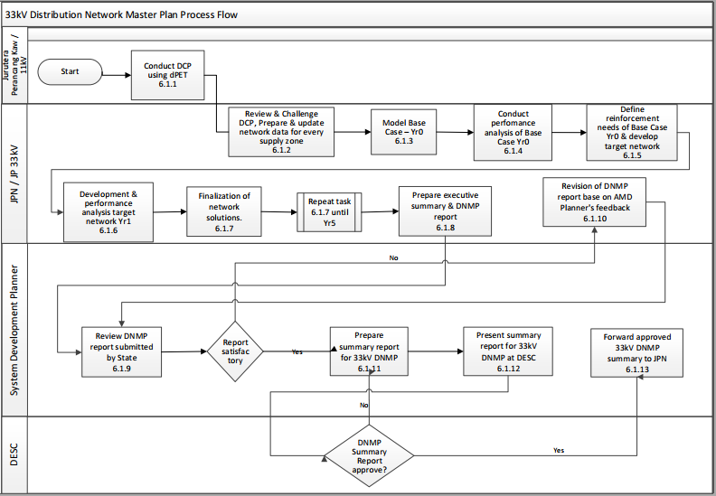
To get data from GIS

