Slide 1
NE7202-NETWORK AND INFORMATION SECURITY

Slide 2
OBJECTIVES
To understand the fundamentals of Cryptography
To acquire knowledge on standard algorithms used to provide confidentiality, integrity and authenticity.
To understand the various key distribution and management schemes.
To understand how to deploy encryption techniques to secure data in transit across data networks
To design security applications in the field of Information technology
IFETCE/M.E CSE/NE7202-NIS/Unit 1
Slide #1-<number>

Slide 3
Unit I
Introduction

Slide 4

What is “Security”
Security is a state of well-being of information and infrastructures in which the possibility of successful yet undetected theft, tampering, and disruption of information and services is kept low or tolerable
Security rests on confidentiality, authenticity, integrity, and availability
IFETCE/M.E CSE/NE7202-NIS/Unit 1

Slide 5
Why do we need security?
Protect vital information while still allowing access to those who need it
  Trade secrets, medical records, etc.
Provide authentication and access control for resources
  Ex: AFS
Guarantee availability of resources
  Ex: 5 9’s (99.999% reliability)
IFETCE/M.E CSE/NE7202-NIS/Unit 1

Slide 6
Who is vulnerable?
Financial institutions and banks
Internet service providers
Pharmaceutical companies
Government and defense agencies
Contractors to various government agencies
Multinational corporations
ANYONE ON THE NETWORK
IFETCE/M.E CSE/NE7202-NIS/Unit 1

Slide 7
Background
Information Security requirements have changed in recent times
Traditionally provided by physical and administrative mechanisms
Computer use requires automated tools to protect files and other stored information
Use of networks and communications links requires measures to protect data during transmission
IFETCE/M.E CSE/NE7202-NIS/Unit 1
Slide #1-<number>
Notes:
The requirements of information security within an organization have undergone two major changes in the last several decades. Before the widespread use of data processing equipment,the security of information felt to be valuable to an organization was provided primarily by physical (eg. rugged filing cabinets with locks) and administrative mechanisms (eg. Personnel screening procedures during hiring process).
Growing computer use implies a need for automated tools for protecting files and other information stored on it. This is especially the case for a shared system, such as a time-sharing system, and even more so for systems that can be accessed over a public telephone network, data network, or the Internet.
The second major change that affected security is the introduction of distributed systems and the use of networks and communications facilities for carrying data between terminal user and computer and between computer and computer. Network security measures are needed to protect data during their transmission.

Slide 8
Definitions
Computer Security - generic name for the collection of tools designed to protect data and to thwart hackers
Network Security - measures to protect data during their transmission
Internet Security - measures to protect data during their transmission over a collection of interconnected networks
IFETCE/M.E CSE/NE7202-NIS/Unit 1
Slide #1-<number>
Notes:
Here are some key definitions, note boundaries between them are blurred.

Slide 9
Status of security in computing
(in early 2000s)
In terms of security, computing is very close to the wild west days.
Some computing professionals & managers do not even recognize the value of the resources they use or control.
In the event of a computing crime, some companies do not investigate or prosecute.
Has the status changed for the better?
IFETCE/M.E CSE/NE7202-NIS/Unit 1
Slide #1-<number>

Slide 10
Need for Security
Increasing threat of attacks
Availability of tools & resources on Internet that may be used to attack systems
Fast growth of computer networking for information sharing
Enterprise systems share confidential information
Products launched in market concentrate more on ease of use that security
Lack of specialized resources that may be allotted for securing systems
IFETCE/M.E CSE/NE7202-NIS/Unit 1
Slide #1-<number>

Slide 11
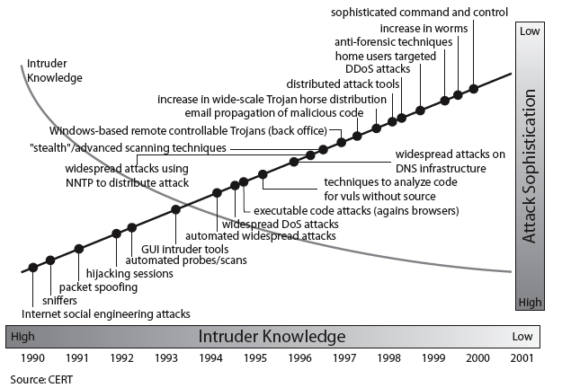
Security Trends
IFETCE/M.E CSE/NE7202-NIS/Unit 1
Slide #1-<number>
Notes:
Discuss observed security trends (Stallings section 1.1 & Figure 1.2 above), noting growth in sophistication of attacks contrasting with decrease in skill & knowledge needed to mount an attack.

Slide 12
Characteristics of Computer Intrusion
A computing system: a collection of hardware, software, data, and people that an organization uses to do computing tasks
Any piece of the computing system can become the target of a computing crime.
The weakest point is the most serious vulnerability.
The principles of easiest penetration
IFETCE/M.E CSE/NE7202-NIS/Unit 1
Slide #1-<number>

Slide 13
Security Breaches- Terminology
Exposure
  a form of possible loss or harm
Vulnerability
  a weakness in the system
Attack
  Any action that compromises the security of information owned by an organization.
Threats
  Human attacks, natural disasters, errors
Control – a protective measure
Assets – hardware, software, data
IFETCE/M.E CSE/NE7202-NIS/Unit 1
Slide #1-<number>

Slide 14
Vulnerabilities, Threats, and Controls
Vulnerability = a weakness in a security system
A threat is a potential violation of security.
  Flaws in design, implementation, and operation.
Controls = means and ways to block a threat, which tries to exploit one or more vulnerabilities
IFETCE/M.E CSE/NE7202-NIS/Unit 1
Slide #1-<number>

Slide 15
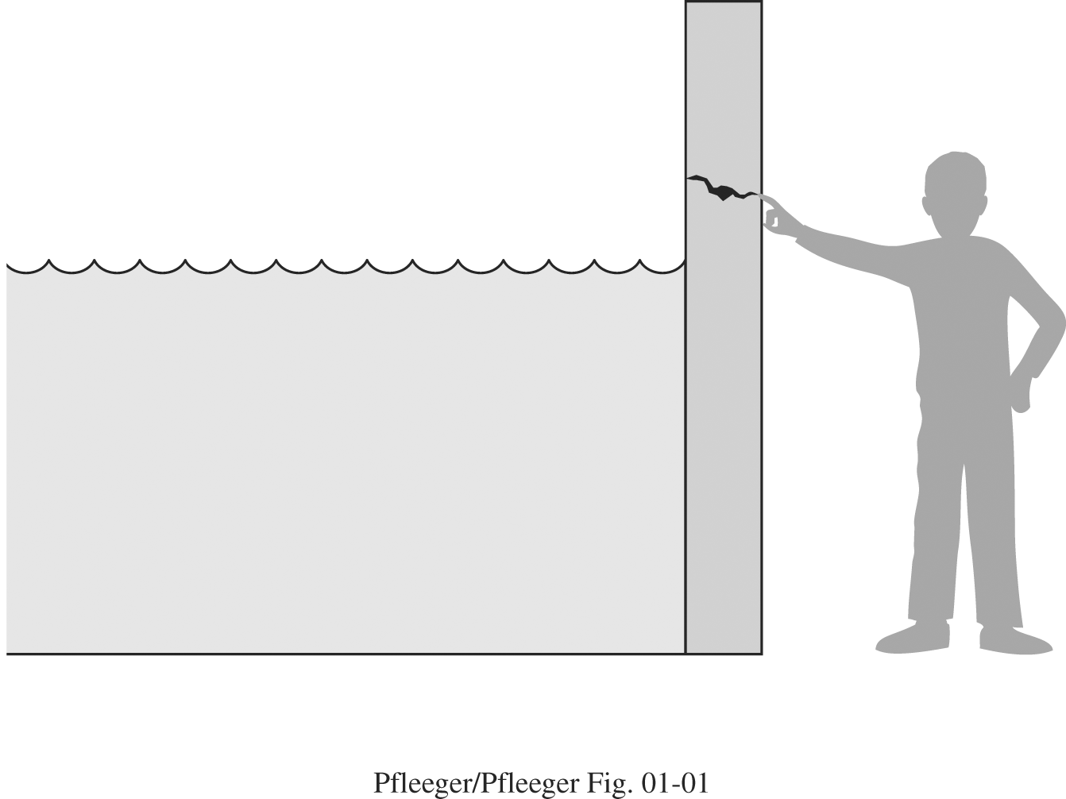
Threats, Controls, and Vulnerabilities
IFETCE/M.E CSE/NE7202-NIS/Unit 1
Slide #1-<number>

Slide 16
Classes of Threats
Interception
  an unauthorized party (human or not) gains access to an asset
Interruption
  an asset becomes lost, unavailable, or unusable
Modification
  an unauthorized party changes the state of an asset
Fabrication
  an unauthorized party counterfeits an asset
IFETCE/M.E CSE/NE7202-NIS/Unit 1
Slide #1-<number>

Slide 17
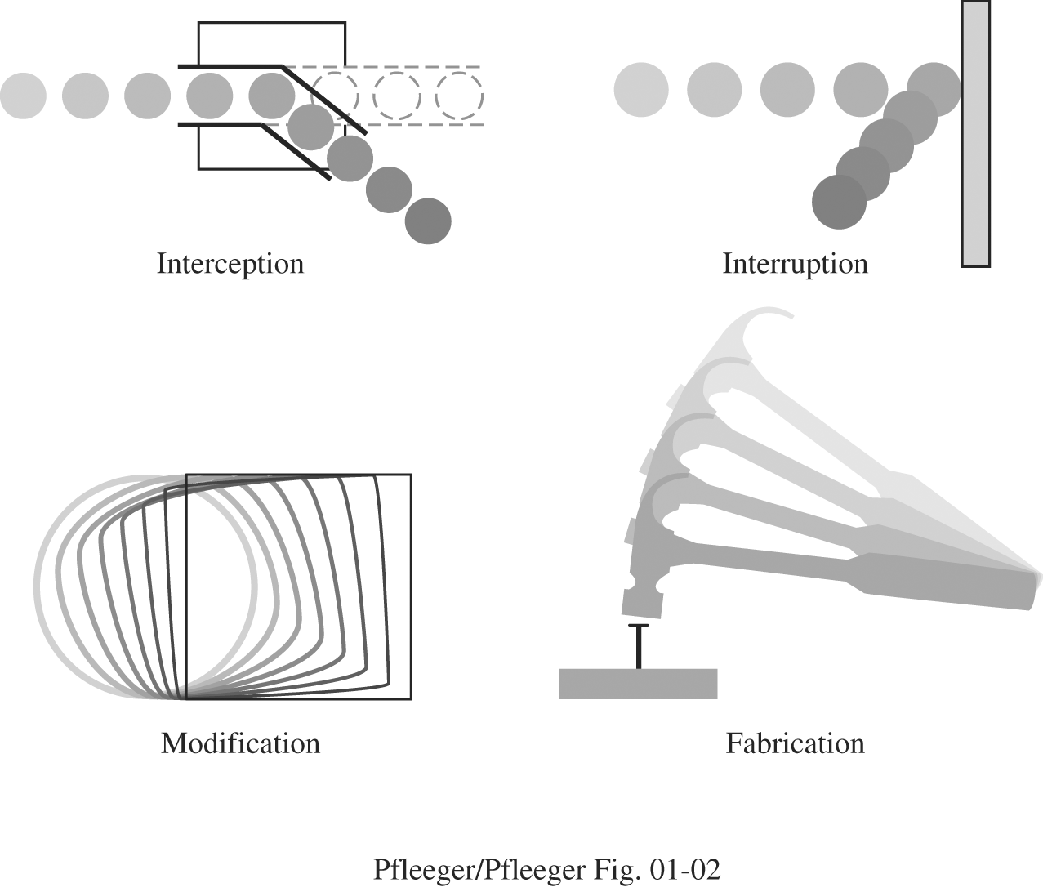
Figure 1-2 System Security Threats.
IFETCE/M.E CSE/NE7202-NIS/Unit 1
Slide #1-<number>

Slide 18
Basic Security Components
Confidentiality : The assets are accessible only by authorized parties.
  Keeping data and resources hidden
Integrity: The assets are modified only by authorized parties, and only in authorized ways
  Data integrity (integrity)
  Origin integrity (authentication)
Availability: Assets are accessible to authorized parties.
  Enabling access to data and resources
IFETCE/M.E CSE/NE7202-NIS/Unit 1
Slide #1-<number>
Notes:
Confidentiality: a good example is cryptography, which traditionally is used to protect secret messages. But cryptography is traditionally used to protect data, not resources. Resources are protected by limiting information, for example by using firewalls or address translation mechanisms.
Integrity: a good example here is that of an interrupted database transaction, leaving the database in an inconsistent state (this foreshadows the Clark-Wilson model). Trustworthiness of both data and origin affects integrity, as noted in the book’s example. That integrity is tied to trustworthiness makes it much harder to quantify than confidentiality. Cryptography provides mechanisms for detecting violations of integrity, but not preventing them (e.g., a digital signature can be used to determine if data has changed).
Availability: this is usually defined in terms of “quality of service,” in which authorized users are expected to receive a specific level of service (stated in terms of a metric). Denial of service attacks are attempts to block availability.

Slide 19
Basic Components of Security
CIA
  Confidentiality: Who is authorized to use data?
  Integrity: Is data „good?”
  Availability: Can access data whenever need it?
C
I
S
A
S = Secure
CIA or CIAAAN… ☺
  (other security components added to CIA)
  Authentication
  Authorization
  Non-repudiation
  …
IFETCE/M.E CSE/NE7202-NIS/Unit 1
Slide #1-<number>

Slide 20
Need to Balance CIA
Example 1: C vs. I+A
  Disconnect computer from Internet to increase confidentiality
  Availability suffers, integrity suffers due to lost updates
Example 2: I vs. C+A
  Have extensive data checks by different people/systems to increase integrity
  Confidentiality suffers as more people see data, availability suffers due to locks on data under verification
IFETCE/M.E CSE/NE7202-NIS/Unit 1
Slide #1-<number>
Notes:
In addition to all the rules and regulations, policies and procedures and the related system specific documentation, there are some current computer security issues of which you as the Executive should be made aware.

Slide 21
1. Confidentiality
“Need to know” basis for data access
  How do we know who needs what data?
  Approach: access control specifies who can access what
  How do we know a user is the person she claims to be?
    Need her identity and need to verify this identity
    Approach: identification and authentication
“Need to access/use” basis for physical assets
  E.g., access to a computer room, use of a desktop
IFETCE/M.E CSE/NE7202-NIS/Unit 1
Slide #1-<number>

Slide 22
2. Integrity
Integrity vs. Confidentiality
  Concerned with unauthorized modification of assets
  Confidentiality - concered with access to assets
  Integrity is more difficult to measure than confidentiality
    Could mean any subset of these asset properties:
  { precision / accuracy / currency / consistency /
  meaningfulness / usefulness / ...}
    Three aspects of integrity:
      Authorized actions
      Separation and protection of resources
      Error detection and correction
IFETCE/M.E CSE/NE7202-NIS/Unit 1
Slide #1-<number>

Slide 23
3. Availability
We can say that an asset (resource) is available if:
  Timely request response
  Fair allocation of resources (no starvation!)
  Fault tolerant (no total breakdown)
  Easy to use in the intended way
  Provides controlled concurrency (concurrency control, deadlock control, ...)
IFETCE/M.E CSE/NE7202-NIS/Unit 1
Slide #1-<number>

Slide 24
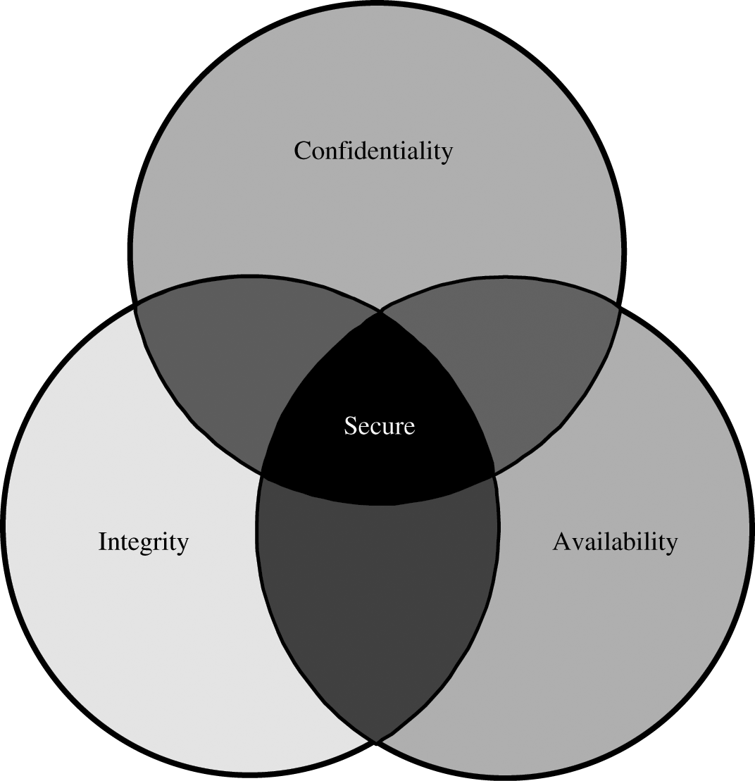
Relationship Between Confidentiality, Integrity, and Availability.
IFETCE/M.E CSE/NE7202-NIS/Unit 1
Slide #1-<number>

Slide 25
Goals of Security
Prevention
  Prevent attackers from violating security policy
Detection
  Detect attackers’ violation of security policy
Recovery
  Stop attack, assess and repair damage
  Continue to function correctly even if attack succeeds
IFETCE/M.E CSE/NE7202-NIS/Unit 1
Slide #1-<number>
Notes:
Prevention is ideal, because then there are no successful attacks.
Detection occurs after someone violates the policy. The mechanism determines that a violation of the policy has occurred (or is underway), and reports it. The system (or system security officer) must then respond appropriately.
Recovery means that the system continues to function correctly, possibly after a period during which it fails to function correctly. If the system functions correctly always, but possibly with degraded services, it is said to be intrusion tolerant. This is very difficult to do correctly; usually, recovery means that the attack is stopped, the system fixed (which may involve shutting down the system for some time, or making it unavailable to all users except the system security officers), and then the system resumes correct operations.

Slide 26
Security Attacks
An attack is any action that violates security.
  Active adversary
An attack has an implicit concept of “intent”
  Router mis-configuration or server crash can also cause loss of availability, but they are not attacks
IFETCE/M.E CSE/NE7202-NIS/Unit 1
Slide #1-<number>

Slide 27
Types of Attacks on
Data CIA
Disclosure
  Attack on data confidentiality
Unauthorized modification / deception
  E.g., providing wrong data (attack on data integrity)
Disruption
  DoS (attack on data availability)
Usurpation
  Unauthorized use of services (attack on data confidentiality, integrity or availability)
IFETCE/M.E CSE/NE7202-NIS/Unit 1
Slide #1-<number>

Slide 28
Ways of Attacking Data CIA
Examples of Attacks on Data Confidentiality
  Tapping / snooping
Examples of Attacks on Data Integrity
  Modification: salami attack -> little bits add up
    E.g/ „shave off” the fractions of cents after interest calculations
  Fabrication: replay data -> send the same thing again
    E.g., a computer criminal replays a salary deposit to his account
Examples of Attacks on Data Availability
  Delay vs. „full” DoS
Examples of Repudiation Attacks on Data:
  Data origin repudiation: „I never sent it”
    Repudiation = refusal to acknowledge or pay a debt or honor a contract
  Data receipt repudiation: „I never got it”
IFETCE/M.E CSE/NE7202-NIS/Unit 1
Slide #1-<number>

Slide 29



Friends and enemies: Alice, Bob, Trudy
well-known in network security world
Bob, Alice (lovers!) want to communicate “securely”
Trudy (intruder) may intercept, delete, add messages
Alice
Bob
channel
data, control messages
secure
sender
secure
receiver
data
data
Trudy

Slide 30
Eavesdropping - Message Interception (Attack on Confidentiality)
Unauthorized access to information
Packet sniffers and wiretappers
Illicit copying of files and programs
A
B
Eavesdropper
IFETCE/M.E CSE/NE7202-NIS/Unit 1
Slide #1-<number>

Slide 31
Integrity Attack - Tampering With Messages
Stop the flow of the message
Delay and optionally modify the message
Release the message again
A
B
Perpetrator
IFETCE/M.E CSE/NE7202-NIS/Unit 1
Slide #1-<number>

Slide 32
Authenticity Attack - Fabrication
Unauthorized assumption of other’s identity
Generate and distribute objects under this identity
A
B
Masquerader: from A
IFETCE/M.E CSE/NE7202-NIS/Unit 1
Slide #1-<number>

Slide 33
Attack on Availability-Interruption
Destroy hardware (cutting fiber) or software
Modify software in a subtle way (alias commands)
Corrupt packets in transit
Blatant denial of service (DoS):
  Crashing the server
  Overwhelm the server (use up its resource)
A
B

Slide 34
Policies and Mechanisms
Policy: a statement of what is, and is not allowed.
  This defines “security” for the site/system/etc.
Mechanism: a procedure, tool, or method of enforcing a policy.
  Mechanisms enforce policies
Composition of policies
  If policies conflict, discrepancies may create security vulnerabilities
IFETCE/M.E CSE/NE7202-NIS/Unit 1
Slide #1-<number>
Notes:
Policy: may be expressed in
natural language, which is usually imprecise but easy to understand;
mathematics, which is usually precise but hard to understand;
policy languages, which look like some form of programming language and try to balance precision with ease of understanding
Mechanisms: may be
technical, in which controls in the computer enforce the policy; for example, the requirement that a user supply a password to authenticate herself before using the computer
procedural, in which controls outside the system enforce the policy; for example, firing someone for ringing in a disk containing a game program obtained from an untrusted source
The composition problem requires checking for inconsistencies among policies. If, for example, one policy allows students and faculty access to all data, and the other allows only faculty access to all the data, then they must be resolved (e.g., partition the data so that students and faculty can access some data, and only faculty access the other data).

Slide 35
Policies and Mechanisms (Cont)
Security mechanisms implement functions that help prevent, detect, and respond to recovery from security attacks.
Security functions are typically made available to users as a set of security services through APIs or integrated interfaces.
Cryptography underlies many security mechanisms.
IFETCE/M.E CSE/NE7202-NIS/Unit 1
Slide #1-<number>

Slide 36
Trust and Assumptions
Underlie all aspects of security
Trust and verify vs Verify before trust?
Policies
  Unambiguously partition system states
  Correctly capture security requirements
Mechanisms
  Assumed to enforce policy
  Support mechanisms work correctly
IFETCE/M.E CSE/NE7202-NIS/Unit 1
Slide #1-<number>
Notes:
All security policies and mechanisms rest on assumptions; we’ll examine some in later chapters, most notably Chapter 22, Malicious Logic. Here is a taste of the assumptions.
Policies: as these define security, they have to define security correctly for the particular site. For example, a web site has to be available, but if the security policy does not mention availability, the definition of security is inappropriate for the site. Also, a policy may not specify whether a particular state is “secure” or “non-secure.” This ambiguity causes problems.
Mechanisms: as these enforce policy, they must be appropriate. For example, cryptography does not assure availability, so using cryptography in the above situation won’t work. Further, security mechanisms rely on supporting infrastructure, such as compilers, libraries, the hardware, and networks to work correctly. Ken Thompson’s modified C preprocessor (see the example on p. 615) illustrates this point very well.

Slide 37
Types of Mechanisms
secure
precise
broad
set of reachable states
set of secure states
IFETCE/M.E CSE/NE7202-NIS/Unit 1
Slide #1-<number>
Notes:
A reachable state is one that the computer can enter. A secure state is a state defined as allowed by the security policy.
The left figure shows a secure system: all reachable states are in the set of secure states. The system can never enter (reach) a non-secure state, but there are secure states that the system cannot reach.
The middle figure shows a precise system: all reachable states are secure, and all secure states are reachable. Only the non-secure states are unreachable.
The right figure shows a broad system. Some non-secure states are reachable. This system is also not secure.

Slide 38
Assurance
Specification
  Requirements analysis
  Statement of desired functionality
Design
  How system will meet specification
Implementation
  Programs/systems that carry out design
IFETCE/M.E CSE/NE7202-NIS/Unit 1
Slide #1-<number>
Notes:
Assurance is a measure of how well the system meets its requirements; more informally, how much you can trust the system to do what it is supposed to do. It does not say what the system is to do; rather, it only covers how well the system does it.
Specifications arise from requirements analysis, in which the goals of the system are determined. The specification says what the system must do to meet those requirements. It is a statement of functionality, not assurance, and can be very formal (mathematical) or informal (natural language). The specification can be high-level or low-level (for example, describing what the system as a whole is to do vs. what specific modules of code are to do).
The design architects the system to satisfy, or meet, the specifications. Typically, the design is layered by breaking the system into abstractions, and then refining the abstractions as you work your way down to the hardware. An analyst also must show the design matches the specification.
The implementation is the actual coding of the modules and software components. These must be correct (perform as specified), and their aggregation must satisfy the design.
Note the assumptions of correct compilers, hardware, etc.

Slide 39
Operational Issues
Cost-Benefit Analysis
  Is it cheaper to prevent or recover?
Risk Analysis
  Should we protect something?
  How much should we protect this thing?
Laws and Customs
  Are desired security measures illegal?
  Will people do them?
IFETCE/M.E CSE/NE7202-NIS/Unit 1
Slide #1-<number>
Notes:
Security does not end when the system is completed. Its operation affects security. A “secure” system can be breached by improper operation (for example, when accounts with no passwords are created). The question is how to assess the effect of operational issues on security.
Cost-Benefit Analysis: this weighs the cost of protecting data and resources with the costs associated with losing the data. Among the considerations are the overlap of mechanisms’ effects (one mechanism may protect multiple services, so its cost is amortized), the non-technical aspects of the mechanism (will it be impossible to enforce), and the ease of use (if a mechanism is too cumbersome, it may cost more to retrofit a decent user interface than the benefits would warrant).
Risk Analysis: what happens if the data and resources are compromised? This tells you what you need to protect and to what level. Cost-benefit analyses help determine the risk here, but there may be other metrics involved (such as customs).
Laws and Customs: these constrain what you can do. Encryption used to be the biggie here, as the text indicates. How much that has changed is anybody’s guess. Customs involve non-legislated things, like the use of urine specimens to determine identity. That is legal, at least in the US in some cases; but it would never be widely accepted as an alternative to a password.

Slide 40
Human Issues
Organizational Problems
  Power and responsibility
  Financial benefits
People problems
  Outsiders and insiders
  Social engineering
IFETCE/M.E CSE/NE7202-NIS/Unit 1
Slide #1-<number>
Notes:
Organizations: the key here is that those responsible for security have the power to enforce security. Otherwise there is confusion, and the architects need not worry if the system is secure because they won’t be blamed if someone gets in. This arises when system administrators, for example, are responsible for security, but only security officers can make the rules. Preventing this problem (power without responsibility, or vice versa) is tricky and requires capable management. What’s worse is that security is not a direct financial incentive for most companies because it doesn’t bring in revenue. It merely prevents the loss of revenue obtained from other sources.
People problems are by far the main source of security problems. Outsiders are attackers from without the organization; insiders are people who have authorized access to the system and, possibly, are authorized to access data and resources, but use the data or resources in unauthorized ways. It is speculated that insiders account for 80-90% of all security problems, but the studies generally do not disclose their methodology in detail, so it is hard to know how accurate they are. (Worse, there are many slightly different definitions of the term “insider,” causing the studies to measure slightly different things!) Social engineering, or lying, is quite effective, especially if the people gulled are inexperienced in security (possibly because they are new, or because they are tired).

Slide 41
How to Make a System Trustworthy?
Specification
  A statement of desired functions
Design
  A translation of specifications to a set of components
Implementation
  Realization of a system that satisfies the design
Assurance
  The process to insure that the above steps are carried out correctly
  Inspections, proofs, testing, etc.
IFETCE/M.E CSE/NE7202-NIS/Unit 1
Slide #1-<number>

Slide 42
The Security Life Cycle
The iterations of
  Threats
  Policy
  Specification
  Design
  Implementation
  Operation and maintenance
IFETCE/M.E CSE/NE7202-NIS/Unit 1
Slide #1-<number>

Slide 43
Tying Together
Threats
Policy
Specification
Design
Implementation
Operation
IFETCE/M.E CSE/NE7202-NIS/Unit 1
Slide #1-<number>
Notes:
The point to this slide is that each step feeds into the earlier steps. In theory, each of these should only affect the one before it, and the one after it. In practice, each affects all the ones that come before it.
Feedback from operation and maintenance is critical, and often overlooked. It allows one to validate the threats and the legitimacy of the policy.

Slide 44
Key Points
Policy defines security, and mechanisms enforce security
  Confidentiality
  Integrity
  Availability
Trust and knowing assumptions
Importance of assurance
The human factor
IFETCE/M.E CSE/NE7202-NIS/Unit 1
Slide #1-<number>

Slide 45

OSI Security Architecture
ITU-T X.800 “Security Architecture for OSI”
defines a systematic way of defining and providing security requirements
for us it provides a useful, if abstract, overview of concepts we will study
Slide #1-<number>
Notes:
To assess effectively the security needs of an organization and to evaluate and choose various security products and policies, the manager responsible for security needs some systematic way of defining the requirements for security and characterizing the approaches to satisfying those requirements. This is difficult enough in a centralized data processing environment; with the use of local and wide area networks,the problems are compounded. ITU-T Recommendation X.800, Security Architecture for OSI, defines such a systematic approach. The OSI security architecture is useful to managers as a way of organizing the task of providing security.

Slide 46
Aspects of Security
consider 3 aspects of information security:
  security attack
  security mechanism
  security service
IFETCE/M.E CSE/NE7202-NIS/Unit 1
Slide #1-<number>
Notes:
The OSI security architecture focuses on security attacks,mechanisms,and services. These can be defined briefly as follows:
• Security attack: Any action that compromises the security of information owned by an organization.
• Security mechanism: A process (or a device incorporating such a process) that is designed to detect, prevent,or recover from a security attack.
• Security service: A processing or communication service that enhances the security of the data processing systems and the information transfers of an organization.The services are intended to counter security attacks, and they make use of one or more security mechanisms to provide the service.

Slide 47
Security Attack
any action that compromises the security of information owned by an organization
information security is about how to prevent attacks, or failing that, to detect attacks on information-based systems
often threat & attack used to mean same thing
have a wide range of attacks
can focus of generic types of attacks
  passive
  active
IFETCE/M.E CSE/NE7202-NIS/Unit 1
Slide #1-<number>
Notes:
Expand on definition and use of “security attack”, as detailed above.
See Stallings Table 1.1 for definitions of threat and attack.

Slide 48
Security Attacks
Passive attacks - eavesdropping on, or monitoring of, transmissions to:
  obtain message contents, or to monitor traffic flows
Active attacks – modification of data stream to:
  masquerade of one entity as some other
  replay previous messages
  modify messages in transit
  denial of service
IFETCE/M.E CSE/NE7202-NIS/Unit 1
Slide #1-<number>

Slide 49

Passive Attacks
IFETCE/M.E CSE/NE7202-NIS/Unit 1
Slide #1-<number>
Notes:
Have “passive attacks” which attempt to learn or make use of information from the system but does not affect system resources.
By eavesdropping on, or monitoring of, transmissions to:
+ obtain message contents (as shown above in Stallings Figure 1.3a), or
+ monitor traffic flows
Are difficult to detect because they do not involve any alteration of the data.

Slide 50

Active Attacks
IFETCE/M.E CSE/NE7202-NIS/Unit 1
Slide #1-<number>
Notes:
Also have “active attacks” which attempt to alter system resources or affect their operation.
By modification of data stream to:
+ masquerade of one entity as some other
+ replay previous messages (as shown above in Stallings Figure 1.4b)
+ modify messages in transit
+ denial of service
Active attacks present the opposite characteristics of passive attacks. Whereas passive attacks are difficult to detect, measures are available to prevent their success. On the other hand, it is quite difficult to prevent active attacks absolutely, because of the wide variety of potential physical,software,and network vulnerabilities. Instead, the goal is to detect active attacks and to recover from any disruption or delays caused by them.

Slide 51
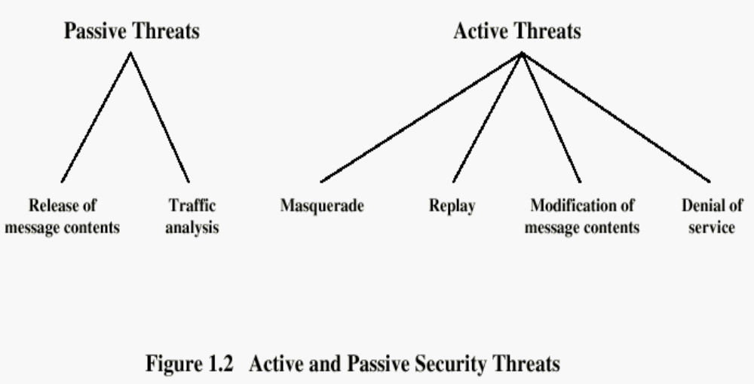

Security Attacks
IFETCE/M.E CSE/NE7202-NIS/Unit 1
Slide #1-<number>

Slide 52
Active Attacks
These attacks involve some modification of the data stream or the creation of a false stream.
Categories: masquerade, replay, modification of messages, denial service.
A masquerade takes place when one entity pretends to be a different entity.
Replay involves the passive capture of a data unit and its subsequent retransmission to produce an unauthorized effect.
IFETCE/M.E CSE/NE7202-NIS/Unit 1
Slide #1-<number>

Slide 53
Active Attacks
Modification of messages simply means that some portion of a legitimate message is altered, or that messages are delayed or reordered, to produce an unauthorized effect.
The denial of service prevents or inhibits the normal use or management of communications facilities.
IFETCE/M.E CSE/NE7202-NIS/Unit 1
Slide #1-<number>

Slide 54
Security Services
X.800:
  “a service provided by a protocol layer of communicating open systems, which ensures adequate security of the systems or of data transfers”
RFC 2828:
  “a processing or communication service provided by a system to give a specific kind of protection to system resources”
IFETCE/M.E CSE/NE7202-NIS/Unit 1
Slide #1-<number>
Notes:
Also have a couple of definition of “security services” from relevant standards. X.800 defines a security service as a service provided by a protocol layer of communicating open systems, which ensures adequate security of the systems or of data transfers. Perhaps a clearer definition is found in RFC 2828, which provides the following definition: a processing or communication service that is provided by a system to give a specific kind of protection to system resources; security services implement security policies and are implemented by security mechanisms.

Slide 55
Security Services
Confidentiality (privacy): confidentiality is the protection of transmitted data from passive attacks
Authentication: the authentication service is concerned with assuring the identity of the sender (who created or sent the data)
Integrity :integrity service is the protection of data from unauthorized modifications during the transmission
Non-repudiation : this service prevents either sender or receiver from denying transmitted message.
IFETCE/M.E CSE/NE7202-NIS/Unit 1
Slide #1-<number>

Slide 56
Security Services
Access control: is the ability to limit and control the access to host systems and applications via communications links.
  To achieve this control, each entity trying to gain access must first be identified, so that access rights can be tailored to the individual.
Availability: This service is concerned with assuring the permanence of a service or data for authorized users
- Denial of Service Attacks
- Virus that deletes files
Slide #1-<number>

Slide 57
Security Services (X.800)
Authentication - assurance that the communicating entity is the one claimed
Access Control - prevention of the unauthorized use of a resource
Data Confidentiality –protection of data from unauthorized disclosure
Data Integrity - assurance that data received is as sent by an authorized entity
Non-Repudiation - protection against denial by one of the parties in a communication
IFETCE/M.E CSE/NE7202-NIS/Unit 1
Slide #1-<number>
Notes:
See Table 1.4 for details of the 5 Security Service categories and the 14 specific services.

Slide 58
Security Mechanism
feature designed to detect, prevent, or recover from a security attack
no single mechanism that will support all services required
however one particular element underlies many of the security mechanisms in use:
  cryptographic techniques
hence our focus on this topic
IFETCE/M.E CSE/NE7202-NIS/Unit 1
Slide #1-<number>
Notes:
Now introduce “Security Mechanism” which are the specific means of implementing one or more security services.
Note these mechanisms span a wide range of technical components, but one aspect seen in many is the use of cryptographic techniques.

Slide 59
Security Mechanisms (X.800)
specific security mechanisms:
  encipherment, digital signatures, access controls, data integrity, authentication exchange, traffic padding, routing control, notarization
pervasive security mechanisms:
  trusted functionality, security labels, event detection, security audit trails, security recovery
IFETCE/M.E CSE/NE7202-NIS/Unit 1
Slide #1-<number>
Notes:
Some examples of mechanisms from X.800. Note that the “specific security mechanisms” are protocol layer specific, whilst the “pervasive security mechanisms” are not. We will meet some of these mechanisms in much greater detail later.
See Stallings Table 1.3 for details of these mechanisms in X.800, and Table 1.4 for the relationship between services and mechanisms.

Slide 60
Security Mechanisms (X.800)
Specific security mechanisms:
  Encipherment
  Digital signatures
  Access controls
  Data integrity
  Authentication exchange
  Traffic padding
  Routing control
  Notarization
Pervasive security mechanisms:
  Trusted functionality
  Security labels
  Event detection
  Security audit trails
  Security recovery
IFETCE/M.E CSE/NE7202-NIS/Unit 1
Slide #1-<number>
Notes:
see Table 1.5 for details of these mechanisms, and Table 1.6 for the relationship between services and mechanisms.
The “specific security mechanisms” are protocol layer specific, whilst the “pervasive security mechanisms” are not.
Will meet some of these mechanisms in much greater detail later.

Slide 61

Model for Network Security
IFETCE/M.E CSE/NE7202-NIS/Unit 1
Slide #1-<number>
Notes:
In considering the place of encryption, its useful to use the following two models from Stallings section 1.6.
The first, illustrated in Figure 1.5, models information flowing over an insecure communications channel, in the presence of possible opponents. Hence an appropriate security transform (encryption algorithm) can be used, with suitable keys, possibly negotiated using the presence of a trusted third party.

Slide 62
Model for Network Security
using this model requires us to:
  design a suitable algorithm for the security transformation
  generate the secret information (keys) used by the algorithm
  develop methods to distribute and share the secret information
  specify a protocol enabling the principals to use the transformation and secret information for a security service
IFETCE/M.E CSE/NE7202-NIS/Unit 1
Slide #1-<number>
Notes:
This general model shows that there are four basic tasks in designing a particular security service, as listed.

