Slide 1
GUIDED TRUCK LOADING AND MANUAL ROUTING
SCREEN 1
Notes:
Guided Truck Loading And Manual Routing.

Slide 2
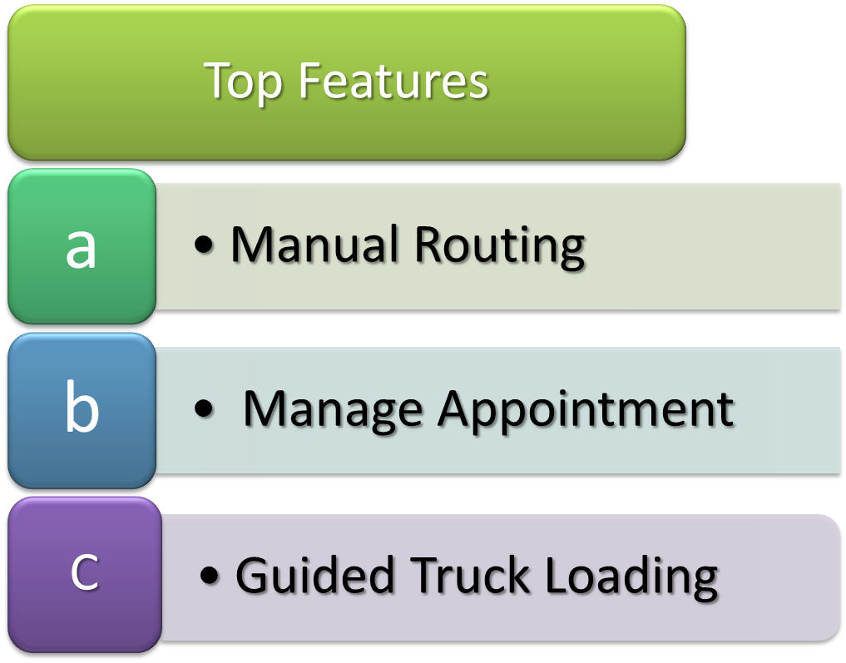
Today’s Overview
SCREEN 2
Notes:
Manual Routing: Allows you to route orders without the need for electronic data interchange. You can route orders even if the routing information is received via e-mail, website or phone.
Manage Appointment: Routed orders can be associated with an appointment after the BOL is created. You will add all the orders which you want to ship together in one appointment. DCMS can now help you in assembling these orders and loading them to a truck.
Guided Truck Loading: You enter the appointment number for which you want to load orders. STT guides you to pick each pallet.

Slide 3
MANUAL ROUTING
Notes:
Includes:-
Routing Summary:- View the routing status of all open orders.
Unrouted:- View a list of orders for which the routing information has not been sent to customer.
Routing Orders:- View a list of orders for which ATS date has been specified to the customer.
Routed Orders:- View a list of orders for which routing information has been specified by the customer. Customer would tell you the carrier details, pickup date during this phase.
Bill of Ladings:- View a list of orders for which BOL has been created by you.

Slide 4
Routing Overview
1. Route un-routed orders whose cancel date is imminent.
Choose orders to route and assign ATS date.
System displays routing information for these orders.
Use this to enter info on customer site.
2. Enter routing information received from customer back to DCMS system.
3. Create BOLs for routed orders.
4. Assign appointments to BOLs.

Slide 5
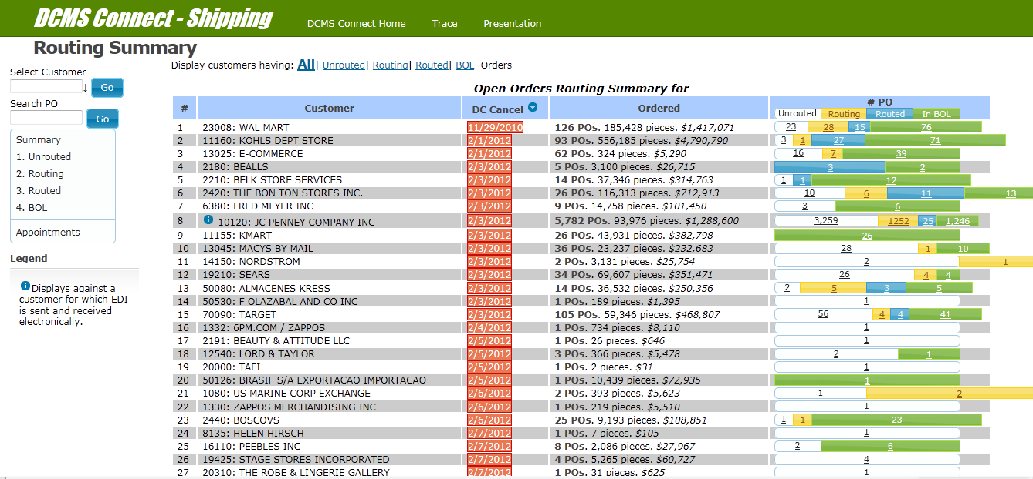
ROUTING SUMMARY
Notes:
Routing summary of open orders:-
It shows total number of Unrouted ,Routing and Routed orders along with the total no. of BOLs created.
It also shows total pieces ordered, no. of pieces along with the dollar value.
List is sorted on DCCancel date. So you get to see orders which have cancel date near on the top.
Clicking on highlighted numbers will lead you to the appropriate screen.
e.g.:- Click on Unrouted no. takes you to screen where you can route orders.

Slide 6
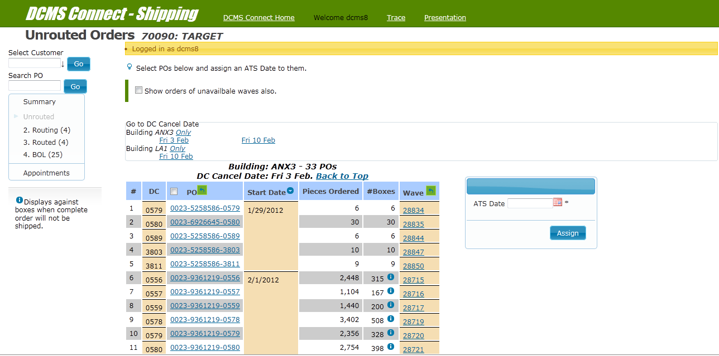
UNROUTED ORDERS
Notes:
Unrouted Screen:-
You can see the details of the unrouted orders of the selected customer. Select orders you want to route together and enter ATS date. After assigning the date, you will get to see these POs in the routing screen.
NOTE:- You can add your orders to an existing ATS date. These dates are displayed in orange.

Slide 7
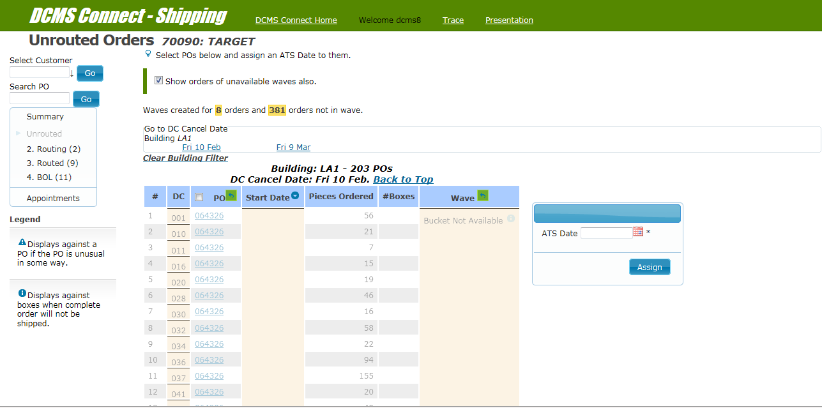
UNROUTED ORDERS
Notes:
Click on check box to see orders of unavailable buckets as well.
Orders of unavailable buckets can’t be routed.

Slide 8
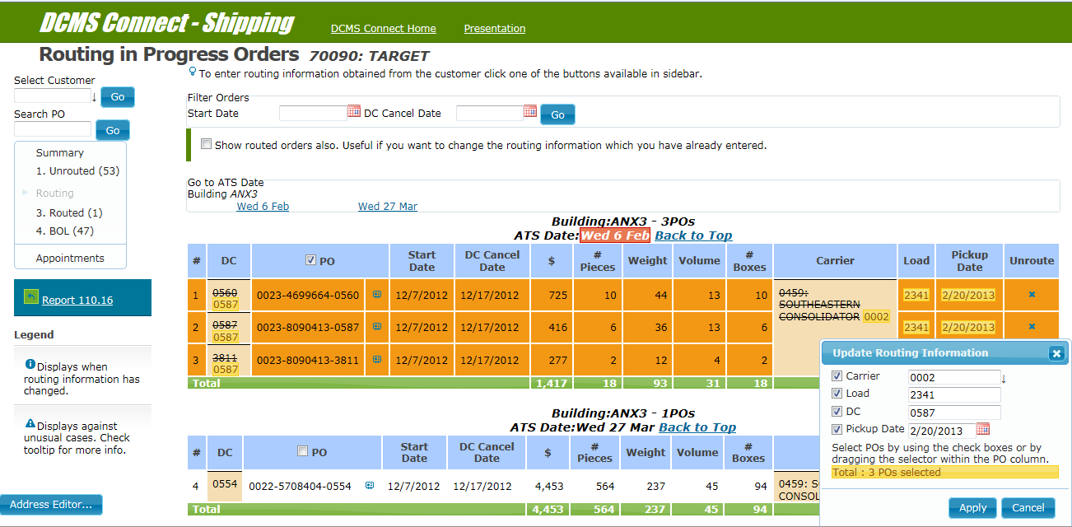
ROUTING ORDERS
Notes:
Routing Screen:-
Enter routing information received from customer here.
You can this page by identifying the customer on routing summary. Select the POs for which routing info is available and enter it.
You can enter or change following routing information:
Carrier, DC, Load, Pickup Date, Shipping Address.

Slide 9
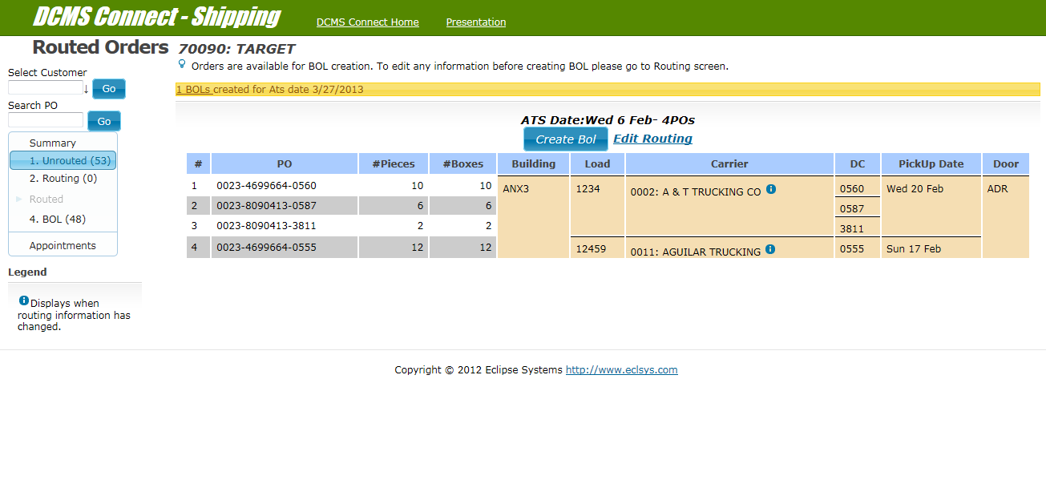
ROUTED ORDERS
Notes:
Routed Screen:-
Orders show up on this screen after the routing information has been entered. Create BOLs for routed orders.
One BOL will be created for each load,dc,carrier and door (entered during Bucket Creation).
Click on Create Bol to create bol

Slide 10
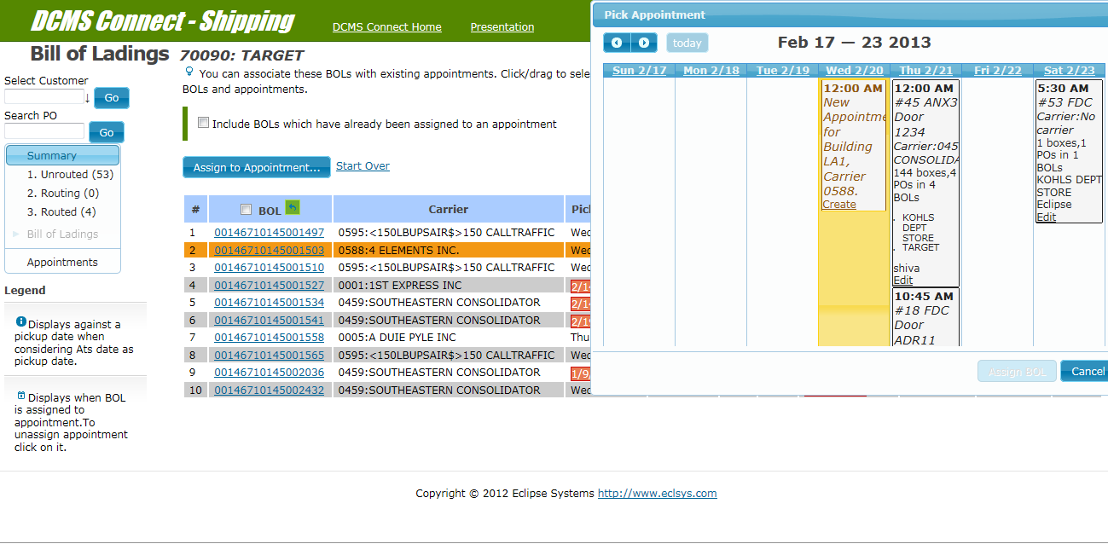
BILL OF LADING
Notes:
BOL Screen:-
Add the BOLs to an existing appointment or create a new appointment for it. If you select a BOL we offer you to add all the existing bols which have same carrier and pickup date to it.
A dummy appointment is suggested for creation if no real appointment exist.
Appointment is also along with matching bols if appointment exist on clicking any bol.

Slide 11
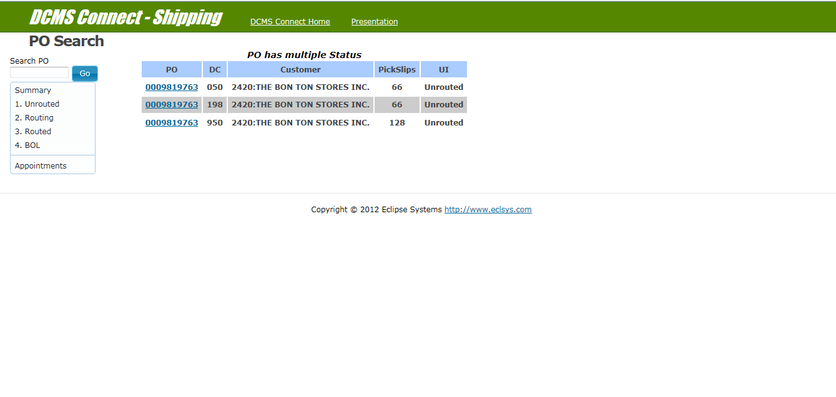
PO SEARCH
Notes:
Po search helps you locate PO with all UIs.
If BOL has been created then it redirects to report 110.21.

Slide 12
MANAGE APPOINTMENTS
Notes:
Microsoft Engineering Excellence
Microsoft Confidential
Manage Appointments.

Slide 13
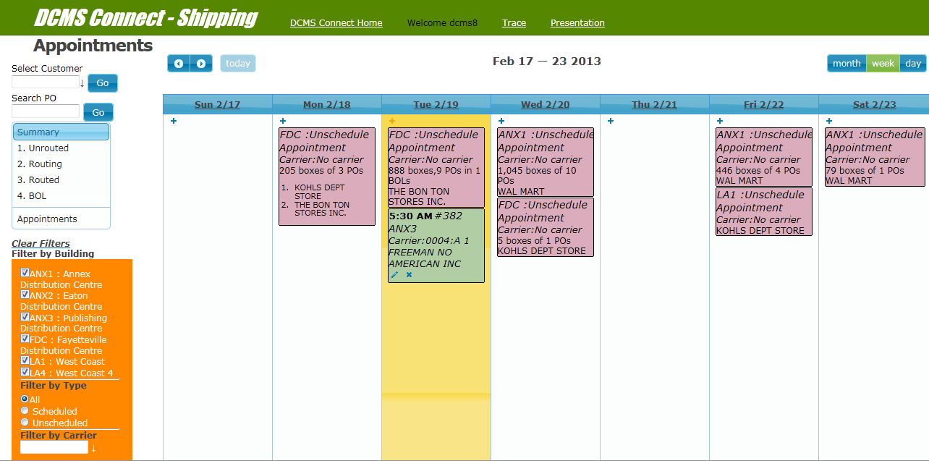
MANAGE APPOINTMENTS
Notes:
On the appointment screen, you can manage the appointments monthly,
Weekly or on day to day basis.
You can edit or delete the existing appointments. You can also create a new appointment.
There are options to find appointment by number.
Appointment of certain date can also be viewed.
Option to see shipped appointments as well.

Slide 14
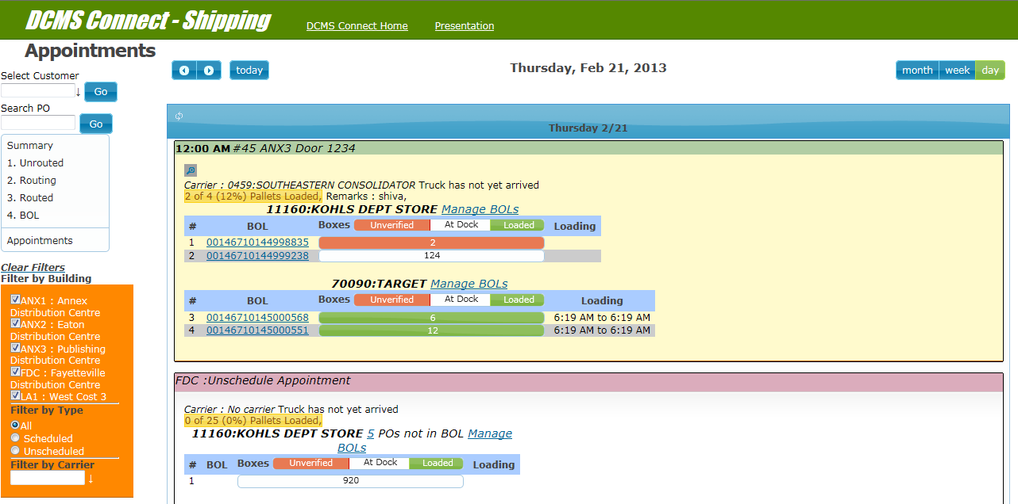
MANAGE APPOINTMENTS
Notes:
Click on header of each date of week view leads to day view.
Clicking on Manage Bol link takes you BOL UI.

Slide 15
SCAN TO TRUCK

Slide 16
SCAN TO TRUCK
Loaders enter the appointment number in ScanToTruck screen. ScanToTruck guides them to assemble correct pallets and load them to the truck.

Slide 17
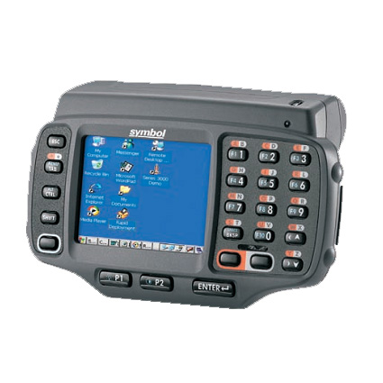

SCAN TO TRUCK
As the trucker arrives at shipping office, he supplies appointment number already assigned to him during appointment creation. The shipping supervisor pulls up appointment information from appointment screen and directs the trucker to the appropriate gate.
Loader scans an appointment number.

Slide 18
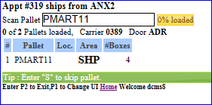
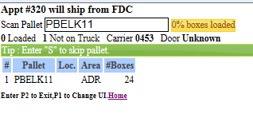
SCAN TO TRUCK
The screen displays summary information of the shipments to be loaded to the truck. This information includes the following.
Pallets loaded on truck.
Total Pallets to be loaded on truck.
Carrier details.
Loading progress.
Pick up door.
Location.
Area.
No. of boxes in pallet.
A pallet suggestion is provided to get you started. Loader scans a pallet in the screen and loads it to the truck. To get another suggestion skip suggested pallet by pressing S.

Slide 19
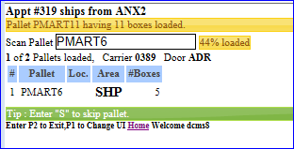
SCAN TO TRUCK
After you scan the pallet, the program displays a message that pallet loaded successfully.
Notes:
You can enter ‘S’ to skip any pallet.

Slide 20
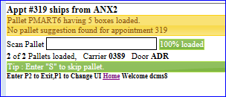
SCAN TO TRUCK
After loading all pallets loading progress will be shown as 100 % pallets loaded.

Slide 21
THANKS
Notes:
Microsoft Engineering Excellence
Microsoft Confidential

