Slide 1

PRESENTATION II • EXAMINATION RESULTS MONITORING SYSTEM
Physical Database Design, Security Architecture & Front-End Integration
Department of Computing • Faculty of Applied Sciences • Rajarata University of Sri Lanka
DEVELOPED BY TEAM SYNTAX SQUAD
Assessments Covered: Physical Database Design | Security Design | Front-End Integration & System Demonstration

Slide 2
RUSL • EXAMINATION RESULTS MONITORING SYSTEM
Presentation Agenda (Examiner Evaluation Outline)
01. Context & Architecture
High-level 3-tier structure & requirements context
02. Physical Database Design
17 tables in 3NF/BCNF, foreign keys, indexing & transactions
03. Security Architecture
Bcrypt hashing, JWT authentication & 6-role RBAC
04. Cryptographic Handover
6-digit SHA-256 OTP for physical exam script transfers
05. Front-End Integration
React 18, TypeScript, Tailwind, dashboards & state timeline
06. System Demonstration
Live lifecycle walkthrough from scheduling to approval lock
07. Design Decisions & Rationale
Relational vs. NoSQL, OTP vs. paper signatures, seniority matrix
08. Challenges & Justifications
Calendar month arithmetic, race conditions & bylaw compliance

Slide 3
SYSTEM ARCHITECTURE
System Overview & 3-Tier Architecture
Presentation Tier
Application Tier (API)
Data Tier (MySQL)
• React 18 Single Page App (SPA)
• TypeScript for strict client typing
• Vite fast-bundle build toolchain
• Tailwind CSS for responsive layouts
• Lucide React unified icon library
• Axios client with Bearer interceptors
• Role-tailored dashboards (HOD, AR, Lecturer, Dean, Clerk)
• Node.js + Express.js in TypeScript
• 13 modular RESTful controllers
• JWT Authentication middleware
• Role-Based Access Control (RBAC)
• 6-Digit Cryptographic OTP engine
• Multer PDF upload & SHA-256 checks
• Calendar-month date calculation engine
• Automated Gmail SMTP notifications
• MySQL / MariaDB on Port 3306
• Database: exam_monitoring_db
• 17 Normalized 3NF/BCNF tables
• pure mysql2/promise connection pool
• 15 concurrent connection limit
• withTransaction atomic isolation
• Foreign key cascade & null constraints
• Permanent immutable audit tables

Slide 4
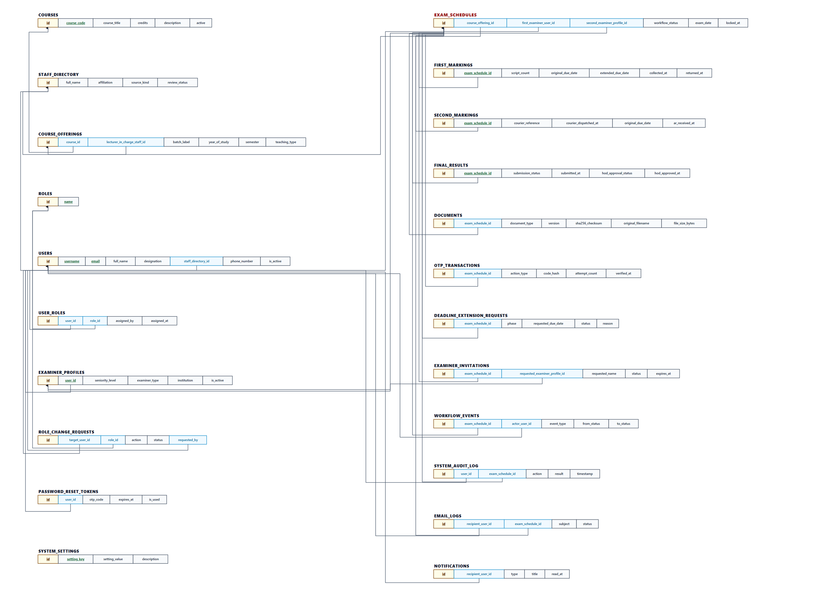
PHYSICAL DATABASE DESIGN
Physical Database Design: Relational Schema & Entities
Key Schema Specifications
✔ 17 Normalized Tables: Eliminates update, insert, and delete anomalies.
✔ Role Decoupling: Separates core login accounts (users) from multi-role permissions (user_roles).
✔ Seniority Profiles: Dedicated examiner_profiles table mapping academic rank (1-12).
✔ Script Tracking Lifecycle: Dedicated first_markings, second_markings, and final_results tables.
✔ OTP Table: Secure otp_transactions with cryptographic hash and purpose enum.
✔ Audit Trail: system_audit_log and workflow_events for immutable record-keeping.

Slide 5
PHYSICAL DATABASE DESIGN
Database Normalization (3NF/BCNF) & Integrity Rules
Third Normal Form (3NF) & BCNF
Referential Integrity & Constraints
Data Type Optimization
• Every non-key attribute is non-transitively dependent on primary key.
• Users and academic designations decoupled to avoid transitive dependency.
• Course catalog (courses) separated from seasonal offerings (course_offerings).
• Marking stages decoupled from exam schedules to allow independent timeline tracking.
• Strict Foreign Keys: All child tables enforce FK relationships to parent IDs.
• ON DELETE CASCADE: Used for draft stages and dependent metadata.
• ON DELETE SET NULL: Used for staff directory pointers to prevent orphan cascades.
• UNIQUE Constraints: Enforced on exam_schedule_id in final_results (single marksheet rule).
• INT(11) AUTO_INCREMENT for compact, B-Tree index-friendly primary keys.
• VARCHAR(191) compliant with utf8mb4 multi-byte indexing limits.
• DATETIME(3) millisecond precision for dispute-free audit trail timestamps.
• ENUM-style VARCHAR validations for deterministic workflow state tracking.

Slide 6
PHYSICAL DATABASE DESIGN
Indexing Strategy & ACID Transaction Isolation
Strategic B-Tree Indexing
ACID Transactions (withTransaction)
• Primary Keys: Clustered B-Tree index on all table IDs for O(log N) lookup.
• Foreign Key Secondary Indexes: Indexed exam_schedule_id, actor_user_id, and user_id to ensure instantaneous table JOINs.
• State Filtering Indexes: Indexed status fields in exam_schedules to render dashboard metrics in under 5ms.
• Natural Keys: Unique indexes on users.username, users.email, and staff_directory.id.
• Query Optimization: Zero table scans during active examination cycle monitoring.
• Atomicity: Implemented custom withTransaction() wrapper ensuring multi-statement updates either all succeed or all rollback.
• Critical Use Case — HOD Final Approval Lock:
• 1. Update final_results status to 'APPROVED_BY_HOD'
• 2. Update exam_schedules status to 'APPROVED_LOCKED'
• 3. Insert immutable event into workflow_events
• 4. Insert entry into system_audit_log
• Consistency: Foreign key cascades and check rules maintained across all operations.
• Isolation: READ COMMITTED transaction isolation to prevent dirty reads during script submission.

Slide 7
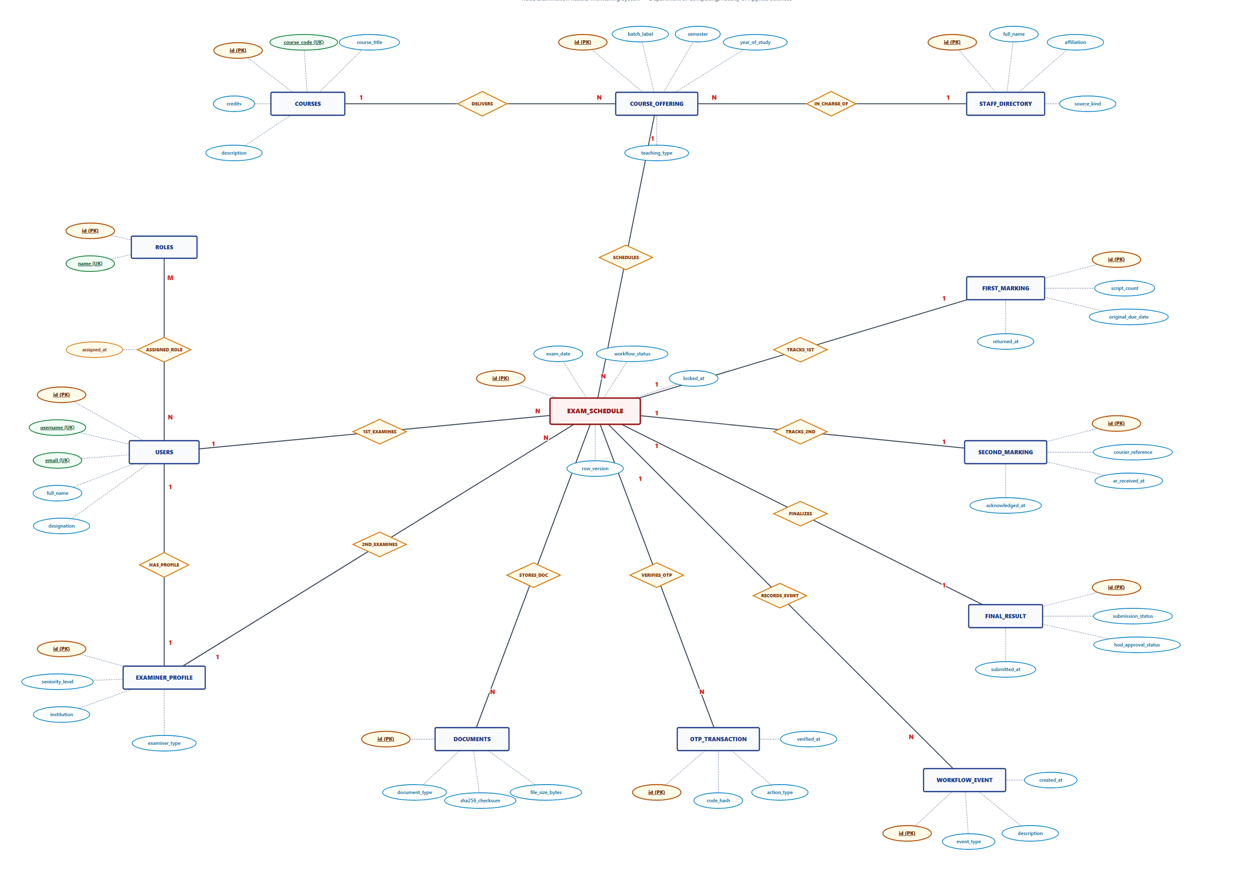
PHYSICAL DATABASE DESIGN
Enhanced Entity-Relationship (EER) Architecture
Design Cardinalities
✔ Users to Roles: Many-to-Many (N:M) via user_roles associative entity.
✔ Course to Offerings: One-to-Many (1:N) for recurring academic years.
✔ Schedule to Markings: One-to-One (1:1) lifecycle mapping ensuring single active stream per exam.
✔ Schedule to Workflow Events: One-to-Many (1:N) maintaining comprehensive chronological event logs.
✔ Exam Schedule to OTPs: One-to-Many (1:N) for collection and return handovers.

Slide 8
SECURITY ARCHITECTURE
Security Design: Authentication & Password Protection
Password Security (Bcrypt)
Stateless JWT Tokens
Role-Based Access Control
• Industry standard Bcrypt algorithm with salt factor 10.
• Adaptive hashing protects against brute-force and rainbow table attacks.
• Pass-hashes stored securely; plain text never logged or transmitted.
• Secure password reset workflow with time-limited tokens.
• Signed with HMAC SHA-256 secret key.
• Payload contains user ID, username, and assigned role array.
• Configurable 7-day expiration (JWT_EXPIRES_IN).
• Extracted and validated per request via authenticateToken middleware.
• Granular requireRoles() middleware protecting all API endpoints.
• Separation of duties: Lecturers cannot approve marksheets; AR cannot assign examiners.
• requireScheduleAccess validates examiner assignment before revealing exam data.

Slide 9
SECURITY ARCHITECTURE
Security Design: 6-Tier Role Permission Matrix
Head of Department (HOD)
First Examiner (Lecturer)
Assign First/Second examiners, enforce seniority bylaws, approve schedules, grant final approval and lock results.
Request script collection OTP, submit 1st marking reports, compile final marksheet, submit to HOD.
Second Examiner (Internal/Ext)
Examination Branch (AR)
Acknowledge courier script receipt, conduct independent re-marking, submit 2nd marking report.
Verify script collection and return OTPs, dispatch scripts via courier, record courier tracking numbers.
Department Clerk (HOD Office)
Faculty Dean
Register courses, create draft schedules, enter preliminary course records, administrative assistance.
High-level institutional oversight, audit log inspections, and faculty-wide examination monitoring.

Slide 10
SECURITY ARCHITECTURE
Cryptographic OTP Physical Script Handover Verification
1. Request Handover
First Examiner clicks 'Request Script Collection OTP' upon visiting AR examination vault.
2. SHA-256 Token
Server generates secure 6-digit random token, hashes it using SHA-256, and stores with 10-minute expiry.
3. Physical Presentation
Examiner verbally or digitally presents the 6-digit OTP in person to the Assistant Registrar.
4. AR Verification
AR inputs OTP into AR portal. Server matches hash, consumes token (is_used=1), and logs timestamp.
5. Custody & Timer
Physical custody officially transfers; 3-calendar-month marking countdown triggers automatically.

Slide 11
SECURITY ARCHITECTURE
Document Security, SHA-256 Checksums & Signed Access
Upload Validation
SHA-256 File Checksums
Tamper-Proof Signed URLs
• Strict Multer upload filtering: accepts only application/pdf MIME type.
• File size capped at 10 MB to prevent Denial of Service (DoS) attacks.
• Files stored outside the client public web root in a dedicated /uploads folder.
• Randomized UUID filenames prevent directory traversal and file overwrite attacks.
• Cryptographic SHA-256 hash calculated upon upload and stored in documents table.
• Guarantees bit-level file integrity; prevents undetected file replacement or tampering.
• Hash verification performed before serving sensitive marking reports.
• Direct static file download routes disabled.
• Downloads require signed, time-limited cryptographic URL tokens.
• Generated on-demand via /api/documents/:id/download-link for authorized sessions only.

Slide 12
FRONT-END INTEGRATION
Front-End Integration: Modern React 18 Architecture
Core UI Stack
Unified API Layer
Component Hierarchy
• React 18 + TypeScript with strict interface types.
• Vite next-gen build tool with instant HMR and optimized tree-shaking.
• Tailwind CSS for responsive layout, grid systems, and university colors.
• Lucide React for clear contextual icon navigation.
• Centralized Axios client (api/client.ts).
• Automatic JWT Authorization Bearer injection via request interceptors.
• Global response interceptors intercepting 401s to redirect to login.
• Custom error handlers displaying meaningful university toast alerts.
• Modular component breakdown promoting code reusability.
• Independent role-specific dashboards loaded based on active persona.
• Shared atomic components: StatusBadge, WorkflowTimeline, LecturerAvatar.
• Interactive modals for OTP redemption, profile editing, and email logs.

Slide 13
FRONT-END INTEGRATION
Front-End Integration: Persona-Driven Dynamic Dashboards
HOD Executive Dashboard
Lecturer & First Examiner View
Real-time KPI metrics (Active exams, pending approvals, overdue scripts). Examiner seniority selector with immediate conflict warnings. One-click marksheet review and approval locking.
Course schedule list, interactive OTP request trigger, drag-and-drop PDF report upload with progress feedback, and real-time 3-calendar-month deadline countdown timers.
AR Office Logistics Portal
Dean & Clerk Portals
Script handover verification terminal with OTP keypad, courier dispatch tracking input (Certis Lanka / Prompt Xpress), and physical return receipt logger.
Dean: Faculty-wide examination monitoring, audit logs, and compliance oversight. Clerk: Draft schedule entry, course registry, and administrative workflow assistance.

Slide 14
FRONT-END INTEGRATION
Workflow Timeline Component: 10-Stage State Machine
Stage 1
DRAFT
(Clerk/HOD)
Stage 2
SCHEDULED
(Examiners Assigned)
Stage 3
EXAM_CONCLUDED
(Vault Deposit)
Stage 4
FIRST_COLLECTION_REQUESTED
(OTP)
Stage 5
FIRST_MARKING_ACTIVE
(3-Mo Timer)
Stage 6
SECOND_MARKING_READY
(Courier)
Stage 7
SECOND_MARKING_ACTIVE
(1-Mo Timer)
Stage 8
SECOND_MARKING_COMPLETE
(Returned)
Stage 9
FINAL_MARKSHEET_SUBMITTED
(Review)
Stage 10
APPROVED_LOCKED
(Final Release)

Slide 15
FRONT-END INTEGRATION
Front-End State Management, Vector Avatars & UX
Reactive UI Updates
Professional Vector Avatars
Real-Time Countdown Timers
• Optimistic state rendering provides instant user feedback.
• Dynamic badge coloring: Green (Completed), Blue (In Progress), Amber (Pending Review), Red (Overdue).
• Auto-closing modals and toast notifications upon OTP verification and approval.
• Auto-generated deterministic SVG avatars for staff profiles.
• Rendered on-the-fly using seed hashing (professionalVectors.ts).
• Ensures clean, uniform visual identity across all faculty dashboards without requiring manual photo uploads.
• Visual deadline calculation badges calculating exact remaining days.
• Automated color shifting to warn examiners when deadlines approach within 7 days.
• Integrated deadline extension request modal directly linked to HOD inbox.

Slide 16
SYSTEM DEMONSTRATION
Live System Demonstration: 4-Phase Evaluation Walkthrough
Phase 1: Scheduling & Seniority Check
Log in as HOD ('hod'). Create schedule for COM1302. Attempt to assign junior second examiner -> demonstrate university bylaw violation block. Assign qualified examiner and activate schedule.
Phase 2: Physical Script Handover via OTP
Log in as First Examiner ('charith'). Click 'Request Collection OTP'. Log in as AR ('ar'), access Verification Terminal, enter OTP, and complete handover. 3-calendar-month deadline initiates.
Phase 3: Courier Tracking & 2nd Marking
AR dispatches scripts via courier with tracking number (SPEEDPOST-77210). Second Examiner logs in, acknowledges receipt. 1-calendar-month deadline starts. Second marking report uploaded.
Phase 4: Final Marksheet Approval & Lock
First Examiner uploads compiled final marksheet PDF. HOD reviews submission, clicks 'Approve & Lock'. Schedule transitions to APPROVED_LOCKED (immutable, read-only release).

Slide 17
SYSTEM DEMONSTRATION
Pre-Seeded Demonstration Accounts (All Passwords: Password@123)
Administrative Personas
Academic Examiners
System Test Coverage
• hod (Dr. Kasun Bandara) - Head of Department
• ar (Mr. Kamal Rathnayake) - Senior Asst. Registrar
• clerk (Ms. Niluka Jayawardena) - Senior Management Assistant
• dean (Prof. Sunanda Wijeratne) - Faculty Dean
• charith (Dr. Charith Jayasundara) - Senior Lecturer Gr. I (Rank 6)
• palliya (Mr. Tharindu Wickramasinghe) - Lecturer Prob. (Rank 4)
• hettige (Dr. Priyantha Dissanayake) - Senior Lecturer Gr. II (Rank 5)
• gunathilake (Prof. Nihal Senanayake) - External Prof. (Rank 12)
• 28 pre-seeded user accounts in database
• Pre-loaded with active, overdue, and completed schedules
• Pre-configured with test courses and course offerings
• Ready for immediate examiner evaluation

Slide 18
DESIGN DECISIONS
Technical Design Decisions & Architecture Rationale
Relational MySQL vs. NoSQL (MongoDB)
6-Digit Cryptographic OTP vs. Paper Signatures
12-Tier Numerical Seniority Matrix
• Requirement: Absolute data consistency and zero risk of orphan marksheet records.
• Decision: Pure MySQL schema with declarative FOREIGN KEY constraints and transactional isolation (ACID).
• Benefit: Prevents inconsistent states during multi-stage marksheet approvals.
• Requirement: Eliminate physical logbook disputes and backdating of script collection dates.
• Decision: Cryptographic OTP with SHA-256 server-side hash and 10-minute expiry.
• Benefit: Irrefutable, timestamped proof of physical custody transfer.
• Requirement: Enforce RUSL examination bylaw that Second Examiner >= First Examiner seniority.
• Decision: Mapped academic designations to numerical ranks (1-12) evaluated programmatically at schedule creation.
• Benefit: 100% automated bylaw compliance; human oversight errors eliminated.

Slide 19
CHALLENGES & RESOLUTIONS
Technical Challenges Encountered & Resolutions
Challenge 1: Calendar Month Deadline Arithmetic
Challenge 2: Concurrency & Duplicate Handover Requests
Challenge 3: Dual-Role Academic Personas
• Problem: University bylaws mandate '3 calendar months' and '1 calendar month', not fixed 30-day blocks. Simple +90 days calculations fail on 31-day months, February, and leap years.
• Resolution: Engineered date arithmetic utilities (utils/dates.ts) using native JavaScript date boundary clamping to calculate exact calendar-month offsets accurately.
• Problem: Potential race conditions where a lecturer could generate simultaneous OTPs or AR could double-verify.
• Resolution: Implemented single-use invalidation flags (is_used=1), row-level locks, and strict state preconditions in the workflow state engine.
• Problem: Faculty members frequently act as First Examiner for one course and Second Examiner for another.
• Resolution: Designed unified role switcher in the navigation bar allowing users to seamlessly pivot their active role context without requiring multiple logins.

Slide 20
REQUIREMENTS SATISFACTION
Justification: How the Proposed Solution Satisfies Requirements
Elimination of Publication Delays
Strict Bylaw & Seniority Enforcement
Automated deadline countdowns, visual warning flags, and HOD escalation dashboards ensure script marking stays on track, preventing graduation delays.
Mathematical ranking ensures Second Examiners always meet or exceed First Examiner seniority, completely removing manual allocation errors.
Dispute-Free Chain of Custody
Institutional Audit Integrity
Cryptographic OTP handovers and courier tracking codes create an unbroken, verifiable audit trail from exam hall to final release.
Immutable APPROVED_LOCKED final state and append-only workflow logs guarantee that published results cannot be tampered with.

Slide 21
CONCLUSION
Conclusion & Project Summary
Delivered System
Security & Trust
Immediate Impact
• Full-stack web application tailored for RUSL Department of Computing.
• End-to-end digitisation of the examination monitoring lifecycle.
• Zero data redundancy with 3NF physical relational database.
• Bcrypt, JWT, and 6-role RBAC security.
• Fraud-proof physical script handover via 6-digit cryptographic OTPs.
• Immutable audit logs preserving institutional examination integrity.
• Ready for departmental deployment.
• Drastically reduces administrative burden on HOD, AR, and faculty.
• Guarantees compliance with Faculty Examination Bylaws.

Slide 22
THANK YOU!
Questions & Discussion
Examination Results Monitoring System • Department of Computing, RUSL
TEAM SYNTAX SQUAD
GitHub Repository: https://github.com/sharadaakalanka670-sys/exam-results-monitoring-system

