Slide 1
MINI PROJECT ON COMPUTER GRAPHICS
1
“blackey jack GAME”

Slide 2
AGENDA
Introduction
Problem Statement
Objectives
Working
Design and Implementation
Special function calls
Flow chart
Results and Snapshot
Conclusion
References

Slide 3
ABSTRACT
There is still scope left in the development of project like, after “game over” a list should show top ten scorers, a need to embed a button “play again”.
Welcome screen need more modification there is scope of embedding buttons like “about”, “how to play”, “configuration”, “profiles”, etc.
In future we hope we would implement it in source code for better experience of playing this game.
Finally, we could say by developing the game we have learnt the basics of computer graphics and in future by developing it further we shall learn more.
It will be our pleasure if we could develop in 3d graphics package.

Slide 4
INTRODUCTION
Computer Graphics become a most powerful tool.
OpenGL is a multi-platform application programming interface.
The API is typically used to interact with GPU, to achieve hardware-accelerated rendering.
References of flash game like “THE AMAZING DARE DOZEN CHALLENGE” project create ”BLACKEY JACK” game using Open GL.

Slide 5
Problem statement
Learning computer graphics as a part of academics and implementing it as a project on OpenGL made us to create a game i.e. blackey jack game in OpenGL which included all the basic library functions.

Slide 6
Objectives of the project
The main objective this project is to show how the “Blackey Jack ” game works with the help of built-in graphics library functions.
Learning how to build a similar game like catch the egg.
Illustrating about the keyboard and mouse interaction.
To provide entertainment to the user.

Slide 7
Working
We have developed a game named “BLACKEY JACK”, this is about a guy
who goes around with many obstacle to reach his goal.
Goal is the ending point of our game. The goal is to find his friend Jack.
Blackey is the name of our main character.
We have 10 levels in our game.
First level will be simple with few obstacle ,as the level increases speed also increases.
After the end of 10th level he can safe his Friend Jack by reaching goal.
Our game initiates in first level as the Blackey starts to run to reach his friend Jack.
While running he should overcome from some obstacles like thorns.

Slide 8
DESIGN AND IMPLEMENTATION
The whole program has been implemented in C language.
The bottom line of the design is Translation function, mouse interaction and keyboard interaction are included.
Some minor functions are used to print the text on the screen.
Ellipse is the major part and it is created by using simple polygon

Slide 9
Special function call used
void glutInitDisplayMode(unsigned int mode);
void glutInitWindowSize(int width, int height);
void glutWindowPosition(int x, int y);
int glutCreateWindow(char *name);
void glutDisplayFunc(void (*func)(void));
void glutMouseFunc(void (*func)(int button, int state,int x, int y));
void glutKeyboardFunc(void (*func)(char key,int width,int height));
void glViewport(int x,int y,GLsizei width,GLsizei height);
void glutMainLoop(void);
void glFlush();
void glClear(GL_COLOR_BUFFER_BIT);

Slide 10
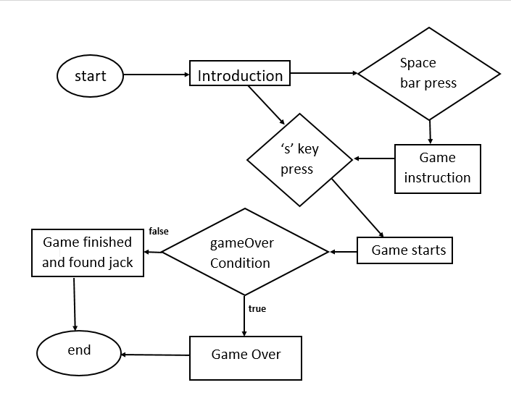
FLOW CHART

Slide 11
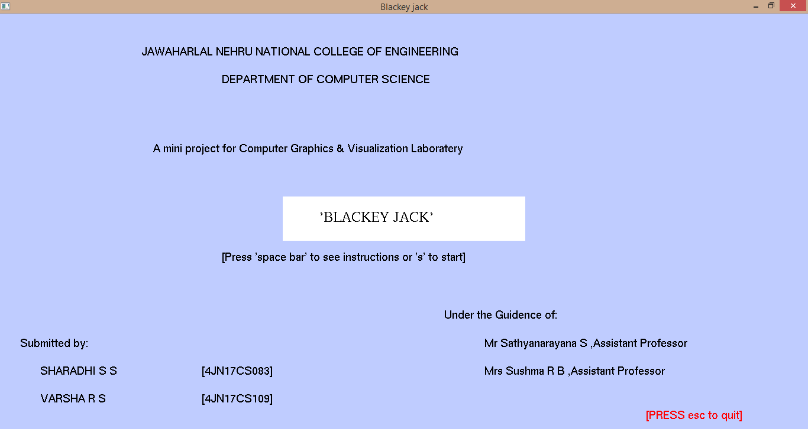
RESULTS AND SNAPSHOT
Fig 1: Snapshot showing Front Sheet of the project

Slide 12
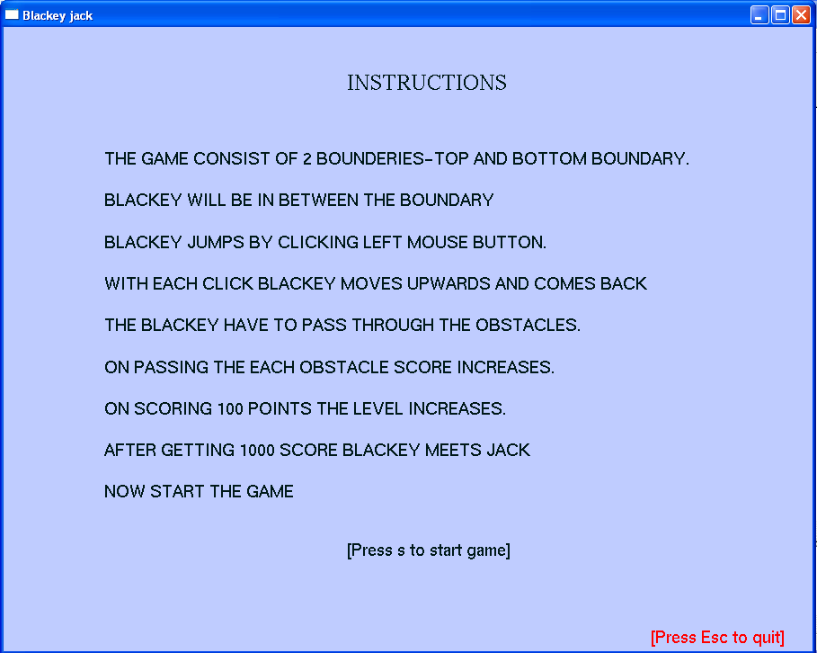
Fig 2: Snapshot showing instructions available

Slide 13
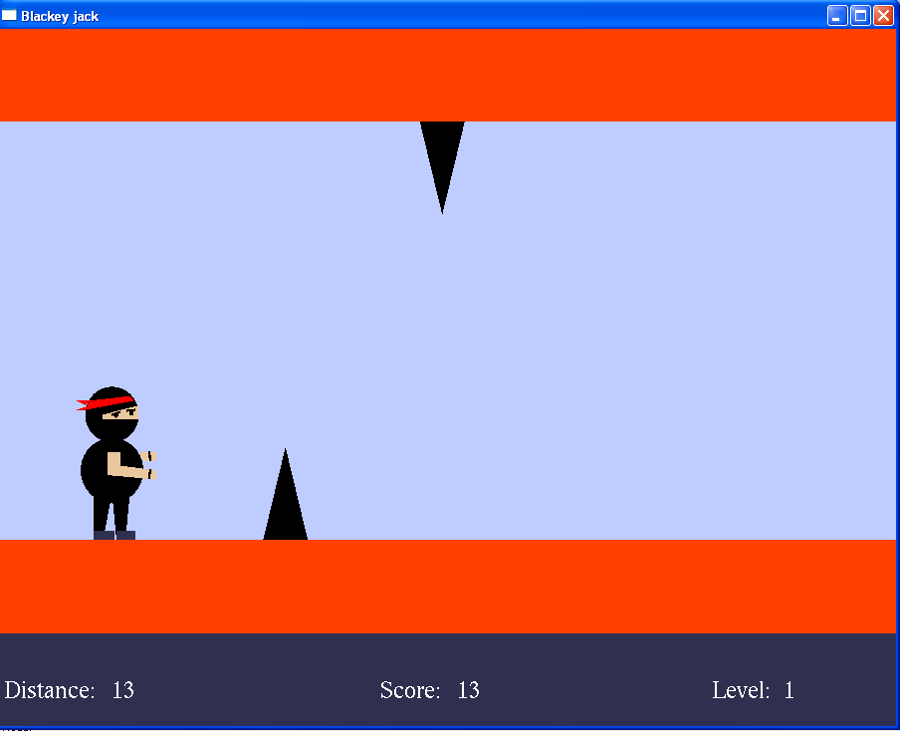
Fig 3: showing game design

Slide 14
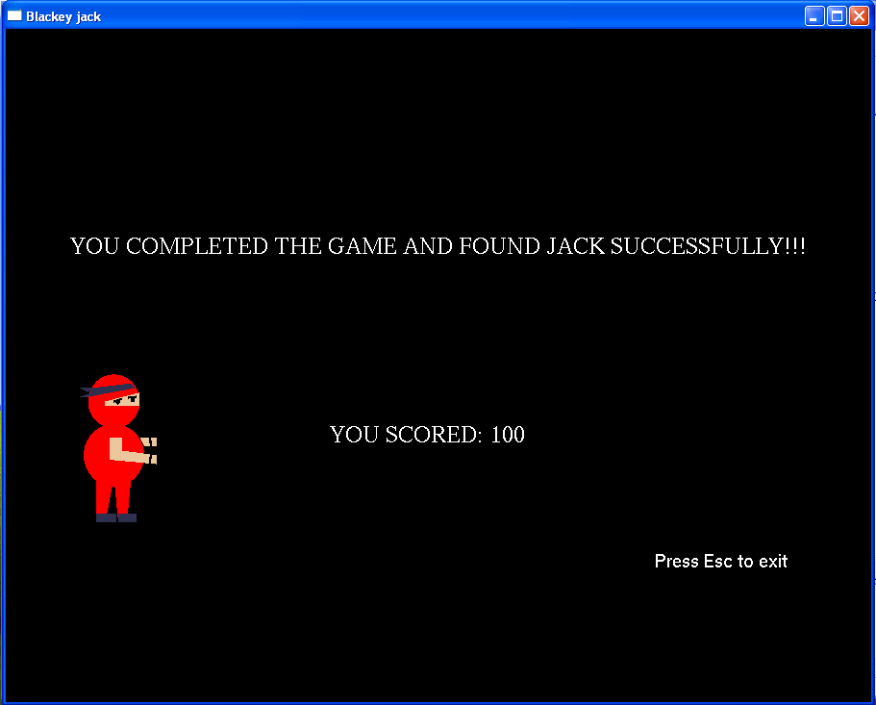
Fig 4: game completion

Slide 15
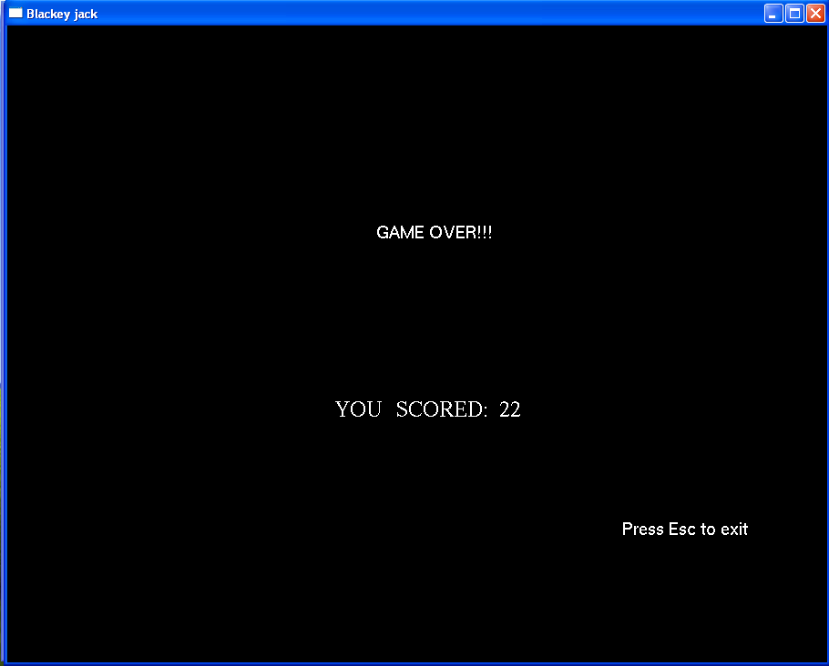
Fig 5: Game Over and other option display

Slide 16
CONCLUSION AND FUTURE ENHANCEMENT
Conclusion
The new interactive way of playing this game on the computer is displayed.
The demo is made more interactive with a keyboard and mouse interaction module in the program.
Future scope
Even though demo designed is enriched with many options, it is a two dimensional demo, in future it can be re-designed with 3D animation and sound effects.
By using this demo further coins and players can be implemented.

Slide 17
REFERENCES
[1] Edward Angel, Interactive Computer Graphics,5th Edition, Addison-Wesley, 2008
[2] F.S Hill Jr: Computer Graphics Using OpenGL,3rd Edition.
[3] Donald Hearn and Pauline Baker: Computer Graphics- OpenGL Version,3rd Edition.
[4] http://www.opengl.org/documentation/books.

Slide 18
THANK YOU
SHARADHI S S 4JN17CS083
VARSHA R S 4JN17CS109

