Slide 1
INTERNSHIP PROJECT · CODEC TECHNOLOGIES
Market Basket
Analysis
20,136
4,077
baskets (invoices)
products
Finding which products customers buy together, using the Apriori algorithm and association rules
375
151
frequent itemsets
useful rules
Sharad Jain · B.Tech CSE (Data Science)

Slide 2
The goal: what do customers buy together?
1
Identify frequently purchased product combinations
Online Retail dataset
541,909
2
Generate association rules with the Apriori algorithm
rows of retail transactions
3
Analyze support, confidence and lift
8
4
Show insights in a Streamlit dashboard
columns: InvoiceNo, StockCode, Description, Quantity, InvoiceDate, UnitPrice, CustomerID, Country
5
Export association rules as a CSV file

Slide 3
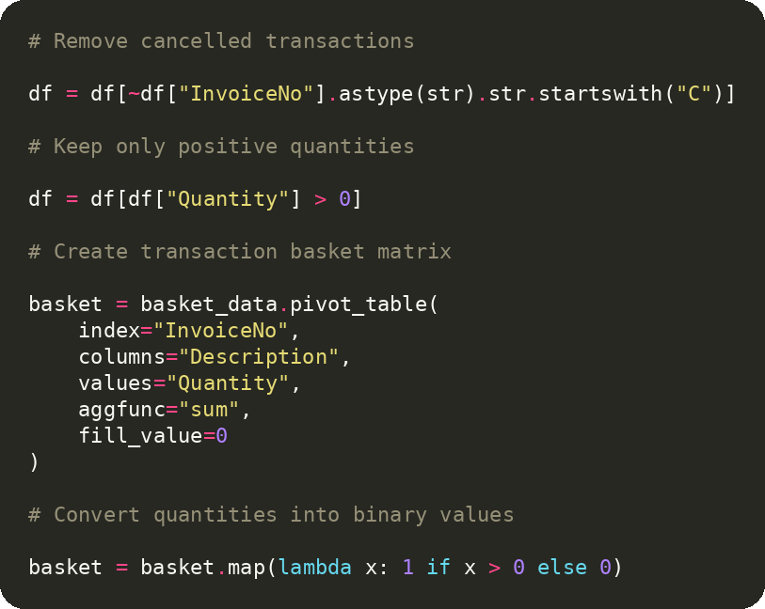
Cleaning the data and building baskets
541,909 rows
Raw Online Retail dataset (8 columns)
531,167 rows
Missing descriptions and cancelled invoices removed
530,693 rows
Only positive quantities kept
20,136 × 4,077
Basket table: invoices × products (1 = bought, 0 = not)

Slide 4
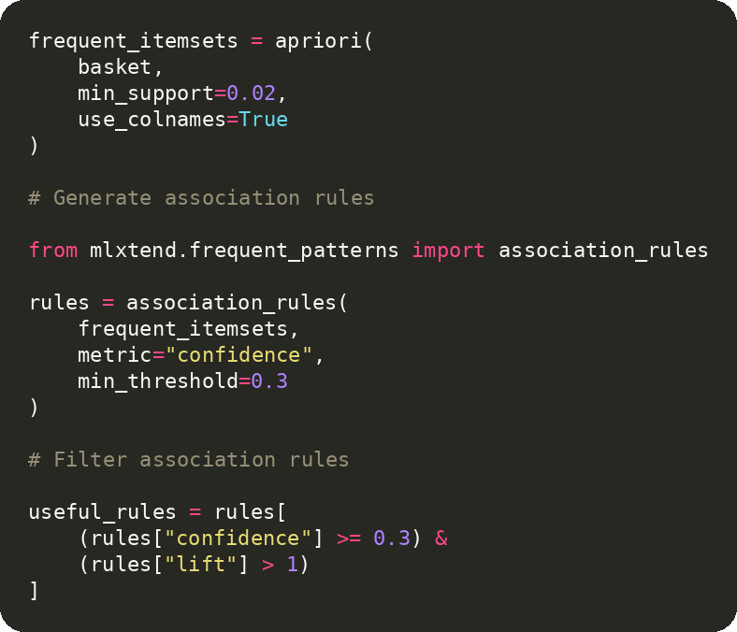
Apriori: from baskets to rules
375
frequent itemsets
Support ≥ 0.02: a combination must appear in at least 2% of baskets.
≥ 0.3
minimum confidence
If a customer buys A, how often do they also buy B?
151
useful rules
Lift > 1: bought together more often than by chance.

Slide 5
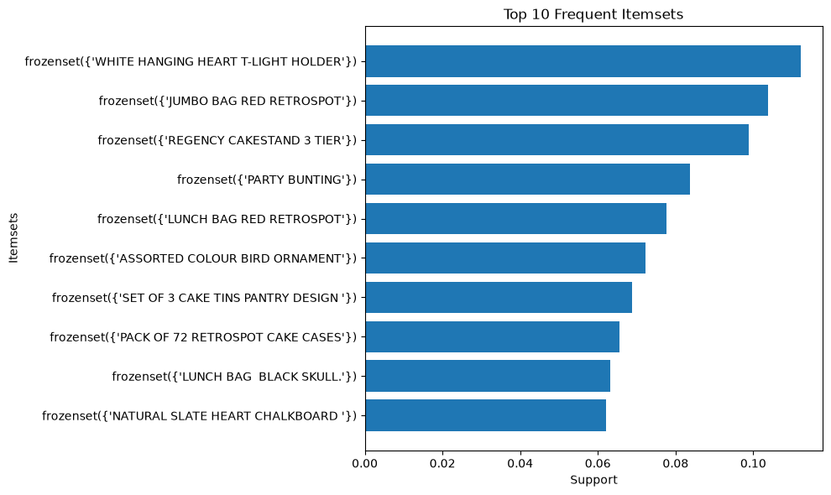
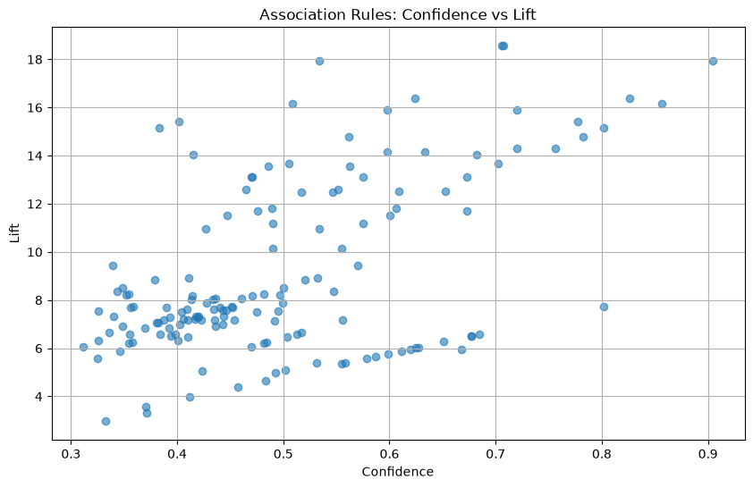
What the graphs show
Top 10 frequent itemsets: the best seller, WHITE HANGING HEART T-LIGHT HOLDER, appears in over 11% of all baskets.
Confidence vs. lift: all 151 useful rules sit well above lift 1 (roughly 3 to 18.5).

Slide 6
Strongest rules and how a store can use them
If a customer buys → they also buy | Confidence | Lift
Green + Roses Regency Teacup and Saucer → Pink Regency Teacup and Saucer | 0.71 | 18.55
Pink + Roses Regency Teacup and Saucer → Green Regency Teacup and Saucer | 0.90 | 17.95
Pink Regency Teacup and Saucer → Green Regency Teacup and Saucer | 0.83 | 16.39
Green + Pink Regency Teacup and Saucer → Roses Regency Teacup and Saucer | 0.86 | 16.17
Gardeners Kneeling Pad Keep Calm → Gardeners Kneeling Pad Cup of Tea | 0.60 | 15.89
Business use
Bundling: offer the three teacup sets as one combo.
Cross-selling: suggest the matching colour at checkout.
Store layout: place related designs side by side.
Promotions: discount one item to lift its partner.
Lift 18.55 means bought together about 18.5× more often than by chance.

Slide 7
Streamlit dashboard, limits and next steps
16,864
150
286
213
Transactions
Products analyzed
Frequent itemsets
Useful rules
Dashboard test run: top 150 products, item pairs, adjustable support and confidence.
Dashboard features
Limitations and future scope
KPI cards for transactions, products, itemsets, rules
Top 10 products by quantity sold
Frequent itemsets and association rules tables
Confidence vs. lift scatter plot
Sidebar sliders for support and confidence
One-click CSV download of the rules
Dashboard covers the top 150 products and item pairs only
Association does not mean causation
Next: product recommendations and date-wise sales analysis
Next: customer segmentation and online deployment

Slide 8
THANK YOU

