Slide 1
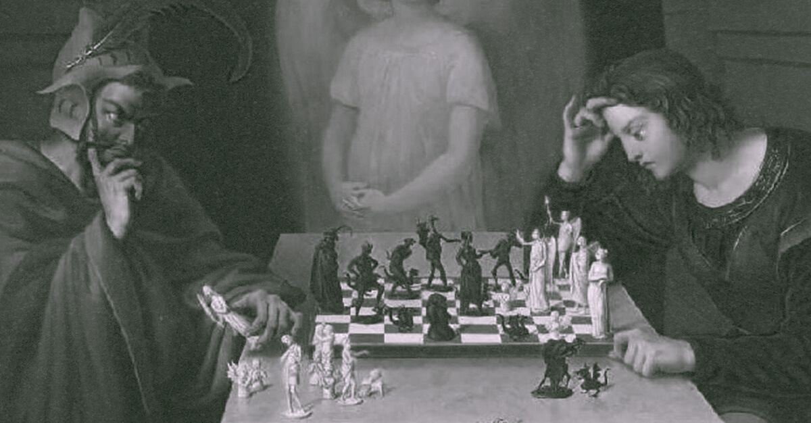
Caïssa –Chess Engine
Presented By-
Utkarsh Raj [2211072]
Sharad Kumar [2211065]
Sargam Vishwakarma [2211064]

Slide 2
Introduction
Chess is a strategic game with complex rules and AI challenges.
This project builds a playable chess engine from scratch in Python.
Objective: Create an interactive chess engine with AI and full rule support.

Slide 3

Problem Statement
Most chess engines are complex and not beginner-friendly.
Lack of educational tools to learn chess logic and AI together.
Goal: Build a modular, understandable engine for learning and experimentation.

Slide 4

Goals & Objectives
Support complete chess rules including en passant, castling, etc.
Enable PvP, PvAI, and AivAi gameplay modes.
Use Minimax with Alpha-Beta pruning for AI decisions.
Design an intuitive Pygame-based GUI.

Slide 5

System Architecture
UI Layer: Handles display and user interaction (Pygame).
Game Logic Layer: Validates and executes moves (`chessEngine.py`).
AI Layer: Evaluates best moves using Minimax and Alpha-Beta Pruning (`SmartMoveFinder.py`).

Slide 6
Core Features
Legal move generation and validation.
Checkmate, stalemate, draw condition detection.
Undo, resign, and captured pieces tracking.
Evaluation bar and status display.

Slide 7
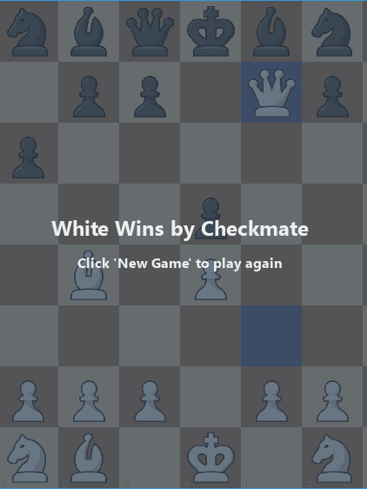
CheckMate
Checkmate in chess occurs when player’s king is in a position to be captured (in check) and no legal move can prevent the capture. It signifies the end of the game, declaring victory for the attacking player.

Slide 8
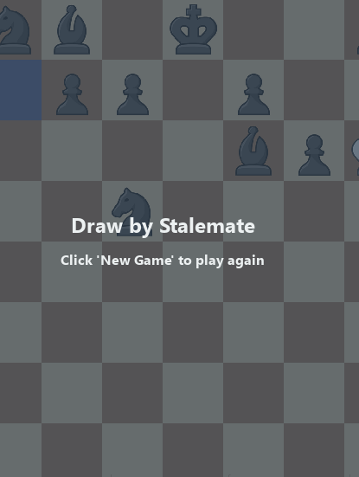
Draw Condition
STALEMATE
Stalemate in chess happens when a player has no legal moves and their king is not in check. It results in draw. Though not a win, it can be used strategically to avoid losing a game in difficult positions.

Slide 9
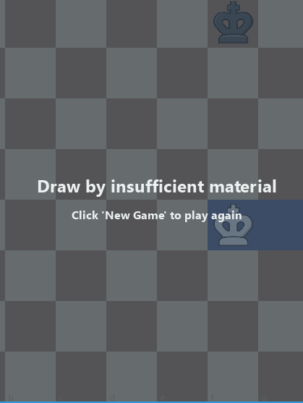
Draw Condition
Insufficient Material
Draw by insufficient material occurs when neither player has enough pieces to checkmate the opponent. Common examples includes King versus King, or King and Bishop versus King. In such cases, the game ends in a draw automatically, regardless the position

Slide 10
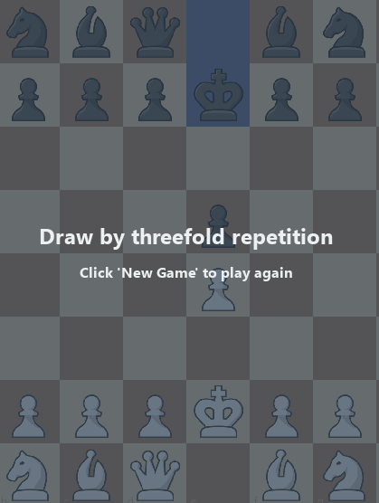
Draw Condition
Threefold Repetition
Draw by threefold repetition occurs when the same position occurs three times with the same player to move and all possible moves available each time. Either player can claim a draw in this situation, preventing further progress in the game.

Slide 11

SPECIAL MOVES

Slide 12
En Passant
En passant is a special pawn capture. If an opposing pawn moves two squares forward from its starting position and lands beside your pawn, you can capture it as if it moved one.

Slide 13
Castling
Castling is a defensive move involving the king and a rook. If neither piece has moved and no squares between are under attack, the king moves two squares toward the rook, which jumps over.

Slide 14
Pawn Promotion
Pawn promotion occurs when a pawn reaches the opponent’s back rank. It is then promoted to a queen, rook, bishop, or knight, typically a queen, gaining new power and strategic importance.

Slide 15
Technical Implementation
Language: Python
Libraries: Pygame for GUI.
Algorithms: Minimax with Alpha-Beta Pruning.
Structure: Modular, object-oriented design.

Slide 16
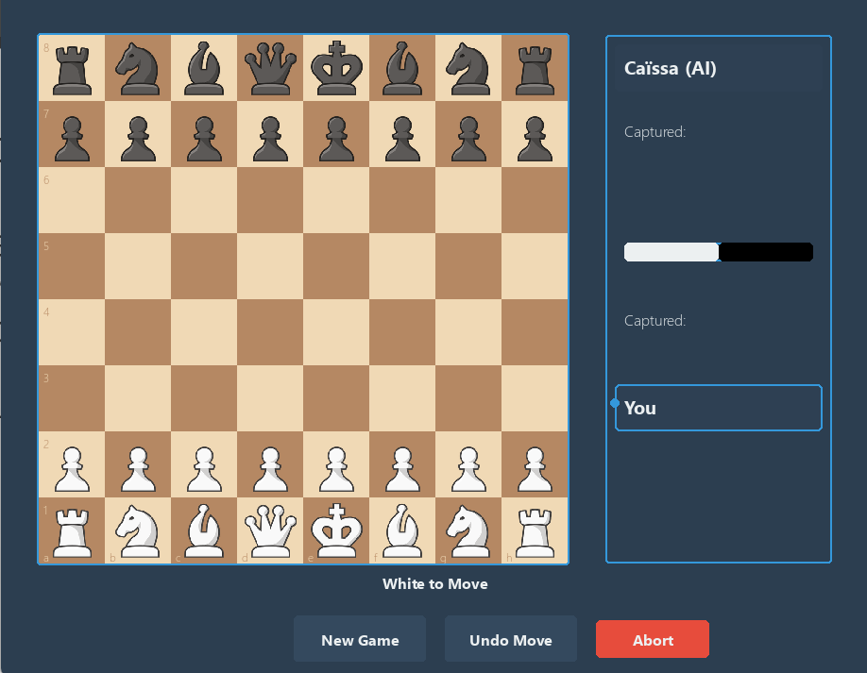
CAISSA INTERFACE
Game interface showing current position and evaluation bar.
Captured pieces, player indicators, and user controls.
Highlight of last move and possible moves.

Slide 17
HOW IT WORKS???

Slide 18
EVALUATION FUNCTION
The evaluation function measures the strength of a chess board.
Positive value → White is better; Negative value → Black is better.
A score near zero indicates an equal position.
Piece values (in ones):
Pawn = 1
Knight = 3
Bishop = 3
Rook = 5
Queen = 9
The king has no material value, but its safety and activity are evaluated.
Thus, the white tries to maximize the evaluation whereas black tries to minimize it.

Slide 19
MINMAX ALGORITHM
The Minimax algorithm is a decision-making algorithm used in two-player turn-based games like chess. It assumes both players play optimally. The AI (maximizer) tries to maximize its chances of winning, while the opponent (minimizer) tries to minimize them.
How It Works:
The game tree is constructed with all possible future moves up to a certain depth.
The AI simulates all possible opponent responses.
Leaf nodes are evaluated using a scoring (evaluation) function.
The algorithm chooses the move that leads to the best guaranteed outcome assuming the opponent plays optimally.

Slide 20
MINMAX PSEUDOCODE
function minimax(node, depth, isMaximizingPlayer):
if depth == 0 or node is a terminal state:
return evaluate(node)
if isMaximizingPlayer:
maxEval = -infinity
for each child in node.children:
eval = minimax(child, depth - 1, false)
maxEval = max(maxEval, eval)
return maxEval
else:
minEval = +infinity
for each child in node.children:
eval = minimax(child, depth - 1, true)
minEval = min(minEval, eval)
return minEval

Slide 21
2
Depth 0
Depth 1
-1
2
Depth 2
4
-1
6
2
-3
4
-2
-1
4
6
-4
2
Depth 3
MINMAX ALGORITHM

Slide 22
ALPHA BETA PRUNING
Alpha-Beta Pruning is an enhancement to the Minimax algorithm that reduces the number of nodes evaluated in the game tree.
It prunes (cuts off) branches that cannot possibly affect the final decision, improving efficiency without changing the outcome.
Alpha (α): Best value the maximizer can guarantee so far.
Beta (β): Best value the minimizer can guarantee so far.
If β ≤ α, further evaluation of that node is stopped (pruned).

Slide 23
ALPHA BETA PRUNING ALGORITHM
Alpha-Beta Pruning is an enhancement to the Minimax algorithm that reduces the number of nodes evaluated in the game tree.
It prunes (cuts off) branches that cannot possibly affect the final decision, improving efficiency without changing the outcome.
Alpha (α): Best value the maximizer can guarantee so far.
Beta (β): Best value the minimizer can guarantee so far.
If β ≤ α, further evaluation of that node is stopped (pruned).

Slide 24
ALPHA-BETA PRUNING PSEUDOCODE
function alphabeta(node, depth, alpha, beta, isMaximizingPlayer):
if depth == 0 or node is terminal:
return evaluate(node)
if isMaximizingPlayer:
maxEval = -infinity
for each child in node.children:
eval = alphabeta(child, depth - 1, alpha, beta, false)
maxEval = max(maxEval, eval)
alpha = max(alpha, eval)
if beta <= alpha:
break // Beta cutoff
return maxEval
else:
minEval = +infinity
for each child in node.children:
eval = alphabeta(child, depth - 1, alpha, beta, true)
minEval = min(minEval, eval)
beta = min(beta, eval)
if beta <= alpha:
break // Alpha cutoff
return minEval

Slide 25
3
Depth 0
Depth 1
3
<-4
Depth 2
3
>5
-4
?
-1
3
5
?
-6
-4
?
?
Depth 3
ALPHA BETA PRUNING ALGORITHM

Slide 26
Challenges Faced
Efficient rule enforcement for complex scenarios (e.g., castling, en-passant & stalemate).
Smooth GUI integration with logic.
Ensuring AI gives fast yet competitive responses.
UI polish and interactivity.

Slide 27
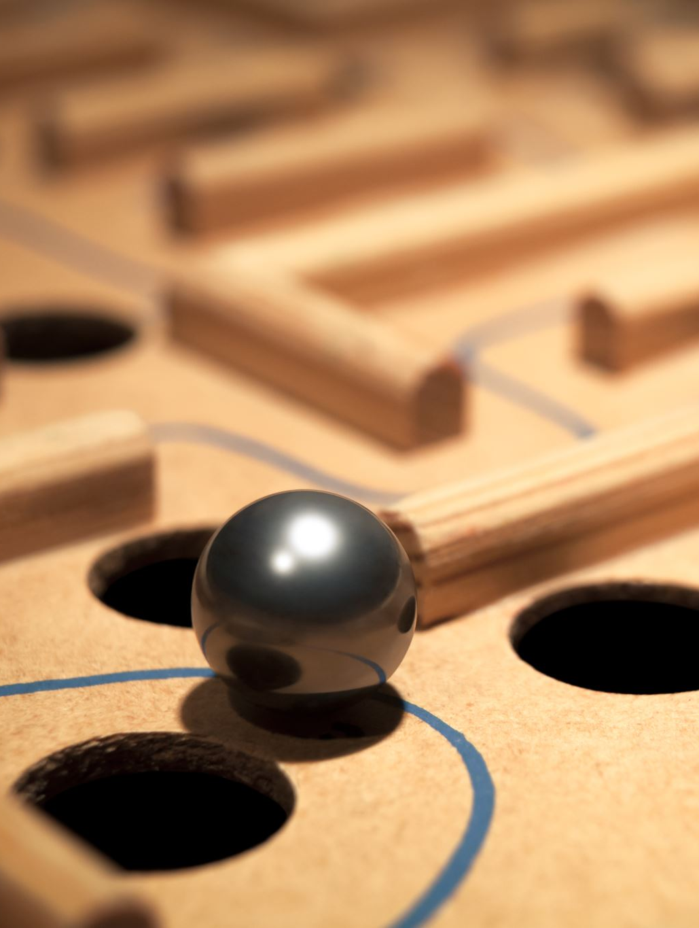
Why This Project Matters
Educational value: learn search algorithms and GUI integration.
Designed from scratch: not built on external chess engines.
Customizable and modular: good for learning and enhancements.
Bridges game dev and AI with real-time interaction.

Slide 28
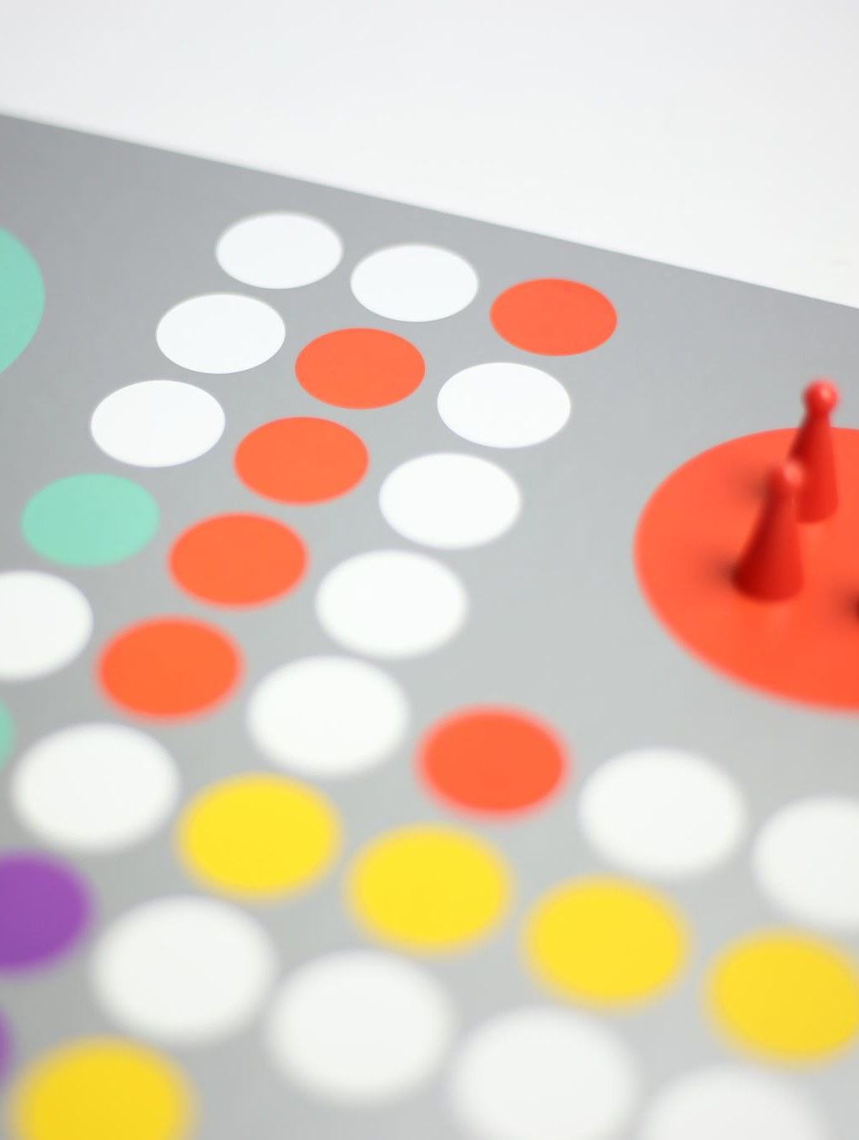
Future Scope
Difficulty levels by increasing AI depth.
Integrate opening books and endgame tables.
Use ML-based evaluation instead of static scoring.
Bit Board representation for faster AI
Per Piece evaluation on different positions on the board

Slide 29

Conclusion
Developed a working chess engine with AI and full rule support.
Blends game development, rule logic, and AI concepts.
Can be extended further for education or research.

Slide 30
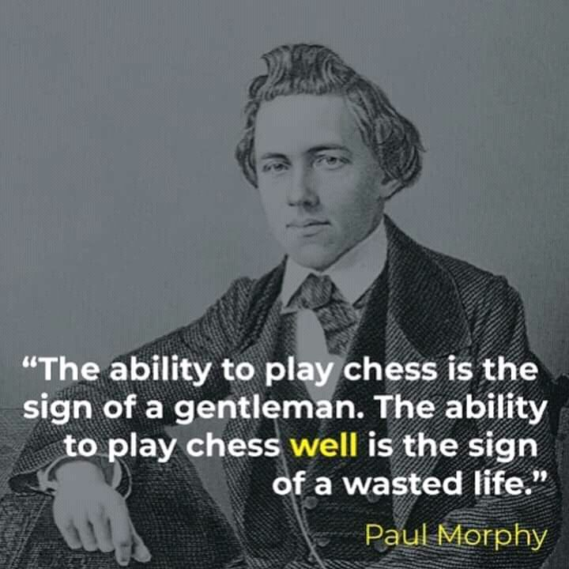

Slide 31

Q & A
Thank you!
REFERENCE – ChatGPT & Claude and ollama
We are open to any questions.

