Slide 1


Introduction to Artificial Intelligence
SUDOKU USING AI TECHNIQUES
Team Member:
Sharadkumar Patel (00818264)
Urvang Patel (00839397)
Guided By : Dr. Shivanjali Khare

Slide 2

PROJECT TITLE
“I hypothesize that Search Algorithms can significantly improve the efficiency and accuracy of solving Sudoku puzzles.”

Slide 3
OBJECTIVE
To develop an intelligent Sudoku solver that uses various AI-based search techniques (DFS, BFS, A*and Greedy) and evaluate their performance in terms of efficiency, accuracy, and scalability.

Slide 4
APPROACH
Problem Modeling: Sudoku is framed as a Constraint Satisfaction Problem (CSP) with variables, domains, and constraints.
Search Algorithms to be Implemented:
DFS (Backtracking) – baseline recursive solver.
BFS (Breadth-First Search) – level-wise exploration of possible states.
Greedy Search – selects values with least conflicts.
A* – uses cost and heuristic to guide search.

Slide 5
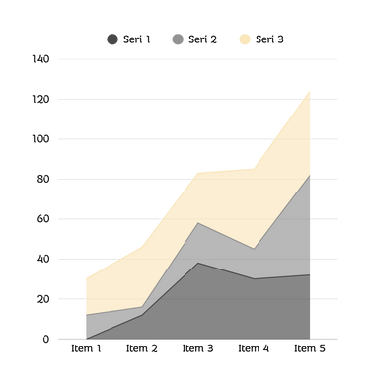
DELIVERABLES
What We Will Submit:
A complete and functional Sudoku Solver application.
Performance comparison charts showing time, nodes explored and accuracy.
Well-documented source code (GitHub)
Project Report & Final Presentation
Presentation summarizing the work, results and evaluation.

Slide 6
EVALUATION METHODOLOGY
Metrics for Comparison:
• Execution Time
• Number of Nodes Explored
• Success Rate / Accuracy
• Algorithm Efficiency (Heuristics Impact)
Testing Strategy:
• Use Sudoku puzzles of varying difficulty (Easy to Evil)
• Run each algorithm on identical test cases
• Record and compare outputs using graphs
THANK YOU

