Slide 1
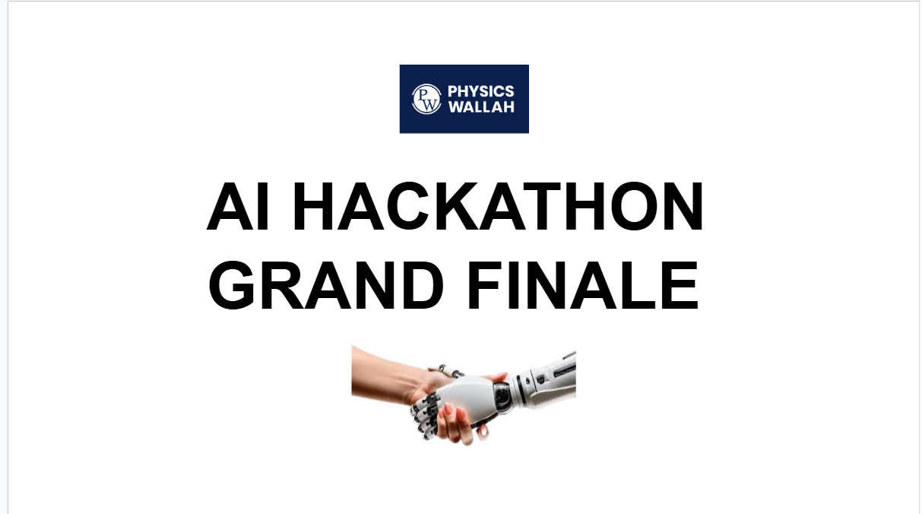

Slide 2


AI HACKATHON | GRAND FINALE
AI-based Question Bank
T H E C O R E P R O B L E M
Building exam papers is manual, expert & slow
• Questions typed from PDFs by hand — heavy DTP load
• Every answer key checked & every solution written manually
• Solution videos recorded one question at a time
• Each paper balanced by syllabus & difficulty by hand
Error-prone, faculty-heavy and impossible to scale across batches & verticals.
Team 1 · AI Content Wallah
Led by Lovee Mittal — 3 years in Academics R&D, paper-setter for AITS, Real Test, Milestone & AIR.
Our mission make question-bank and test-paper creation fast, accurate and AI-assisted.

Slide 3
PW
AI HACKATHON | GRAND FINALE
Introduction & Implementation at Organisational / Departmental Level
Scope
• Generate, verify & assemble high-quality test papers across educational and competitive exam verticals.
Ownership
• Content Strategy team with Technology, Product & AI; SMEs from each vertical own domain validation & QA.
Required Data / Systems
• PW servers / AWS for app & DB hosting, enterprise AI API access, and the current QBG question database.
Integrations
• 10+ AI provider APIs — Gemini, OpenAI, Anthropic, OpenRouter, Groq, Grok, NVIDIA, Fireworks (+ local)
• Supabase — Postgres database, Auth & file Storage
• Media & math — ElevenLabs / Edge TTS for narration · Wiris MathType for equations
• Content I/O — PDF / Word import & export · existing QBG bank
Rollout Timeline
9 Months
Phased go-live, vertical by vertical

Slide 4
PW
AI HACKATHON | GRAND FINALE
Adaptability & Applicability in the Organisation
The platform sits on top of the copy of existing QBG database and plugs into every academic content workflow — from a single faculty member building one test to a central team producing thousands of papers across verticals.
Where it applies
• JEE, NEET & Foundation / board verticals
• AITS, Real Test, Milestone, AIR & custom papers
• Online and offline batches, every centre
• Hindi + regional vernacular delivery
How it adapts
• Model-agnostic — 10+ AI providers, swap per task
• Ingests any PDF / Word source paper
• Configurable exam pattern, difficulty & syllabus
• Role-based access + per-user API keys
Adoption & scalability risks
• AI errors → human-in-the-loop at every step
• Low-quality scans → multi-provider fallback
• Cost at scale → usage governance & caching
• Phased, vertical-by-vertical rollout

Slide 5
PW
AI HACKATHON | GRAND FINALE
ROI: Revenue Upliftment or Cost Saving
₹28.2 Cr
Net annual impact
~1,000%
Year-1 ROI
~4 days
Payback period
4.06 L hrs
Saved / year · 300 staff
Where the value comes from ₹30.6 Cr / yr
• Time saved → ₹28.6 Cr across 300 staff — AI-assisted QC, auto solutions, bulk typing & coordination
• New revenue → ₹2.0 Cr QC platform licensed to external coaching institutes
• Faculty 3 hrs→30 min QC · DTP 6 hrs→2 min typing · video 1 day→30 min / 100 Q
What it costs ₹2.47 Cr / yr running
• One-time build → ₹31.5 L solution design, build & QA, AI tooling, onboarding & data setup
• Annual running → ₹2.47 Cr LLM APIs (50 L questions QC), storage, infra subscriptions
• Biggest line → SME review time of the ~20% of questions the AI flags for a human
ROI = (Annual benefit − Annual running cost − One-time build) ÷ (Running + Build). Modelled at full deployment: 300 staff, 240 working days/yr. Source: AI Initiative Impact workbook (Team 1).

Slide 6
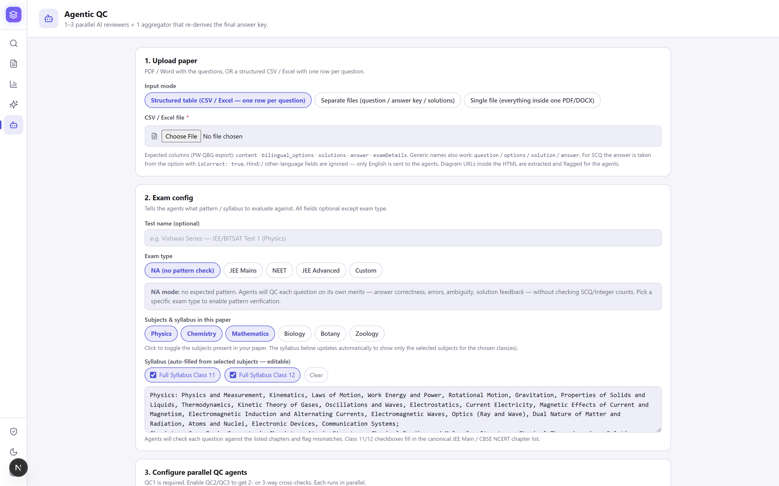
PW
AI HACKATHON | GRAND FINALE
MVP Content
Agentic QC — papers checked by a team of AI agents
Point a full paper at multiple QC agents running in parallel. Each solves and checks the questions; an aggregator then votes on the final answer key.
• 1–3 parallel QC agents — choose provider + model for each
• Flags wrong / suspicious answers, out-of-syllabus & pattern issues
• Exam-aware: JEE Main, JEE Advanced, NEET or custom patterns
• AI clears ~80%; humans review only the flagged ~20%
Faculty QC time per test: 3 hrs → 30 min.

Slide 7
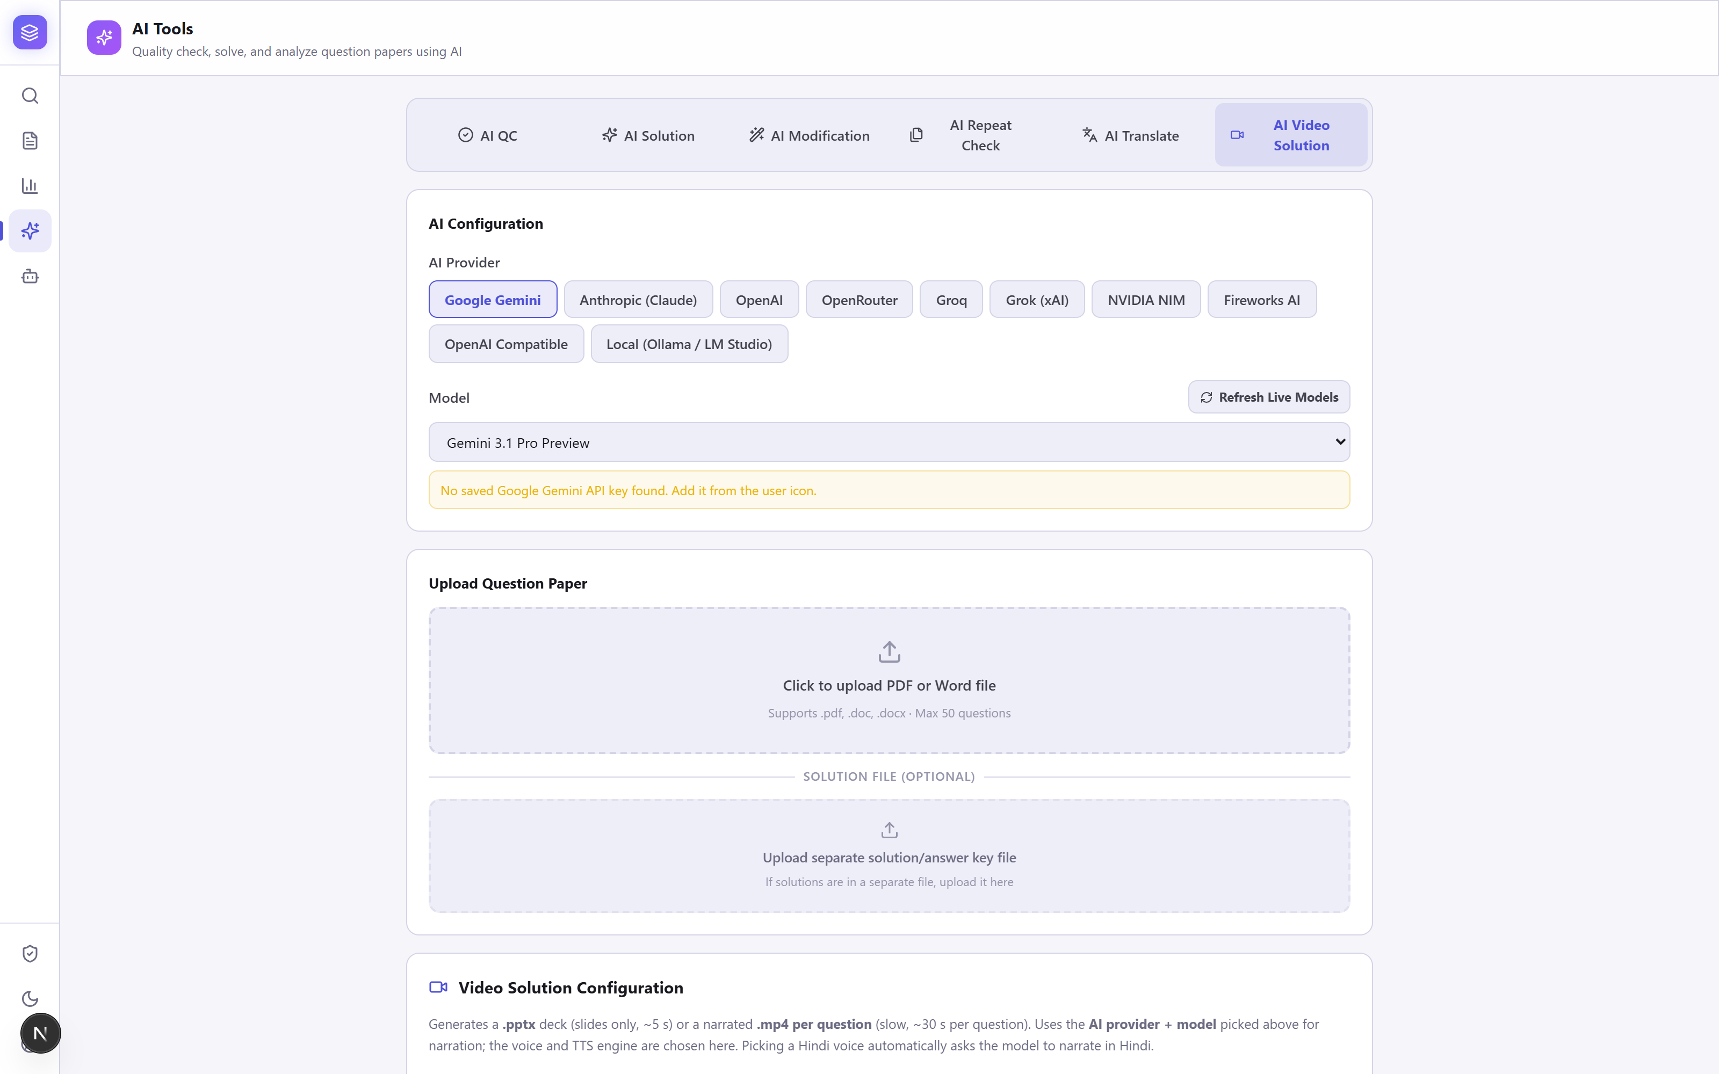
PW
AI HACKATHON | GRAND FINALE
MVP Content
AI video solutions — auto-generated & narrated
Turn any question into a narrated, handwritten-style solution video — or a slide deck — in minutes, composed on PW's branded base slide.
• Natural voice narration (ElevenLabs / Edge TTS), English or Hindi
• Handwriting-style working with an animated tick on the right option
• Exports an MP4 video or a PPTX deck per question
• Faculty recording: 1 day → ~30 min per 100 questions
Scales solution videos without faculty studio time.

Slide 8
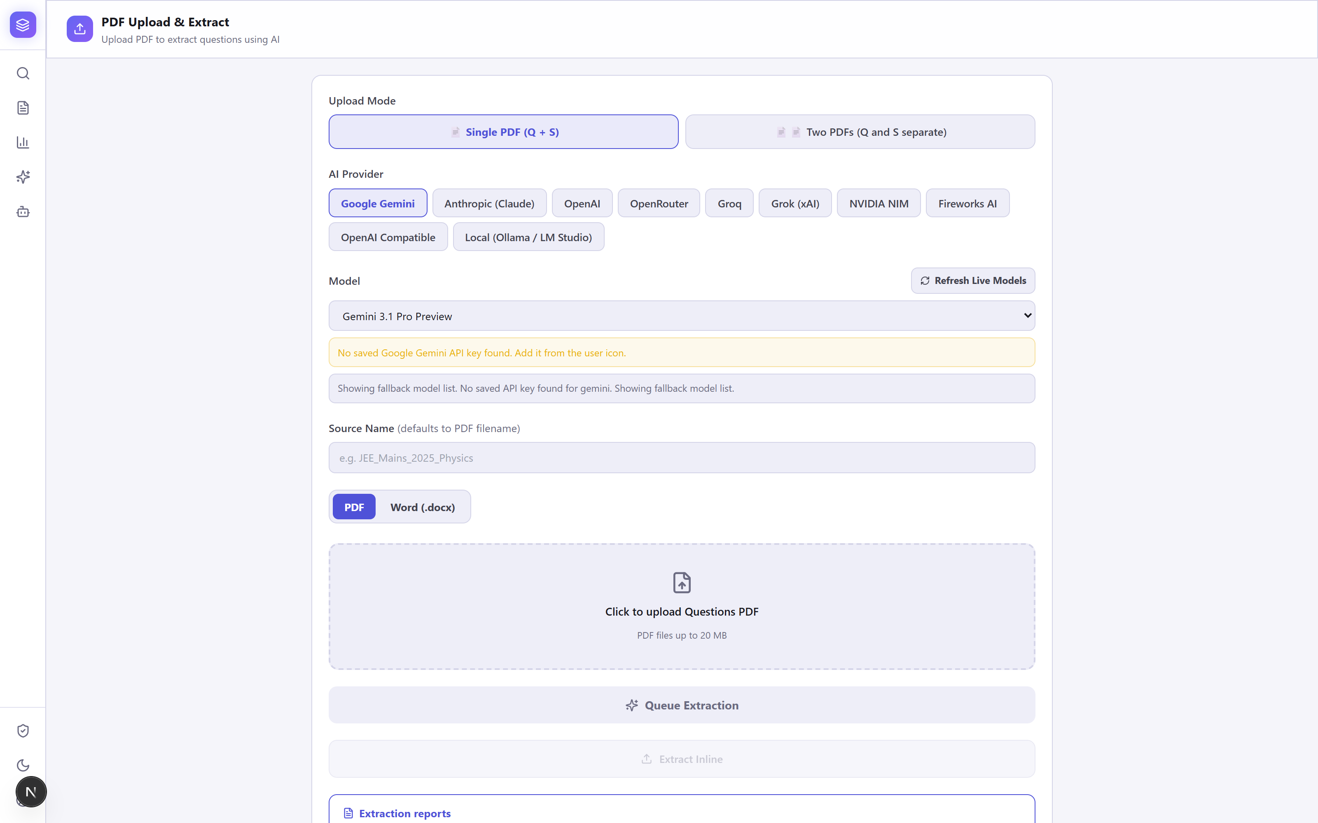
PW
AI HACKATHON | GRAND FINALE
MVP Content
Bulk PDF import — zero manual typing
Upload a question paper (and solutions) as PDF or Word. AI extracts every question, option, answer key, solution and metadata straight into the structured bank.
• Replaces the DTP team's slow manual typing — 6 hrs → ~2 min per test
• Single combined file, or separate question / solution files
• Any provider — Gemini, Claude, OpenAI & more — review before save
The biggest DTP & data-entry time saver in the workflow.

Slide 9
PW
AI HACKATHON | GRAND FINALE
What's Next — Roadmap & Commercial Upside
Phase 1 ships the verified question bank and AI toolkit. Phase 2 turns PW's biggest asset — student performance data — into truly personalised practice, and opens a new revenue line by licensing the platform to other institutes.
P H A S E 2
Personalised Practice Papers
• Verified DB first — then enrich every question with real usage metadata.
• Signals captured — avg time-to-correct answer, correct-vs-wrong attempt rate, true (data-driven) difficulty.
• Adaptive delivery — each student is served questions matched to their current level.
• Why it works — data is gold, and a huge number of students already use the PW app.
N E W R E V E N U E
Productise & License It Out
• Sell to other coaching — offer the platform as a white-label / SaaS product to other institutes.
• Test papers on demand — exam-pattern papers, QC & video solutions in a few clicks, downloadable as PDF / Word.
• New revenue stream — monetise the platform externally, beyond internal cost savings.

Slide 10
PW
AI HACKATHON | GRAND FINALE
Thank You
AI Content Wallah
Thank you for your time. We'd love to hear your questions and feedback.

