Slide 1
📌 About Me
Notes:
Hey everyone, My name is sharad regoti. I working as a consultant on an internet project of Xebia called as XLR8s.
I have 2 years of experience of building platforms around Kubernetes & Golang.

Slide 2
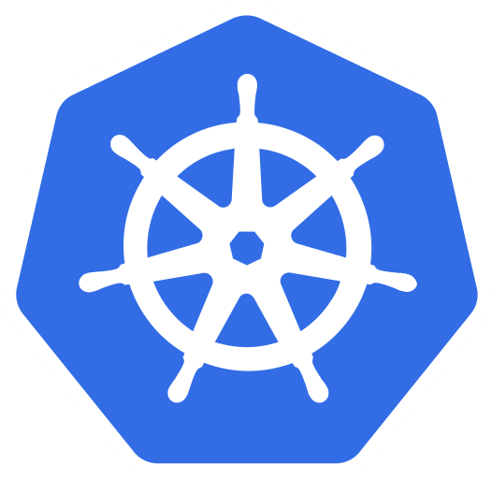
Let’s Talk About Kubernetes Services
Notes:
Today we will be talking about Services in Kubernetes & Here is the agenda

Slide 3
📌 Agenda
Understanding What Is a Service In Kubernetes & Why It is Required?
Types Of Services
Where To Use Which Service
What Is a Ingress & Ingress Controller
Use case of Ingress Controller
Notes:
Go through the pointers

Slide 4
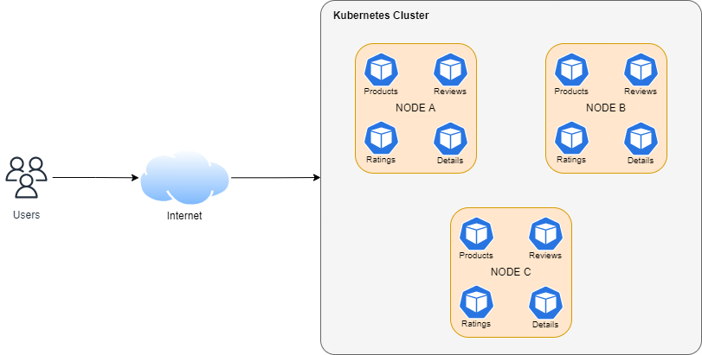
📌 Demo Architecture
Notes:
In the entire presentation, we will be referencing this architecture. As you can see, we have a k8s cluster consisting of 3 nodes (A,B,C). A node in k8s represents VM. Which is running a microservices application consisting of 4 services (products, reviews, ratings, details) There are 3 replicas of each service on each VM for high availability purposes.

Slide 5
📌 Let’s Clarify The Confusing Name
Services !== Application
Notes:
In the context of Kubernetes whenever sombeoday says services don’t kae into the assumption of sservice

Slide 6



📌 Why Services Are Required In Kubernetes?
Hard Coded Address
K8s Cluster
Self Healing
10.0.0.1 : 8080
10.1.1.2 : 8080
10.8.9.3 : 8080
http://10.1.1.2:8080
Users
{“rating”:”5”}
products
ratings
ratings
😅 Applications Are Ephemeral In Nature
Notes:
Kubernetes Cluster
In which 2 apps are running
K8s assigns IP address to application when it starts
Request Comes From Internet
Products app depends upon ratings app
Products app gets the IP address from config
Makes the http call & gets the response
Everything good
What if ratings app goes down?
No need to worry, as k8s will restart the service
But there is problem, whenever an app restarts k8s changes it IP address
Now the hardcoded address in products configuration won’t work
So to summarize - Applications are ephemeral/short lived in nature
Which leads to restart of application & IP address changes
This failes the network
So what do we need to solve this?
What we really need is just a sticky identity
And we have an example already being used at a big scale, that is the DNS
This is how service discovery solved in kubernetes

Slide 7
📌 DNS
Notes:
When you create a service in Kubernetes, it creates a mapping of host address & it ensure it always resolves to the latest IP address.
Now we have resilient internal communication

Slide 8

📌 This Is Where Services Helps You
Ensures Latest IP
K8s Cluster
10.0.0.1 : 8080
10.1.1.2 : 8080
10.8.9.3 : 8080
http://ratings-svc:8080
ratings-svc
ratings-svc:8080
10.8.9.3:8080
http://10.8.9.3:8080
{“rating”:”5”}
products
ratings
Mapping
Notes:
When you create a service in Kubernetes, it creates a mapping of host address & it ensure it always resolves to the latest IP address.
Now we have resilient internal communication

Slide 9
📌 The Technical Term
Service discovery is the actual process of figuring out how to connect to a service.
Kubernetes Uses DNS To Solve Service Discovery Problem
Notes:
What we saw previously is not something new to the software world
It is still applicable & the term is called as service discovery
There are variety of other ways to do it. Kubernetes choose DNS resolution as one

Slide 10
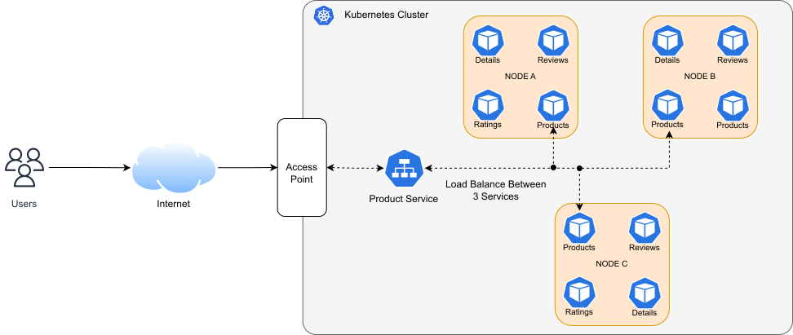
📌 Another Advantage Of Services Is Load Balancing
10.8.9.1:8080
product-svc:8080
10.8.9.2:8080
10.8.9.3:8080
Mapping

Slide 11
📌 How does a Service Work?

Slide 12
📌 Types Of Services
Cluster IP
Node Port
Load Balancer
External Name
Notes:
There are 4 types of services in Kubernetes. Cluster IP, NP, LB, EN
Let’s a look at them 1 by 1.

Slide 13
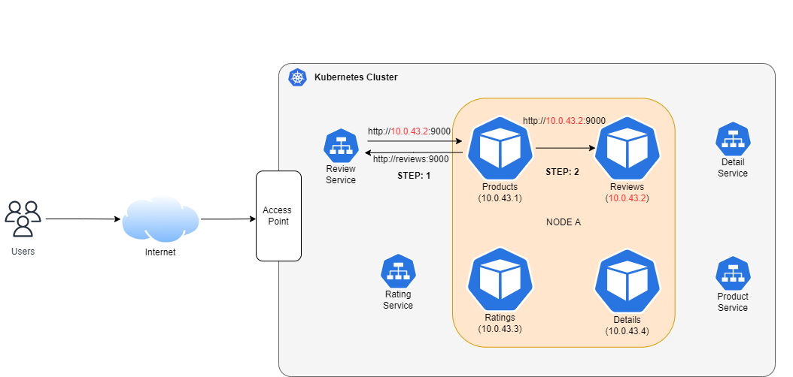
📌 Cluster IP
Internal Communication
Notes:
Starting with cluster IP This service is used for *internal communication between the apps inside the cluster. As you can see from the diagram (Explain)

Slide 14
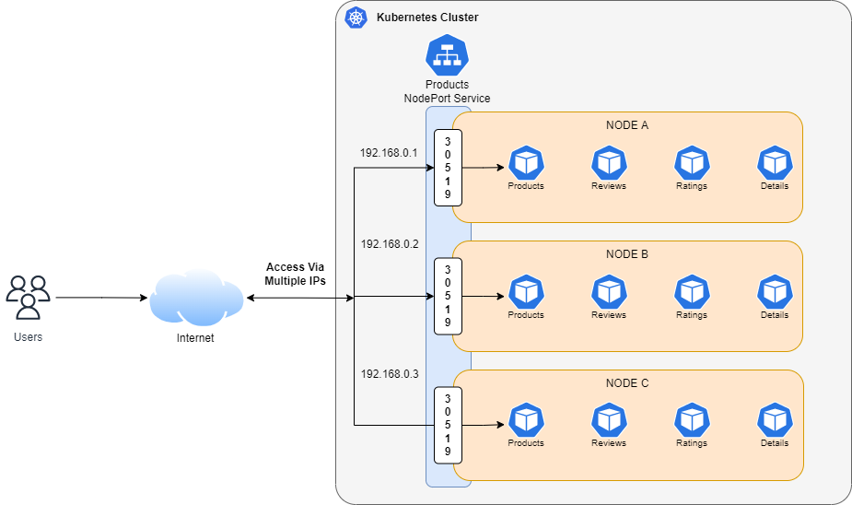
📌 NodePort
Making applications accessible outside the Kubernetes cluster

Slide 15
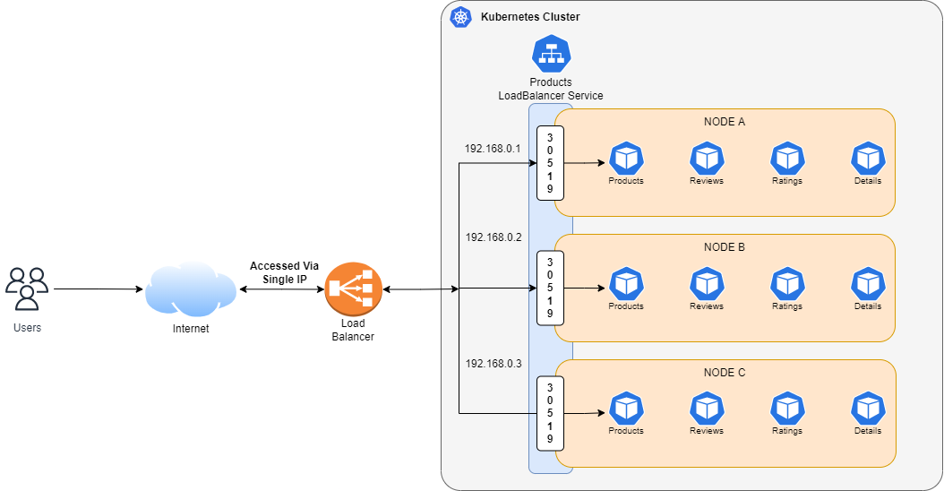
📌 Load Balancer
Making applications accessible outside the Kubernetes cluster

Slide 16
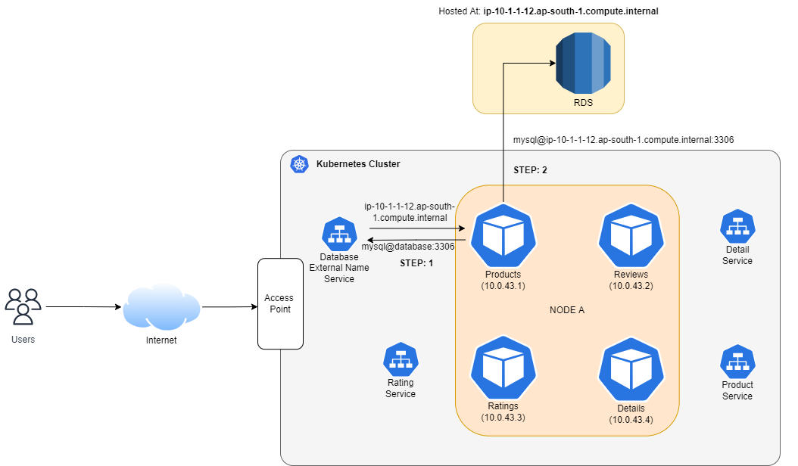
📌 External Name

Slide 17
📌 Where To Use Which Service
Cluster IP
Used for internal communication
Node Port
Used for exposing application out of the k8s cluster, usually used for testing purposes
Load Balancer
Used for exposing application out of the k8s cluster
External Name
Used for proxying request for external services

Slide 18
📌 End

Slide 19
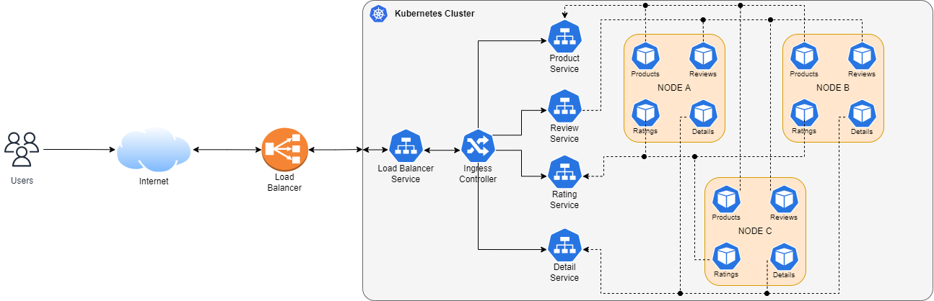
📌 Ingress Controller

