Slide 1

MyCI
My Campus Information Chatbot
Team: CrowdIT
Neha Sree Thuraka
Sharad Shriram
Salim Salmi
Yizi Chen
Notes:
15 seconds

Slide 2
MyCI
Hey! I am John. I want to have lunch with 6 other friends. The Cafeteria seems to be full and we are not able to find a table that can accommodate all of us.
Hello, I am Marina. I have to attend a lecture at 13:45 in hall E at EWI. But I will reach the campus by 13:00. I would like to find a silent room to study nearby the lecture hall so that I don’t waste my time.

Slide 3
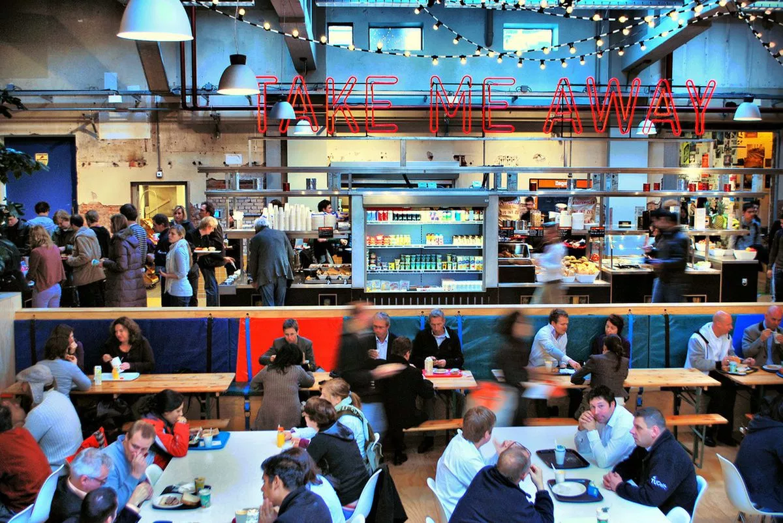
Introduction
MyCI
Finding a particular type of free place at a particular location
Problem:
Difficulty in finding real time information
No automatic APIs

Slide 4
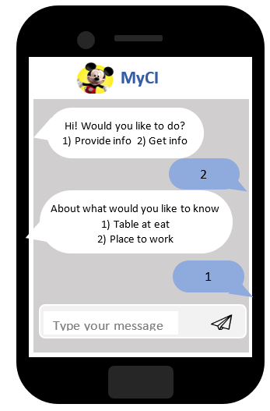
Our solution
MyCI
Crowdsourced chatbot
Notes:
The solution to this problem that we will be presenting today is a crowdsourced chatbot service to help student find free space
Quickly on what a chatbot is. It is a program which can be interacted with in a conversational manner, usually through a messages on a chat platform.
The students will ask the bot for information. The crowdsourcing aspect comes in the form of other students providing this information that’s being asked for.
What is the need for MyCI?
Saving time for students looking for information
Leveraging information from other students
Informed decisions for productivity

Slide 5
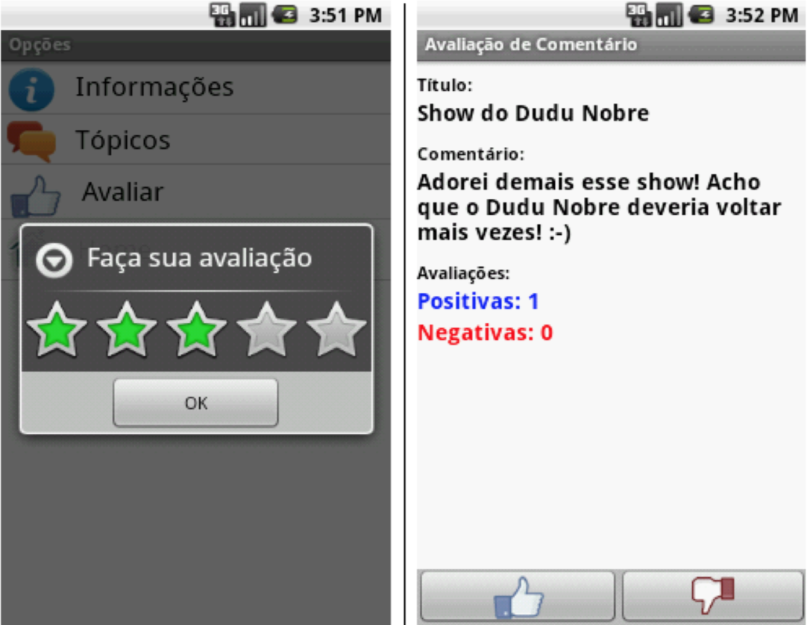
Motivation
MyCI
Why chatbot?
Easily accessible
Interactive and timely
Can work with any open social chat platform
Oliveira, J., Silva, A., & Franckini, R. (2013, June). Collaborative information gathering and recommendation using mobile computing. In Computer Supported Cooperative Work in Design (CSCWD), 2013 IEEE 17th International Conference on (pp. 67-71). IEEE.
Notes:
Why did we opt for a chatbot?
Other similar solutions are have been proposed like the app you see here. This is also a crowdsourced application for finding information on campus but on a android app.
This is where the advantage of a chatbot comes in. No need to install applications as it integrates with applications students already have.
Oliveira J., et.al. proposed a campus based system for information gathering and recommendation which is an android application which has registered users express their thoughts and comment for different activities across the campus of the Federal University of Rio de Janeiro.[1]
This work establishes that crowdsourced, collaborative information gathering and recommendation across campus events is a feasible and useful application.
However, the daily needs of the campus like finding the menu at a particular food court, finding a workplace are necessities which will make the campus a better place. An application cannot cater

Slide 6
Motivation
MyCI
Why chatbot?
Easily accessible
Interactive and timely
Can work with any open social chat platform
Why crowdsourced?
Information is not currently being recorded by other means
Students already at location → Low effort task
Notes:
Why we did we opt for a crowdsourced solution over a tradition chatbot?
No services or APIs available for the use cases like the ones of john and maria. If they want the information they need to either go there personally or know a friend that’s already there and get the information from them.
With a crowdsourced solution

Slide 7
Features
MyCI
Be a conversable chatbot
Source quality answers from a motivated and active crowd
Fast, timely and relevant answer
Personalisation
Notes:
Here is the features of our chatbot system.
For the chatbot, we need a basic function conversable chatbot
For the crowd, we need a motivated and active crowd to provide source quality answers
Furthermore, we need chatbot to provide fast, timely and relevant answer
Lastly, the chatbot need to ask question according to the personalization. Such as preference of the users.

Slide 8
Designing MyCI
MyCI
Leveraging the crowd
User types a message on the chatbot application
Create micro-tasks based on user text, and notify workers based on certain rules
Aggregate responses [responses also stored in Database for performance]
Display the most relevant results to the user, through the chatbot.
Quality Control is done here!
Incentivise workers!
http://www.program-o.com/
Notes:
Next, i will talk about the implementation overview for our design.
Firstly, user types a message on the chatbot application,
After that, system create micro-tasks based on user text and notify workers based on certain rules.
Then, the aggregator collect all the response from the workers and store into the database.
Lastly, we need to display the result through the chatbot.

Slide 9
Incentives and Quality Control
MyCI
Incentives will in the form of Points and Levels
“As the data reported by workers cannot be verified, there is a tendency to report random data without actually solving the task. This can be countered by making the reward for an answer depend on its consistency with answers given by other workers, an approach called peer consistency.”
Mapping responses to the tasks based on the user-location. The same idea is also used for task allocation (a user model with location preference is assumed).
Radanovic, G., Faltings, B., & Jurca, R. (2016). Incentives for effort in crowdsourcing using the peer truth serum. ACM Transactions on Intelligent Systems and Technology (TIST), 7(4), 48.
Notes:
Incentives:
Points
When the user registers, he gets some points
User would need to spend points when he asks a question
He would get some points when he acts as a crowd worker and completes some task.
These points can be added even if the answer is not validated
Levels
Depending upon the number of validated answers a crowd worker gives, he would be assigned a level from novice to expert (For example, the worker would reach level 1 when he provides 50 validated answers)
Here, only the validated answers would count
At the end of the year, depending on the level of the worker, they would be given a free voucher.

Slide 10
Challenges
MyCI
Making the chatbot! Mapping chat text to crowdsourcing task and the reverse.
Low latency in responding to questions
Aggregation and Quality Control
Privacy concerns in location sharing

Slide 11
Summary
MyCI
What does MyCI do?
Why MyCI?
Features
Design
Incentives & Quality control
Challenges
Thanks to MyCI, I found a place for my group at EWI cafeteria. Share the word! This application brings the campus to life!!
Notes:
To sum up, the Easily accessible chatbot is built to solve the problem of the difficulties of finding real time information.
Summary

Slide 12
Questions?
MyCI
The team behind MyCI, will now take your questions.
Notes:
Replace it with a few key points

Slide 13

MyCI
Special thanks to
Panagiotis Mavridis & Sihang Qiu
Thank you all for the attention!
Notes:
Replace it with a few key points

