Slide 1
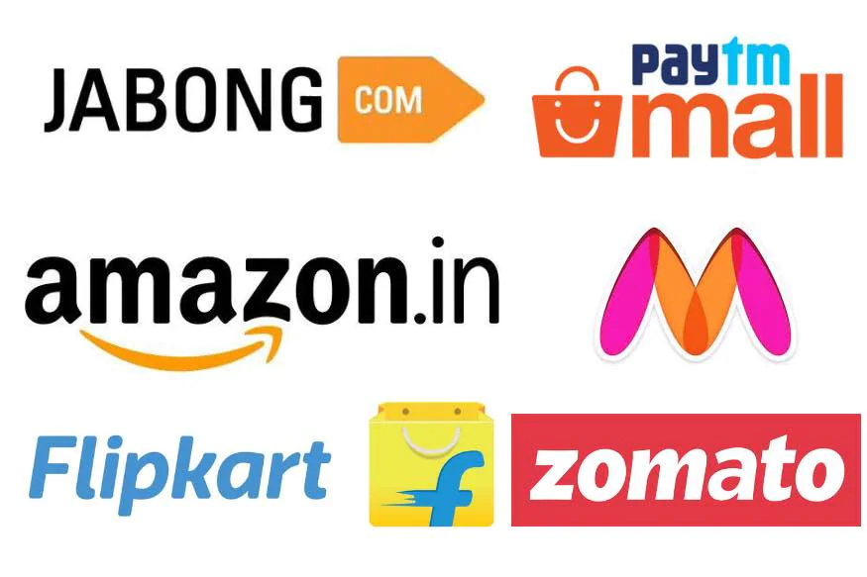
A case study from Indian e-commerce customers
E-commerce Analysis

Slide 2
Problem statement
Customer satisfaction is key to retain current customers as loyal to buy product even better product available on other site.
Customer retention driven factor is trust build-up ,service quality, privacy, better product with complete info, best offers among all peers .
The main goal is here combination of both utilitarian value and hedonistic values are needed to affect the repeat purchase intention (loyalty) positively.

Slide 3
EDA(Exploratory data analysis )
First step to import library and the import data file
data=pd.read_excel(r"C:\Users\INPshy\Desktop\DATA Science\customer_retention_dataset.xlsx")
data.head() This method is used to have overview of data column rows and inside content
#Setting option to show max rows and max columns
pd.set_option("display.max_columns",None)
pd.set_option("display.max_rows", None)
This code is just to see complete rows and column of dataset

Slide 4
Data Types and Shape , and column name cleaning
print(data.shape,data.info()) – this will give us data shape 269 rows and 71 columns including target variable ,data.info will give us data type is object float or integer.
# Cleaning column name ,Removing tab spaces from column name
data.columns = data.columns.str.replace('\t','')
#Removing digits from column name
remove_digits = str.maketrans('', '', digits)
data.columns = data.columns.str.translate(remove_digits)
#Removing leading and trailling spaces from column name
data.columns = data.columns.str.strip()

Slide 5
#check how many unique value present in each column
data.nunique()
This will provide how many unique values present in each column of dataset
After this I have taken few starting column which give customers personal info.
Customer_info=['Gender of respondent','How old are you?','Which city do you shop online from?','What is the Pin Code of where you shop online from?','Since How Long You are Shopping Online ?','How many times you have made an online purchase in the past year?','How do you access the internet while shopping on-line?','Which device do you use to access the online shopping?']

Slide 6
Customer information analysis with Piechart
for i in Customer_info:
plt.figure(figsize=(8,6))
data[i].value_counts().plot.pie(autopct='%1.1f%%')
centre=plt.Circle((0,0),0.7,fc='white')
fig=plt.gcf()
fig.gca().add_artist(centre)
plt.xlabel(i)
plt.ylabel('')
plt.figure()

Slide 7
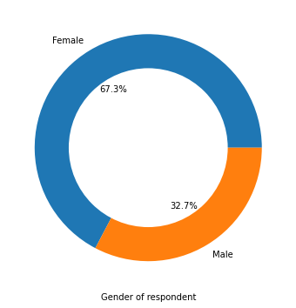
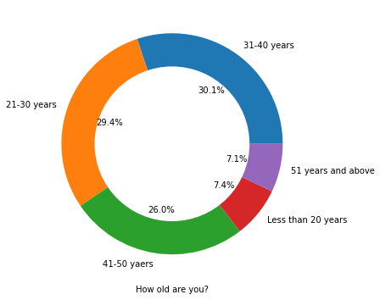
Piechart analysis of gender respondent , and active age group
Female participant is more than male ,age group 21-50 are most active doing online shopping

Slide 8
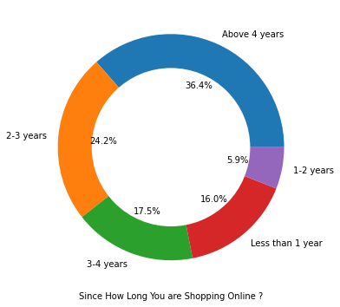
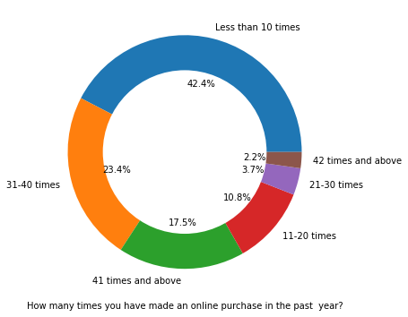
Since how long and how many times did online shopping
Majority of people doing online shopping more than 3-4 years ,42% people doing online shopping less than 10 times but others 60 % doing frequent online shopping

Slide 9
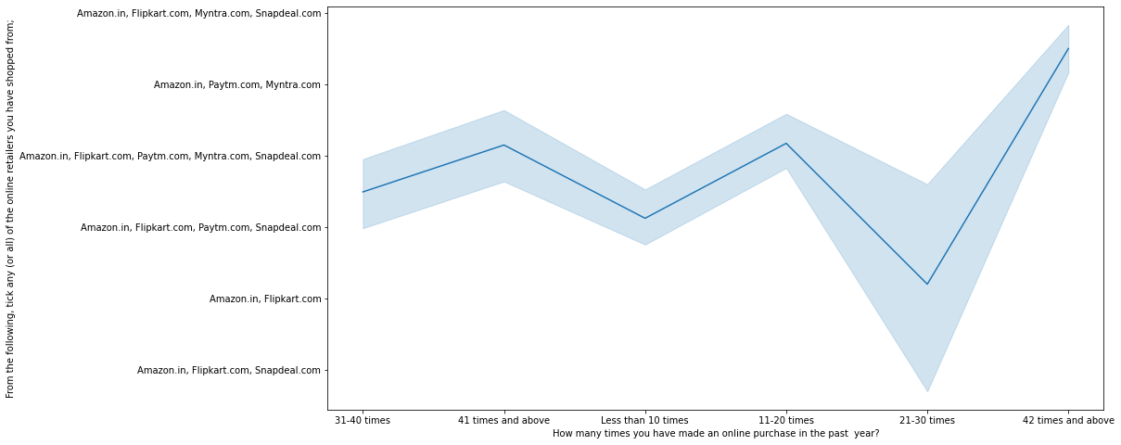
analysis of how many people do more frequent online shopping from which brand
Amazon,flipkart myntra and snapdeal people do more than 42 time shopping ,but some people also do less than 10 times shopping from amazon flipkart and paytm and snapdeal

Slide 10
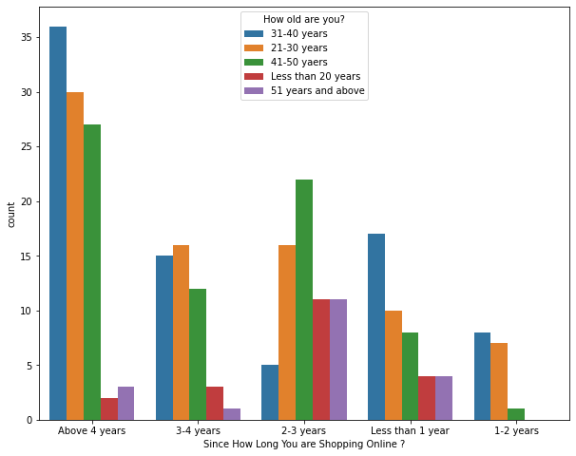
Since how long You are shopping Online?
More than 4 years people doing online shopping majority age group of online shopping is between 21-50 ,but 31-40 age group is highest among all

Slide 11
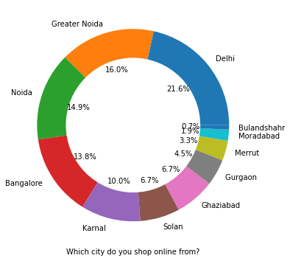
Which City do more online shopping
Delhi and Noida doing more online shopping if we combine noid and Greater Noida then Noida is ahead ,followed by Delhi Banglore and Karnal, surprisingly Gurgaon is behind Karanal and Sonal and Ghaziabad

Slide 12
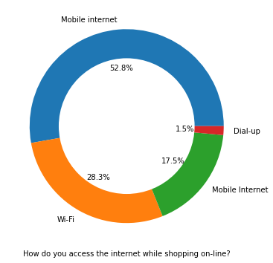
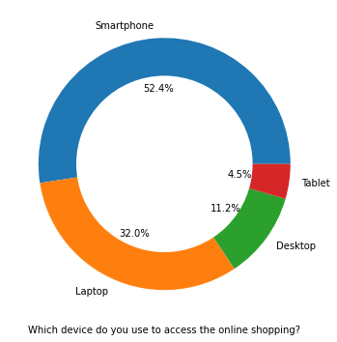
Mobile User Vs Desktop user
Smartphone user is majority because its more handy and convenient compare to desktop or laptop ,smartphone user is maximum number people doing online shopping

Slide 13
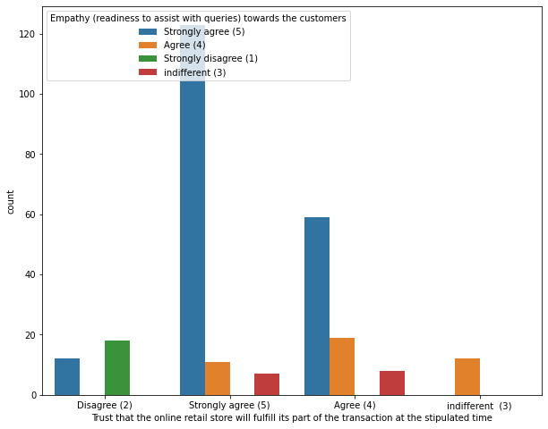
Trust factor
Customers priority to visit on trusted website so trust is major factor as per plot people strongly believe transaction must be safe and trusted for online shopping

Slide 14
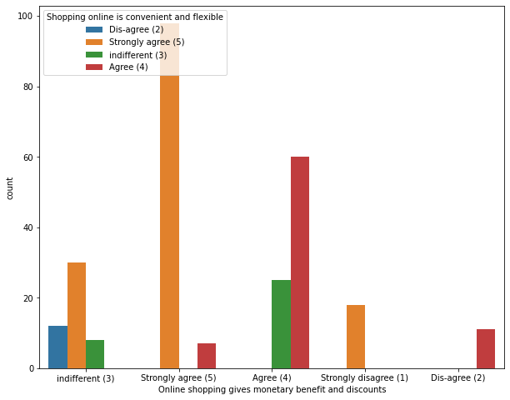
Monetary benefit and discounts
Online shopping does more sales offer to attract customers many discount coupns ,card user discount etc ,people also agree that e-retail gives monetary befits

Slide 15
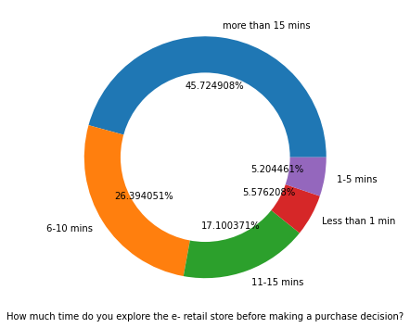
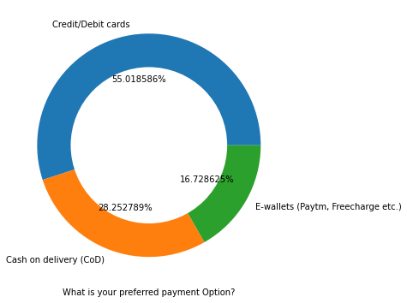
Purchase Decesion and Payment option
Maximum customers spend 6-15 minute before buying any products, most of the customers use credit/debit card for online payment ,few people also using E-wallets.

Slide 16
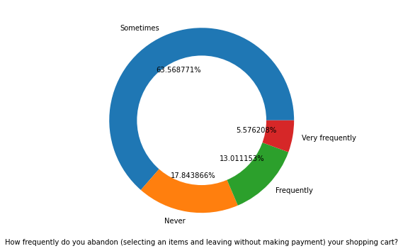
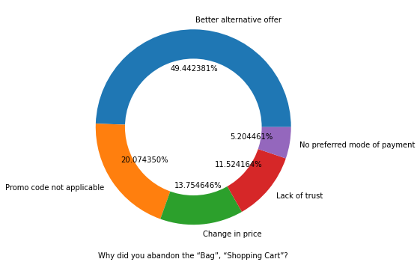
Analysis of Shopping Cart abandon
Most of the customers abandon shopping cart during checkout because they have better attractive offer for same product on other website brand, some times promo code is not working and some time change in price

Slide 17
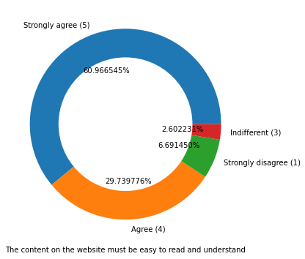
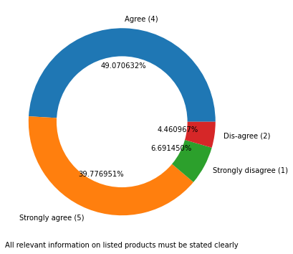
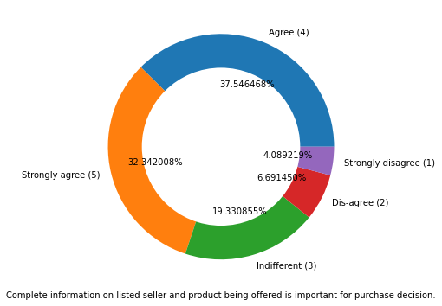
Content and information must be crisp and clear
Content inside website must be easy crisp to understand and complete information about particular product that will convert in final purchase .

Slide 18
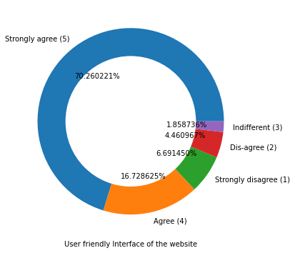
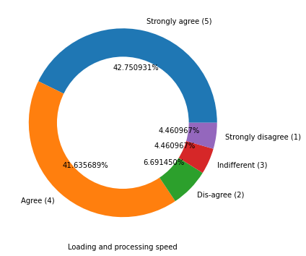
Website must light and fast
Customers wants to access fast user-friendly website, quick loading and processing of desired products

Slide 19
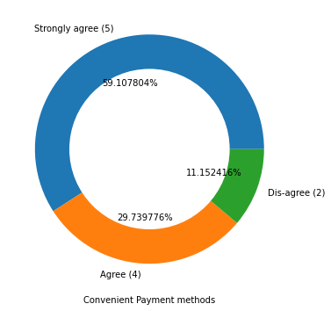
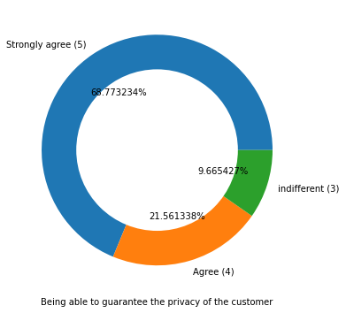
Privacy and Payment method
Customers want convenient payment method option and privacy of customers is utmost priority

Slide 20
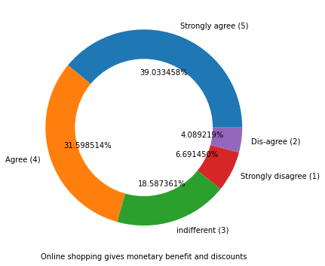
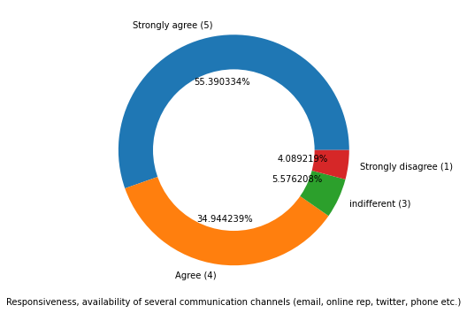
Response through social media and offers
People believe and agree that online shopping response through social media , mail communication ,phone call make them convenient option to gain trust on online shopping ,discounts is more attractive online shopping

Slide 21
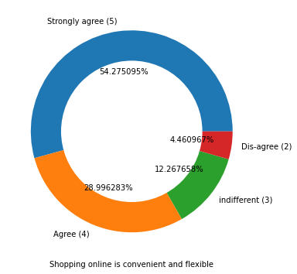
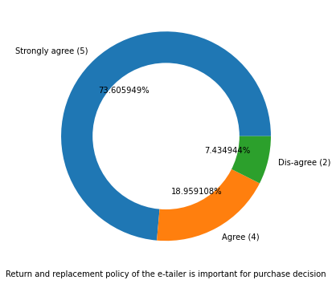
Flexibility and return policy
Many customers agree that online shopping give convenient time to buy products ,return and replacement policy is quite satisfactory

Slide 22
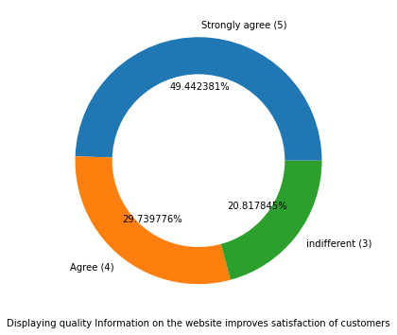
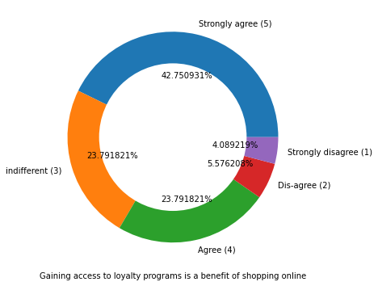
Loyalty Program & Customer satisfaction
People who does frequent shopping from particular website are eligible for loyalty program ,that give attractive discount and offer for loyal customers ,customers wants to improve content and information about product should more genuine and accurate like product colour and actual material display

Slide 23
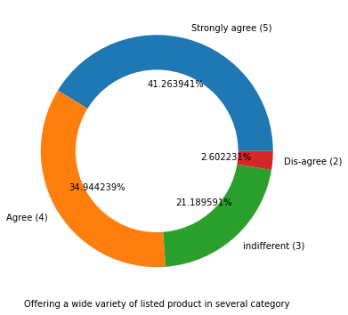
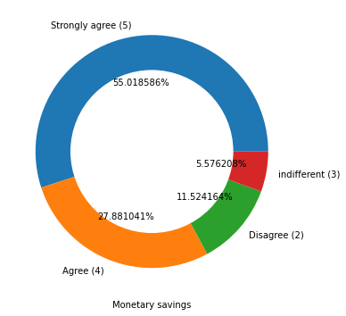
Wide Variety and Monetary savings
Many customers wants wide variety of product in several category to avail many option that’s the advantage of online shopping, many people getting offers on product so overall befit and saving point in online shopping

Slide 24
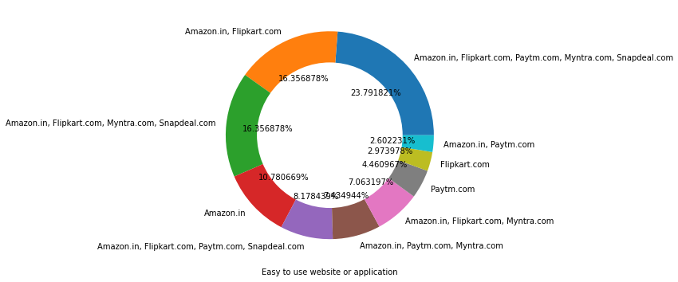
Brand website comparison
Amazon and flipkart are leading brand in e-retail segment, and their website is easy to use among all peers

Slide 25
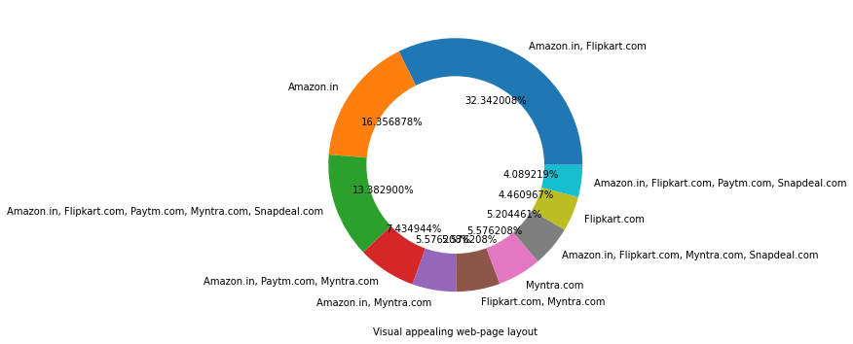
Visual appealing
Amazon and Flipkart webpage have better visual appealing in online product category among all online brand

Slide 26
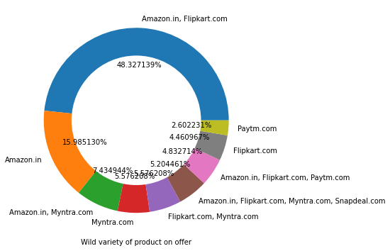
Wild Offers
Amazon is leader followed by flipkart in online sales offers in wide category

Slide 27
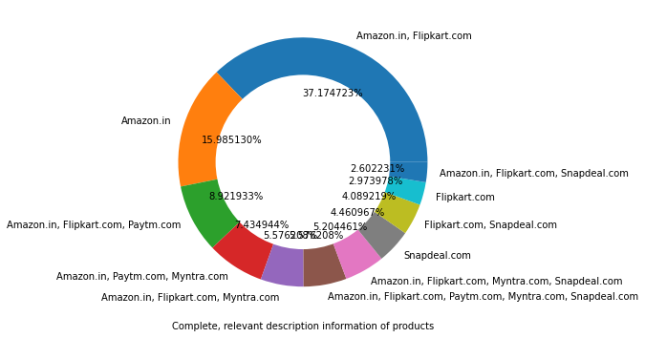
Complete Information
Amazon is leader webpage have complete information about their product ,followed by flipkart

Slide 28
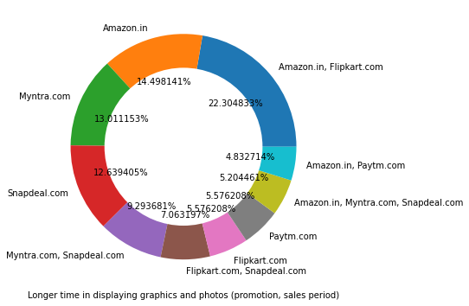
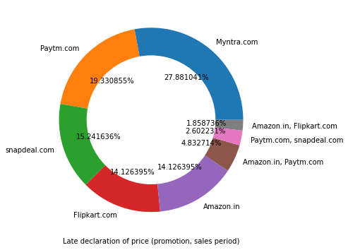
Issue during Sales period
Hevay congetion on webpage during promotion sales period amazon myntra website take longer time to load display graphics of product , late declaration of price during sales period

Slide 29
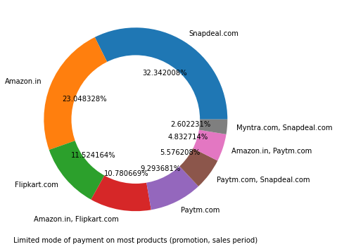
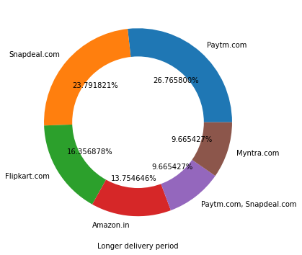
Issue during Sales period
Payment option is limited during sales offer, due to heavy demand surge delivery period longer .highest in Paytm and snapdeal then flipkart ,so here amazon ,myntra service is better than other

Slide 30
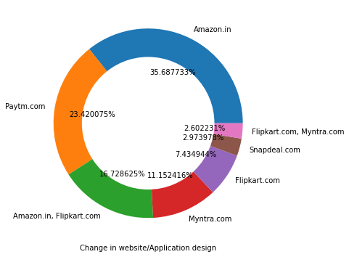
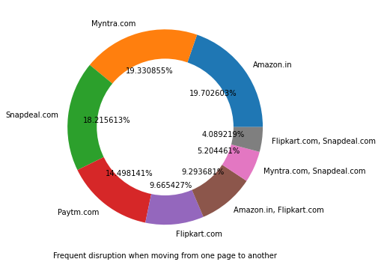
Website concern
Majority of customers wants to improve application design of webpage in amazon and paytm, myntra Amazon and snapdeal shows frequent disruption when moving from one page to another page

Slide 31
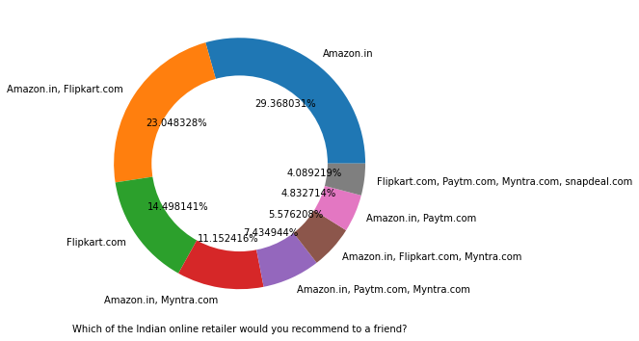
Which online retailer would recommend to a friend
Amazon is leading among all online shopping website followed by Flipkart ,most of user prefer Amazon and also recommend to use their friend .So amazon is at no 1 position and Flipkart at 2 position

Slide 32
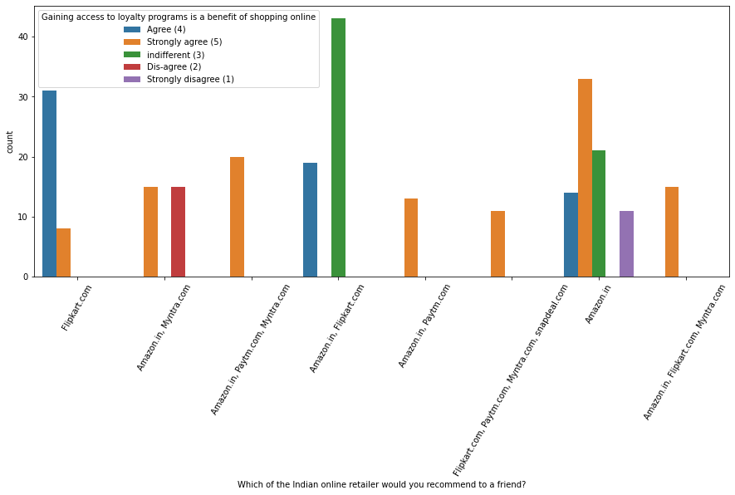
Top brand which would like to recommend to your friend
Amazon and Flipkart both are most trusted brand among all its peers based on different parameters like privacy ,transaction, return policy ,delivery time etc.

