Slide 1

Seasonal Agriculture Performance Analysis
SHARAFALI KT
GOVERNMENT ENGINEERING COLLEGE THRISSUR
AICTE STU ID : STU6a6b0e20d74011785400864

Slide 2

PROBLEM STATEMENT
(Agricultural activities are influenced by seasonal variations in environmental conditions, farming practices, resource availability and market conditions. As a result, agricultural performance may differ from one season to another. However, raw agricultural data does not clearly explain how agricultural performance changes across seasons or what patterns can be observed in different seasonal conditions. The problem is to analyze the given agricultural dataset and investigate seasonal differences in agricultural performance by identifying meaningful patterns, trends, relationships and variations within the available data.

Slide 3
Project Description The primary objective of this project is to analyze agricultural data from different seasons and identify meaningful patterns, trends, relationships and differences in agricultural performance.

Slide 4

WHO ARE THE END USERS?
FARMERS
INDUSTRIES
MEDICAL
PEOPLE

Slide 5

Technology Used
numpy
python
pandas
Matplotlib with pyplot
seaborn

Slide 6
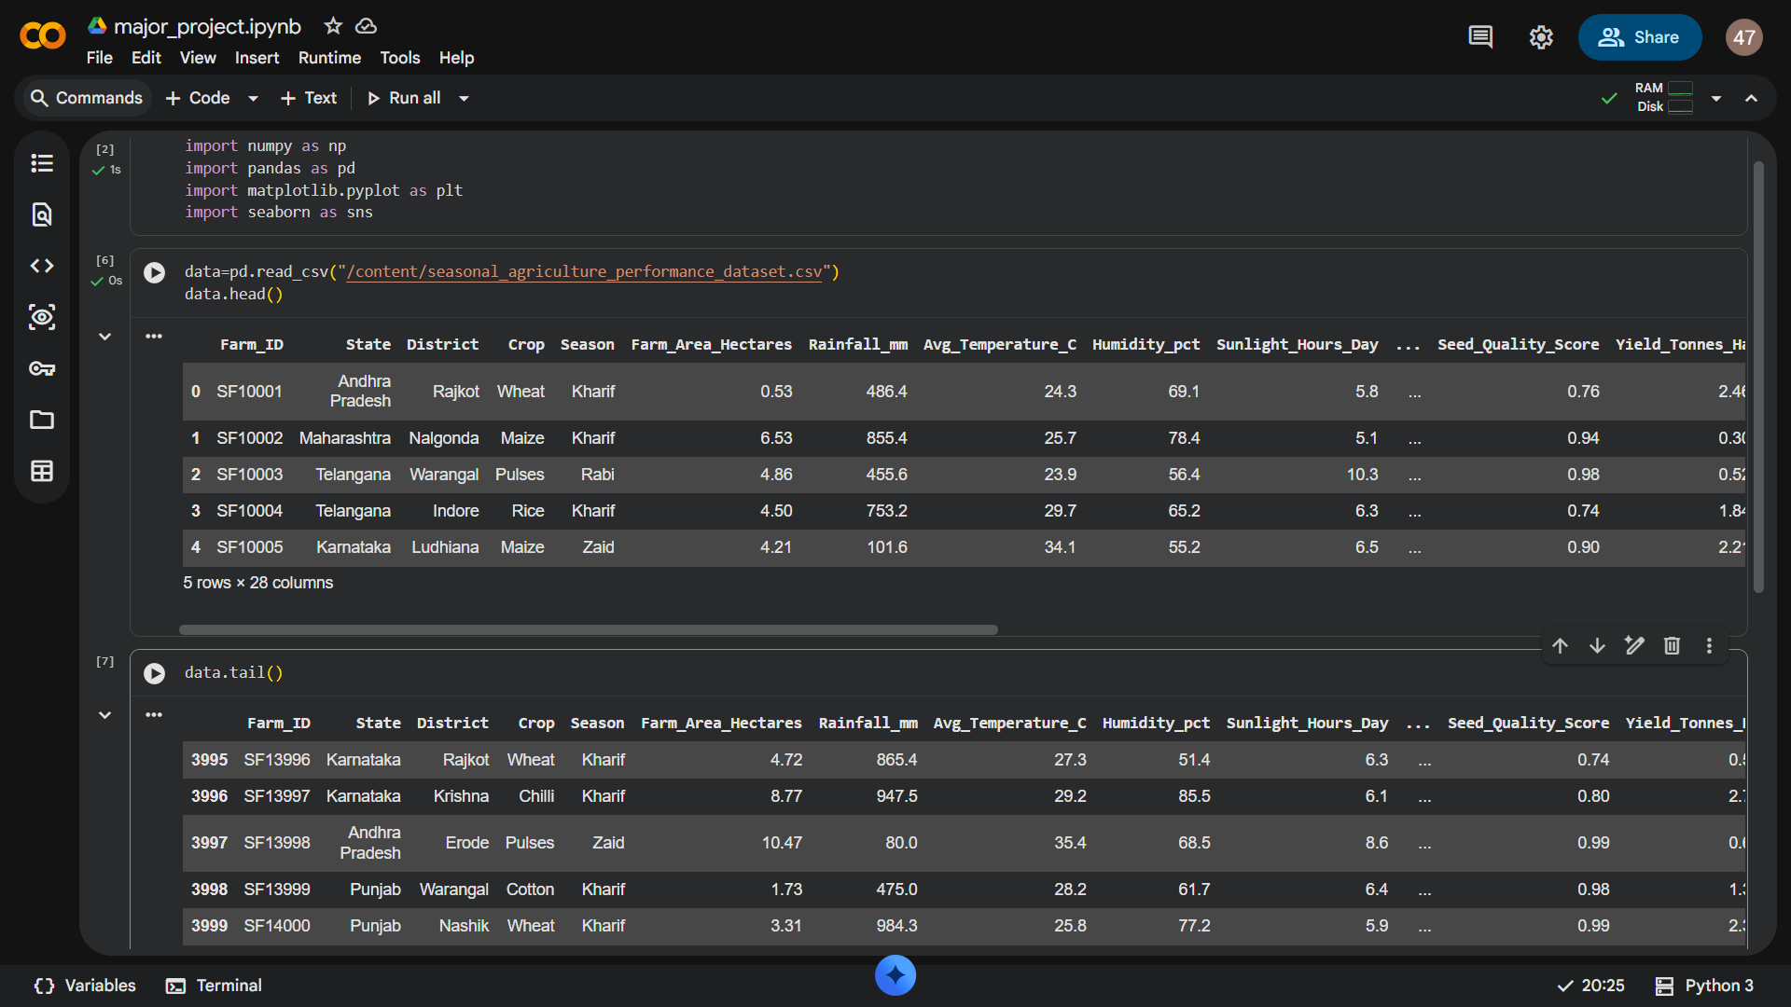
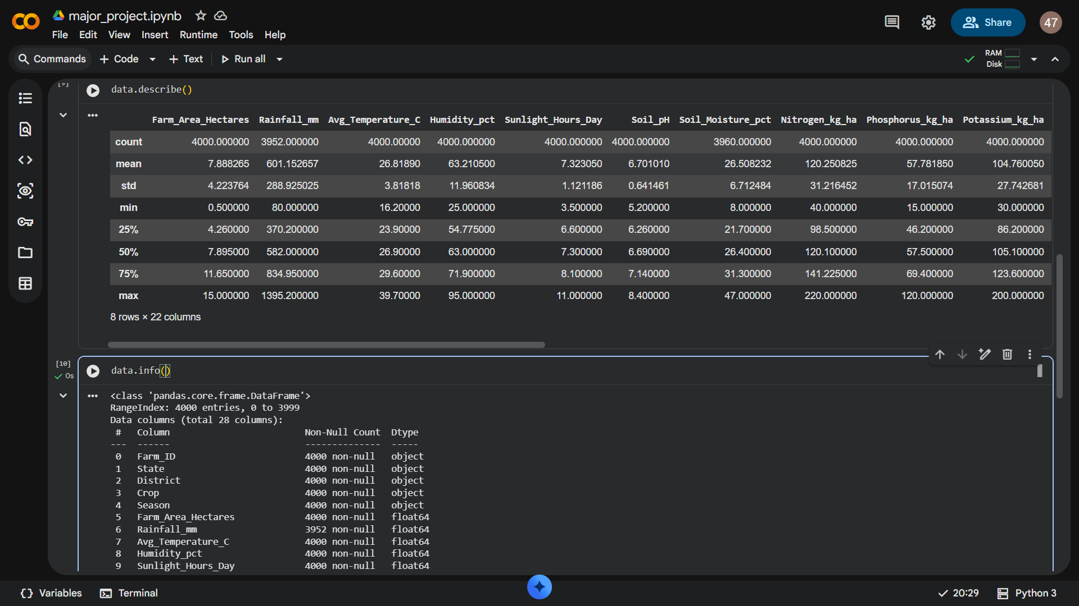
RESULTS

Slide 7
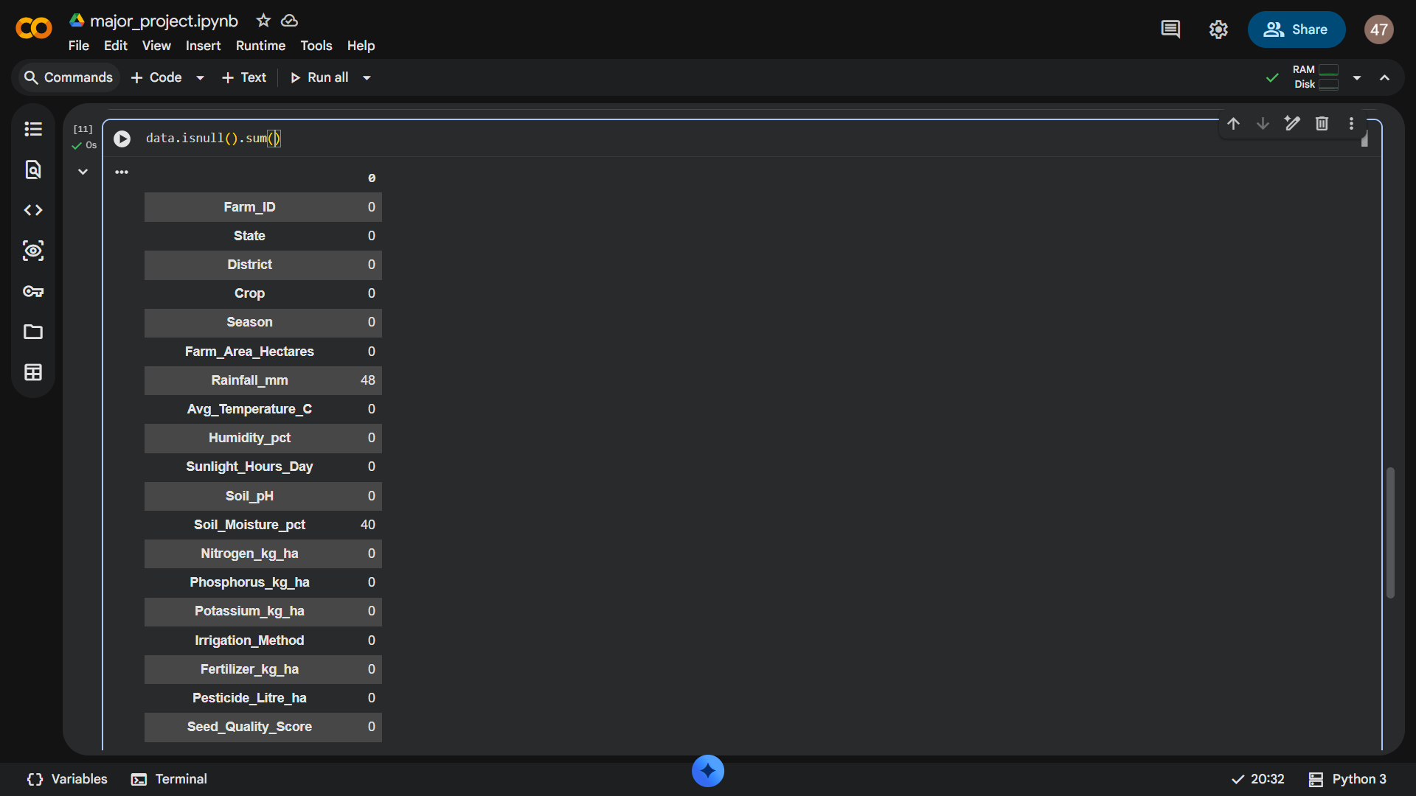
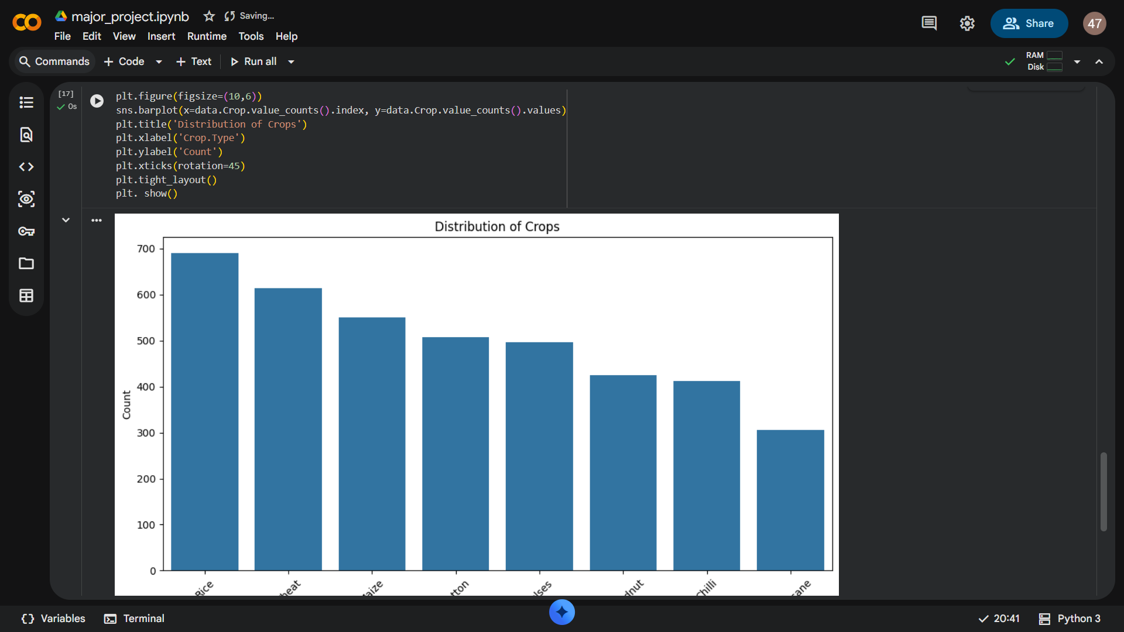
RESULTS
[Add screen shots of your code ]

Slide 8
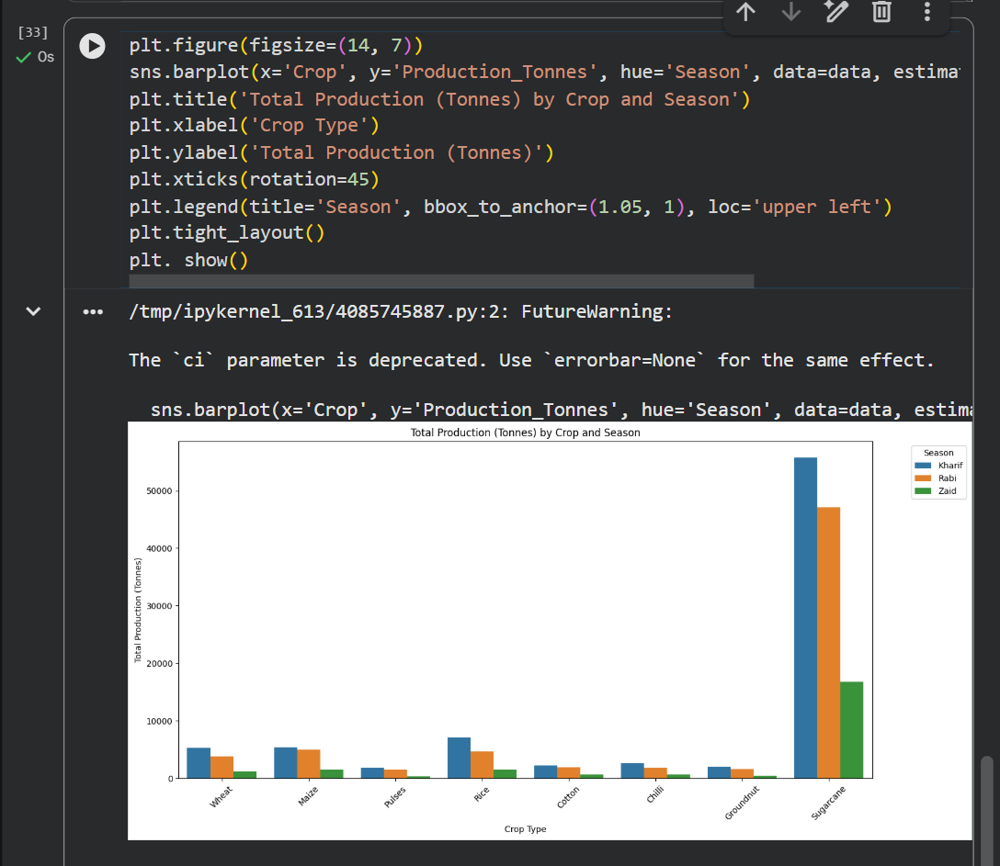
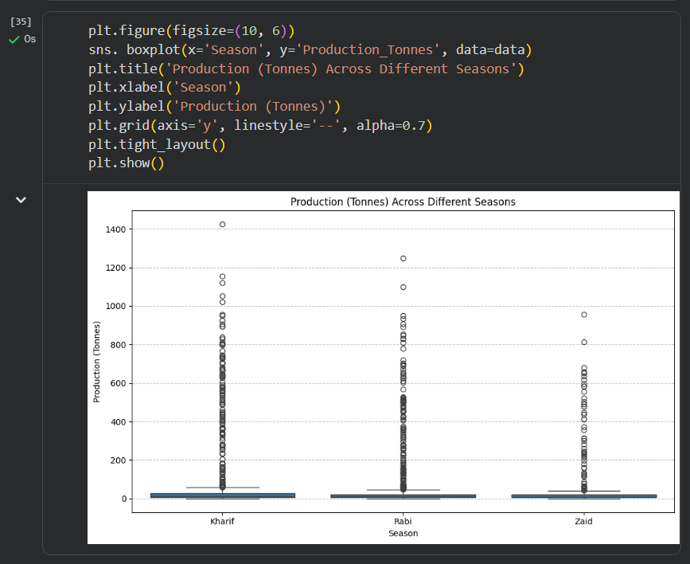
RESULTS

Slide 9
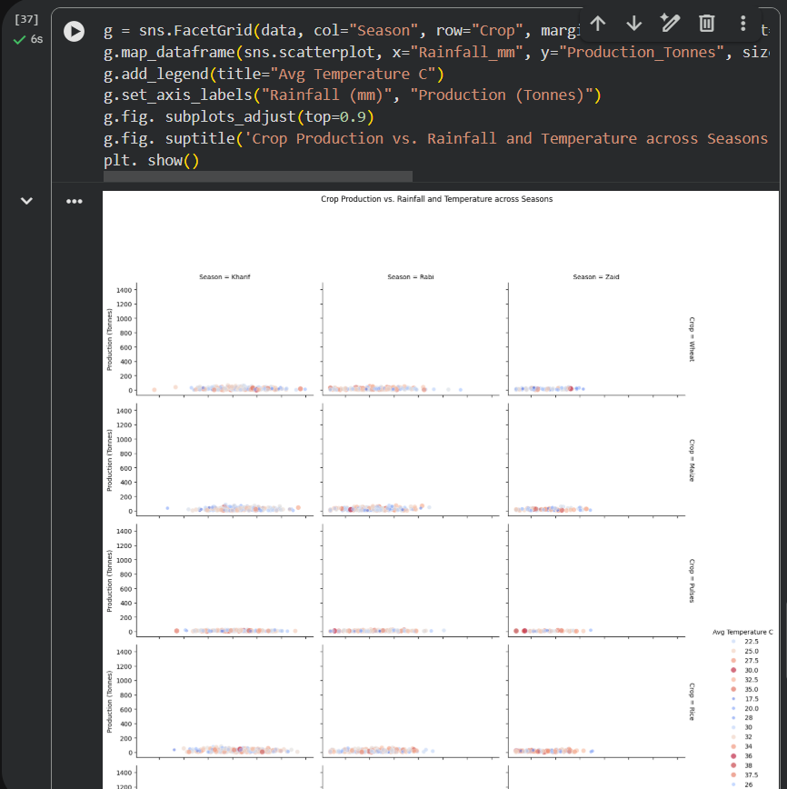
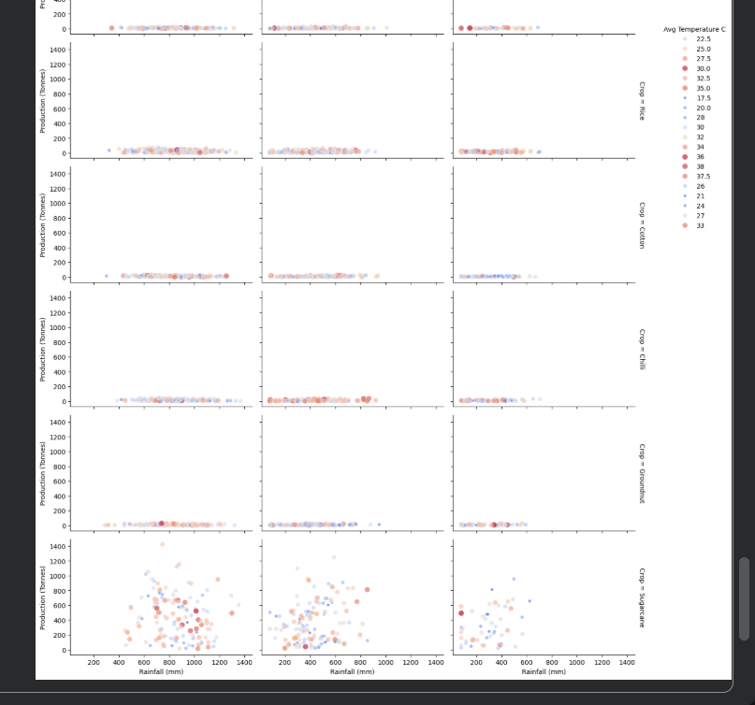
RESULTS
[Add screen shots of your code ]

Slide 10
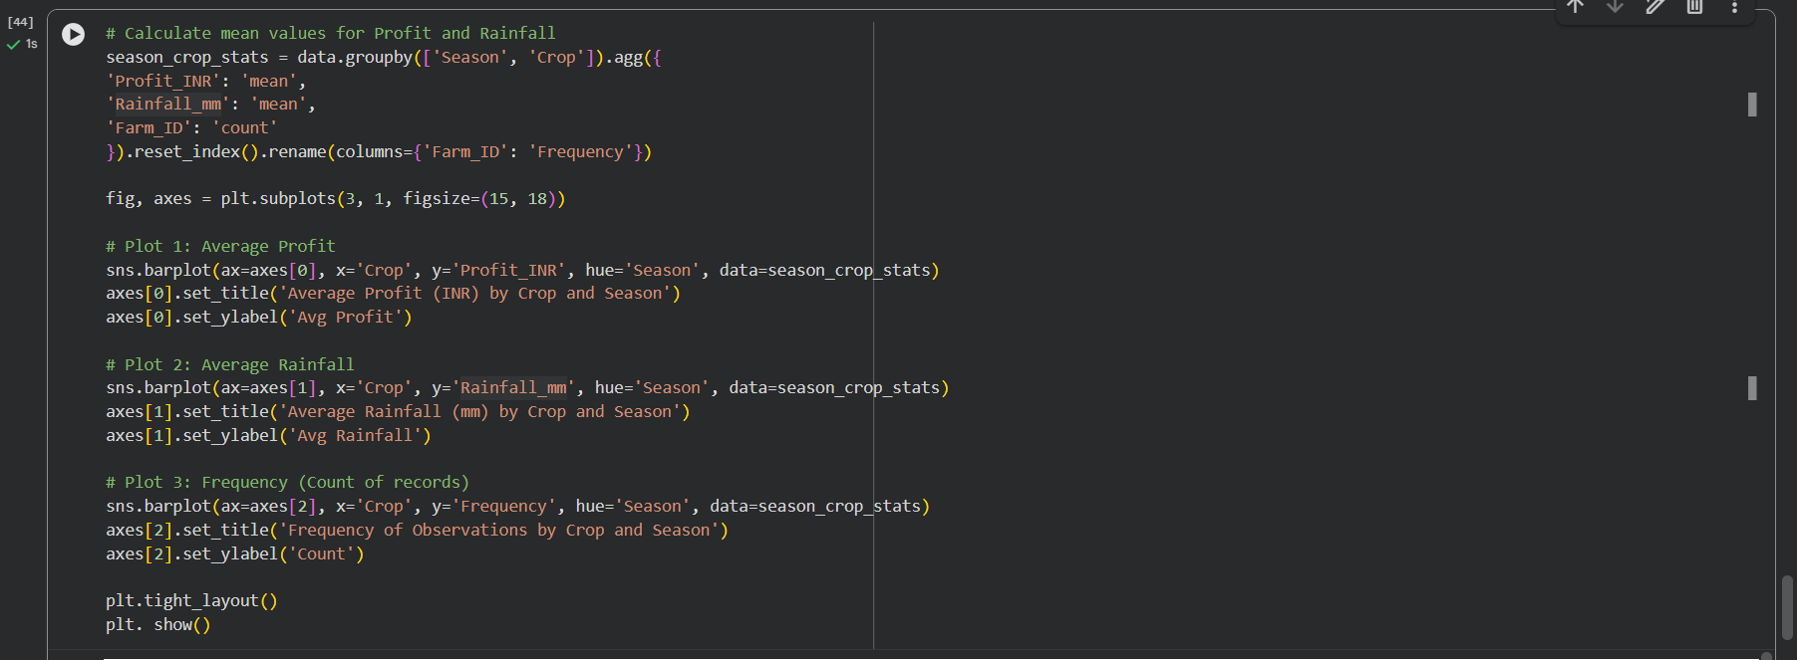
RESULTS
[Add screen shots of your code ]

Slide 11
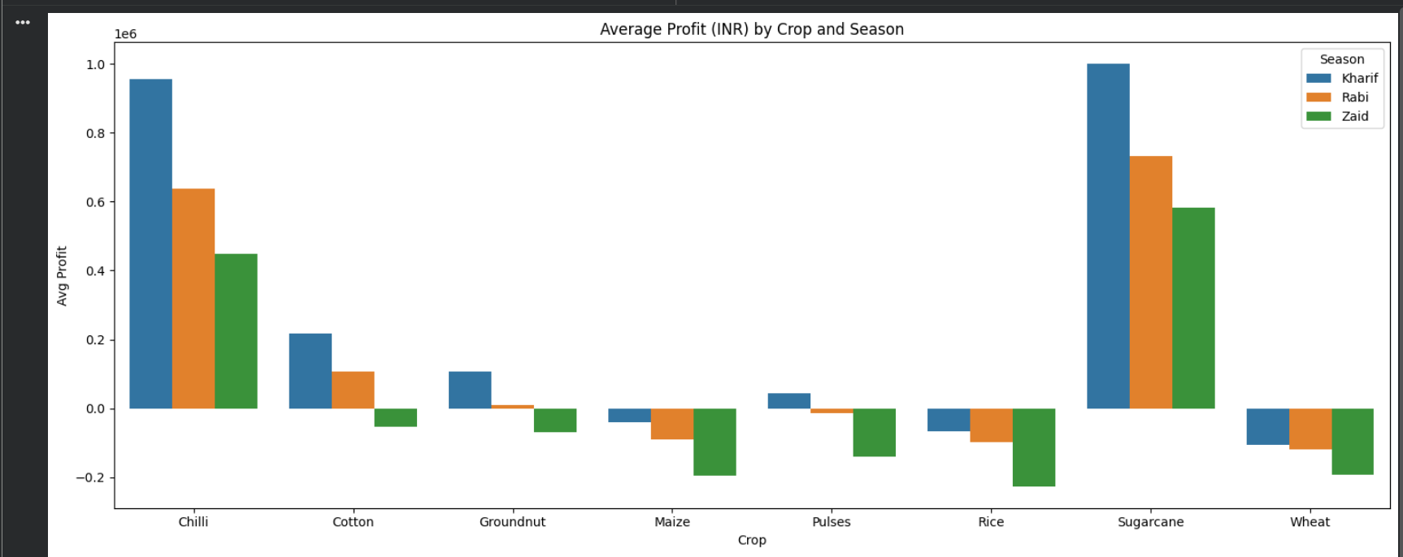
RESULTS
[Add screen shots of your code ]

Slide 12
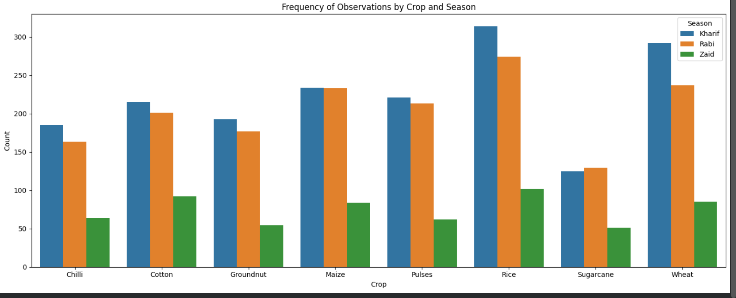
RESULTS
[Add screen shots of your code ]

Slide 13
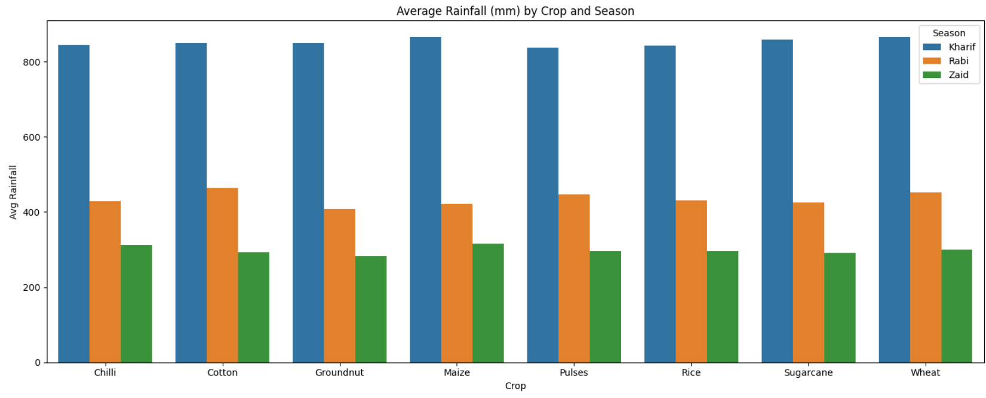
RESULTS
[Add screen shots of your code ]

Slide 14
Future scope
People can have seasonal preferences
Industrial product design
Better planning
Better growth
Higher yields
Economical design

Slide 15
GitHub Link
https://github.com/sharafalikt79-prog/Seasonal-Agriculture-Performance-Analysis-

Slide 16
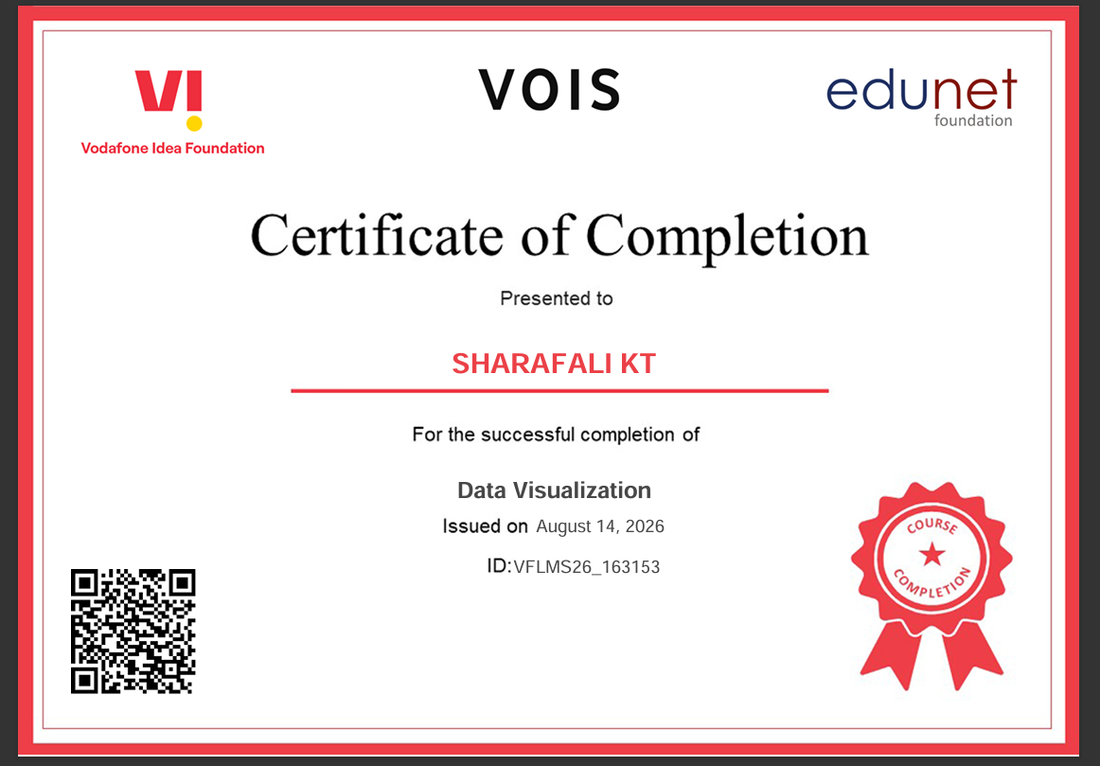
VOIS Course completion certificate - Course name- Data Visualization

Slide 17
Thank you
By
SHARAFALI KT
STU6a6b0e20d74011785400864
.
.

