Slide 1


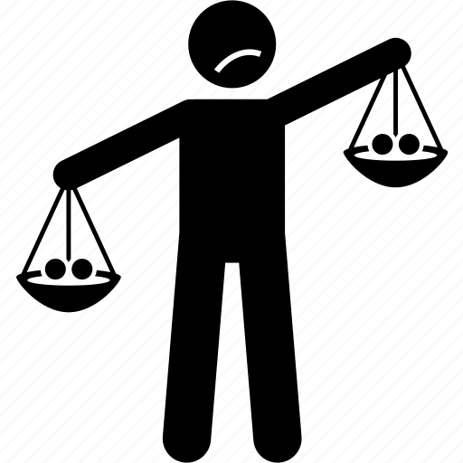


SGM
issues
Race and
globalism
Framing
Politicization
Mpox
Partisan
politics
Public
health
Motivated
reasoning
Public
attitudes

