Slide 1
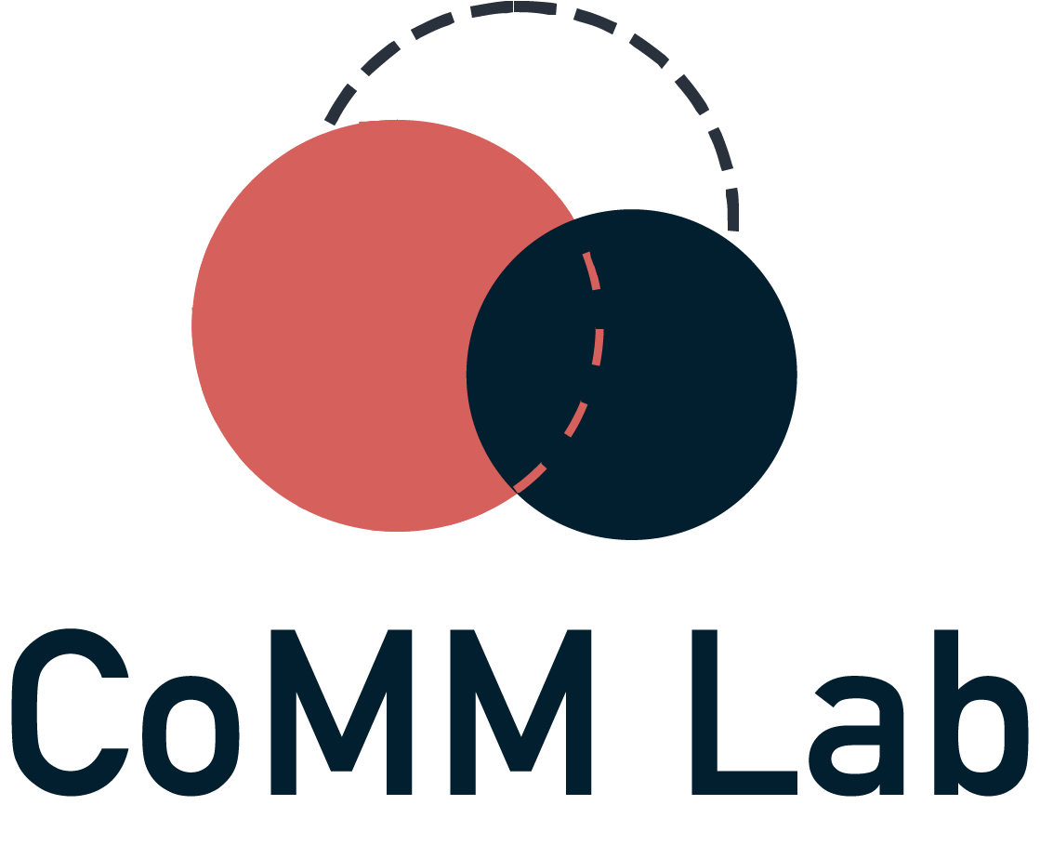


INTERMEDIA FRAME-BUILDING NETWORKS
DURING THE MPOX EPIDEMIC
Network Science X, 2025
Collaborators: Samuel Scarpino, Brooke Foucault Welles
Sharaj Kunjar
17th January 2025

Slide 2

1
Motivation

Slide 3



2
Mpox Epidemic, 2022
Mpox (formerly known as “monkeypox”) Clade II virus spread through skin-to-skin and community transmission across the globe for the first time in 2022.
32, 063 cases and 58 deaths in the U.S. and a global health emergency between 23rd July 2022 and 10th May 2023.
Primarily among contact networks of Sexual and Gender Minorities (SGMs), with 95.2% cases among Men who have Sex with Men (MSMs)
Motivation

Slide 4
3
“We need to have a sex-positive approach to educating people”
“Stigma and discrimination can be as dangerous as any virus”
“Its not a gay disease, but it's happening among men who have sex with men”
“British officials have told those suffering from monkeypox that they should abstain from sex”
“The chief vector of Monkeypox spread is sex between two men”
“Yes, Fauci, Monkeypox Is a Gay Disease”
Motivation

Slide 5
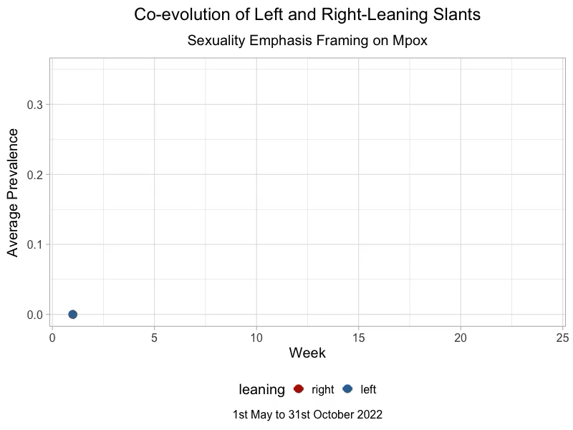
4
How do health controversies unfold through reactive patterns of influence between left and right-leaning outlets?
Motivation

Slide 6
5
Literature
Review

Slide 7
6
Agenda-setting theory
Mass media shapes public perceptions of reality by publicizing select issues and affecting what people think about (McCombs and Shaw, 1972)
Intermedia agenda-setting theory posits that media outlets shape each other’s agendas (Vonbun, 2016) by co-orienting journalists towards specific issues.
Networked evidence of intermedia agenda-setting shows that this effect is primarily co-partisan, and driven by mainstream left-leaning outlets (Stern 2020, Chen 2024)
Reality
People
Media
Literature review

Slide 8
7
Framing theory
Reality
People
Mass media shapes public perceptions of reality by emphasizing specific aspects about issues and affecting how people think about an issue (Entman 1993)
We have very little idea about how media outlets shape each others’ framing choices, i.e., given an agenda, how is one outlets’ way of talking about it influenced by another?
Media
?
Literature review

Slide 9
8
RQ1
Network: What are the intermedia influence patterns that drove the framing choices between different outlets?
Given
Agenda: What issue was talked about (Mpox)
Frame: How the issue was talked about (emphasis on sexuality)
RQ2
Assortativity: How is intermedia influence affected by outlet partisan affiliation?
RQ3
Centrality: Which outlets are the primary frame-builders?
Research questions

Slide 10
9
Data and methods

Slide 11
10
Data mining
Data processing
7721 news articles from Mediacloud
5756 articles scraped from newspaper4k
4142 articles after processing
594 articles chosen for annotation
Time series over 6 months (May-October 2022) for
16 national level news outlets in the US
denoting number of articles published with specific frames
Codebook based manual annotation
Identification of
frames
Data classification
(Applied thematic analysis)
Final dataset
Dataset

Slide 12
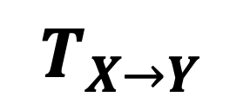
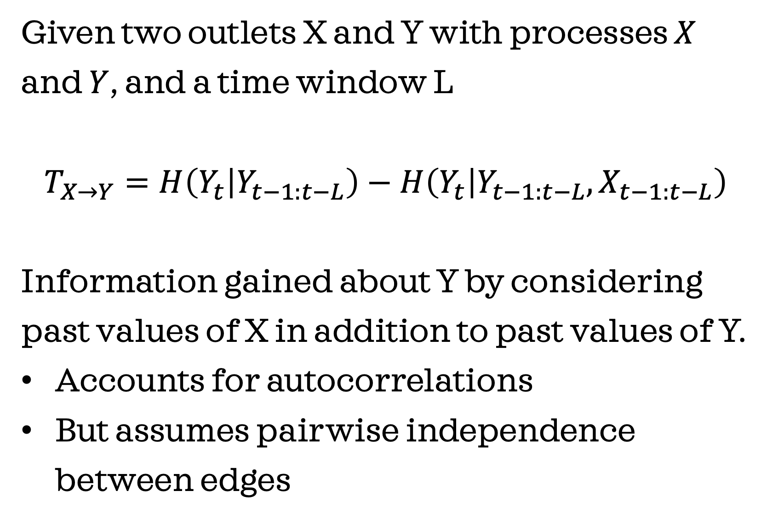
11
Transfer entropy
Given two outlets X and Y with processes $X$ and $Y$, and a time window L
$$T_{X→Y}=H\left(Y_{t} | Y_{t−1:t−L}\right)−H\left(Y_{t} | Y_{t−1:t−L},X_{t−1:t−L}\right)$$
Information gained about Y by considering past values of X in addition to past values of Y.
Accounts for autocorrelations
But assumes pairwise independence between edges
Outlet X
$$T_{X→Y}$$
Outlet Y
Outlet Z
Methods: Network inference
Notes:
Confounders

Slide 13
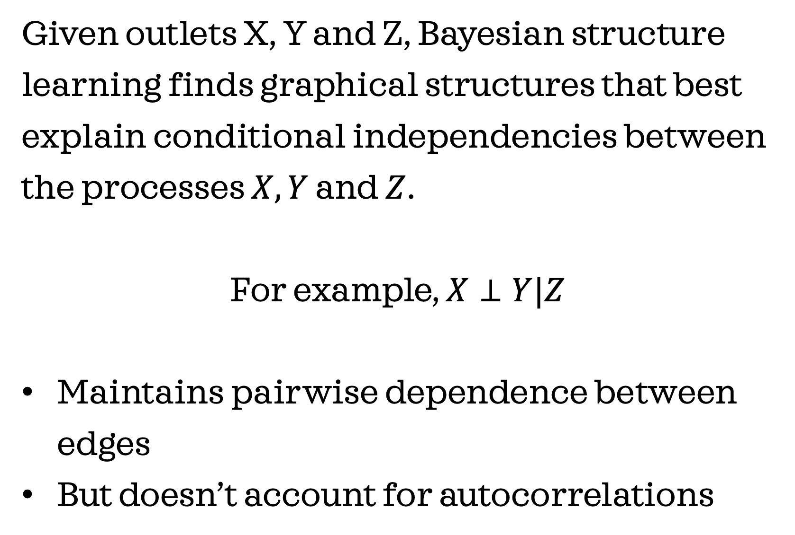
12
Bayesian structure learning
Given outlets X, Y and Z, Bayesian structure learning finds graphical structures that best explain conditional independencies between the processes $X, Y$ and $Z$.
For example, $X⊥Y|Z$
Maintains pairwise dependence between edges
But doesn’t account for autocorrelations
Outlet X
Outlet Y
Outlet Z
Methods: Network inference

Slide 14
13
Our approach
Compute transfer entropy between pairs of outlets
Blacklist insignificant edges (~85% of all edges)
Perform Bayesian structure learning with the blacklist as the constraint.
References: RTransferEntropy, bnlearn
Outlet X
Outlet Y
Outlet Z
Methods: Network inference

Slide 15
14
Results

Slide 16
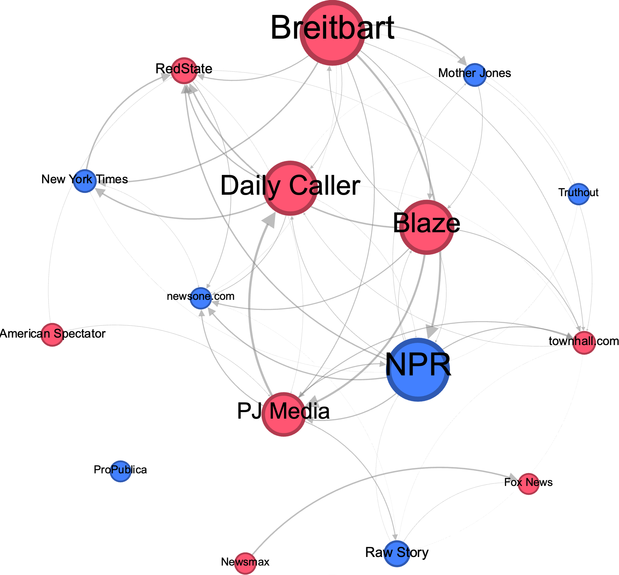
15
Network:
15/16 nodes are in the giant connected component, indicating support for intermedia influence.
Frame-building network with: 16 nodes (9 left, 7 right)
Node size indicates outdegree Edge weight indicates size of influence Plotted with FR layout in Gephi
Results

Slide 17
16
Central nodes:
Contrary to prior work, central actors are right-leaning and less credible outlets such as PJ Media, Blaze and Breitbart.
Frame-building network with: 16 nodes (9 left, 7 right)
Node size indicates outdegree Edge weight indicates size of influence Plotted with FR layout in Gephi
Results

Slide 18
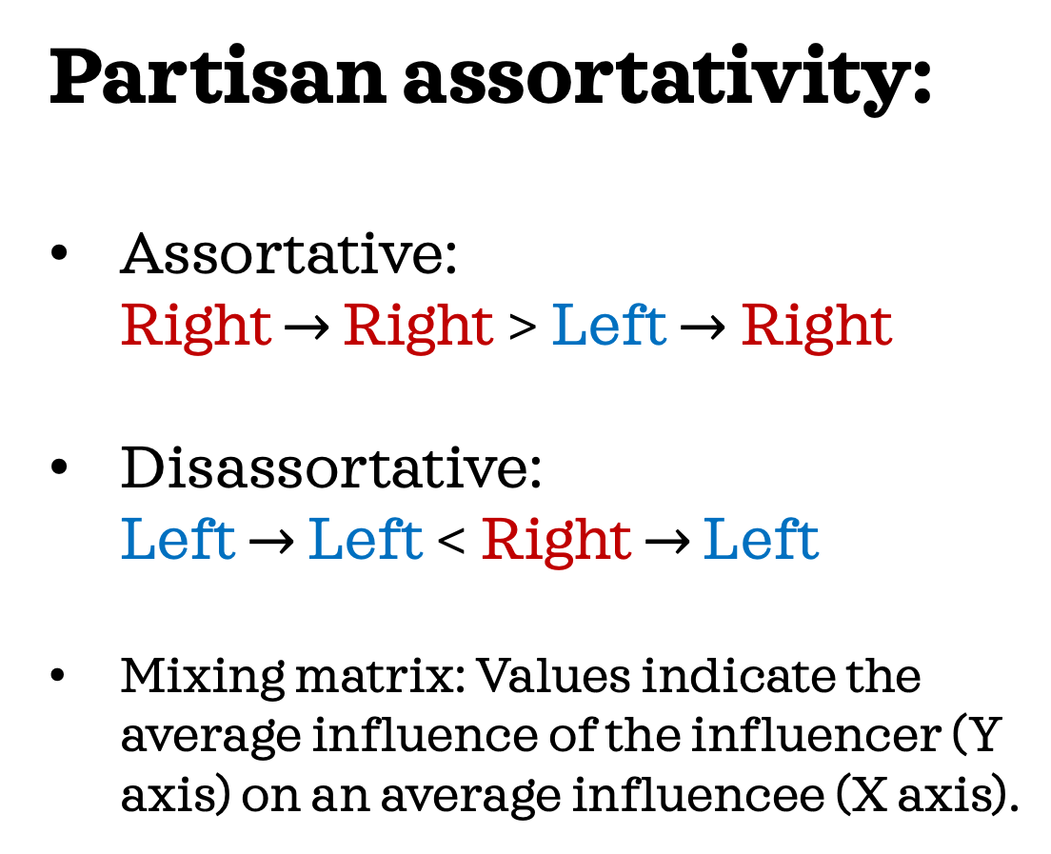
17
Partisan assortativity:
Assortative: Right $→$ Right > Left $→$Right
Disassortative: Left $→$ Left < Right $→$ Left
Mixing matrix: Values indicate the average influence of the influencer (Y axis) on an average influencee (X axis).
Results

Slide 19
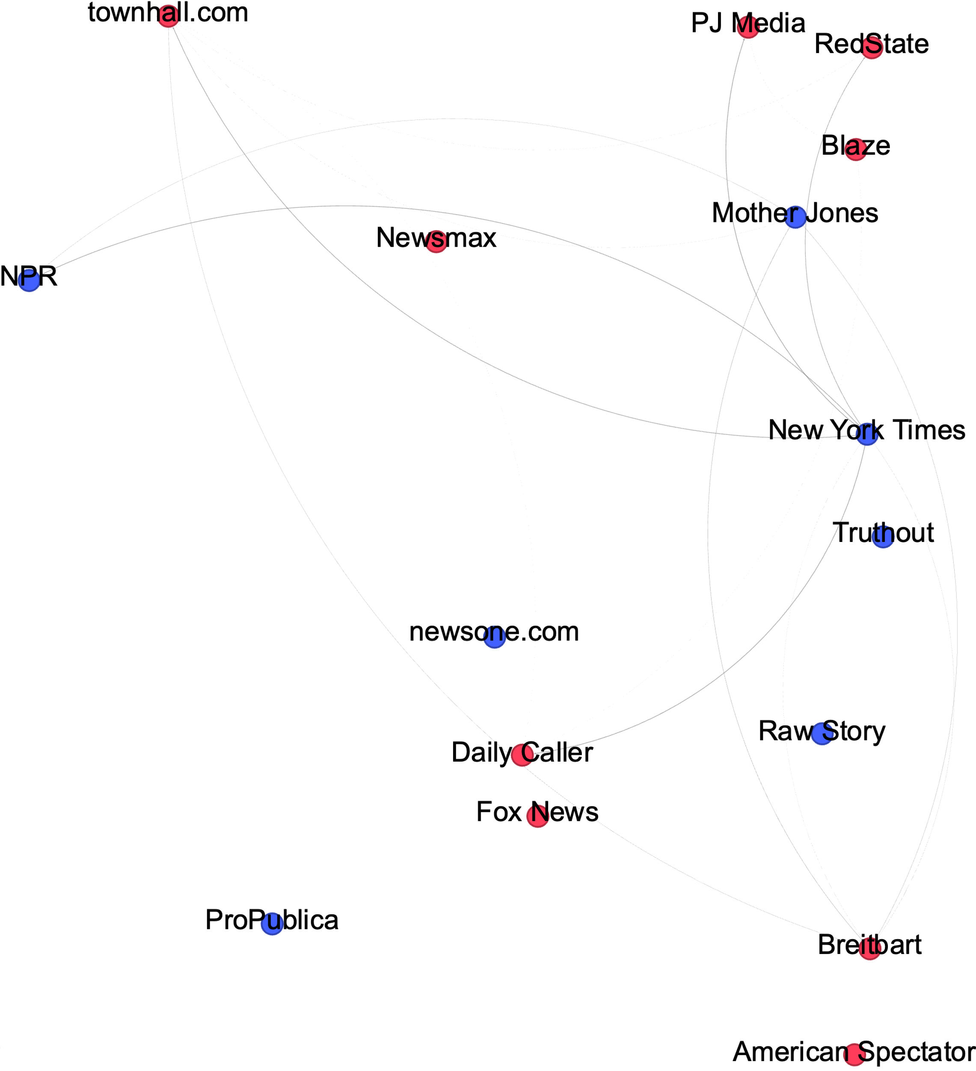
Results are peculiar to competitive framing!
Results

Slide 20
18
Conclusion

Slide 21
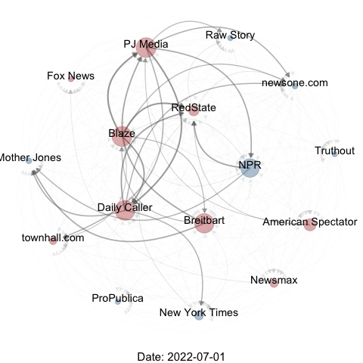
19
To summarize:
Framing choices are primarily driven by right-leaning and fringe outlets.
Intermedia frame-building is often cross-partisan and reactive, i.e., the left and right leaning outlets enable each other.
Social network inference can be an effective way to demonstrate such reactive patterns that give rise to health controversies.
Conclusion

Slide 22
20
Limitations and future directions:
The inference methods used do not imply strict causation. External factors, spurious autocorrelations etc. could still play a role.
The case study is based on a singular agenda and emphasis frame, and hence a broader analysis is required for generalizable results.
Conclusion

Slide 23

Summary:
Framing choices are primarily driven by right-leaning and fringe outlets.
Frame-building is often cross-partisan and reactive, i.e., the left and right leaning outlets enable each other.
To learn more and
get in touch!
Network Science X, 2025
Collaborators: Samuel Scarpino, Brooke Foucault Welles
Sharaj Kunjar
17th January 2025

