Slide 1
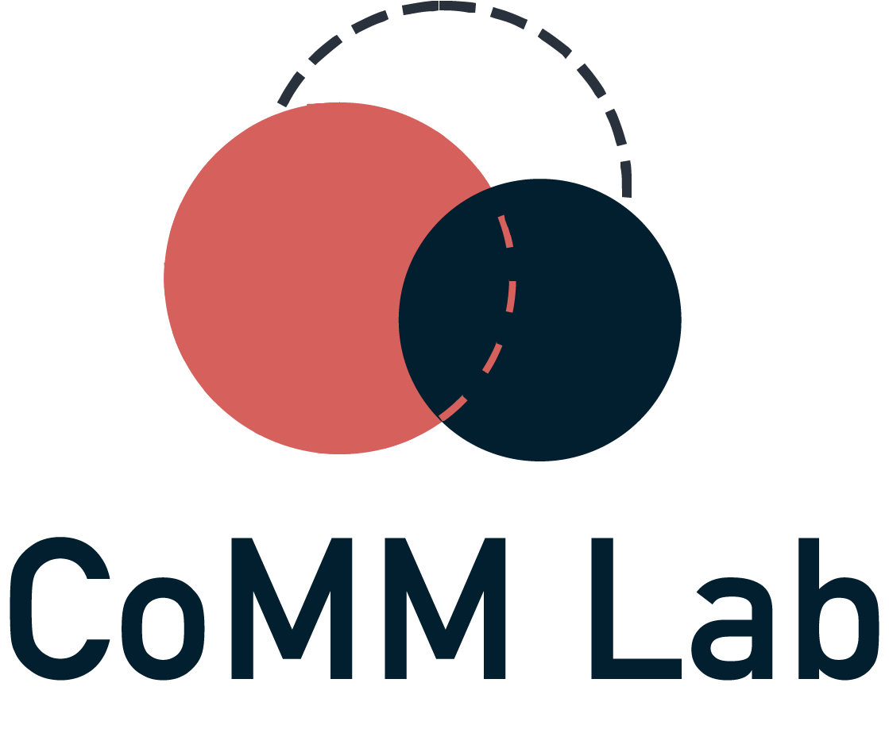

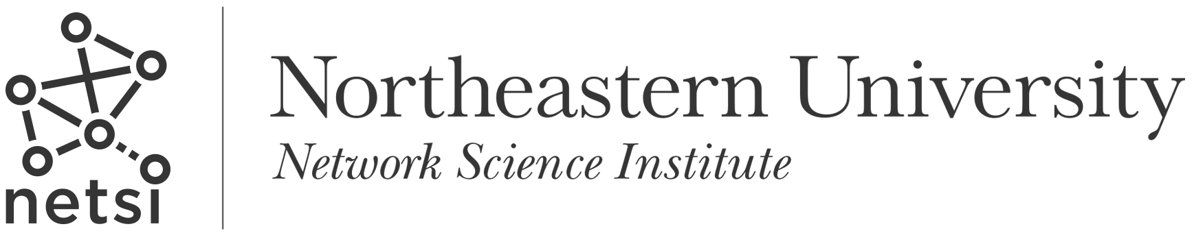
INTERMEDIA FRAME-BUILDING NETWORKS
DURING THE MPOX EPIDEMIC
ICA 2025: Computational Methods Division
Collaborators: Samuel Scarpino, Brooke Foucault Welles
Sharaj Kunjar
15th June 2025
Notes:
High level and ongoing work
Methods section will be brief – I’m spending this time to tell a story, explicate my hypothesis and seek datasets/collaborators

Slide 2

Motivation
Notes:
How did I come across the problem?

Slide 3



1
Mpox Epidemic, 2022
Mpox (formerly known as “monkeypox”) Clade II virus spread through skin-to-skin and community transmission across the globe for the first time in 2022.
32, 063 cases and 58 deaths in the U.S. and a global health emergency between 23rd July 2022 and 10th May 2023.
Primarily among contact networks of Sexual and Gender Minorities (SGMs), with 95.2% cases among Men who have Sex with Men (MSMs)
Motivation

Slide 4
2
“We need to have a sex-positive approach to educating people”
“Stigma and discrimination can be as dangerous as any virus”
“Its not a gay disease, but it's happening among men who have sex with men”
“British officials have told those suffering from monkeypox that they should abstain from sex”
“The chief vector of Monkeypox spread is sex between two men”
“Yes, Fauci, Monkeypox Is a Gay Disease”
Motivation
Notes:
Very interesting coverage about the role of sex and sexual orientation

Slide 5
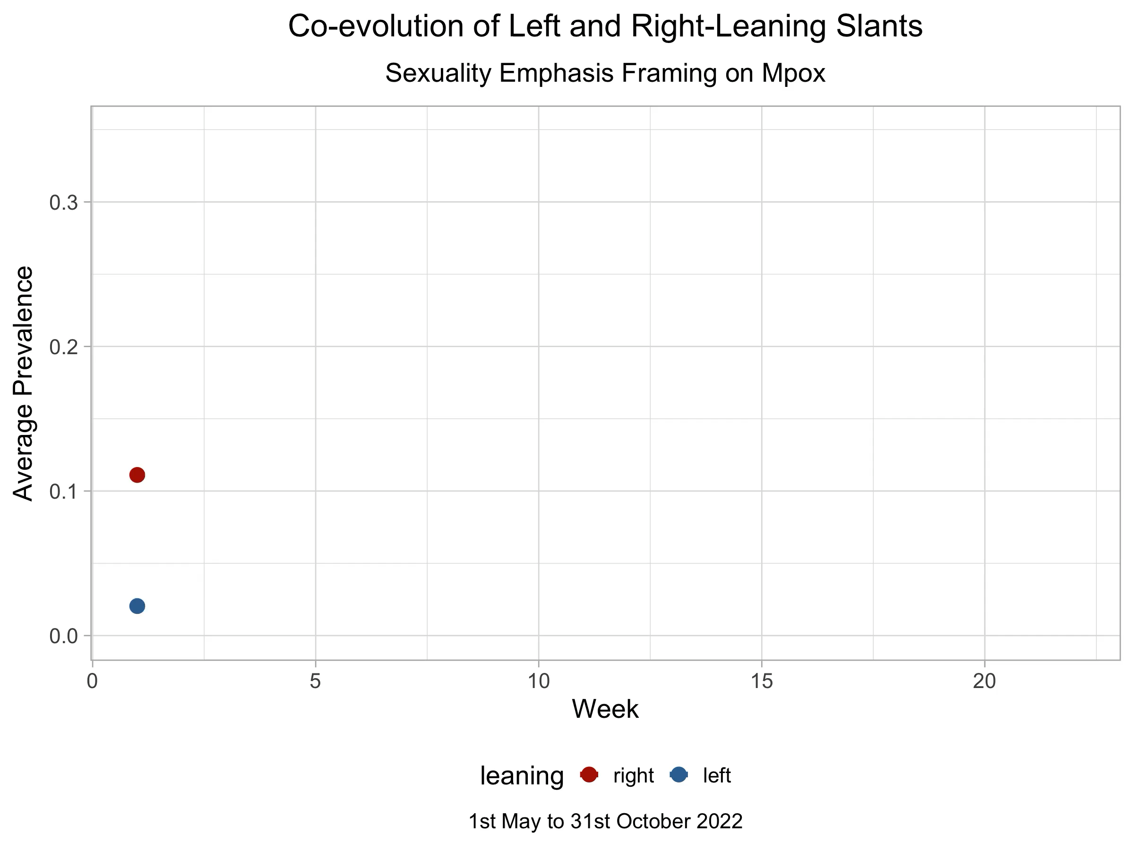
3
How do health controversies unfold through reactive patterns of influence between left and right-leaning outlets?
Motivation
Notes:
So it seems like NPR and Fox news are riffing off of each other
This phenomenon isn’t new in itself – for e.g. in election campaigning….

Slide 6
Background

Slide 7
5
Framing theory
Reality
People
Emphasis framing: Mass media shapes public perceptions of reality by emphasizing specific aspects about issues and affecting how people think about that issue (Entman 1993)
We have very little idea about how media outlets shape each others’ framing choices, i.e., given an agenda of discussion, how is one outlets’ way of talking about it influenced by another?
Media
?
Literature review

Slide 8
6
Intermedia influence
Studies on intermedia agenda-setting show that mainstream left-leaning outlets (e.g. NPR, NYT) tend to be the primary agenda-setters (Chen 2024, Stern 2020)
Studies on intermedia frame-building are limited to influence between platforms (Twitter to news media), rather than a more fine-grained influence between individual media outlets within the same platform (Wang and Guo 2018, Wang 2023).
Literature review

Slide 9
Research questions

Slide 10
7
RQ1
Central actors: What outlets influence framing choices the most?
Given
Agenda: What issue was talked about (e.g. Mpox)
Frame: How the issue was talked about (e.g. emphasis on sexuality)
RQ2
Assortativity: How is intermedia influence mediated by partisan affiliation of the outlets?
RQ3
Mediators: What are the conditions that allow for intermedia influence?
Research questions

Slide 11
Data and methods
Notes:
Going to be super brief about it.

Slide 12
8
Data mining
Data processing
7721 news articles from Mediacloud
5756 articles scraped from newspaper4k
4142 articles after processing
594 articles chosen for annotation
Time series over 6 months (May-October 2022) for
16 national level news outlets in the US
denoting number of articles published with specific frames
Codebook based manual annotation
Identification of
frames
Data classification
(Applied thematic analysis)
Final dataset
Dataset
Notes:
7000 articles are the ones that mention Mpox
Kappa score of 0.62 and accuracy 81%

Slide 13
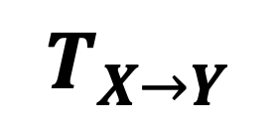
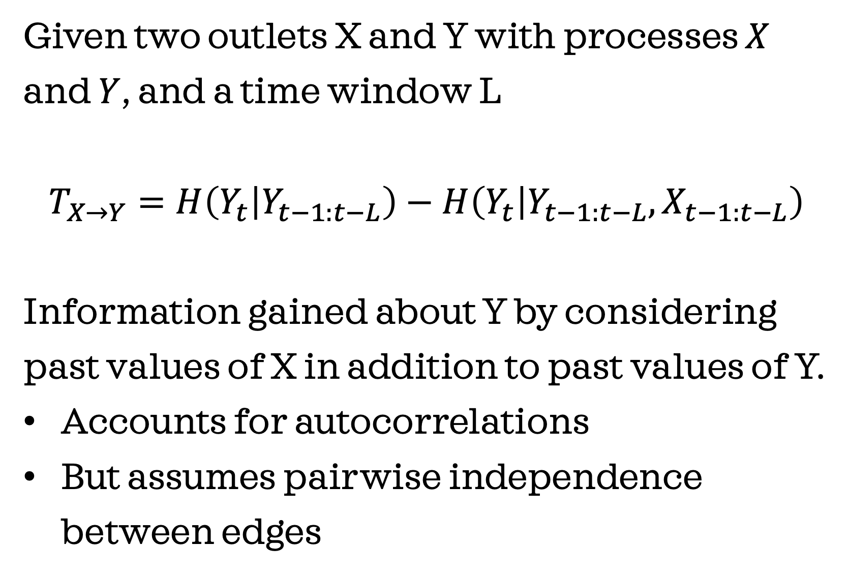
Transfer entropy
Given two outlets X and Y with processes $X$ and $Y$, and a time window L
$$T_{X→Y}=H\left(Y_{t} | Y_{t−1:t−L}\right)−H\left(Y_{t} | Y_{t−1:t−L},X_{t−1:t−L}\right)$$
Information gained about Y by considering past values of X in addition to past values of Y.
Accounts for autocorrelations
But assumes pairwise independence between edges
Outlet X
$$T_{X→Y}$$
Outlet Y
Outlet Z
Methods: Network inference
Notes:
Confounders

Slide 14
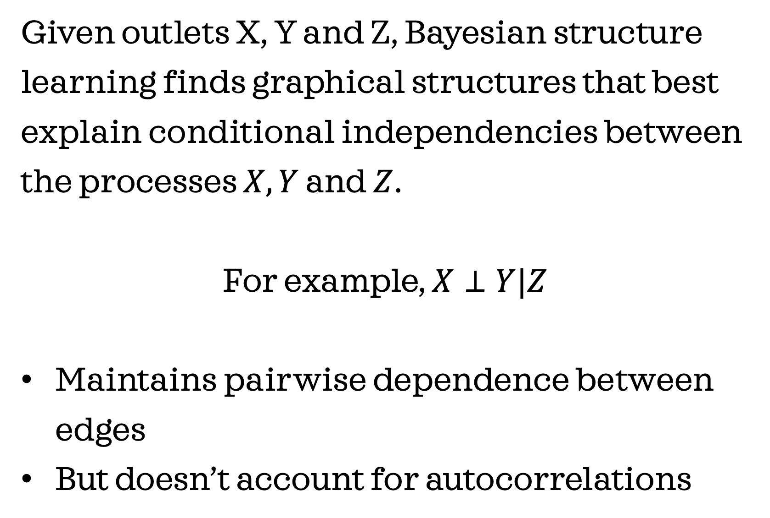
Bayesian structure learning
Given outlets X, Y and Z, Bayesian structure learning finds graphical structures that best explain conditional independencies between the processes $X, Y$ and $Z$.
For example, $X⊥Y|Z$
Maintains pairwise dependence between edges
But doesn’t account for autocorrelations
Outlet X
Outlet Y
Outlet Z
Methods: Network inference

Slide 15
9
Network inference
Compute transfer entropy between pairs of outlets
Blacklist insignificant edges (~85% of all edges)
Perform Bayesian structure learning with the blacklist as the constraint.
References: RTransferEntropy, bnlearn
Outlet X
Outlet Y
Outlet Z
Methods
Notes:
Transfer entropy: is a method that calculates influence between pairs of outlets while accounting for autocorrelations (which is good cos a lot of outlets have styles that are repetitive)
Bayesian structure learning: is a method that that drops the assumption of pairwise independence between edges

Slide 16
12
Results

Slide 17
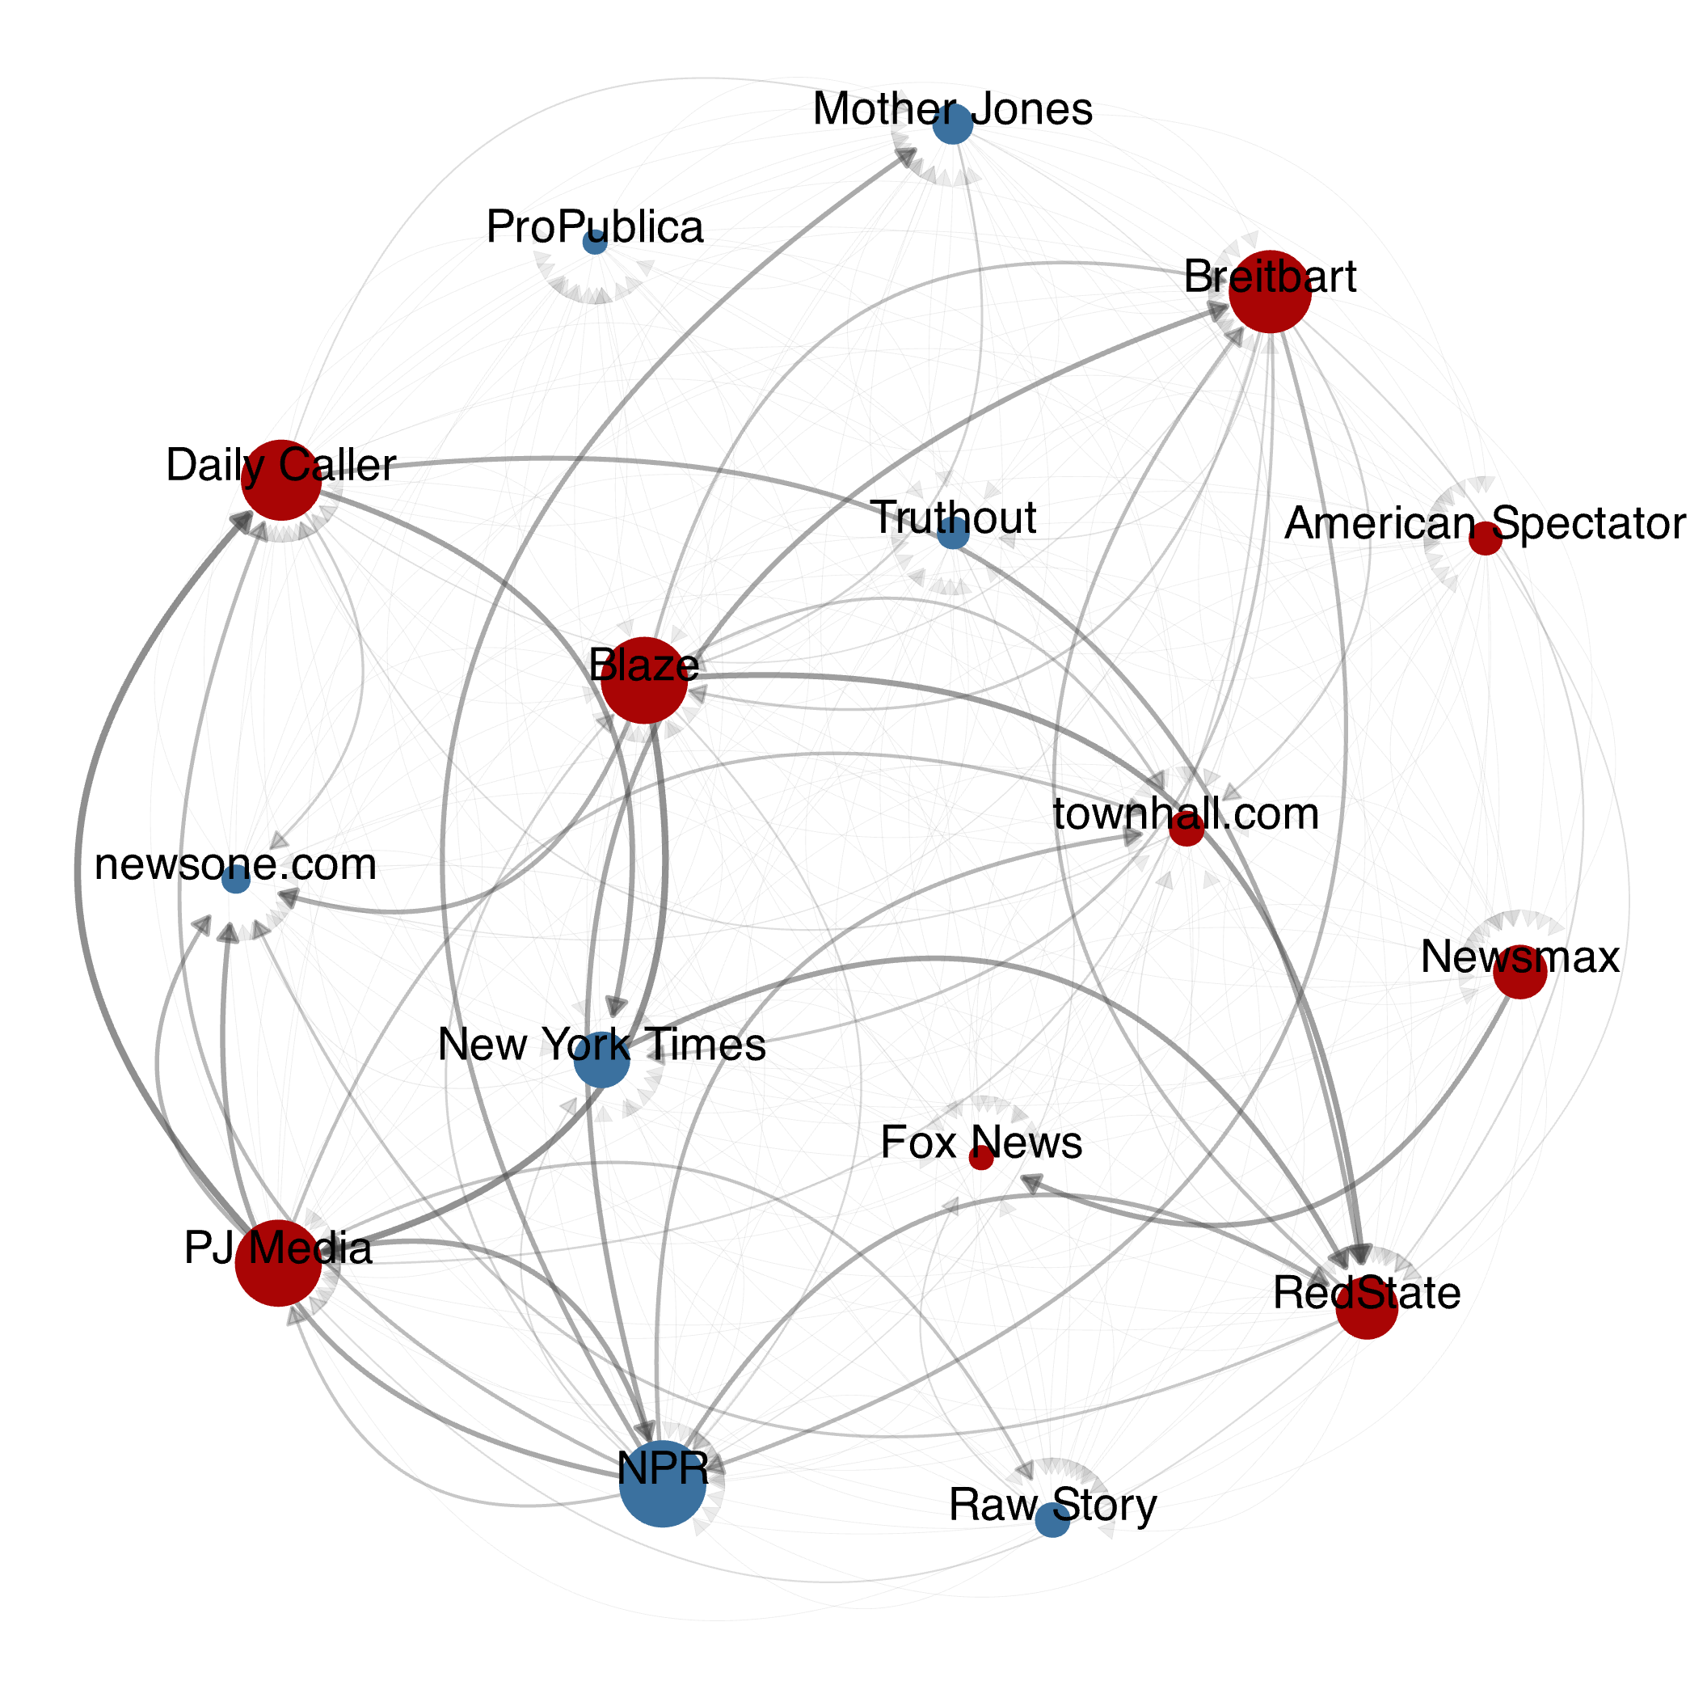
10
Network:
All nodes are in the giant connected component, indicating support for intermedia influence.
Frame-building network with: 16 nodes (9 left, 7 right)
Node size indicates outdegree Edge weight indicates size of influence Plotted with FR layout in igraph
Results

Slide 18
11
Central nodes:
Contrary to prior work, central actors are right-leaning and less credible outlets such as PJ Media, Blaze and Breitbart.
Frame-building network with: 16 nodes (9 left, 7 right)
Node size indicates outdegree Edge weight indicates size of influence Plotted with FR layout in igraph
Results

Slide 19
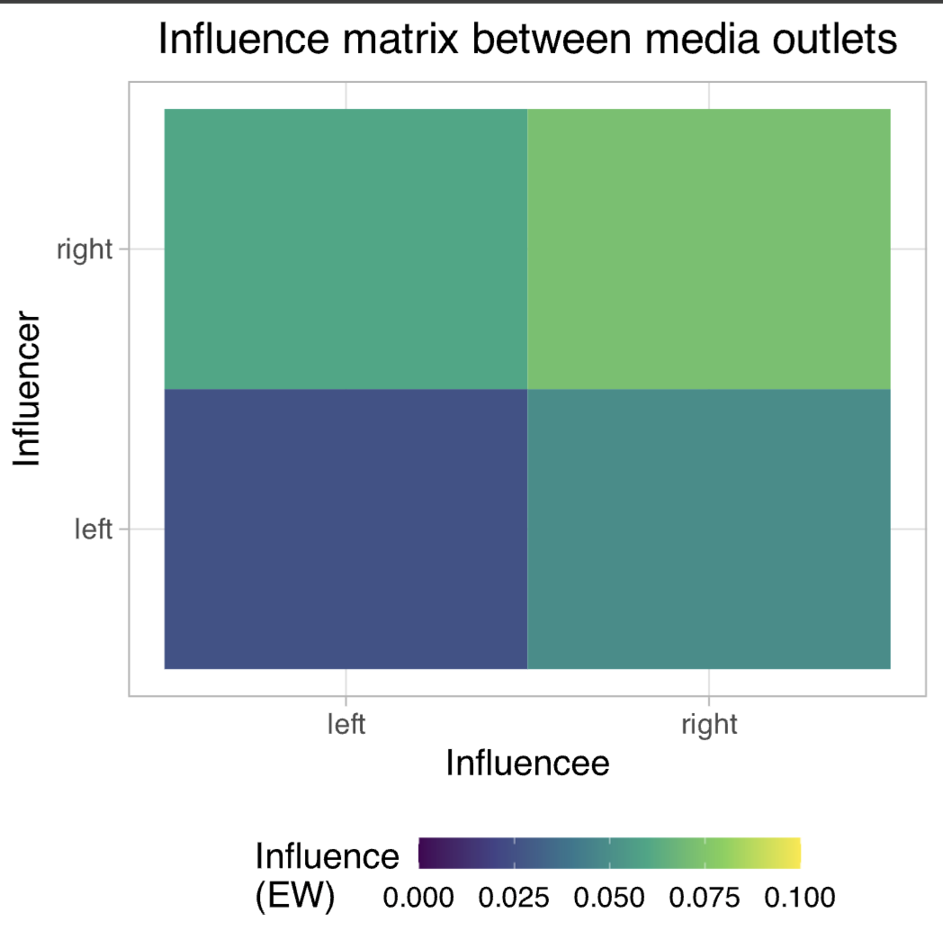
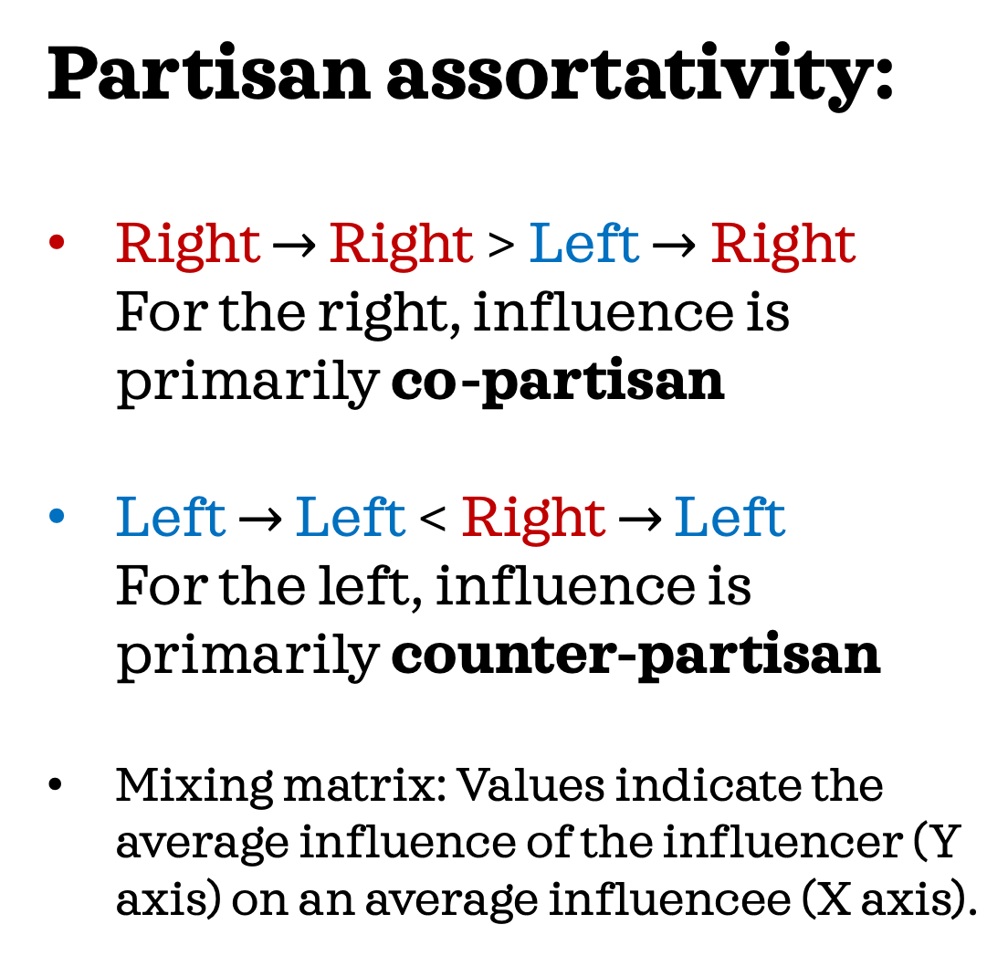
12
Partisan assortativity:
Right $→$ Right > Left $→$Right For the right, influence is primarily co-partisan
Left $→$ Left < Right $→$ Left For the left, influence is primarily counter-partisan
Mixing matrix: Values indicate the average influence of the influencer (Y axis) on an average influencee (X axis).
Results
Notes:
How to read plot?

Slide 20
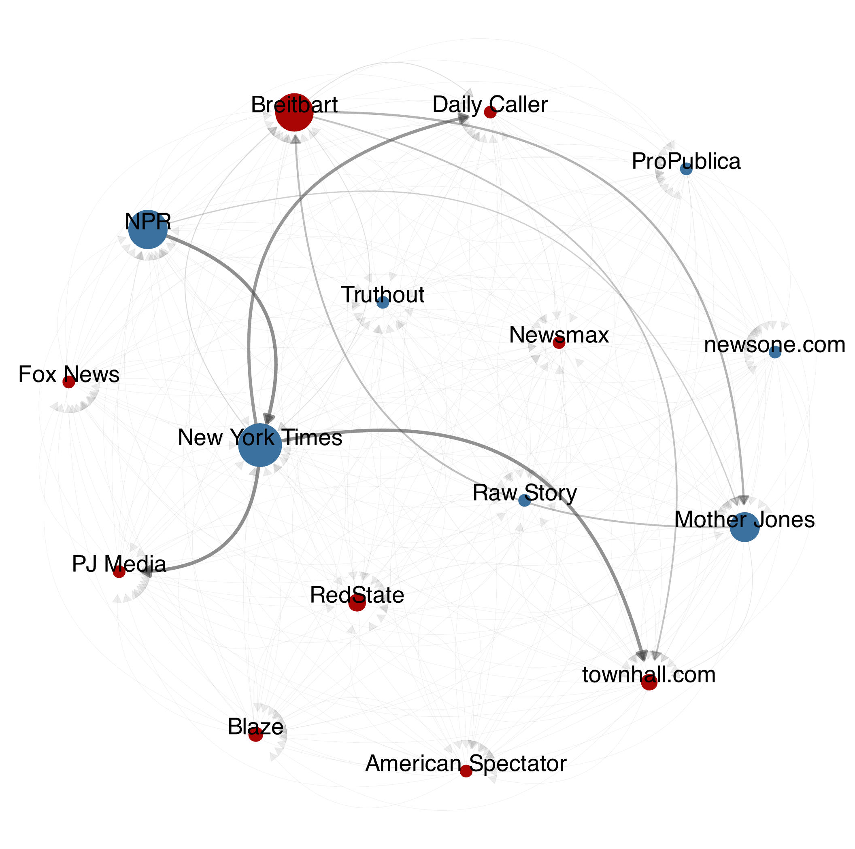
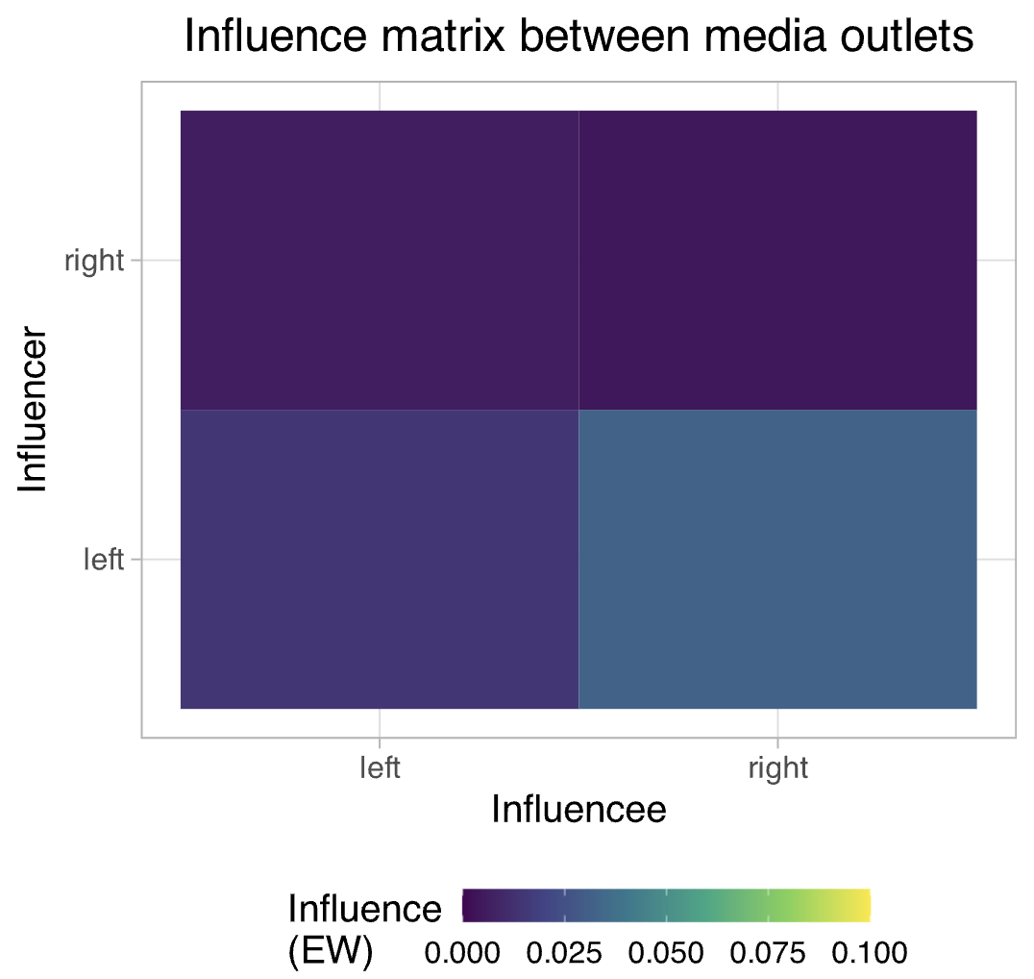
13
Results are peculiar to competitive framing!
Results
Notes:
We recover the agenda-setting results of mainstream outlets being the primary agenda builders
The intermedia influence is also much lower

Slide 21
Conclusion

Slide 22
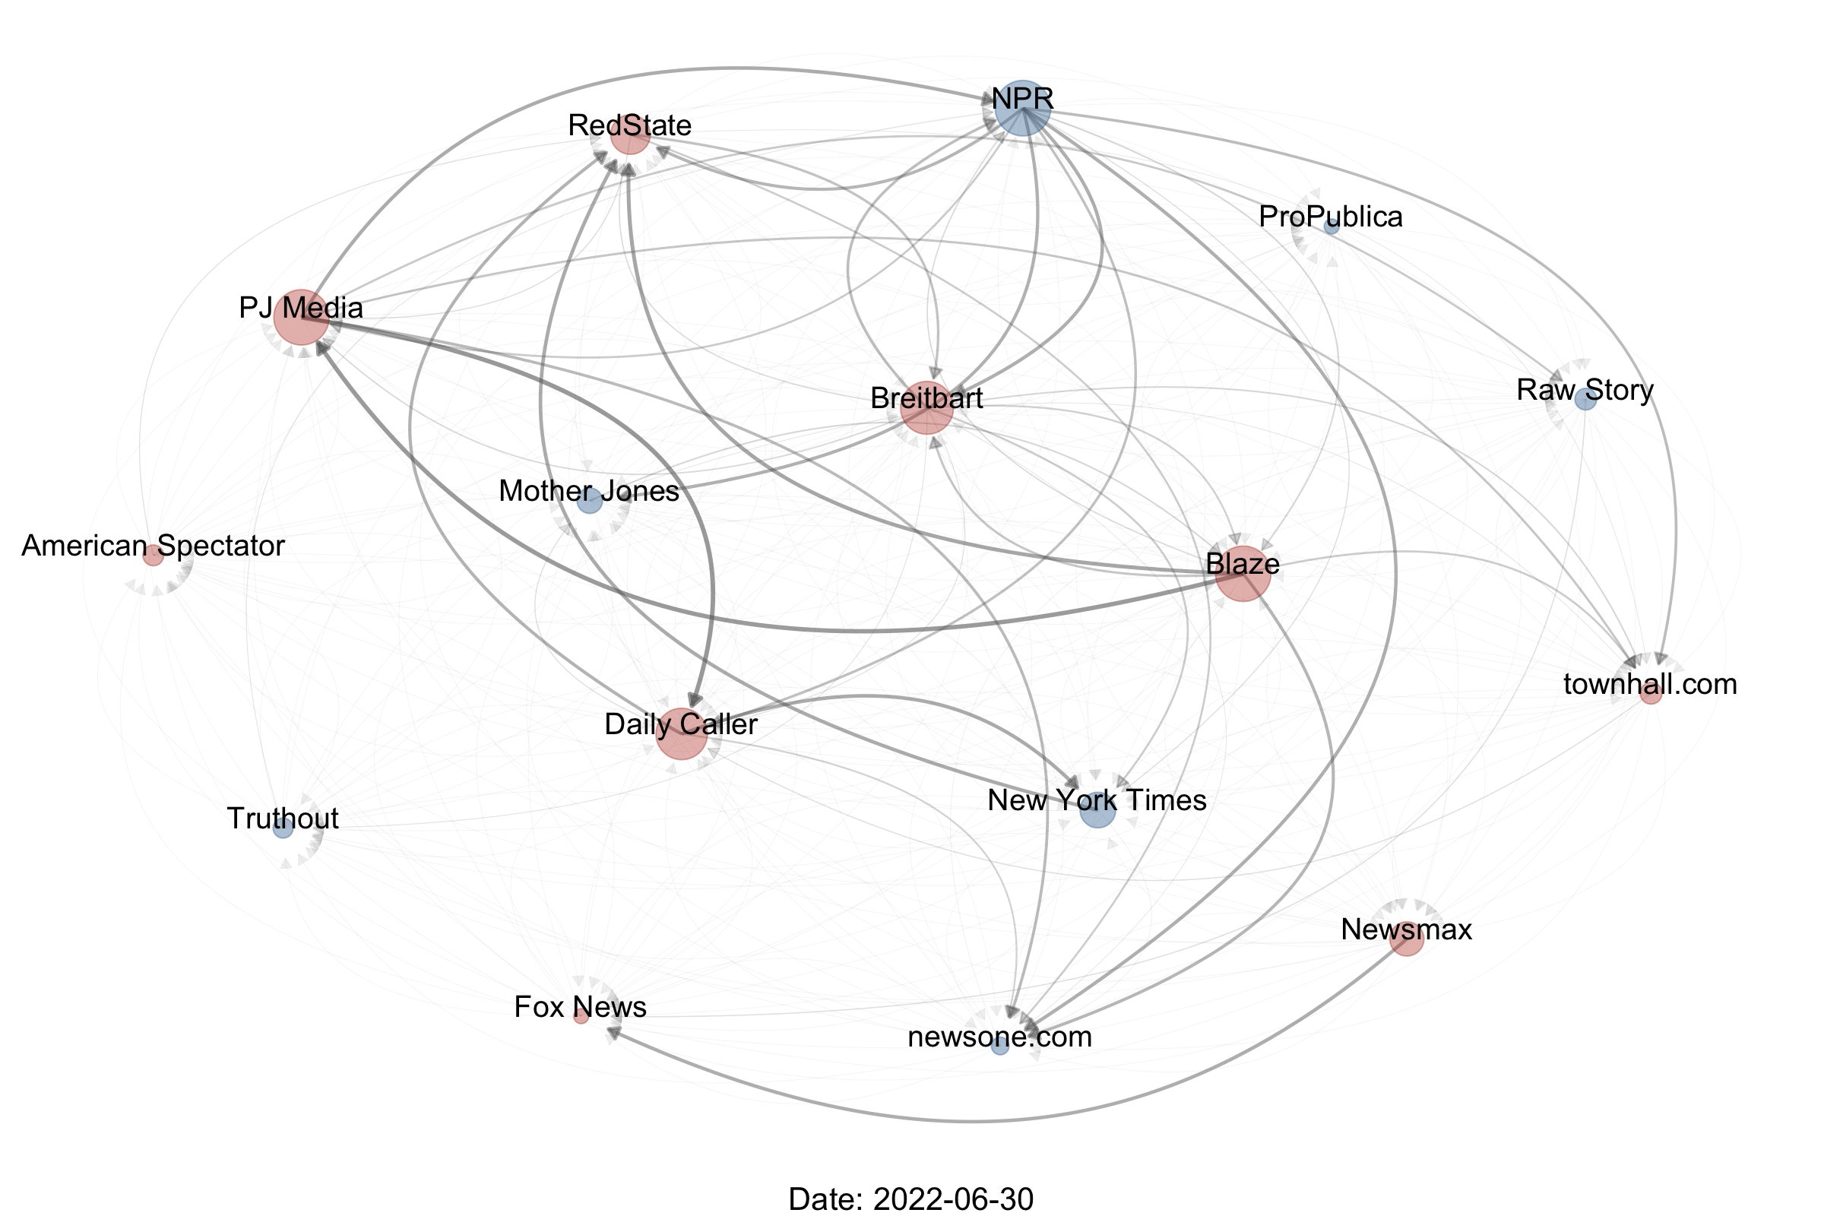
14
To summarize:
Framing choices are primarily driven by right-leaning and fringe outlets.
Intermedia frame-building is often cross-partisan and reactive, i.e., the left and right leaning outlets enable each other.
Such cross-partisan and unconventional influence patterns are mediated by a competitive framing environment.
Conclusion

Slide 23
15
Limitations and future directions:
The inference methods used do not imply strict causation. External factors, spurious autocorrelations etc. could still play a role.
The case study is based on a singular agenda and emphasis frame, and hence a broader analysis is required for generalizable results.
Conclusion

Slide 24

My website!
Summary:
Framing choices are primarily driven by right-leaning and fringe outlets.
Frame-building is often cross-partisan and reactive, i.e., the left and right leaning outlets enable each other.
ICA 2025: Computational Methods Division
Collaborators: Samuel Scarpino, Brooke Foucault Welles
Sharaj Kunjar
15th June 2025

