Slide 1



Online Slam Book
A mini project on database
BATCH NO:-17
K SHARAN KUMAR 21K91A05C3
K MADHUJA 21K91A05C2
K SAI MANISH 21K91A05B0
G DATHA SAI 21K91A0577
G ADITHYA 21K91A0575
Guide Name: Ms. K Naga Maha Lakshmi
Assistant Professor, CSE Department

Slide 2
Outline:
1. Introduction
2. Abstract
3. Existing System
4. Proposed System
5. Functional and Non Functional Requirements
6. Technologies Used
7. Modules in the Project
8. Each Module E-R diagrams and Data flow diagrams
9. Tables for performing operations:
1.Create
2.Insert
3.Update
4.Delete
5.Rename
10. Scope of the Project
11. Conclusion

Slide 3
Introduction:
The word has gone through different ages, now it is time for the electronic age. There was a time when we used to write diaries for our close ones. Now it is time for Slam Book, Slam book application. Which is similar to the hard coded slam books , which will provide you the ease To access your pals review whenever and from wherever you want to access them. This SlamBook App also consists of Audio Recording , Birthday Reminder and Image of your peeps

Slide 4
Abstract
The Online Slam Book project is a digital platform that modernizes the traditional concept of slam books, creating an engaging online environment for users to share memories, experiences, and personal reflections. Users register on the platform, create personalized slam books, and curate a set of questions for friends to respond to with text, images, and multimedia content. The platform facilitates interactions through comments and likes, fostering connections and nostalgia. With features such as customizable privacy settings, predefined questions, and friendship connections, the project provides a playful and interactive means for users to get to know each other better while preserving memories in a digital format

Slide 5
Existing System
Hard to Use: It's not clear how easy it is to use, making it potentially confusing for users.
Uncertain Record Keeping: How friends' records are managed is not specified, causing confusion.
Email Feature is Not Clear: The email feature is mentioned, but it's not explained, so it's unclear how it works.
No Data Protection: There's no mention of keeping user data safe, which is important for trust.
Not Sure How it Saves Time: While it aims to save time, how it does that is not explained.
Don't Know if it Can Grow: It's not clear if the system can handle more users or data.
Details about Reviews Missing: It's not clear what kind of reviews the system deals

Slide 6
Proposed System
Digital Transformation:
- Transition from paper to a digital platform for slam books.
- Enable online creation and access, eliminating physical books.
User Authentication:
- Ensure user privacy and data security with secure credentials.
Dynamic Data Management:
- Shift from static to dynamic data, allowing real-time updates.
Privacy Controls:
- Empower users with advanced controls for viewing slam books.
- Customize settings for personalized and secure experiences.
Multimedia Integration:
- Improve user expression by adding images, videos, and audio to slam book entries.

Slide 7
Functional Requirements
Hardware Requirements
Software Requirements
512 SSD
WINDOWS 10
8 GB RAM
MY SQL SERVER 8.0
I5 11th GEN Processor
MY SQL WORKBENCH

Slide 8
Non-Functional Requirements:
Usability: Intuitive interface with minimal response times.
Reliability: High system availability, data integrity, and secure storage.
Scalability: Smooth scalability to accommodate a growing user base.
Maintainability: Well-documented codebase for easy updates and maintenance.
Privacy and Compliance: Compliance with data protection regulations and customizable privacy settings.
Notification Efficiency: Efficient notification system with user-customizable preferences.

Slide 9
TECHNOLOGY USED:
MySQL: MySQL is an SQL database management system that we used in this project to create database for our project.

Slide 10
Modules:
Admin Module Overview
Admin Dashboard:
Centralized control for administrators.
Access to user management, content moderation, and system settings.
User Management:
Add, edit, and delete user accounts.
Reset passwords and manage user roles.
Content Moderation:
Review and moderate user-generated content.
Manage reported entries, comments, and likes.
System Settings:
Configure application settings.
Manage privacy policies and other system-wide parameters.
Analytics:
Access statistical data on user activity.
Monitor system performance and user engagement.

Slide 11
Modules:
User Module Overview
User Profile:
Personalized user profiles with details and preferences.
View and edit personal information.
Slam Book Creation:
Create and manage slam books.
Choose privacy settings (public or private).
Answer Questions:
Respond to questions within slam books.
Share thoughts, dreams, and memories.
Entry Management:
View, edit, and delete personal entries.
Like and comment on entries.
Friendship Features:
Send and receive friendship requests.
Manage friends list and view friend activities.
Notification Center:
Receive updates on likes, comments, and friend requests.
Stay informed about recent activities.

Slide 12
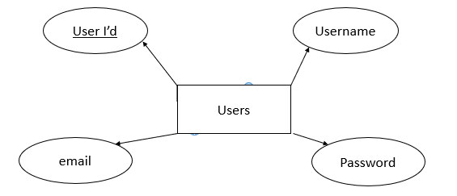
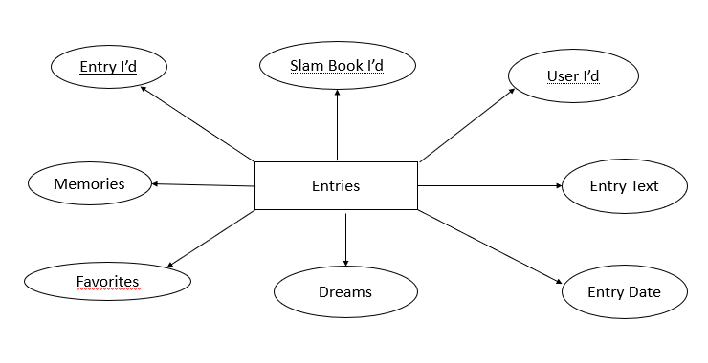
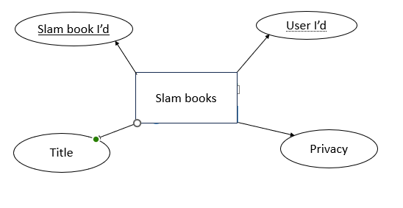
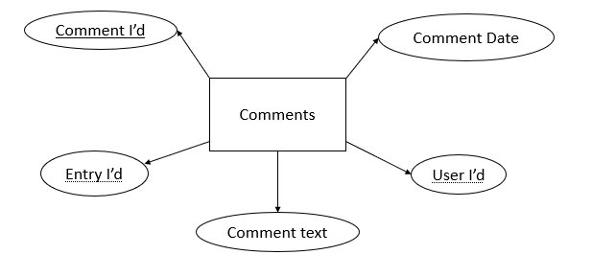
ER Diagrams:

Slide 13
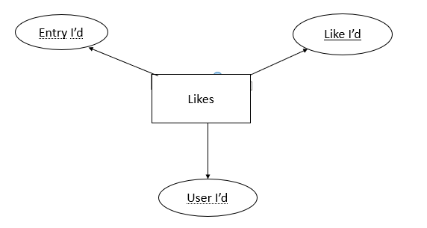
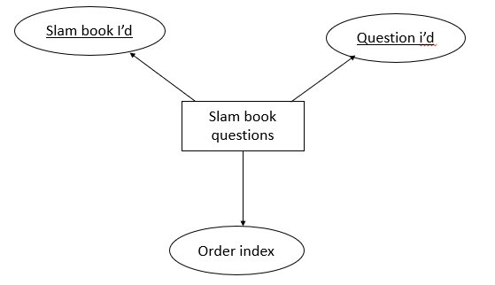
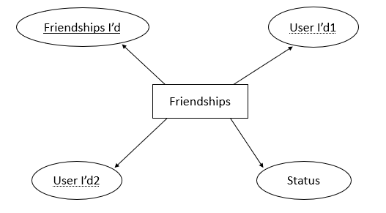
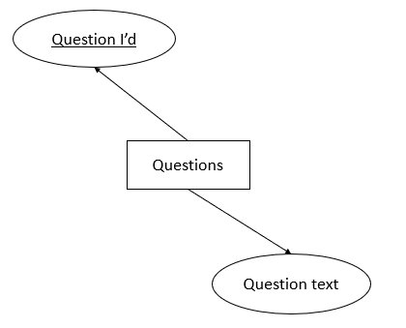

Slide 14
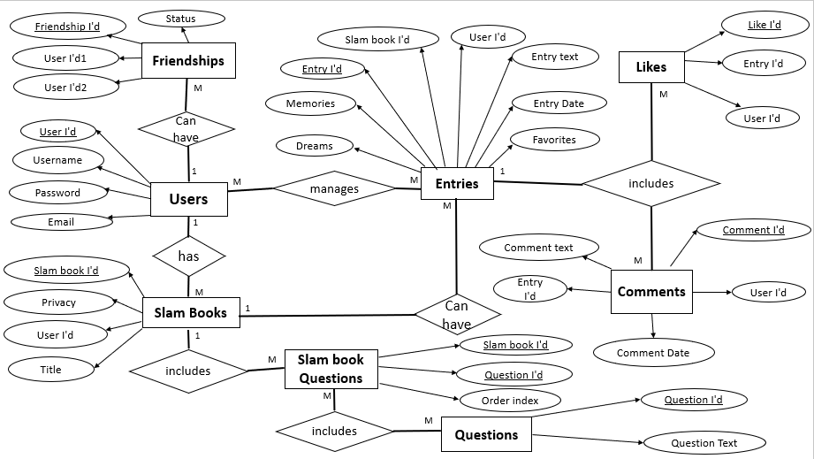
ER DIAGRAM:

Slide 15
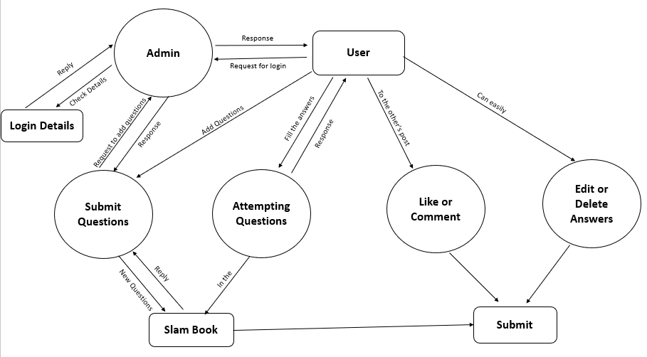
Data Flow Diagram:

Slide 16


Implementation:
To implement the Database we’ve used MySQL Database Management System​
First we’ve installed the software from MySQL :: MySQL Community Downloads​
And we created a Database named “slambook” using command prompt.​
We can create a database using “CREATE DATABASE <database name>;” command in SQL

Slide 17
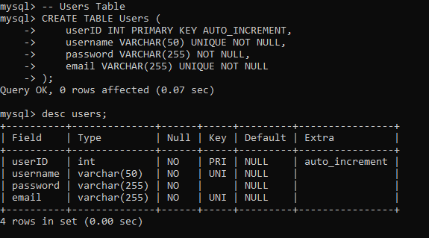
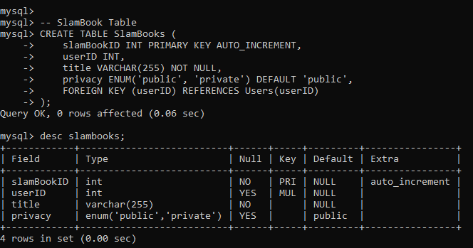
Creating Tables:
Creating users table and showing structure of users table:-
Creating Slambooks table and showing structure of Slambooks table:-

Slide 18
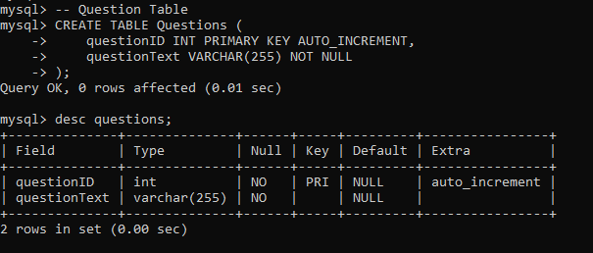
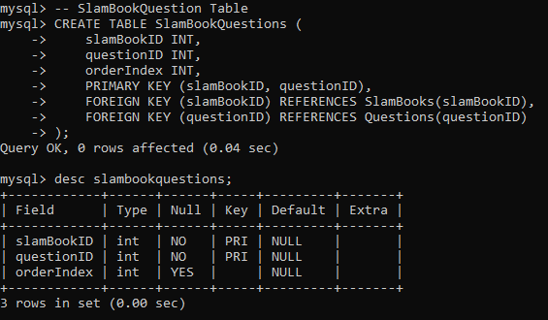
Creating Questions table and showing structure of Questions table:-
Creating Slambookquestions table and showing structure Slambookquestions table:-

Slide 19
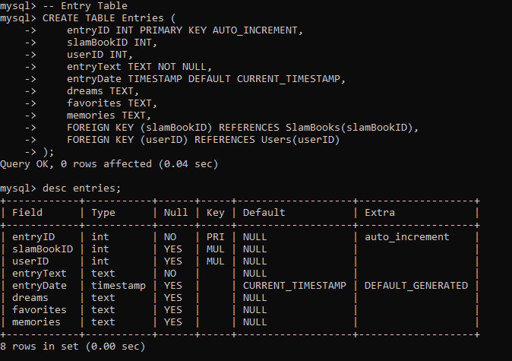
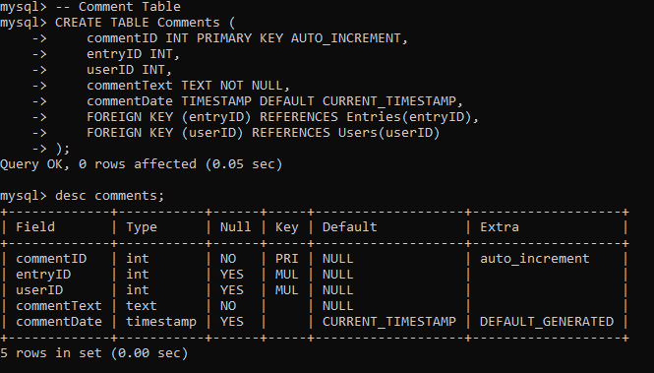
Creating Entries table and showing structure of Entries table:-
Creating Comments table and showing structure of comments table:-

Slide 20
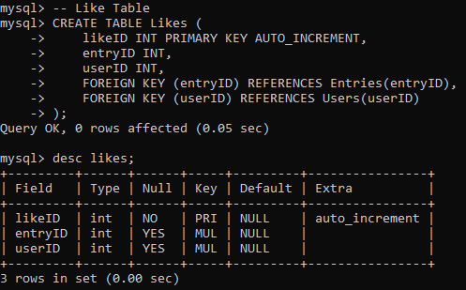
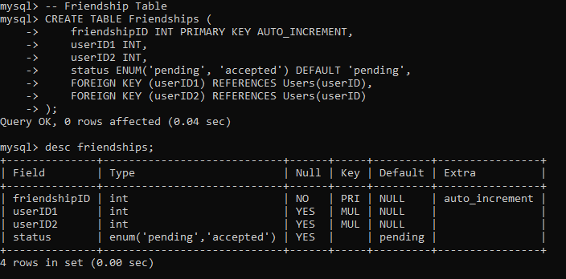
Creating Likes table and showing structure of Likes table:-
Creating Friendship table and showing structure Friendship table:-

Slide 21
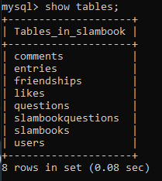
Tables in Slam book:

Slide 22
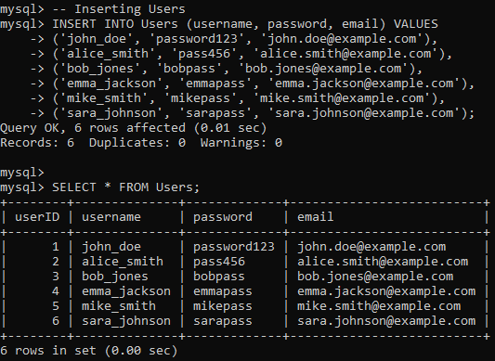
Showing contents in the tables: Users Table

Slide 23
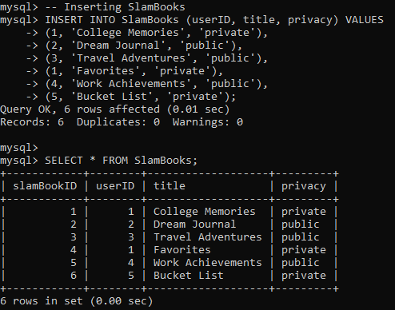
Showing contents in the tables: Slam books Table

Slide 24
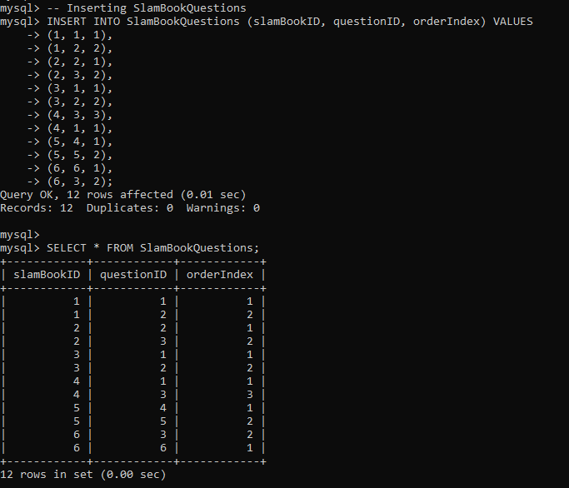
Showing contents in the tables: Slambookquestions Table

Slide 25
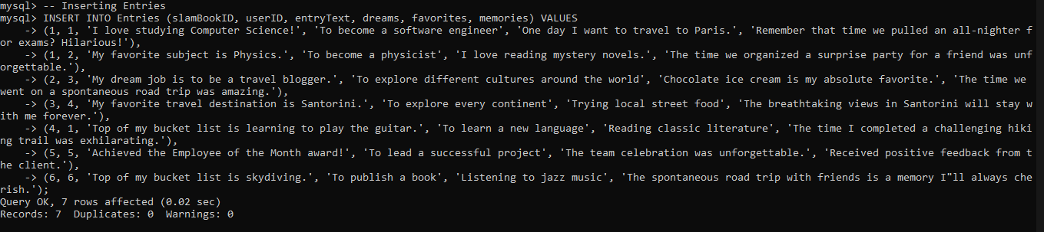
Inserting contents in the tables: Entries Table

Slide 26
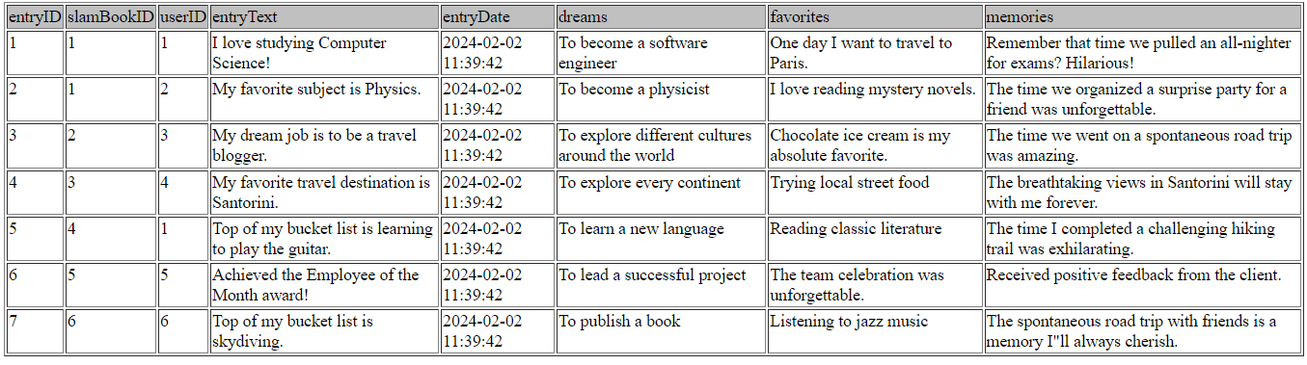
Showing contents in the tables: Entries Table

Slide 27
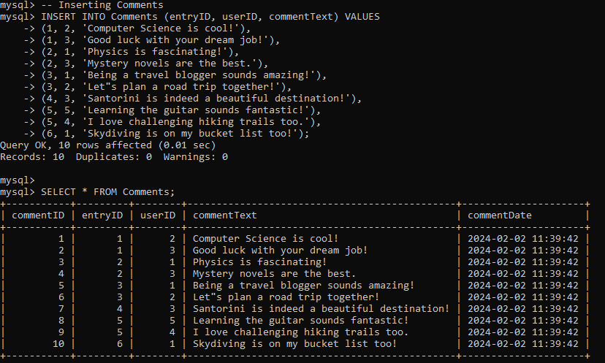
Showing contents in the tables: Comments Table

Slide 28
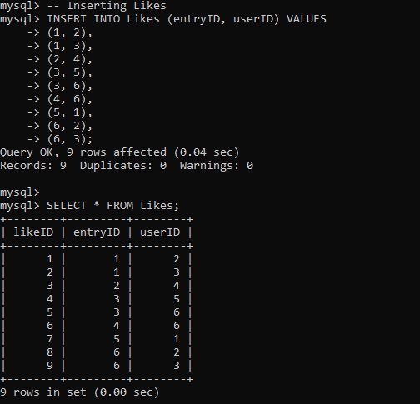
Showing contents in the tables: Likes Table

Slide 29
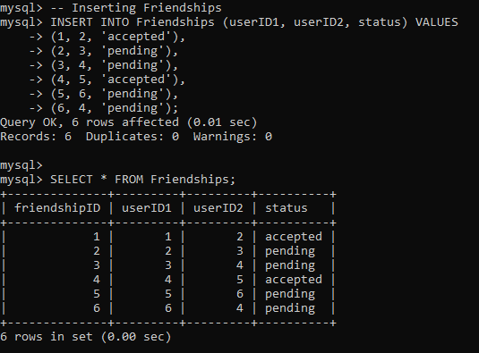
Showing contents in the tables: Friendship Table

Slide 30
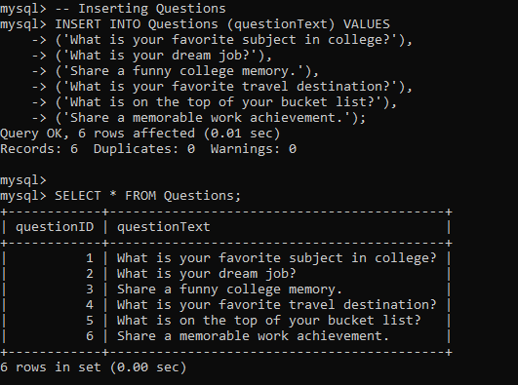
Showing contents in the tables: Questions Table

Slide 31
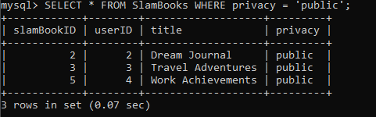
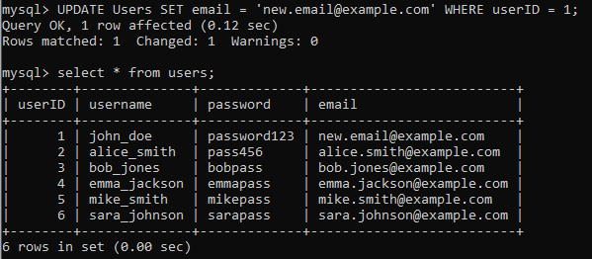
Queries:
Find all public SlamBooks:
This query selects all columns from the ‘SlamBooks’ table where the privacy is set to 'public'. It returns a list of SlamBooks with public visibility.
Update a user's email:
Modifies the email address for the user with ‘userID’ 1 in the ‘Users’ table

Slide 32
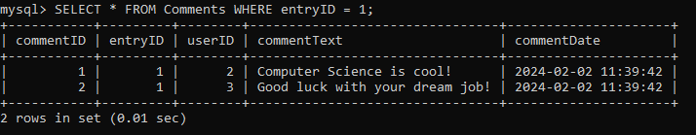
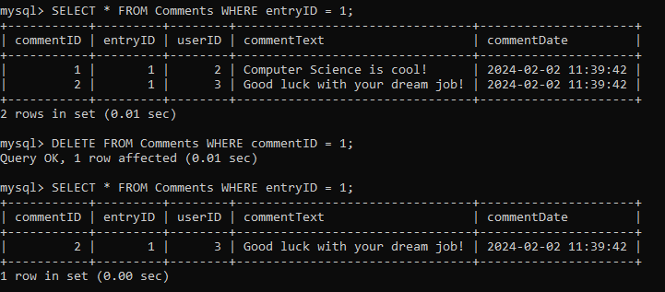
Queries:
Select all comments for a specific entry:
Retrieves all comments from the ‘Comments’ table where the ‘entryID’ is equal to 1, showing comments associated with a specific entry.
Delete a comment by commentID:
Deletes a comment with ‘commentID’ 1 frpm the ‘Comments’ table

Slide 33
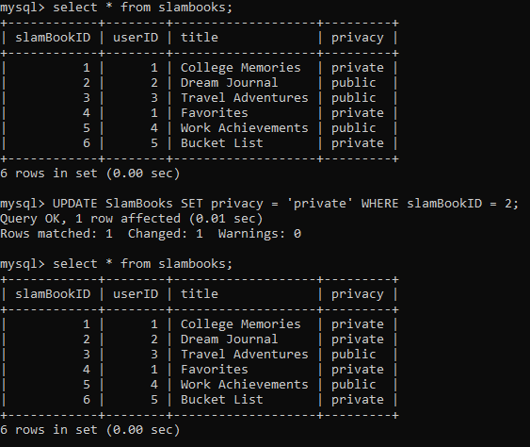
Queries:
Update the privacy status of a SlamBook:
Modifies the privacy status of the SlamBook with ‘slamBookID’1 to ‘private’ in the ‘SlamBooks’ table

Slide 34
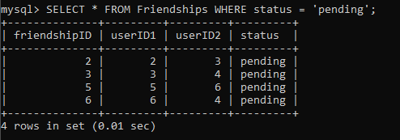
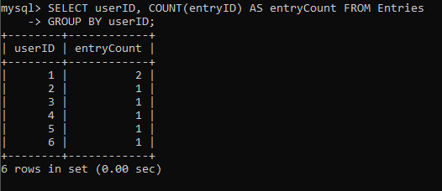
Queries:
Select all pending friendships:
Retrieves all pending friendships from the ’friendships’ table
Count the number of entries for each user:
Counts the number of entries for each user in the system.

Slide 35
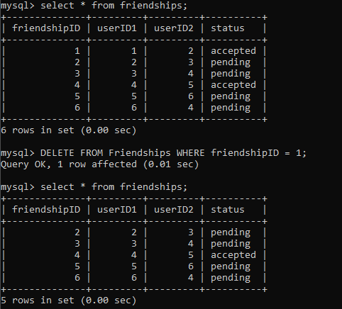
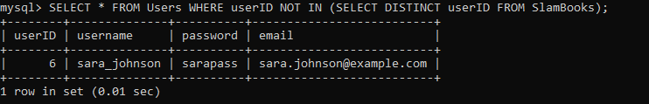
Queries:
Delete a friendship by friendshipID:
Deletes a friendship with’friendshipID’ 1 from the ‘friendships’table
Selecting users who have not created a SlamBook:
Retrieves users who have not created any SlamBooks.

Slide 36
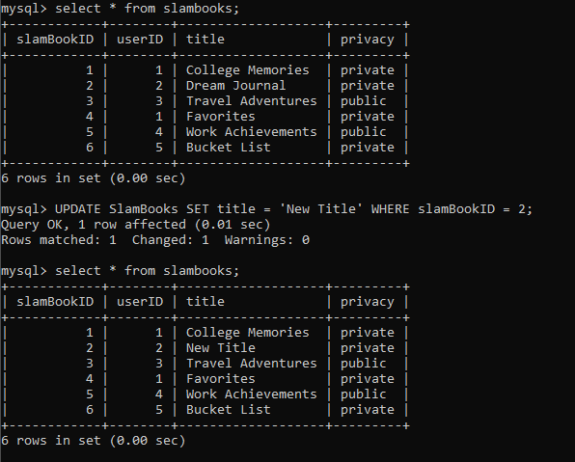
Queries:
Update the title of a SlamBook:
Modifies the title of the SlamBook with ‘slamBookID’2 to ‘New Title’ in the ‘SlamBooks’table

Slide 37
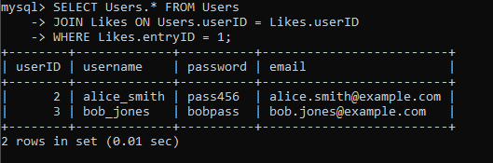
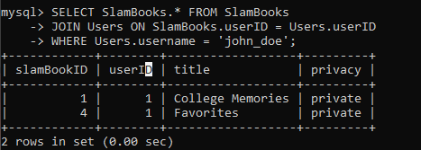
Queries:
Select users who have liked a specific entry:
Retrieves users who have liked the entry with ‘entryID’1
Select all SlamBooks created by a specific user:
Retrieves all SlamBooks created by the user with the username 'john_doe'.

Slide 38
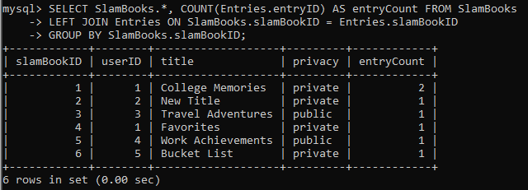
Queries:
Select SlamBooks with the count of associated entries:
Retrieves SlamBooks along with the count of entries in each SlamBook.

Slide 39
Future scope of the project:
The project's future is promising, focusing on user-friendly features like multimedia entries and real-time collaboration. We plan to enhance privacy controls, go mobile, and support multiple languages for a global reach. Introducing gamification elements and advanced analytics will make the platform more engaging and insightful. Integrating with social media, exploring collaborative SlamBooks, and suggesting personalized content using machine learning are on the horizon. We aim to keep it simple and safe, ensuring everyone feels included. Monetization strategies, such as premium features and partnerships, will help sustain the project's growth and viability. Our vision is to create a dynamic, user-centered space that adapts to evolving social networking trends.

Slide 40

Conclusion:
In conclusion, the Online Slambook Platform combines tradition with modernity, offering a digital space for users to capture and share memories. With features like user registration and advanced privacy controls, it provides a versatile and enjoyable experience. The platform evolves by adding multimedia elements and personalized recommendations while preserving the essence of meaningful connections. Designed for users to relive and share memories, it adapts to contemporary preferences, making it a dynamic and enduring space.

