Slide 1
Impact of MU EDCA channel access on IEEE 802.11ax WLANs
Sharan Naribole, Wook Bong Lee and Ashok Ranganath
Samsung Semiconductor, Inc. San Jose CA USA
VTC 2019-Fall September 24, 2019

Slide 2
OFDMA for Dense WLANs
Historically, 802.11 channel access has been CSMA/CA contention-based
Contention parameters (EDCA) advertised by Access Point (AP) in Beacons
Well-suited for small deployments but suffers from collision as network densifies
802.11ax introduced Orthogonal Frequency Division Multiple Access (OFDMA) to meet dense WLAN demands and minimize contention
Channel of transmitting a frame is divided into sub-channels for transmissions to/from multiple number of STAs (end user devices)
Sub-channels are called resource units (RUs)
Each RU dedicated to a different STA and has its own PHY parameters
RU#1
RU#2
RU#3
RU#4
RU#5
frequency
80 MHz channel

Slide 3
Uplink Multi-User Access
Uplink OFDMA (UL MU) initiated by the AP via Trigger frame
For Trigger transmission, AP contends on the wireless medium
Trigger frame enqueued in one of the access queues
Common Info
User Info
User Info
User Info
.
.
Bandwidth
Allocated time
STA Identifier
RU Size
Modulation and Coding
DATA RU#1
Trigger
Multi-STA
Block ACK
DATA RU#2
DATA RU#3
DATA RU#4

Slide 4
Multi-User EDCA (MU EDCA)
Allowing STAs that utilized OFDMA RU grants to further contend using the regular EDCA would be detrimental to objective of reducing contention
MU EDCA for temporary deprioritized access after RU grant
RU-granted STAs use MU EDCA parameters during MU EDCA Timer countdown
EDCA-based access may be fully disabled for a specific parameter set
Trigger
ACK
Regular EDCA mode resumes
DATA
MU EDCA Timer
UL OFDMA operation
MU EDCA mode start
MU EDCA mode end

Slide 5
Motivation
MU EDCA period too small
Falls back to regular EDCA –based network operation
Radio utilization will fail to scale for dense WLANs
MU EDCA period too high (~ 2 seconds)
Performance degradation for real-time “worst-case latency” applications
STA cannot perform operation mode switch e.g. power save, coexistence
Participation in UL OFDMA
STAs can dynamically change their participation in UL OFDMA
Poor scheduling can lead to STAs disabling UL OFDMA operation
Analyzing the impact of MU EDCA on 802.11ax WLANs is much-needed for future 802.11ax deployments and next-generation standards development

Slide 6
Contributions
Using custom ns-3 simulator with 802.11ax OFDMA functionality,
Throughput and latency gain analysis for 802.11ax OFDMA
Up to 4x throughput gain and consistent latency improvements over legacy EDCA
MU EDCA impact on dense WLAN performance
Temporary switch to MU EDCA-based access is indeed beneficial
Scalability of 802.11ax OFDMA operation
For a given latency bound, how density scales for trigger-based access?

Slide 7
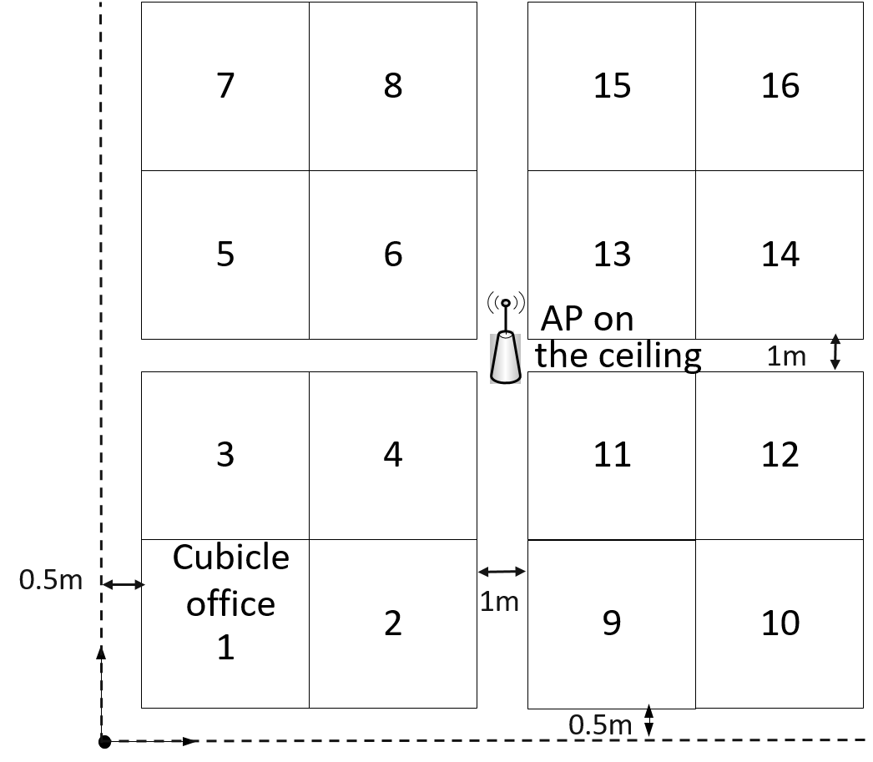
Network Model
Enterprise office deployment scenario [1]
Enterprise topology model and propagation loss model
Buffered video streaming for latency analysis [2]
Single AP operating on 80 MHz channel in 5 GHz band
HE MCS 9 (~= 480 Mbps PHY rate) unless stated otherwise
OFDMA scheduling
Round-robin manner with fixed groups of 4 STAs
Random RU allocation within the group
Queue size provided by STAs in QoS Control
Used for allocating the uplink transmit time
Trigger enqueued in EDCA Voice for high priority
EDCA fully disabled during MU EDCA countdown

Slide 8
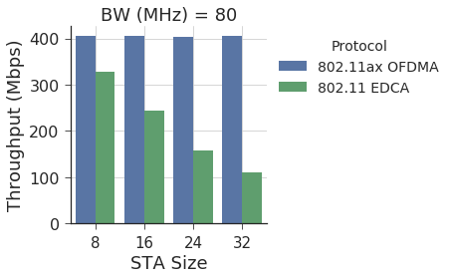
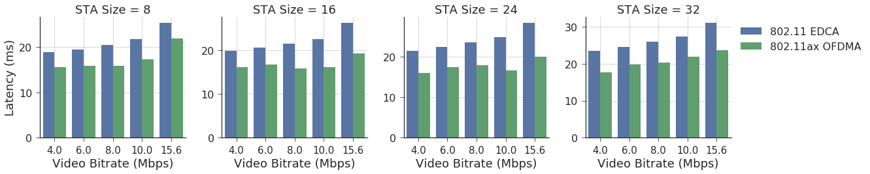
OFDMA MAC gain
Scheduled Access shows higher network throughput
EDCA suffers from collisions with increased congestion
Even without UL OFDMA power benefit, UL OFDMA provides up to 4x gain
Simple round-robin mechanism provides consistent improvement in latency

Slide 9
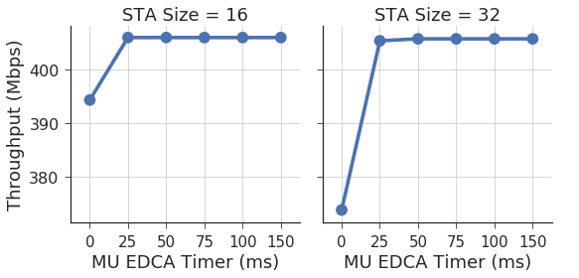
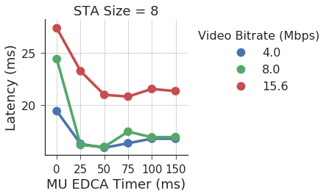
MU EDCA Impact on dense WLAN performance
MU EDCA Timer of 0 corresponds to not using MU EDCA
STAs switch to regular EDCA right after OFDMA RU grant
Temporary switch to MU EDCA-based access is indeed beneficial
MU EDCA Timer duration
With network size of 32 or less, contention impact not significant beyond 25 ms
Round-robin algorithm schedules STA before MU EDCA Timer expiry

Slide 10
OFDMA WLAN Scalability
In an ideal OFDMA WLAN with fair scheduling, STAs are granted RUs without falling back to legacy EDCA
Before the MU EDCA Timer countdown expires
For a given MU EDCA Timer, there is an upper bound on the network size
Multi-STA
Block ACK
UL OFDMA
Block ACK
UL OFDMA
DL OFDMA
TRIGGER
TRIGGER
Trigger-based PPDU
Trigger-based PPDU
HE MU PPDU
Trigger-based PPDU
Trigger-based PPDU
SIFS
SIFS
DIFS
SIFS
SIFS

Slide 11
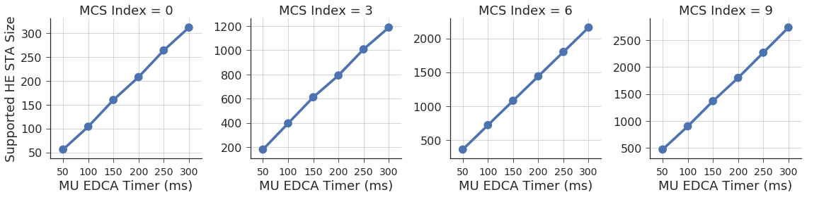
OFDMA WLAN Scalability
MCS index = modulation and coding index for 802.11ax rates
Assuming 1 DL and 1 UL 1500B packet per STA
With a fair scheduling, AP can serve more than 100 active STAs at the lowest MCS with MU EDCA Timer of 100 ms

Slide 12
Related Works
Fairness between UL OFDMA STAs and legacy STAs [3]
AP using high priority parameters for Trigger can starve legacy STAs
Model for AP selecting Trigger frame transmission contention parameters
Scheduling algorithms for throughput and fairness trade-off [4]
AP utilizes buffer status reports to perform efficient scheduling
Benefit of multi-user RTS/CTS for protecting multi-user transmissions [5]
Trade-off between overhead and collision avoidance
The related works are complementary to our contributions

Slide 13
Conclusion and Future Work
Multi-User EDCA
Beneficial for throughput and latency performance
Network scalable to hundreds of STAs
Further Consideration
Multi-user EDCA protocol design for greenfield spectrum
Multi-channel/band and multi-AP transmissions in next-gen 802.11be
Several new scenarios at the device scale and network scale
OFDMA expected to be a key fixture

Slide 14
References
[1] IEEE 802.11ax Task Group, “TGax Simulation Scenarios”
[2] 802.11ax Task Group, “11ax Evaluation Methodology”
[3] Khorov et al., “Several EDCA Parameter Sets for Improving Channel Access in IEEE 802.11ax networks,” in Proc. Of IEEE ISWCS, 2016
[4] Bankov et al., “OFDMA Uplink Scheduling in IEEE 802.11ax Networks,” in Proc. of IEEE ICC, 2018
[5] Bellalta et al., “AP-initiated multi-user transmissions in IEEE 802.11ax WLANs,” Elsevier Ad Hoc Networks, vol. 85, 2019.

