Slide 1
Gesture-Based Password Recovery
Done by:
Vijayadharshni 21BCE1072
Sharan kumar 21BCE1803

Slide 2
Introduction
In today's digital world, keeping our information safe is very important. Traditional passwords can be hard to remember and sometimes not very secure. To make things easier and more secure, we've created a system called Gesture-Based Password Recovery. Instead of typing a password, you can use hand gestures that we've saved before. If your current gesture matches the one we saved, you can change your password. This makes it more secure and easier for you to recover your password.

Slide 3
Problem Statement
In traditional password systems, users often struggle to remember complex passwords, leading to security risks. Moreover, these systems lack robust methods for password recovery. To address these challenges, this project proposes a Gesture-Based Password Recovery system. By using hand gestures represented as tensors, users can securely recover their passwords. The system verifies users by matching their current gestures with previously saved tensors, ensuring that only authorized users can change their passwords. This project aims to enhance password security and usability by leveraging hand gestures for authentication and recovery.

Slide 4
Abstract
In modern digital systems, password security and user experience are critical concerns. Traditional text-based password systems often suffer from vulnerabilities and user inconvenience. To address these issues, we propose a Gesture-Based Password Recovery system. This system utilizes hand gestures, captured as tensors, for password recovery. Users perform a gesture that was previously saved, and if the current gesture matches the saved tensor data, they are granted access to change their password. This approach enhances security by adding a biometric factor to password recovery, while also improving user experience by offering a more intuitive and secure authentication method.

Slide 5
Proposed Work
Capture Hand Gesture: The system captures the user's hand gesture using the webcam of the laptop.
Convert to Tensor: The captured gesture is converted into a tensor, which is a multi-dimensional array that represents the gesture's features.
Compare with Saved Tensors: The system compares the tensor of the captured gesture with the tensors saved during the password setup phase.
Authentication: If the captured gesture matches a saved gesture within a certain threshold, the user is authenticated and allowed to change the password.

Slide 6
Libraries and Models Used
OpenCV: Used for capturing and processing the video feed from the webcam to detect hand gestures. Provides robust tools for computer vision tasks, making it suitable for capturing and processing hand gestures in real-time.
TensorFlow: Used for converting the captured gesture into a tensor and for comparing it with saved tensors.
Keras: Built on top of TensorFlow, used for building and training deep learning models for gesture recognition.
NumPy: Essential for handling tensors, which are the primary data structure used for representing hand gestures.Used for handling multi-dimensional arrays, particularly for manipulating tensors.
Scikit-learn: Used for defining and implementing the matching algorithm, allowing for a customizable and efficient comparison of tensors. In this project it is used for defining the threshold and comparing the tensors to determine if a gesture match is successful.

Slide 7
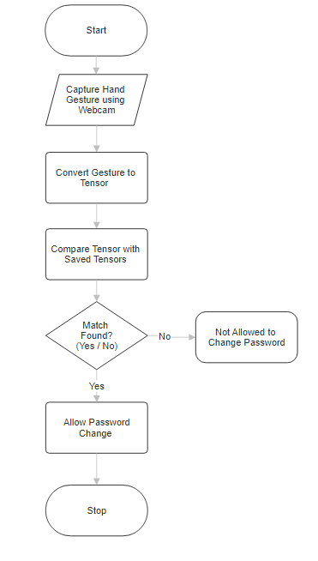
Flow Diagram

Slide 8
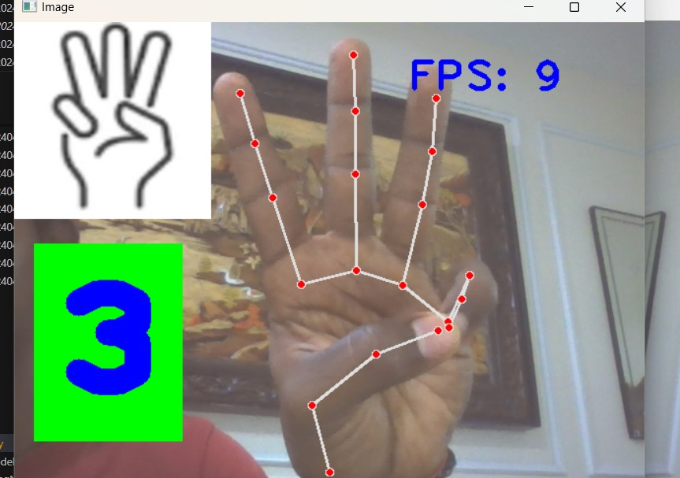
Output - gesture capturing
In this way we capture the gestures of the user

Slide 9
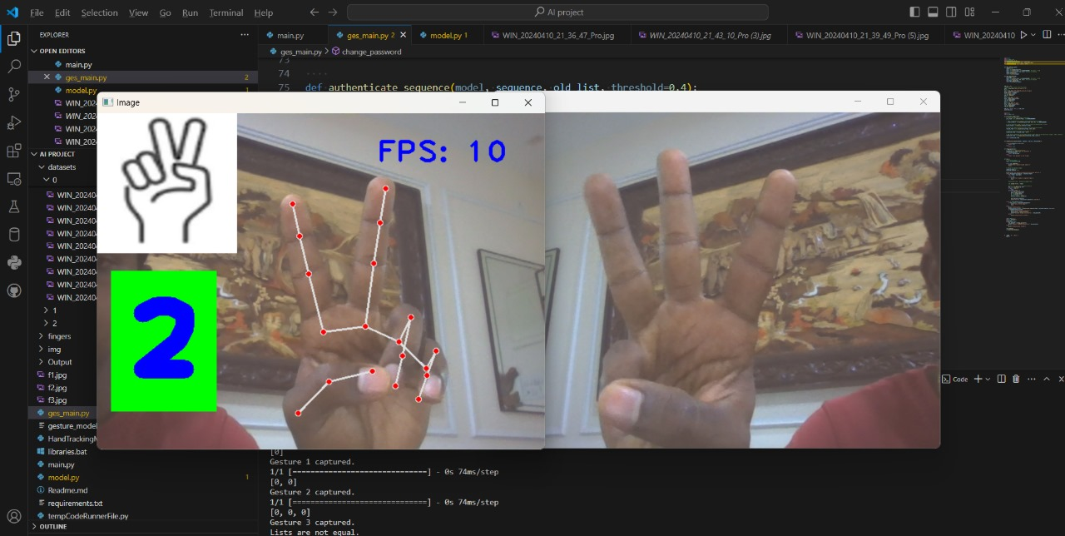

Slide 10

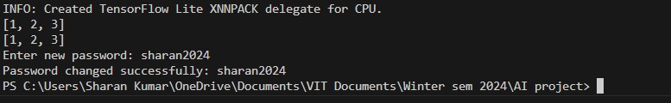
Output got by comparing the tensors of the previously saved gesture and the gesture sequence given by the user.
If the tensors match - the user can change the password(Authentication is successful)
If tensors does not match - the user cannot change the password(Authentication failed)

Slide 11
Conclusion
In conclusion, the Gesture-Based Password Recovery project offers a promising alternative to traditional text-based password recovery methods. By utilizing hand gestures captured as tensors, the system provides a more secure and user-friendly approach to password recovery.The project's success lies in its ability to accurately compare the user's current gesture with the saved tensors, ensuring that only authorized users can change their passwords. This enhances security by adding a biometric factor to the authentication process.As technology continues to evolve, innovative solutions like Gesture-Based Password Recovery will play a crucial role in shaping the future of authentication methods.

