Slide 1
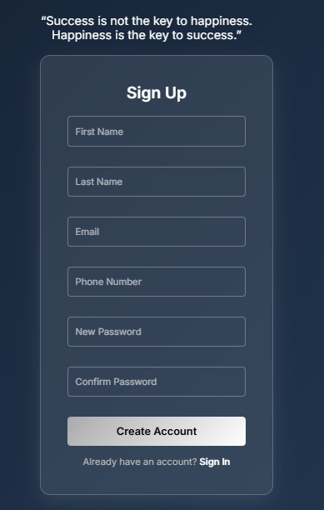
Designing a Captivating
Signup Page
This presentation explores the key elements that drive user engagement and brand perception for a signup page. It showcases design principles applicable across industries, blending aesthetics with user experience to create a captivating experience.

Slide 2
The Psychology of Design
Scarcity
Aspirational Identity
Sensory Appeal
Implied exclusivity enhances perceived value. Examples include limited-time offers or exclusive memberships.
Aligning with the user's desired self-image evokes a sense of belonging and aspiration.
Engaging multiple senses through visuals, micro-interactions, and sound creates a holistic experience.

Slide 3
Core Elements: Visual Aesthetics
Color Palette
Typography
Imagery
Monochromatic or complementary schemes, using muted tones for sophistication, e.g., charcoal, navy, with gold accents.
Elegant fonts that evoke trust and history, e.g., serif fonts like Garamond, Didot, or clean sans-serif pairings.
High-resolution, professionally styled photography or videography showcases the brand's lifestyle or product.

Slide 4
Core Elements: Quote Integration
"Your time is limited, so don’t waste it living someone else’s life." – Steve Jobs
Quotes can inspire users and add a personal touch. Placement should be strategic within the signup flow, with elegant typography and visual treatment.

Slide 5
Glassmorphism and Modern UI
Glassmorphism
Implementation
Benefits
A translucent, frosted glass effect that creates depth and sophistication.
Subtle background blur, light borders, and layered elements for a premium feel.
Enhances visual hierarchy and directs user attention.

Slide 6
Optimizing the User Experience
Minimal Fields
Reduce friction by only requesting essential information.
Clear Call to Action
A prominent, visually distinct signup button with gradient fill or subtle animation.
Mobile Responsiveness
Ensuring a seamless experience across all devices with adaptive layouts and optimized images.

Slide 7




Micro-interactions and Animation
Subtle feedback cues for form validation, button hovers, and loading states.
Smooth transitions between signup steps to maintain engagement.
Examples include animated checkmarks, progress bars, and subtle background animations.

Slide 8
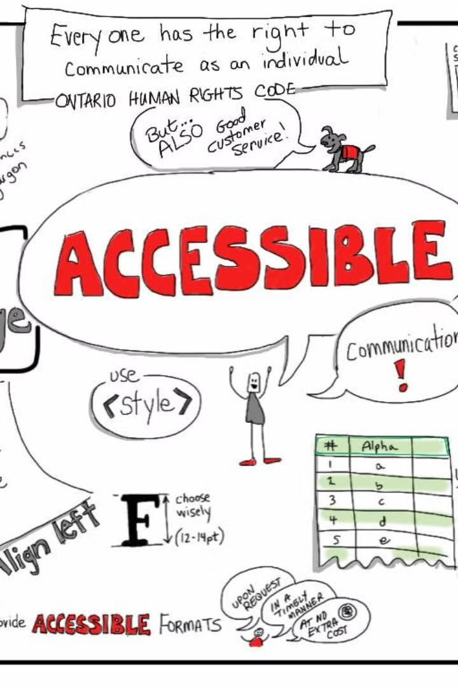
Accessibility Considerations
1
Ensure sufficient contrast between text and background for readability.
2
Implement ARIA attributes to improve screen reader compatibility.
3
Provide clear visual indicators for keyboard navigation.
4
Aim for WCAG 2.1 AA compliance to cater to a wider audience.

Slide 9
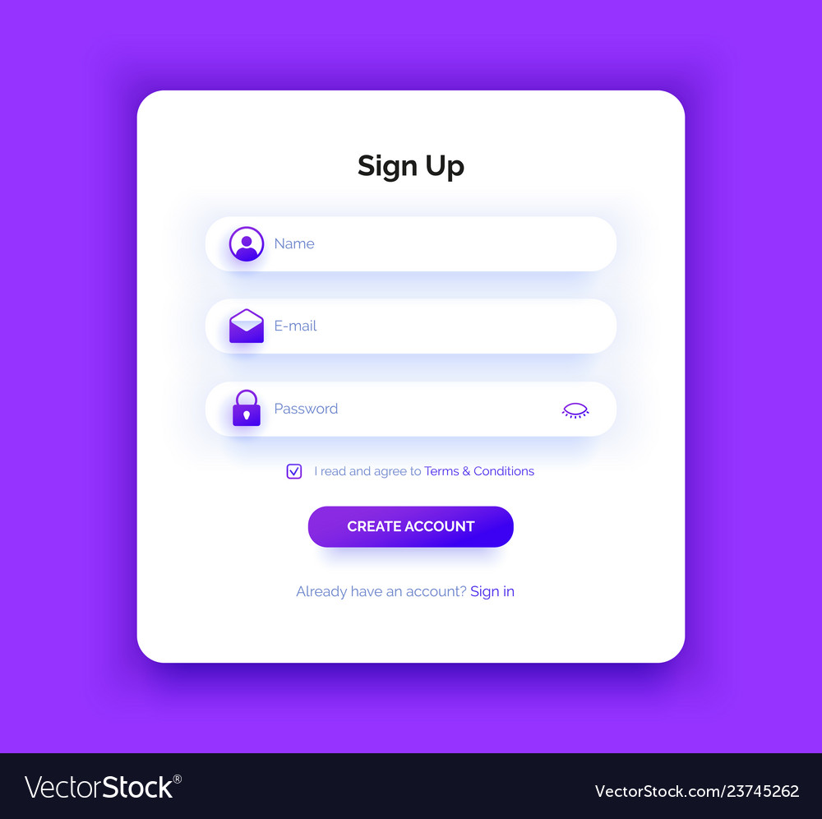
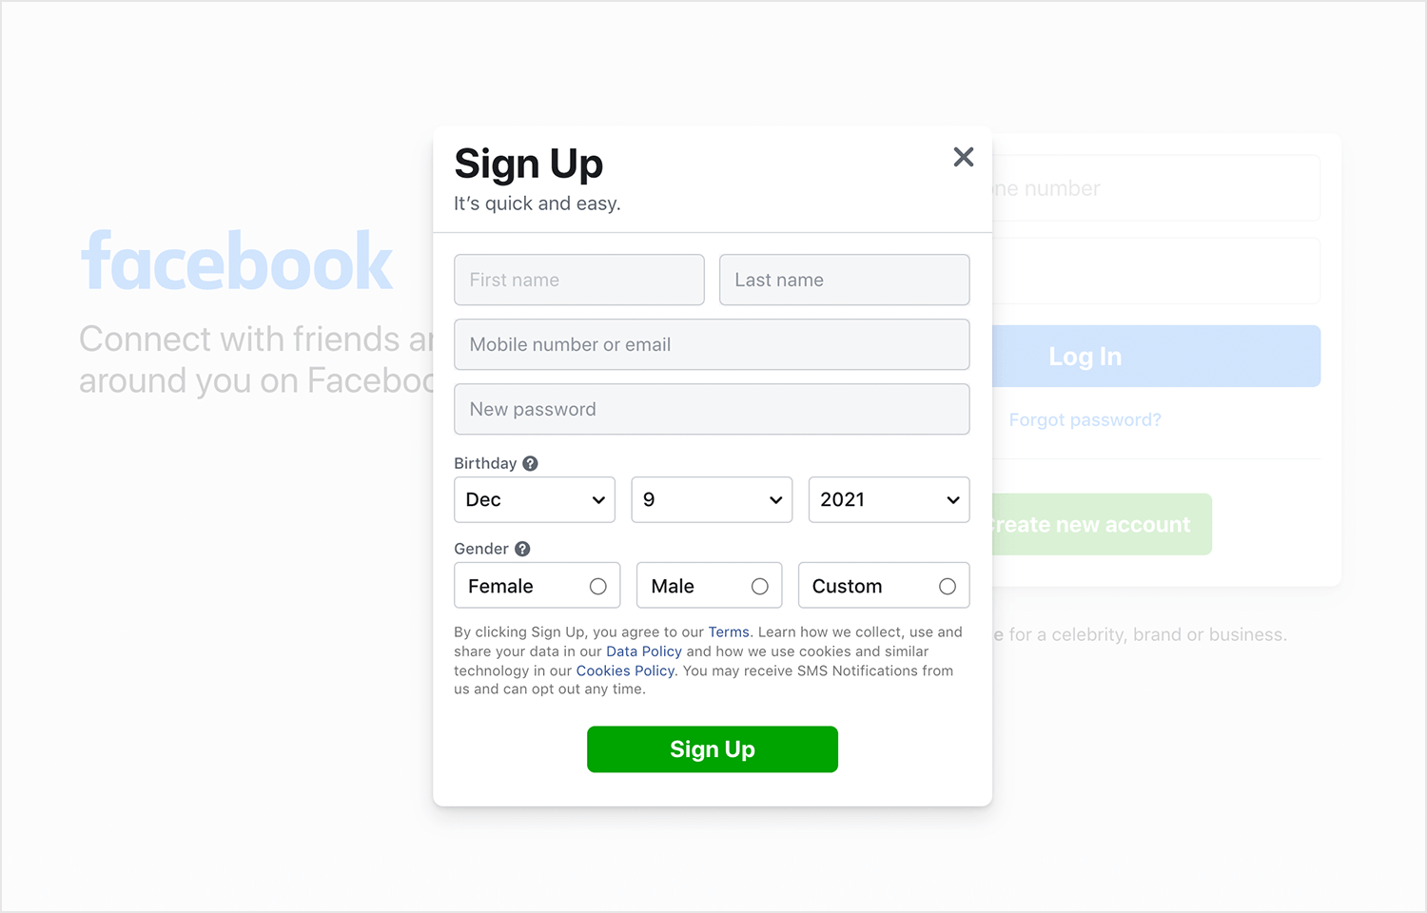
Examples of Successful Signup Pages
1
Case studies: Analyze signup pages from luxury brands across industries, e.g., fashion, hospitality, automotive.
2
Benchmarking: Highlight what makes each example effective in terms of design, UX, and psychology.
3
Key Takeaways: Actionable insights that can be applied to your own signup page design.

Slide 10

Conclusion: Crafting the Ultimate Signup Experience
By embracing these principles, you can craft a luxurious signup experience that captivates users and elevates your brand's perception. Remember to focus on the user experience, visual aesthetics, and psychological considerations to create a truly memorable experience.

