Slide 1
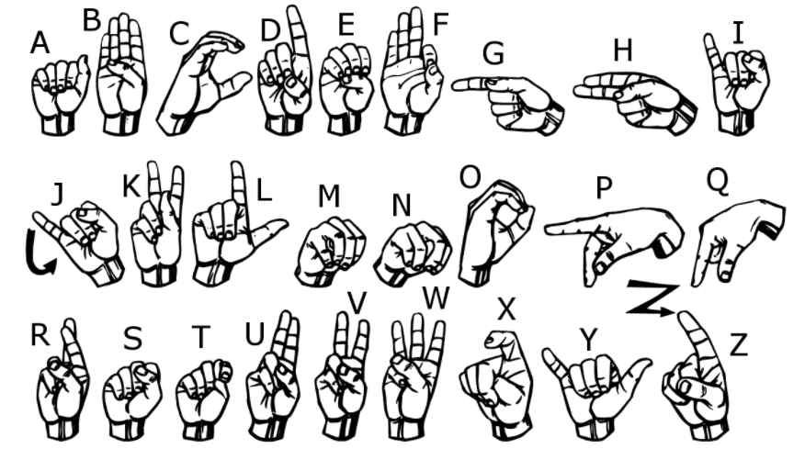
INTRODUCTION
ABSTRACT:
People with disability use different modes to communicate with others, there are number of methods available for their communication one such common method of communication is sign language.
Developing sign language application for deaf people can be very important ,as they’ll be able to communicate easily with even those who don’t understand sign language. The project aims at taking the basic step in bridging the communication gap between normal people, deaf and dumb people using sign language.
To develop a model I have used a CNN(convolutional neural networks), It is a type of feedforward artificial neural network in which the connectivity pattern between its neurons is inspired by the organization of the animal visual cortex.

Slide 2
IMPLEMENTATION:
To train a model to recognize sign languages, American Sign Language dataset(ASL)is used, which is from kaagle. Each training and test case represents a label (0-25) as a one-to-one map for each alphabetic letter A-Z (and no cases for 9=J or 25=Z because of gesture motions). The training data (27,455 cases) and test data (7172 cases) with a header row of label, pixel1,pixel2 ....pixel784 which represent a single 28x28 pixel image with grayscale values between 0-255.
Convolutional Layers, which apply a specified number of convolutional filters to the image. Here, I have used four convolutional layers with the filter frame(3x3). Conv layers are then applied to RELU activation function to the output to introduce non-lineraties to the model.
Next to Convolution layers BATCH Normalisation Is applied to increase the faster processing and training of data.
MAX POOLING layer, is applied next to the BATCH NORMALISATION, which downsample the image data extracted by the convolution layers to reduce the dimensionality of the feature map in order to decrease the processing time. Here I have used 2x2 pixel-tiles
DENSE (Fully Connected) layers, which performs Classification on the features extracted by the convolutional layers and downsampled by the pooling layers. In a dense layer, every node is connected to every node in the preceding layer.
The entire model is implemented using keras

Slide 3
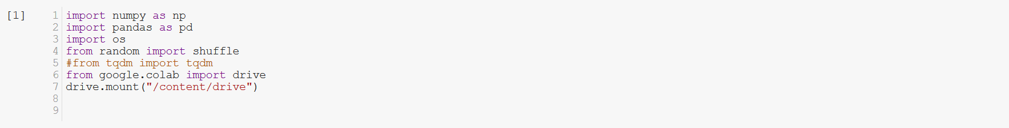
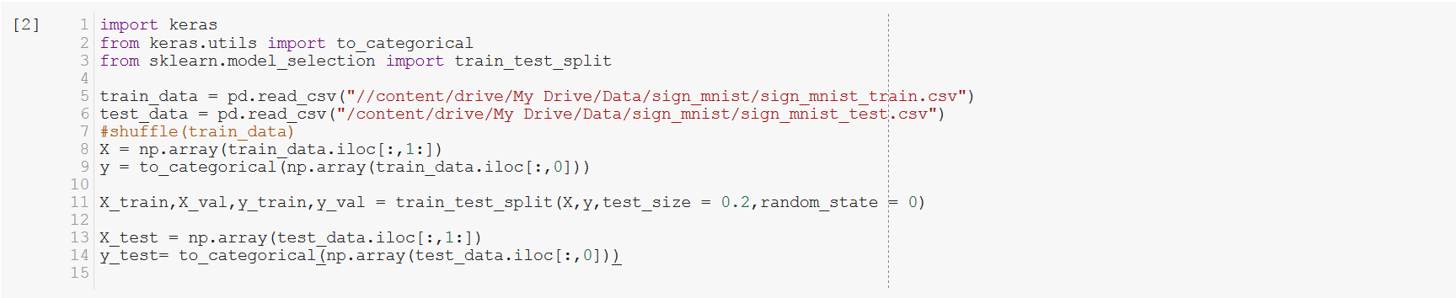
PROGRAMMING IMPLEMENTATION
Importing the required packages and the dataset is mounted to the google drive to retrieve the data
The training and testing data are imported from the path specified. The independent variable is chosen as y and the dependent variable as X, the y contains the labels of the data which is converted into categorical format.
The datas are split into training and validation data using train_test_split library where the 80% of the data is assigned to the training data and the remaining is assigned to the validation data set which is then used for validating the training data.

Slide 4
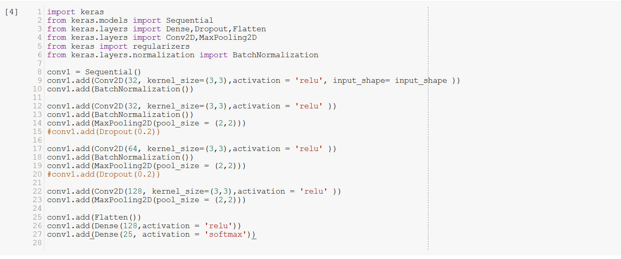
Importing the layers of Keras.
Four convolutional layers are implemented with the batch normalization, max_pooling, flatten, dense layers
To Accelerate the Training of Deep Neural Networks Batch Normalization is used.
Using batch normalization makes the network more stable during training. This may require the use of much larger than normal learning rates, that in turn may further speed up the learning process.
Batch normalization offers some regularization effect, reducing generalization error, perhaps no longer requiring the use of dropout for regularization. Hence removed the dropouts
The dense layers holds the activation of RELU and the SOFTMAX is applied to the final layer of the dense layer.

Slide 5
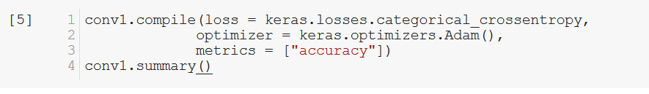
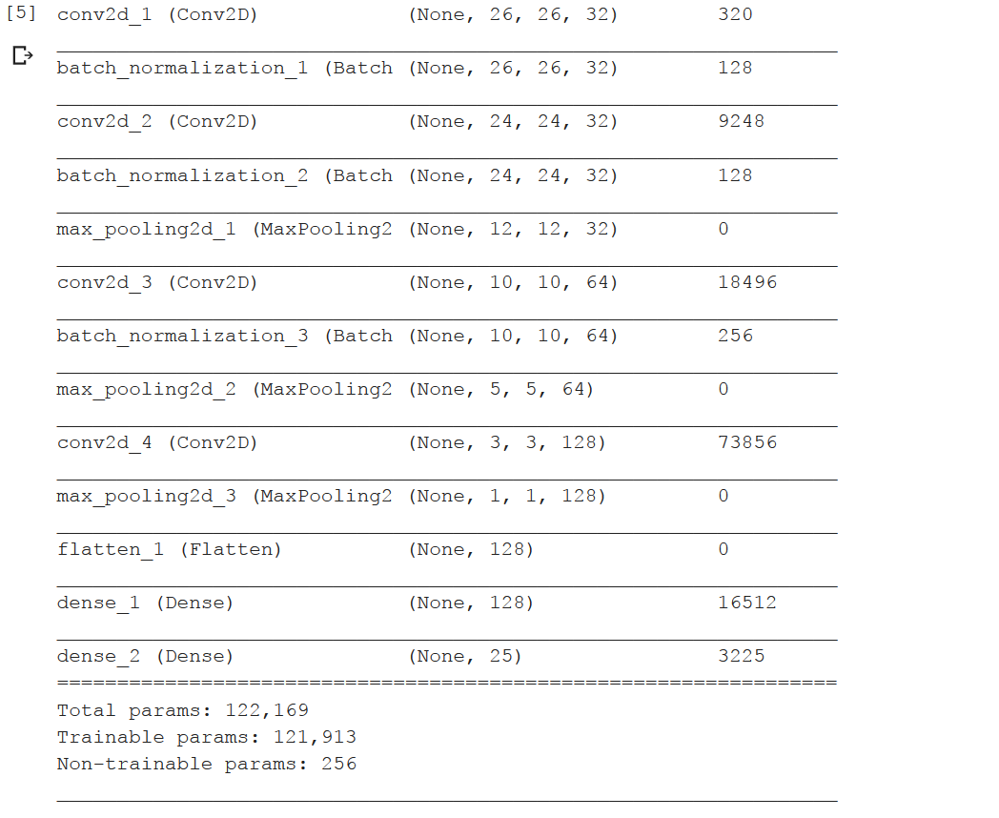
Summary of the Model to be Trained
When compiling the model, I choose categorical_crossentropy as the loss function (which is relevent for multiclass, single-label classification problem) and Adam optimizer.
The cross-entropy loss calculates the error rate between the predicted value and the original value. Categorical is used because there are 25 classes to predict from. If there were 2 classes, I would have used binary_crossentropy.
The Adam optimizer is an improvement over SGD(Stochastic Gradient Descent). The optimizer is responsible for updating the weights of the neurons via backpropagation. It calculates the derivative of the loss function with respect to each weight and subtracts it from the weight.

Slide 6
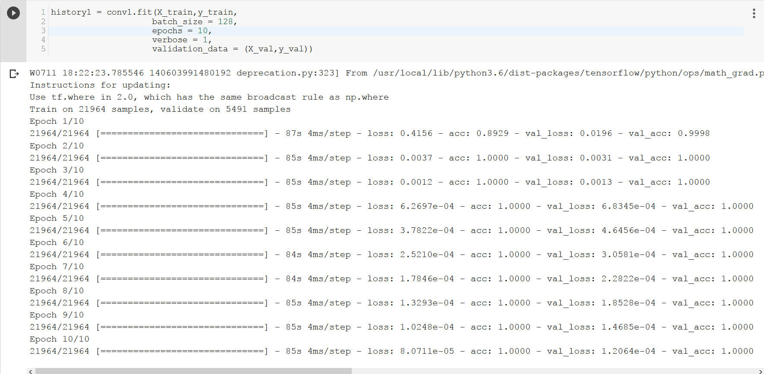
Training the data for 10 epochs involving 21964 training samples and 5491 validation samples

Slide 7
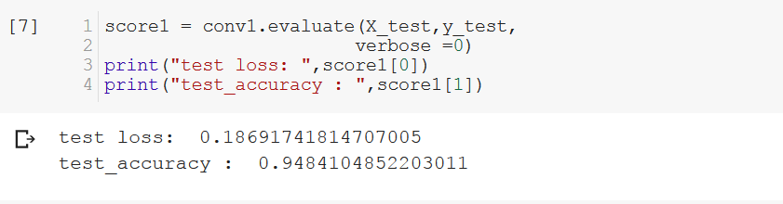
Hence, we got the accuracy percentage of 95%(approximately)
Data Augmentation
Overfitting can be caused by having too few samples to learn from, making me unable to train a model that can generalize to new data. Given infinite data, my model would be exposed to every possible aspect of the data distribution at hand: I would never overfit.
Data augmentation takes the approach of generating more training data from existing training samples, by augmenting the samples via a number of random transformations that yield believable-looking images. The goal is that at training time, my model will never see the exact same picture twice. This helps expose the model to more aspects of the data and generalize better.
In Keras, this can be done by configuring a number of random transformations to be performed on the images read by the ImageDataGenerator instance.
rotation_range is a value in degrees (0–180), a range within which to randomly rotate pictures.
width_shift and height_shift are ranges (as a fraction of total width or height) within which to randomly translate pictures vertically or horizontally.
shear_range is for randomly applying shearing transformations.
zoom_range is for randomly zooming inside pictures.

Slide 8
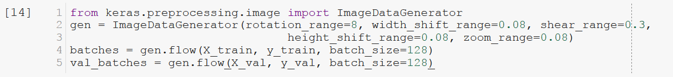
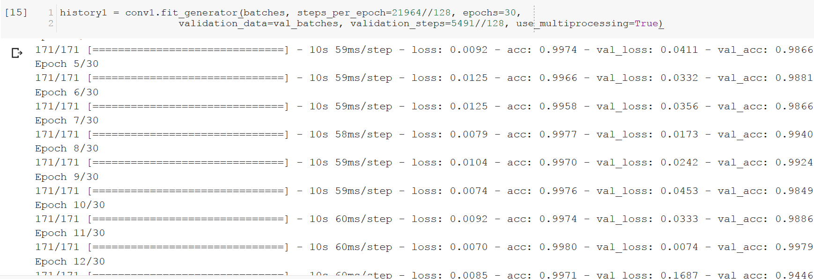
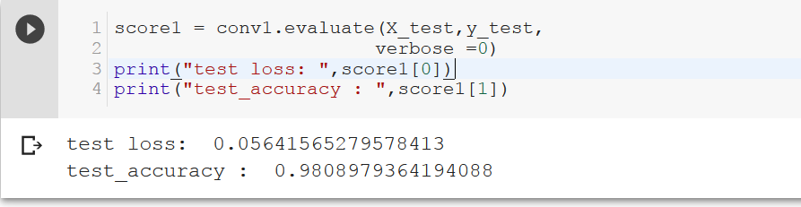
Now, the accuracy percentage has increased from 95% to 98%

Slide 9
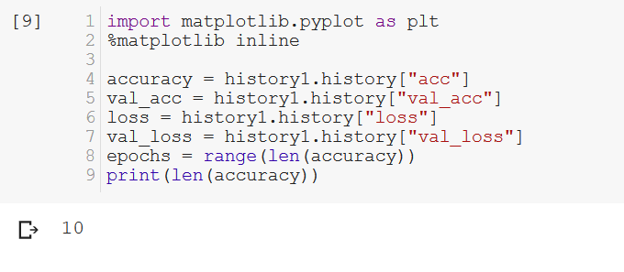
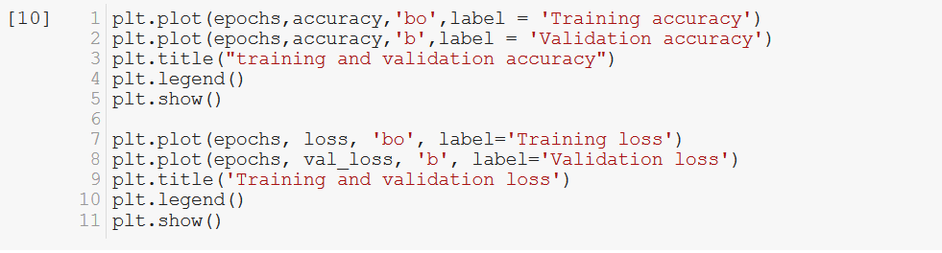
To implement the loss and accuracy curves history library is used
Plotting the graph of training and validation accuracy and losses

Slide 10
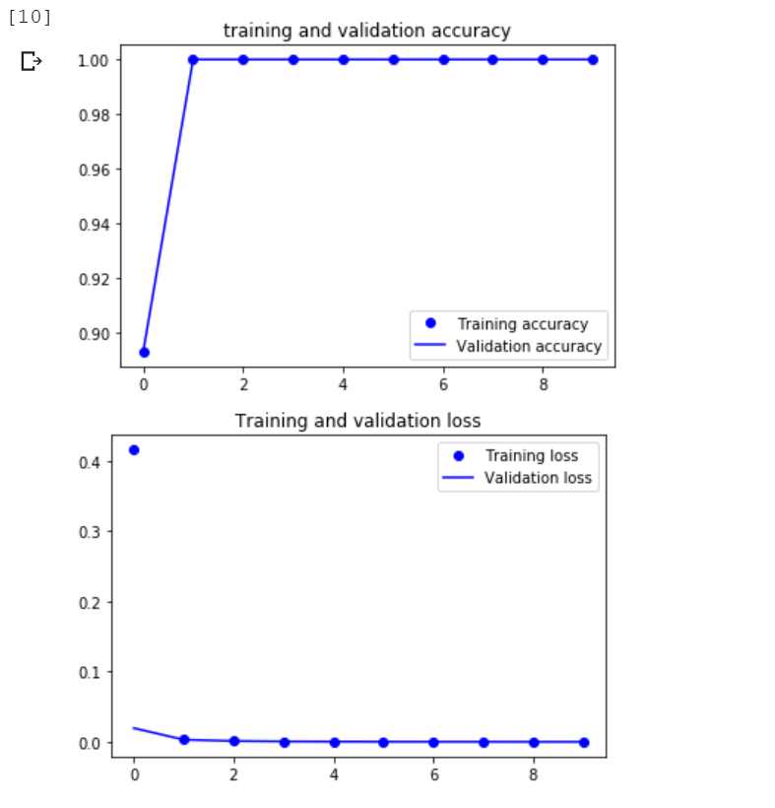

Slide 11
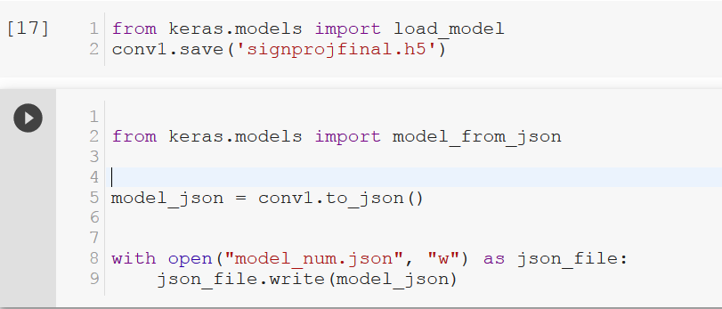
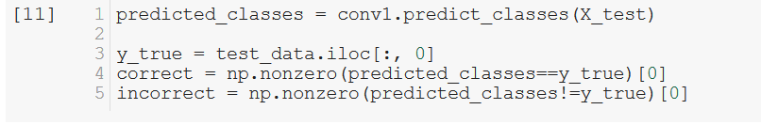
Saving the architecture and weights of the trained model for further training purposes
Storing the correct and incorrect values for the use of plotting the correct prediction images.
The classification report is generated using classification report library of sklearn. This helps in visualizing the underperforming class.

Slide 12
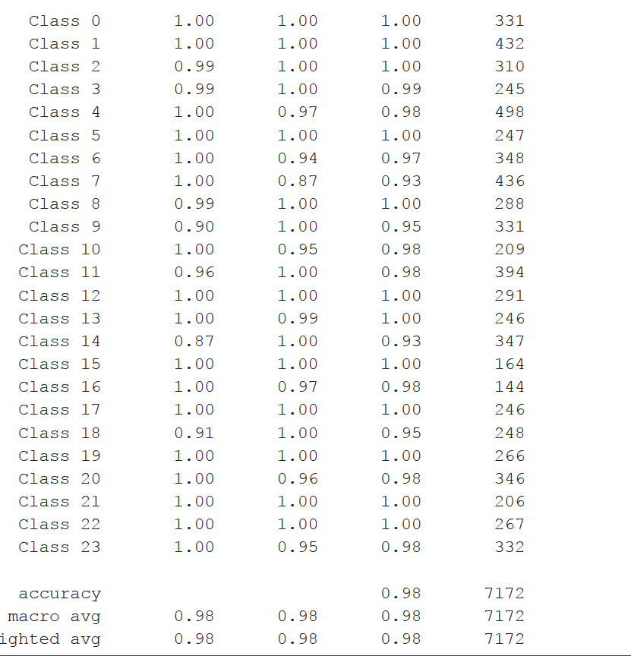
From this classification report it is pretty obvious that all the classes are performing well.
This helps in giving the insight of the classes, before plotting the predicted images

Slide 13
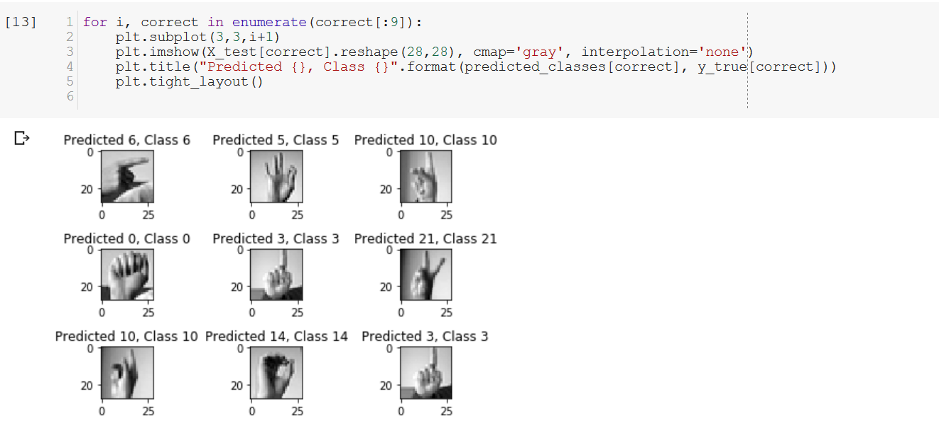
This gives the plotting of the correctly predicted classes

Slide 14
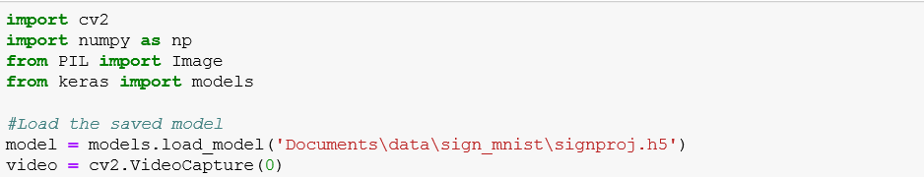
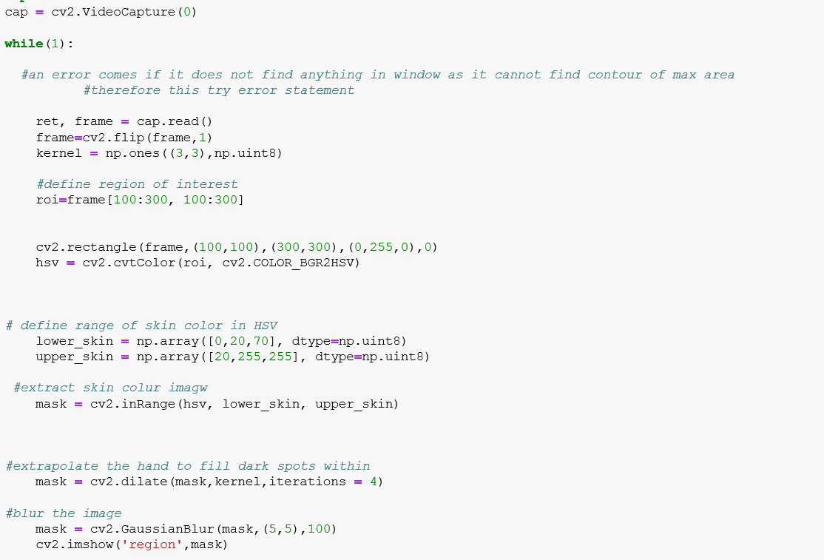
The model is further developed to take the input data as video/webcam and convert into frames of data and predict the labels this will be highly helpful and reliable model to put it in a production. Following are the implementations to deploy a model with Opencv and CNN.
Loading the model that is pre-trained

Slide 15
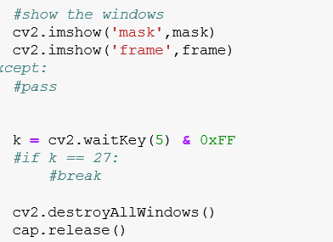
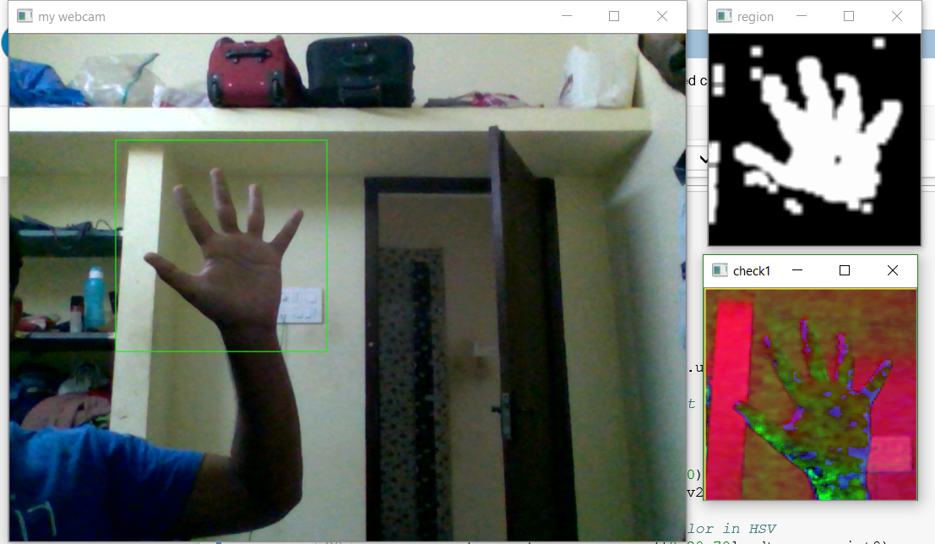
The skin color is detected and the frame is set, and the model is yet to be developed to make it advance!!

Slide 16
THANK YOU
- G.SHARANG RAMANA

