Slide 1


ANALYSIS ON FACEBOOK UTLIZATION
Submitted by
SHARAN KUMAR

Slide 2
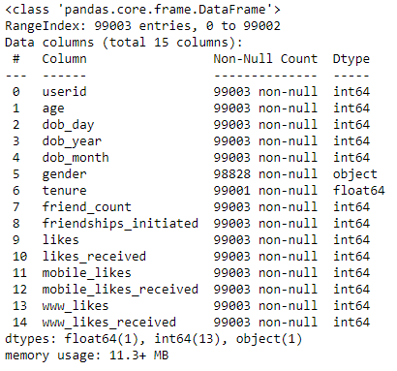
Information about Data Frame

Slide 3
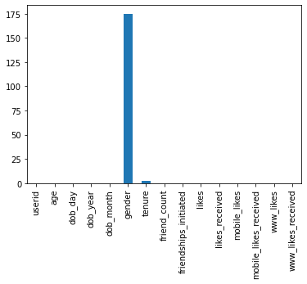
What are the missing values?
In Gender, missing 175 values and in tenure 2 values

Slide 4
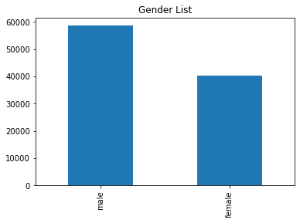
Which gender uses Facebook most?
In gender column, there are 58,574 males and 40,254 females are using Facebook. (Bar-Graph)

Slide 5
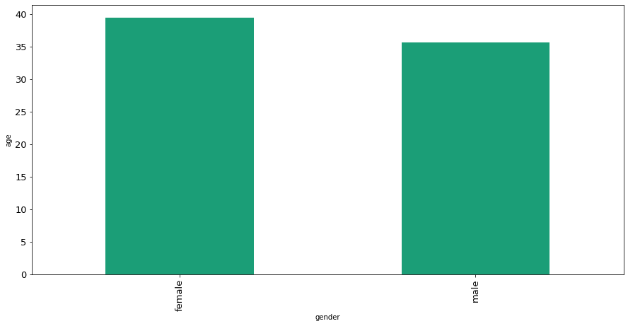
Which gender uses Facebook most in terms of age?
Most of the Female users use Facebook most compared to male users, 39yrs in Female & 35yrs in male

Slide 6
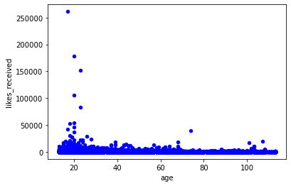
Whose likes received most In terms of age?
18-25 years age of peoples gave most likes in Facebook.(Scatter Plot)

Slide 7
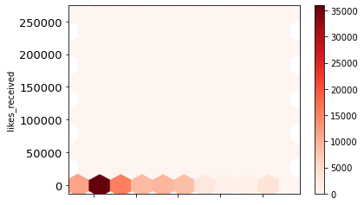
Whose likes received most In terms of age?
18-25 years age of peoples gave most likes in Facebook.(Hex bin Plot)

Slide 8
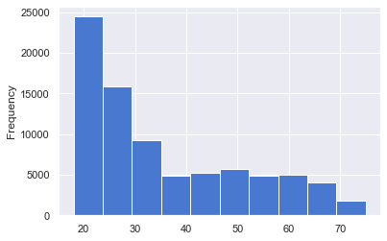

What are the frequency of peoples using Facebook?
In the column age, I found there are peoples who crossed 100 years of age, there are 3687 users whose age crossed 100 yars, hence I cleaned the age and made 18-75 years who use Facebook and more than 75 years are Outliers. (Histogram Plot)

Slide 9
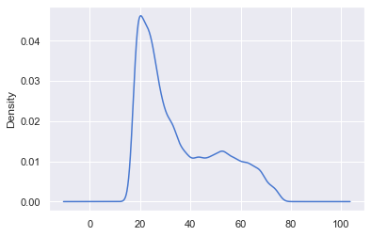
Kernel Density Estimation Plot(age clean)
KDE plot for the age between 18-75 years.

Slide 10
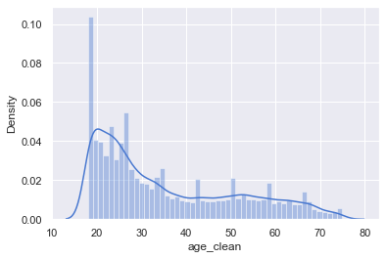
Distribution plot(age-clean)
Distribution plot of age clean from 18-75 years. Distribution plot means that the combination of Histogram and KDE.

Slide 11
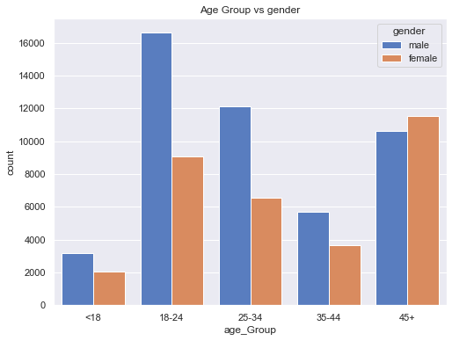
How many users uses Facebook age wise?
I categorized as age group from <18, 18-24,….45+. Age group between 18-24 the counts of male are more who uses Facebook and females at the age 45+ uses Facebook most.

Slide 12
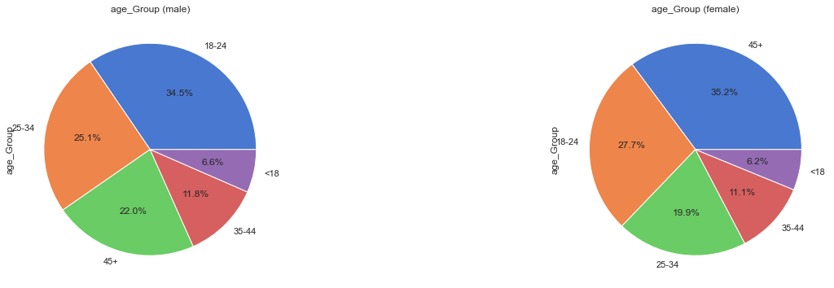
How many users uses Facebook age wise?(donut/pie plot)
In the pie chart/donut chart, its easy to identify whether which age group of male and female uses Facebook most and gives the output in percentage wise.

Slide 13
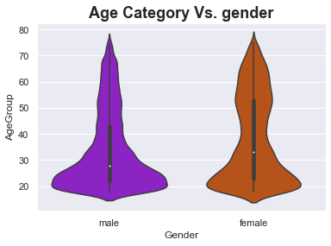
Which age group users uses Facebook?(violin plot)
In male, Higher probability is the age between 18-25 years, lower probability is in the age below 18 years, median is in the age 29 and interquartile range is in between the age 42 and 22.
In female, Higher probability is in the age after 45, lower probability is in the age below 18 years, median is in the age near 32 and interquartile range lies between the age near 52 years and 23 years.

Slide 14
THANK YOU

