Slide 1
APPTITUDE PREPARATION WEBSITE – PracTice.com
Name Roll No.
Nikhitha Jayaprakash 118A1058
Mahalakshmi Thevar 118A1088
Sharan Murli 117A1073

Slide 2
OVERVIEW
INTRODUCTION
Aptitude is a very important aspect of a person’s life. By aptitude, we usually refer to Quantitative aptitude – that basically judges our analytical and problem solving skills. It refers to your unique abilities as a human being – and how well you are able to apply them to specific questions. That's why it’s one of the most important parts of competitive exams and job interviews. You will find aptitude-linked questions in almost every exam paper. Why? The idea is to judge your problem-solving and decision-making skills – which are vital to your academic/professional performance at large. So we decided to develop a website wherein users can get all types of aptitude/Interview questions and solutions so that they can improve their performance and give a statement of competence i.e. A certification of their abilities and problem solving skills.

Slide 3
Project Idea behind Website Creation
People generally believe that aptitude and problem solving skills are not necessary for getting jobs and even for gaining good knowledge. People think that there is no need to study and practice to improve their aptitude and other skills. This is more evident nowadays than ever, when you can see aptitude as being primary to every recruitment team’s assessment of you. This is because aptitude is what predicts how you will perform in your actual job. The main idea to develop such a website was to make everyone aware that aptitude and problem solving skills are very important and to improve those skills there is a need to practice different types of aptitude questions. We have added different elements in our website wherein the user can access different types of aptitude and interview questions and can view their solutions. We have named our Website as PracTice.com .

Slide 4
The user can first register and then login to the website to view and access all the questions and solutions and take different online tests. We have also added a take online test element wherein the users can give online tests on a particular topic. There is also a queries and doubts form wherein the user can ask his/her doubts regarding any question or other things in the website. We have also made our website user-friendly and attractive so that people can enjoy seeing the different elements of the website. We have tried to create a website that is suitable for everyone and which is easy to use and navigate through. We have tried to create something which can have a significant impact on everyone and can change the thinking perspective of each and every individual so that they develop their aptitude and problem solving skills to get a good job in the coming future.

Slide 5
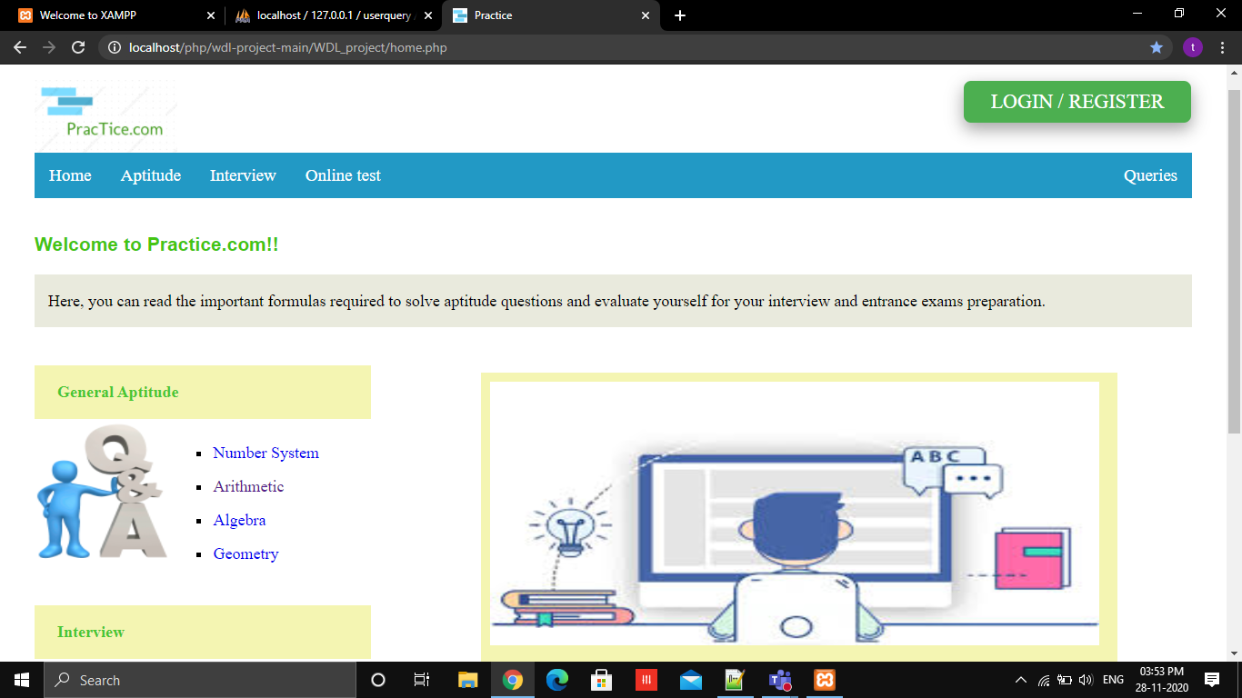
Some Snapshots of the Website

Slide 6
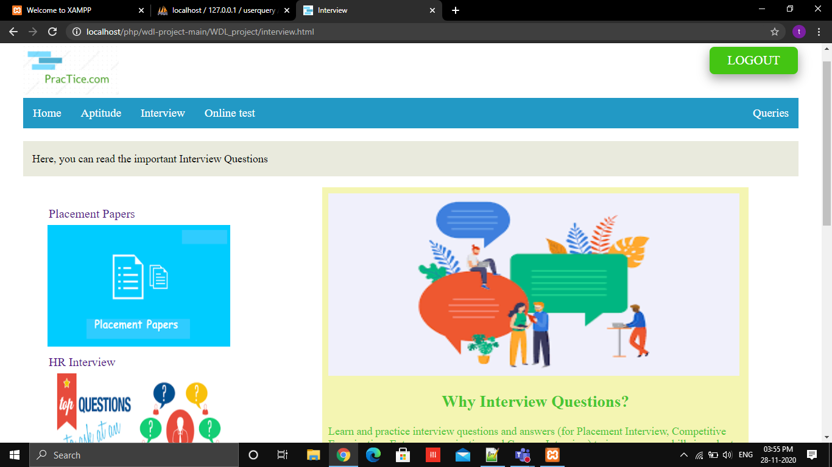

Slide 7
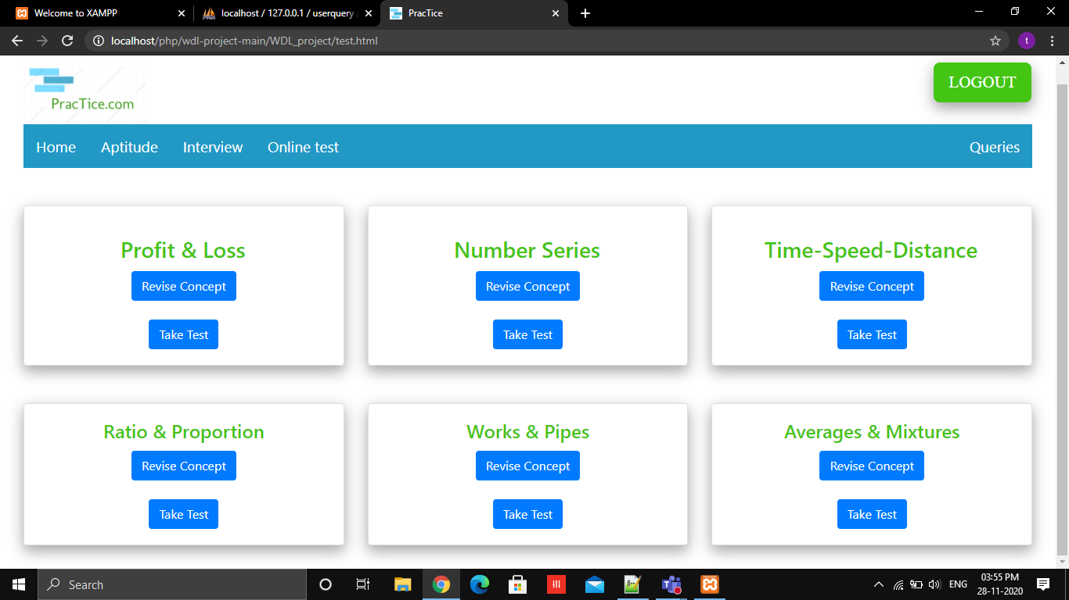

Slide 8
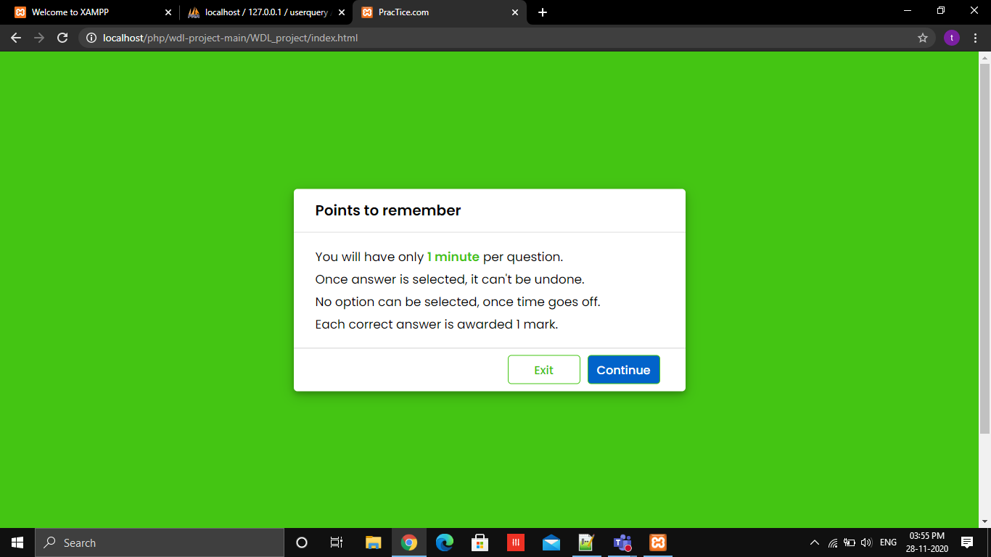

Slide 9
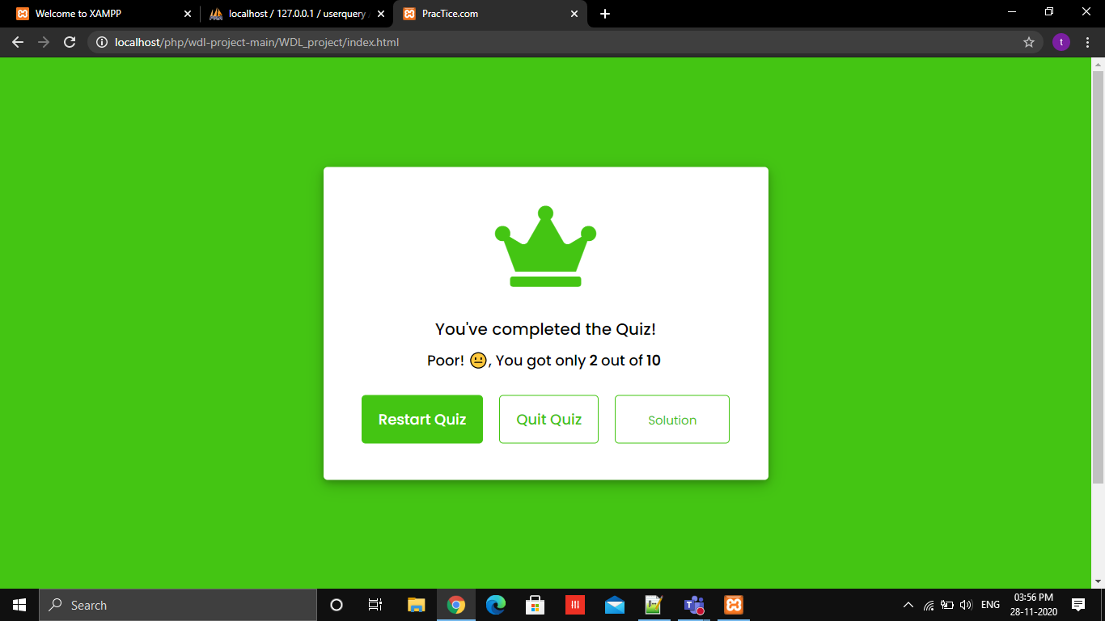

Slide 10
CONCLUSION
The Main objective of choosing this topic was to make people realize that aptitude and problem-solving skills are very important and they are building blocks to get a job in a good company . We also wanted to spread the importance of these skills and to do that we have added different solved aptitude questions so that the user can refer and practice those questions to improve their aptitude. Our idea was also to give a platform to users wherein they can take online tests for a fixed time period and can view their Final score and explanation of the answers as well. Through this website we are providing users with a good experience and allowing them to get free access to the aptitude/Interview Questions.
--THANK YOU

