Slide 1

Smart Parcel Delivery Network
PROJECT GUIDE
Mr. CHINNARAJU K
By
SHARAN M - 2222KB42

Slide 2

ABSTRACT
This project aims to create a web platform that serves as a bridge between parcel senders (those who wish to send items) and public travelers (those traveling from one place to another). The idea is to enable travelers to deliver parcels while they’re already on their journeys, allowing senders to avoid traditional courier services, and providing travelers with an opportunity to earn money by delivering parcels along their routes.

Slide 3
INPUT DESIGN
User Registration | Parcel Posting (Senders) | Parcel Search Filters (Travelers)
Name | Parcel Image | Pickup Location (From)
Email ID | Dimensions (Length, Width, Height) | Delivery Location (To)
Mobile Number | Weight | Parcel Size
Password | Price | Parcel Weight
Address | Pickup Location (From)
Aadhar Card / Driver’s License | Delivery Location (To)

Slide 4
OUTPUT DESIGN
Output Type | Description | Displayed To
User Dashboard | Shows user details, parcel status, and history. | Senders & Travelers
Parcel List Page | Displays available parcels with filters. | Travelers
Tracking Page | Shows real-time parcel status updates. | Senders & Travelers
Notifications | Alerts about parcel selection, pickup, and delivery. | Senders & Travelers
Payment Summary | Shows details of completed deliveries and earnings. | Travelers

Slide 5
DATABASE DESIGN
Users Table
Field Name | Data Type | Description
userId | INT AUTO_INCREMENT PRIMARY KEY | Unique user identifier (Primary Key)
name | VARCHAR(25) | User's full name
emailId | VARCHAR(50) UNIQUE | User's email address (must be unique)
mobileno | BIGINT | User's mobile number (with country code)
password | VARCHAR(10) | Hashed user password
address | VARCHAR(50) | User's address
joindate | DATE | Date the user joined the platform

Slide 6
DATABASE DESIGN
TravelerDetails Table
Field Name | Data Type | Description
travelerId | INT AUTO_INCREMENT PRIMARY KEY | Unique traveler identifier
userId | INT UNIQUE NOT NULL | Foreign key referencing Users(userId)
adharNumber | VARCHAR(20) NOT NULL | Aadhar Card number (mandatory for travelers)
license | VARCHAR(50) NOT NULL | Driver's License (mandatory for travelers)
rating | DECIMAL(2,1) DEFAULT 0.0 | Traveler’s star rating (e.g., 3.5, 4.7)

Slide 7
DATABASE DESIGN
Parcels Table
Field Name | Data Type | Description
productId | VARCHAR(15) | Auto-generated unique ID for each parcel
senderId | BIGINT | Foreign Key: References Users(userId) (Parcel Sender)
travellerId | BIGINT | Foreign Key: References Users(userId) (Traveler who accepts the parcel)
image | VARCHAR(100) | Stores the parcel image path
dimension | VARCHAR(10) NOT NULL | Parcel dimensions (e.g., "10x5x3 cm")
weight | DOUBLE | Weight of the parcel in kg (e.g., 2.50)
price | INT | Price offered for delivery
fromLocation | VARCHAR(50) NOT NULL | Pickup location
toLocation | VARCHAR(50) NOT NULL | Delivery location
status | VARCHAR(10) | Parcel status

Slide 8
MODULE DESCRIPTION
1. User Management Module
Functions:
User Registration (Senders & Travelers)
Login & Authentication (Email/Password)
Profile Management (Update details, upload ID proof)
Role-based Access (Sender, Traveler)
2. Parcel Management Module
Functions:
Parcel Posting (Upload image, weight, dimensions, pickup/delivery locations, price)
Parcel Editing & Deletion (Modify details before pickup)
Parcel Listing (Show available parcels to travelers)

Slide 9
MODULE DESCRIPTION
3. Parcel Matching & Selection Module
Functions:
Search & Filter (Filter parcels by location, weight, size)
Parcel Selection (Travelers reserve parcels)
Sender Notifications (Notify sender when a parcel is selected)
4. Parcel Tracking & Status Module
Functions:
Status Updates (Travelers update status to "Picked Up," "In Transit," "Delivered")
Real-time Tracking (Display current parcel status to sender)
Delivery Confirmation (Sender marks delivery as successful)

Slide 10
MODULE DESCRIPTION
5. Payment & Transaction Module
Functions:
Price Entry by Sender (Set the payment amount)
Payment Confirmation (Traveler receives payment after successful delivery)

Slide 11
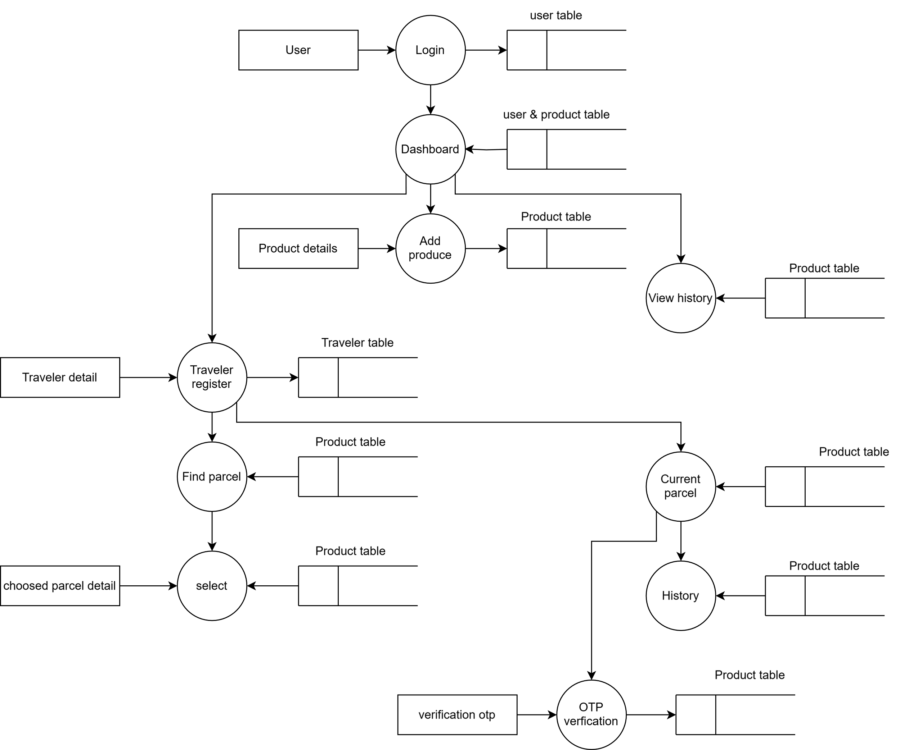
DATA FLOW DIAGRAM

Slide 12
THANK YOU

