Slide 1

Pockets
Empty wallets? Use pockets.

Slide 2

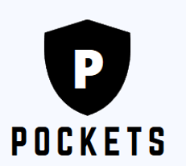
Problem Statement
There are times when you want to borrow a small amount of money and you have no one to lend it to you. How can you get it?
There are times when you have a small amount of money which cannot be invested anywhere. Where can you invest?

Slide 3
Solution
Peer 2 peer Micro Financing system

Slide 4
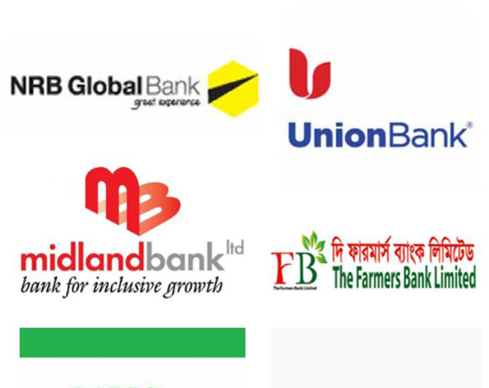

existing Solutions
Micro Financing Banks
P2p loans

Slide 5
Why thy don’t work!
Microfinancing through banks
OMLP2P
Mandatory initial investment
Not user friendly
ROI is high

Slide 6

Proposed solution
A Saas model to transfer money between two different peers in a system with a secure gateway

Slide 7
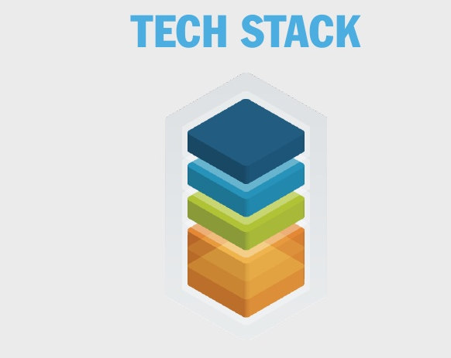
Tech Stack
Multiparty Blockchain
Codeigniter
Bootstrap and Javascript

Slide 8
Our Solution
An app which allows users to request for a micro-loan.
This request is broadcasted to all eligible peers.
Sanctioning of micro-loan can be done by anyone who is willing to lend the money.
Loan re-payment will be given in installments for a fixed amount of time allowed by the investor.

Slide 9
Why use POCKETS?
Investor
Borrower
Rate of return is as high as 32%
Select from high quality borrowers of their choice
Minimized risk due to the security provided by blockchain.
Interest rate as low as 9.99%
No collateral
Less documentation
Seamless online experience

Slide 10
Business model

Slide 11

Requirements
Cloud infrastructure for hosting the app
Initial investment

Slide 12

Cost Structure
Server hosting and maintenance
Bank processing fees
Staffing
Promotions

Slide 13

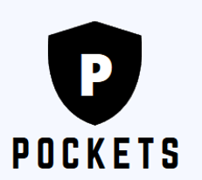
Revenue model
Premium account membership
Interest Rates
Partnerships with e-commerce apps

Slide 14

Client base
College students
Rookie employees
Anyone who wants to borrow money
Anyone who wants to invest money

Slide 15

Customer relationships
A 24x7 tollfree number for reporting problems.
Provide attractive offers to new investors.

Slide 16

Partners
Online E-Commerce websites like
Flipkart
Amazon
BookMyShow

Slide 17
Thank you
TEAM HACKATHRONE
Hari Govind S
Santhosh rishi
Sharan P
Tom Joseph Thomas
Vivek menon

