Slide 1
MGNREGA Karnataka Analytics - FY 2023-24
Automated KPI Report generated via Python

Slide 2
Project Overview
This presentation summarizes the MGNREGA performance metrics across districts of Karnataka.
Key KPIs include:
- Total Individuals Worked
- Total Households Worked
- Total Expenditure and Wages
- Average Wage Rate
- Households Completing 100 Days of Employment

Slide 3
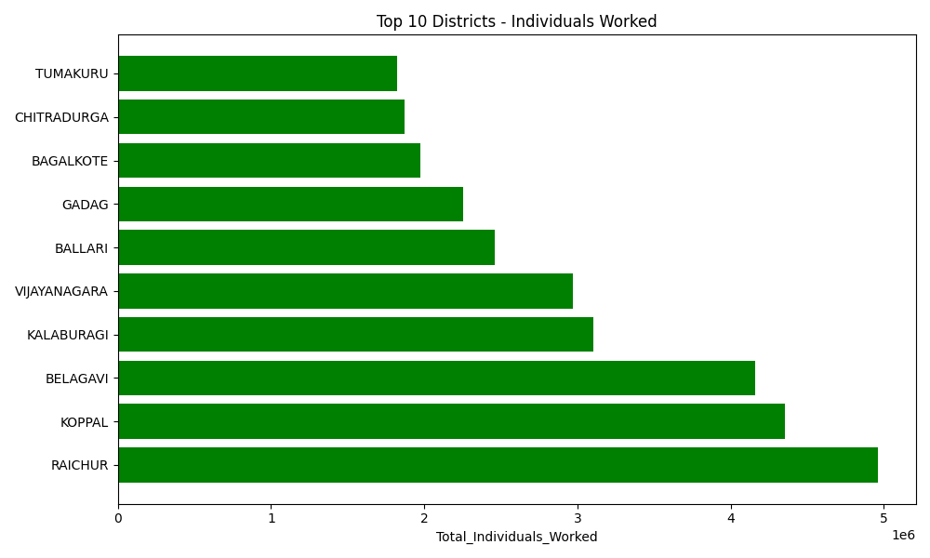
Top 10 Districts - Individuals Worked

Slide 4
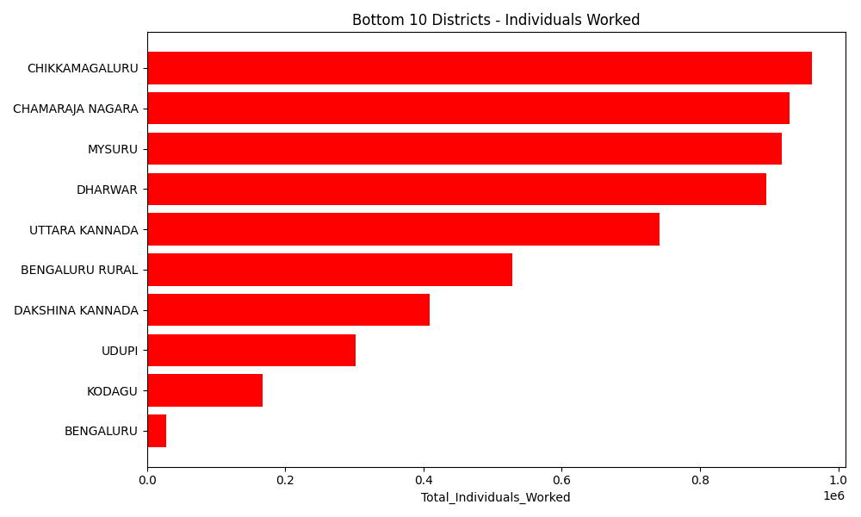
Bottom 10 Districts - Individuals Worked

Slide 5
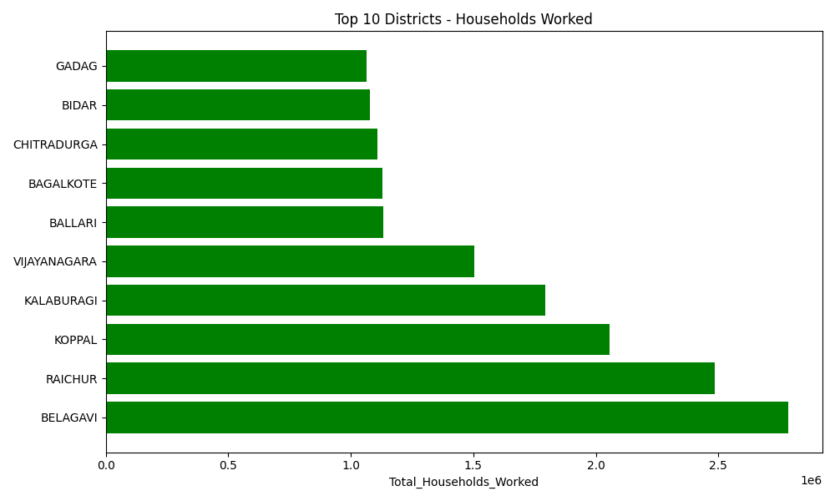
Top 10 Districts - Households Worked

Slide 6
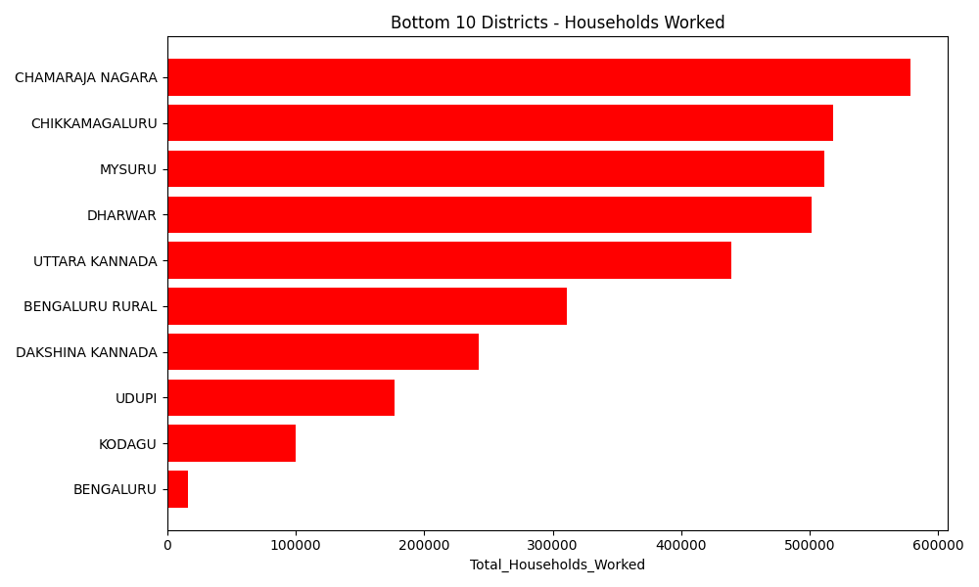
Bottom 10 Districts - Households Worked

Slide 7
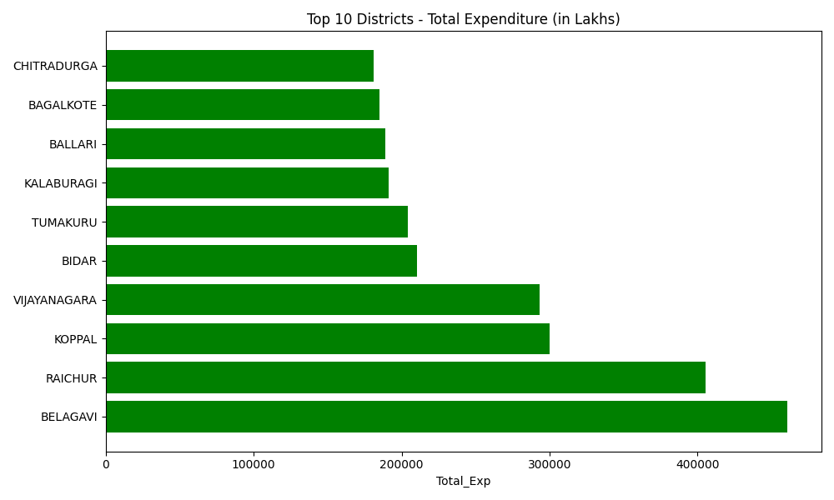
Top 10 Districts - Expenditure

Slide 8
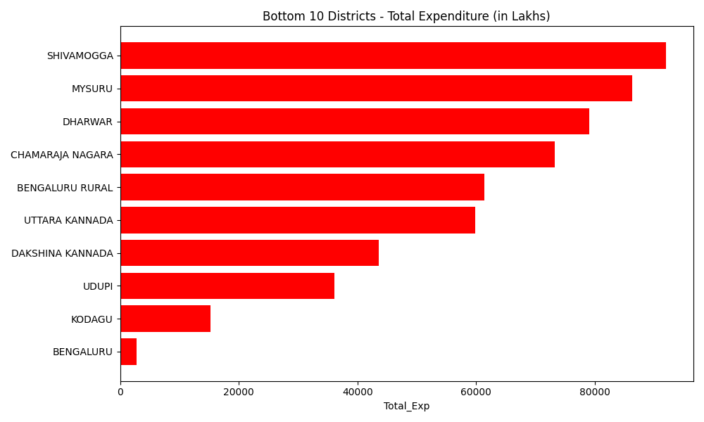
Bottom 10 Districts - Expenditure

Slide 9
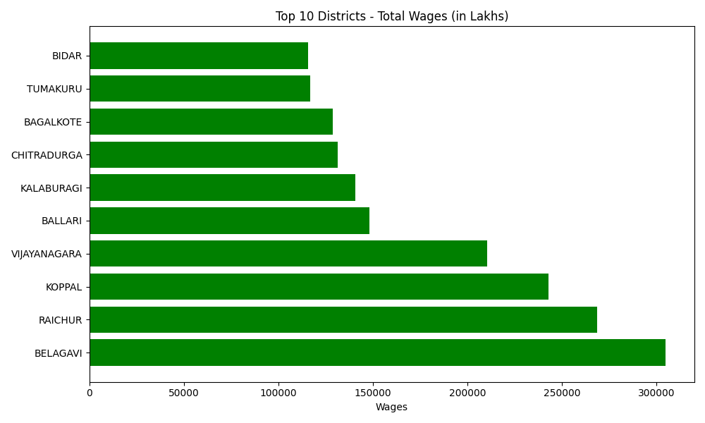
Top 10 Districts - Wages

Slide 10
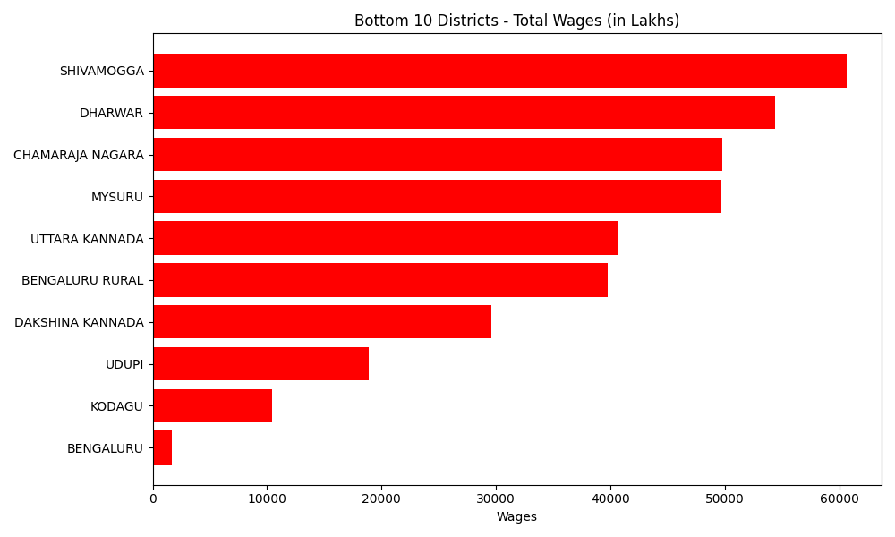
Bottom 10 Districts - Wages

Slide 11
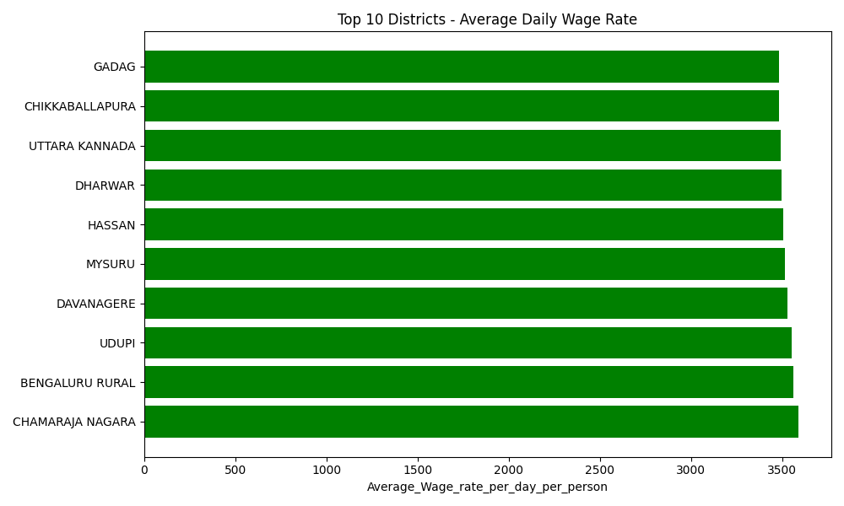
Top 10 Districts - Avg Wage Rate

Slide 12
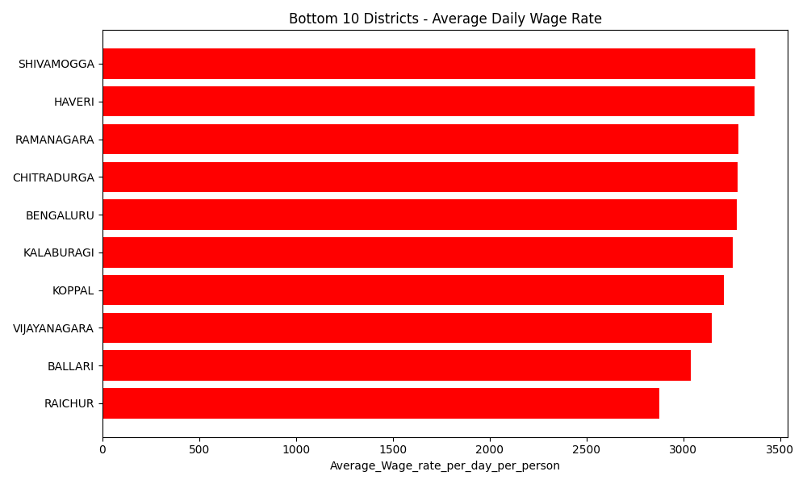
Bottom 10 Districts - Avg Wage Rate

Slide 13
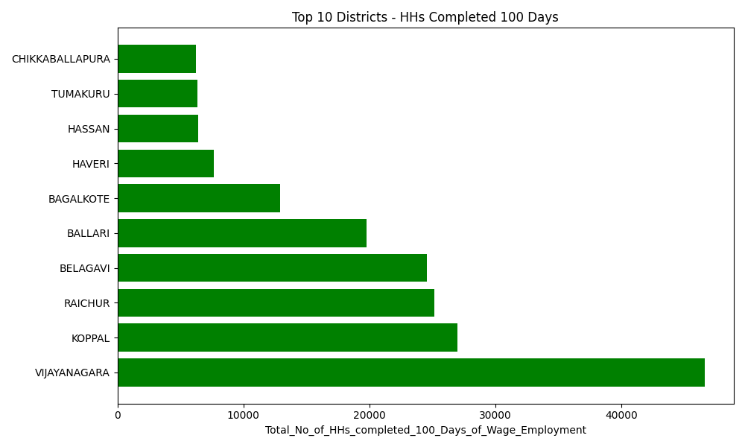
Top 10 Districts - 100 Days Completed

Slide 14
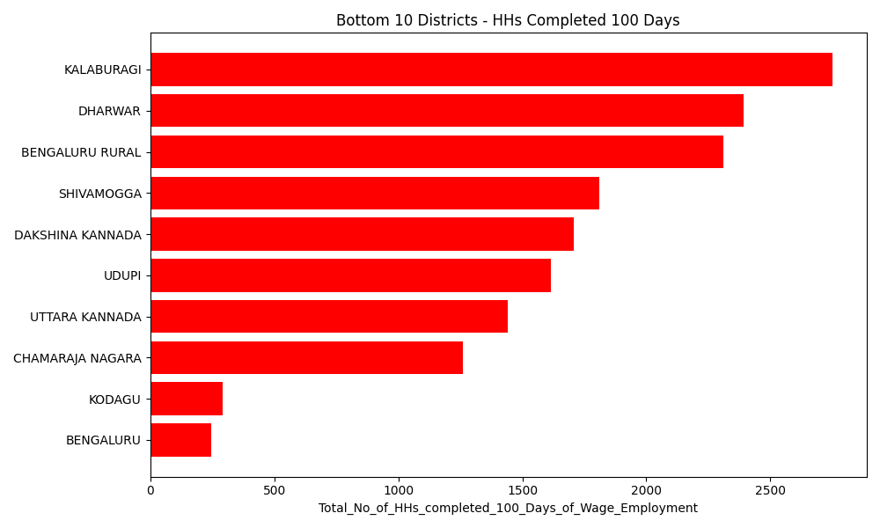
Bottom 10 Districts - 100 Days Completed

Slide 15
Insights Summary
1. Districts like Belagavi, Ballari, and Bagalkote show highest participation.
2. Wage expenditure aligns closely with household engagement.
3. Need improvement in Bengaluru & Kodagu districts.
✅ Generated by: MGNREGA Analytics Automation Script

