Slide 1

Deep Learning for Interference Identification: Band, Training SNR, and Sample Selection
Xiwen Zhang, Tolunay Seyfi, Shengtai Ju, Sharan Ramjee, Prof. Aly El Gamal, ECE Department, Purdue University
Prof. Yonina C. Eldar, Math and Computer Science Department, Weizmann Institute of Science
SPAWC, 2019

Slide 2

Why Wireless Interference Identification?

Slide 3
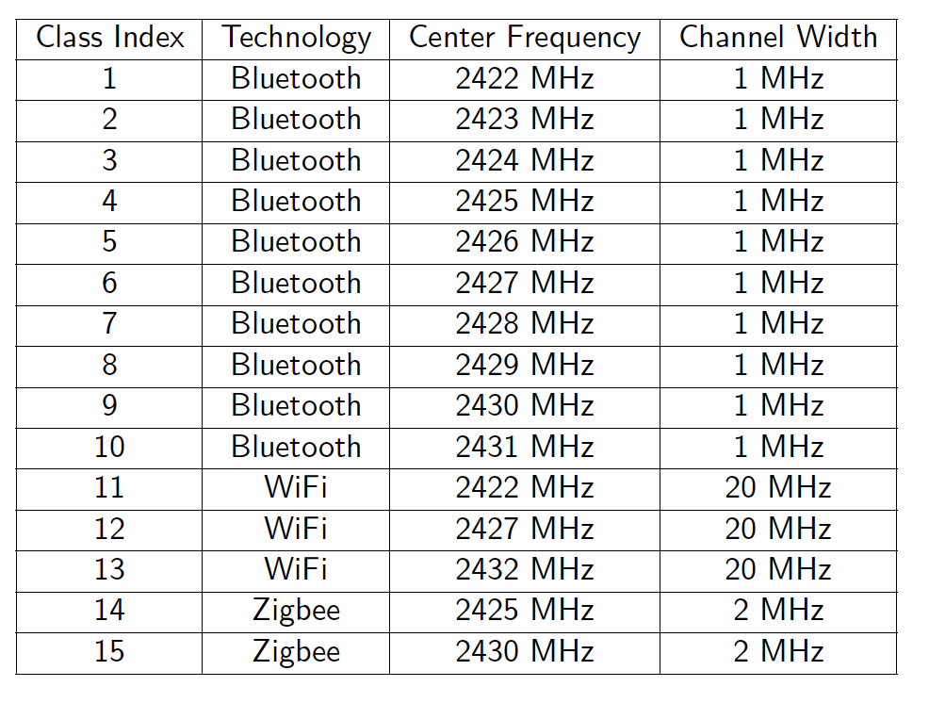
Problem Setup
dataset generated by Schmidtª
225,225 sample vectors for 15 classes in the SNR range of -20 dB to 20 dB with the step size of 2 dB
Each sample vector consists of 128 I/Q samples, corresponding to 12.8μs
I/Q samples of each sample vector are also transformed into the frequency domain by using the Fast Fourier Transform (FFT)

Slide 4
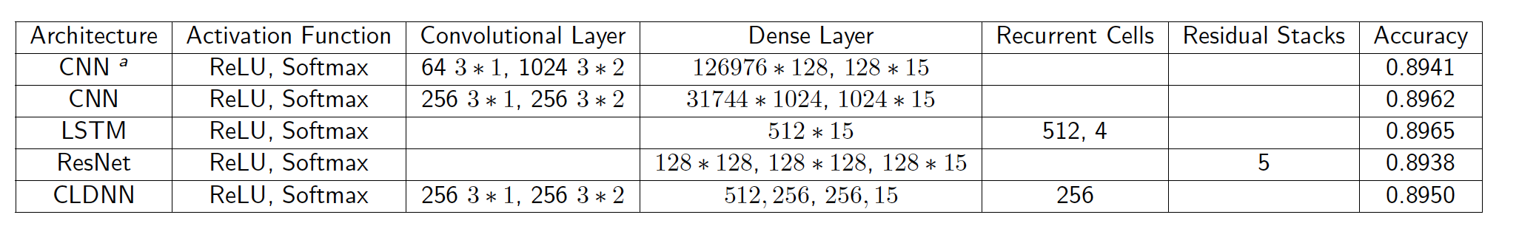
Previous Results and Improvement
four different architectures are studied: CNN, ResNet, CLDNN, and LSTM
based on FFT I/Q data
our proposed CNN architecture delivers a slightly higher accuracy
average training time we obtained for our proposed CNN architecture is around 108s, as opposed to a 180s training time obtained for the original CNN architecture

Slide 5


Results

Slide 6
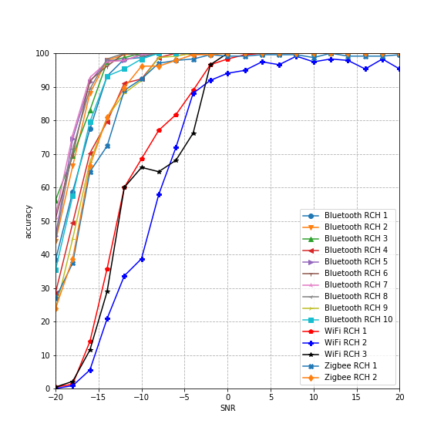
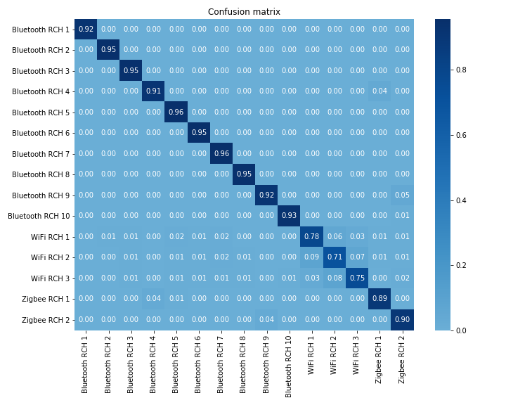
Results
Classification accuracies for the 3 classes of WiFi signals are significantly lower
Focus on the confusion between different WiFi channels

Slide 7

Band Selection

Slide 8
Band Selection
Use only a subset of the 10 MHz frequency range to train and test the neural network classifiers
length of each sample is shorter, neural network shrinks correspondingly
Band selection results in fewer classes, since not all are observable

Slide 9
Band Selection
Start with selecting a narrow band of 2 MHz: from 2429 MHz to 2431 MHz
7 observable classes: 3 bluetooth, 3 WiFi, 1 Zigbee
Training time is reduced by more than 60%
Accuracy for WiFi signals is affected the most
 | 10 MHz | 2 MHz
Bluetooth Accuracy | 94.02% | 91.49%
WiFi Accuracy | 74.67% | 52.55%
Zigbee Accuracy | 89.18% | 92.86%
Total Training Time | 108.64s | 40.75s

Slide 10
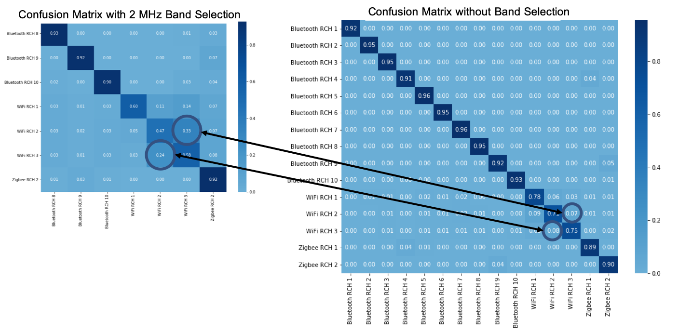
Band Selection: 2 MHz
Select a narrow band of 2 MHz: from 2429 MHz to 2431 MHz
Serious confusion between WiFi RCH 1 and WiFi RCH 2
Select another narrow band to differentiate them!

Slide 11
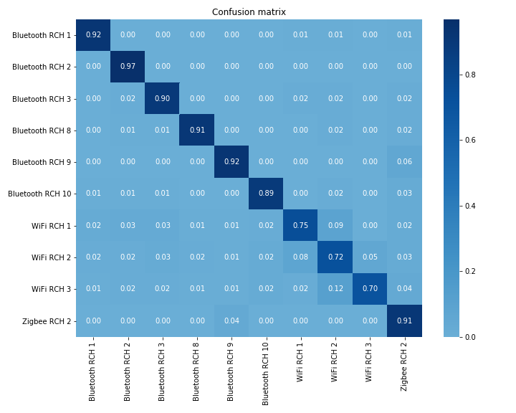
Band Selection: 4 MHz
Select 2 narrow bands: 2422-2424 MHz and 2429-2431 MHz
10 observable classes: 6 bluetooth, 3 WiFi, 1 Zigbee

Slide 12
Band Selection
Accuracy for WiFi signals is improved by 20%
4 MHz band selection reduces the training time by 40%
Accuracy for every technology is preserved
 | 10 MHz | 2 MHz | 4 MHz
Bluetooth Accuracy | 94.02% | 91.49% | 91.96%
WiFi Accuracy | 74.67% | 52.55% | 73.23%
Zigbee Accuracy | 89.18% | 92.86% | 89.67%
Total Training Time | 108.64s | 40.75s | 60.10s

Slide 13
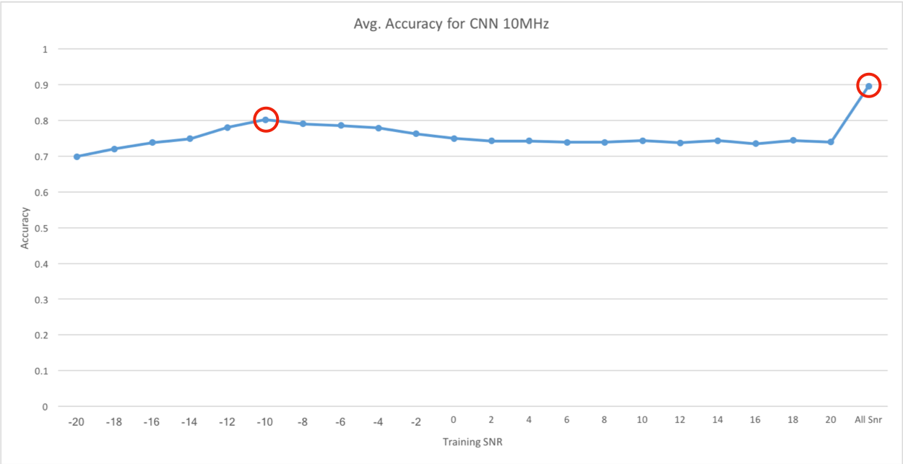
Training SNR Selection: 10 MHz dataset
Use data at a single SNR value to train the model
Training time was reduced drastically
High accuracy for high SNR values
Testing accuracies for different training SNR values are close
Training with -10 dB results in the best average accuracy of about 80%
the average testing accuracies for different training SNR values

Slide 14
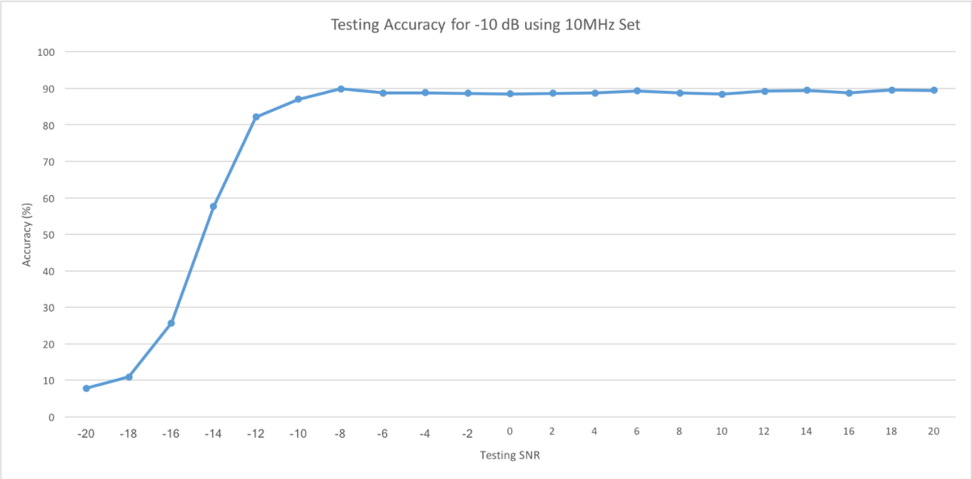
Training SNR Selection: 10 MHz dataset
Training time per epoch is reduced from 16.37s to 0.984s
Total training time is reduced by 92.3%
testing accuracy for each SNR value while training with -10 dB

Slide 15
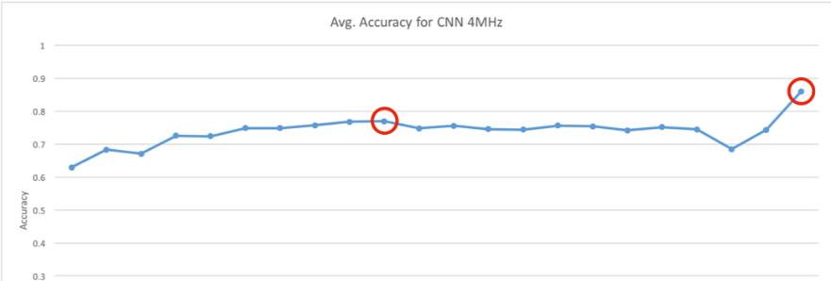
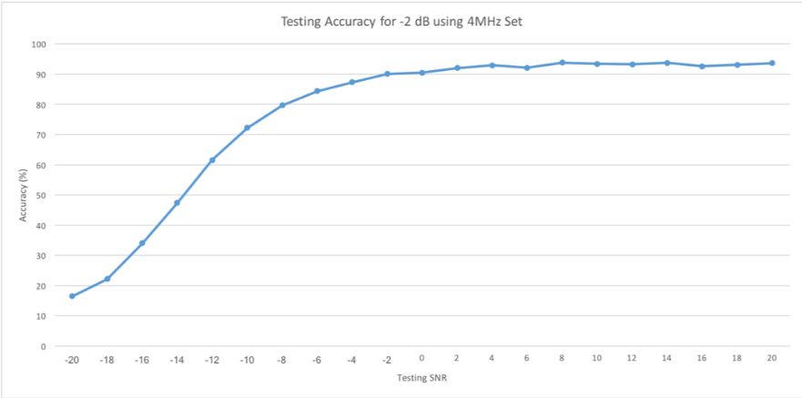
Training SNR Selection: 4 MHz dataset
the average testing accuracies for different training SNR values
Training with only -2 dB data led to best performance with an accuracy of 77%
Total training time is reduced by 90.9%
testing accuracy for each SNR value while training with -2 dB

Slide 16
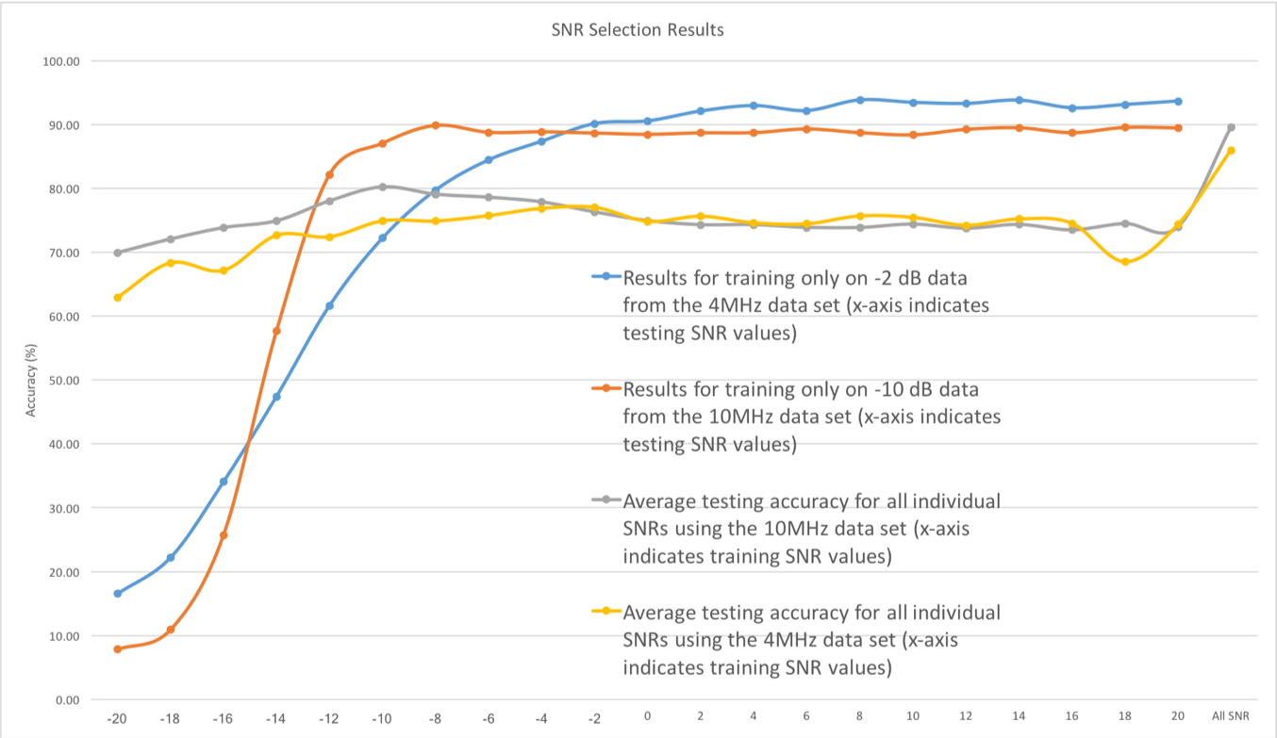
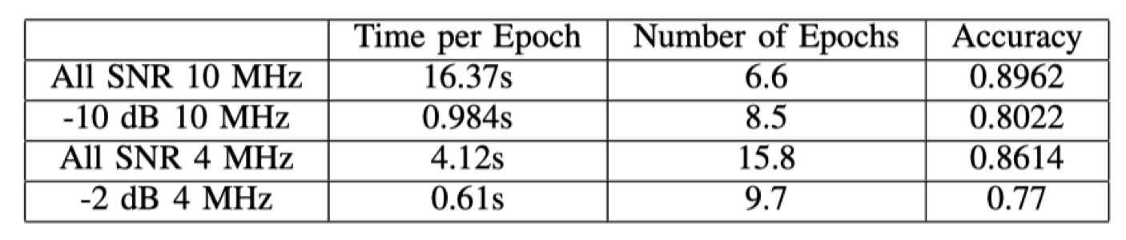
SNR selection
With training SNR selection, the training time is drastically reduced, while the high accuracy for high SNR values is maintained

Slide 17

PCA and Sample Selection

Slide 18
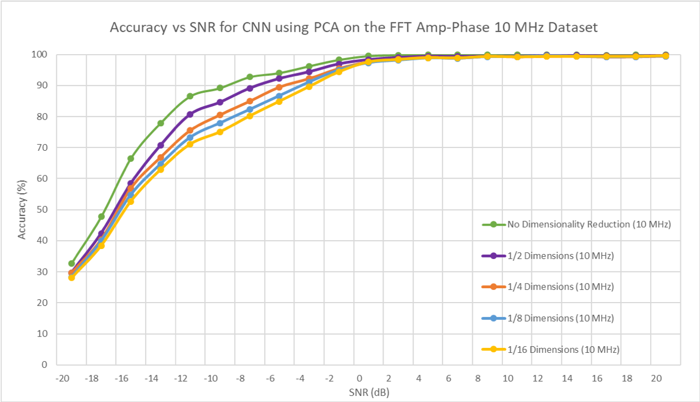
PCA and Sample Selection
Use PCA and various subsampling techniques to reduce the number of dimensions
High accuracy for SNR values above 0 dB for a compression of 16x
Training time reduced by 87.97%, average accuracy is 84.11%

Slide 19
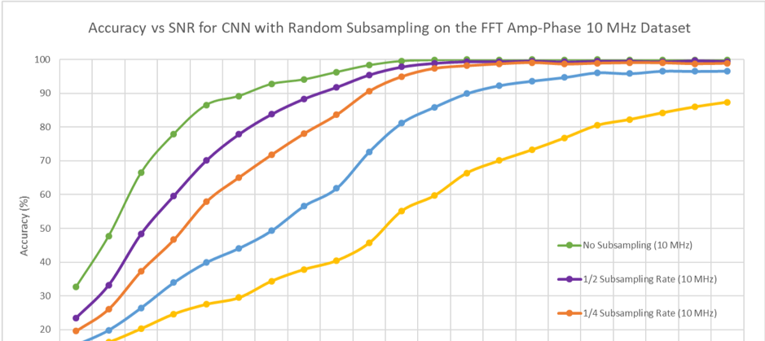
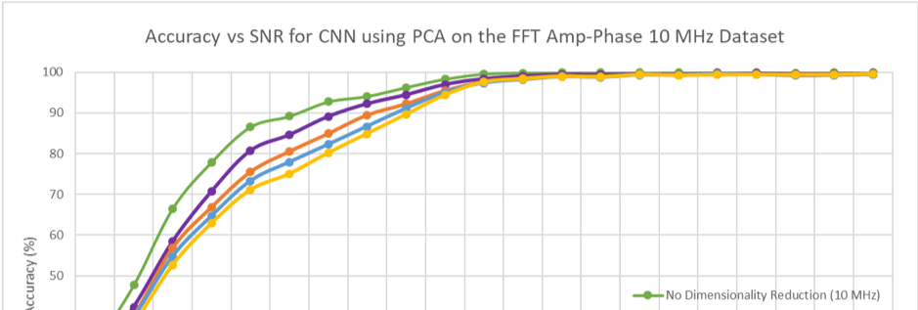
PCA and Sample Selection
Random Subsampling results in large drops in accuracy at low SNR values compared to PCA
High accuracy at high SNR values for a subsampling rate as low as 1/4
Similar results with Uniform Subsampling

Slide 20
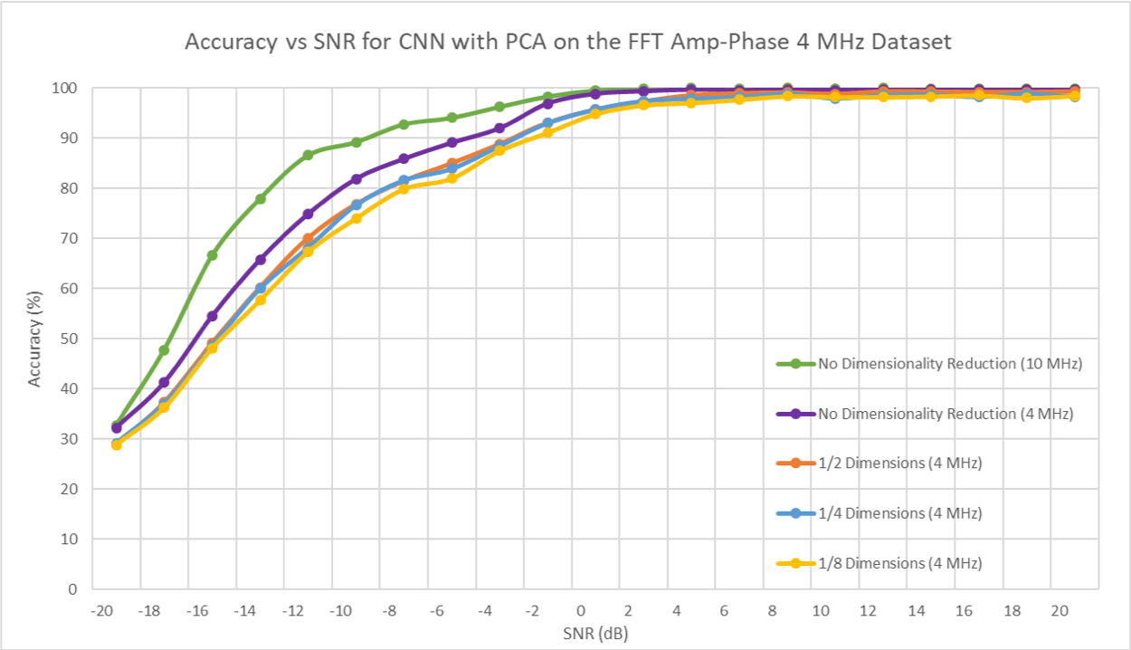
PCA and Sample Selection
Combine PCA with Band Selection (Apply PCA on the 4 MHz Amp-Phase Dataset)
Training time is reduced signicantly
Classication accuracies at moderately high SNR values are still robust

Slide 21
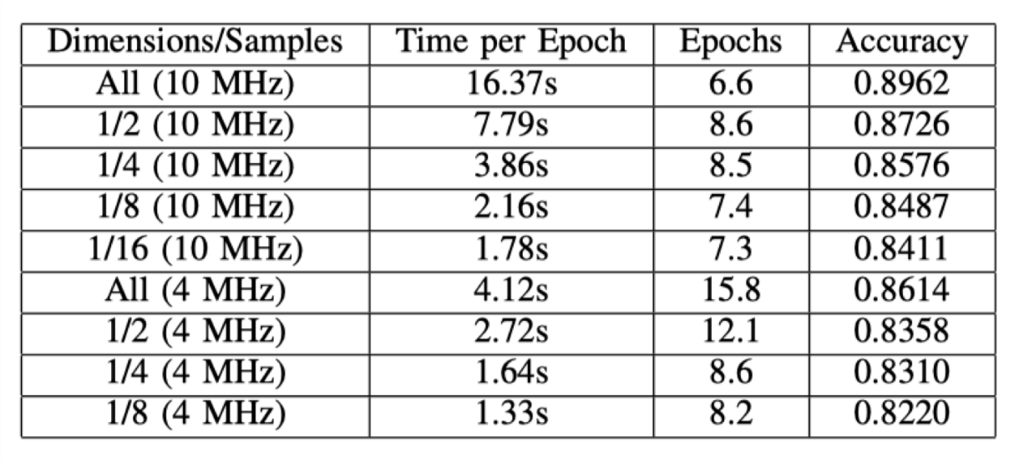
PCA and Sample Selection
Number of features is reduced by PCA, while training time is reduced proportionally
Signicant reduction of total training time (by about 90%)
Classication performances are mostly preserved

Slide 22
Confidence-Based Ensemble Method
 | Mean | Min | Max
CNN | 89.764% | 89.462% | 89.952%
LSTM | 89.713% | 89.488% | 89.972%
ResNet | 89.405% | 89.126% | 89.701%
CLDNN | 89.903% | 89.704% | 90.041%
Considered network architectures: CNN, LSTM, CLDNN & ResNet
All models result in similar accuracies of 89.xx% on the test set

Slide 23
Confidence-Based Ensemble Method
Ensemble method combines decisions from multiple models to improve the overall performance
The simplest ensemble method is voting
We tried voting, it doesn’t work well…
Instead, for every decision made by each model, we assign a confidence score for it
To predict the label for each sample in the test set, we choose the most confident model to make the decision
There are two candidate confidence scores:
The precision score
The output of the last layer (softmax)

Slide 24
Confidence-Based Ensemble Method
 | Mean | Min | Max
CNN | 89.764% | 89.462% | 89.952%
LSTM | 89.713% | 89.488% | 89.972%
ResNet | 89.405% | 89.126% | 89.701%
CLDNN | 89.903% | 89.704% | 90.041%
Softmax-based | 90.067% | 89.921% | 90.312%
Precision-based | 89.743% | 89.519% | 89.941%

Slide 25
Confidence-Based Ensemble Method
SNR | (# times) softmax is better | (# times) precision is better | (# times) softmax and precision are equal
-20 | 22 | 3 | 0
-18 | 24 | 1 | 0
-16 | 25 | 0 | 0
-14 | 25 | 0 | 0
-12 | 23 | 1 | 1
-10 | 24 | 1 | 0
-8 | 20 | 4 | 1
-6 | 23 | 2 | 0
-4 | 20 | 4 | 1
-2 | 16 | 9 | 0
0 | 12 | 9 | 4
2 | 12 | 6 | 7
4 | 8 | 8 | 9
6 | 2 | 16 | 7
8 | 7 | 5 | 13
10 | 7 | 13 | 5
12 | 4 | 14 | 7
14 | 9 | 10 | 6
16 | 2 | 13 | 10
18 | 4 | 14 | 7
20 | 1 | 20 | 4

Slide 26
Confidence-Based Ensemble Method
 | Mean | Min | Max
CNN | 89.764% | 89.462% | 89.952%
LSTM | 89.713% | 89.488% | 89.972%
ResNet | 89.405% | 89.126% | 89.701%
CLDNN | 89.903% | 89.704% | 90.041%
Softmax-based | 90.067% | 89.921% | 90.312%
Precision-based | 89.743% | 89.519% | 89.941%
combine both | 90.081% | 89.921% | 90.339%
Combining these two confidence measure:
Use softmax for SNR from –20 dB to 2 dB
Use precision score for SNR from 4 dB to 20 dB

Slide 27

What is Ax?
Ax is a platform developed by Facebook to explore a large parameter space in order to identify optimal configurations in a resource-efficient manner
It supports Bayesian optimization for continuous-valued configurations and bandit optimization for discrete configurations
We can use it to tune hyper parameters for deep learning models

Slide 28
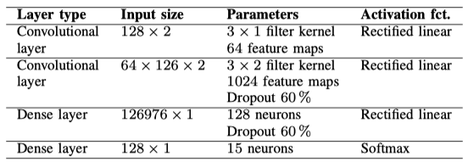
Ax to search for dropout rate
Dropout is an effective technique for regularization
In the previous work by Schmidt, they set the dropout rate to 0.6
It is a magic number. It is possible to use trial and error to determine the value
We use Ax to search for the best value

Slide 29
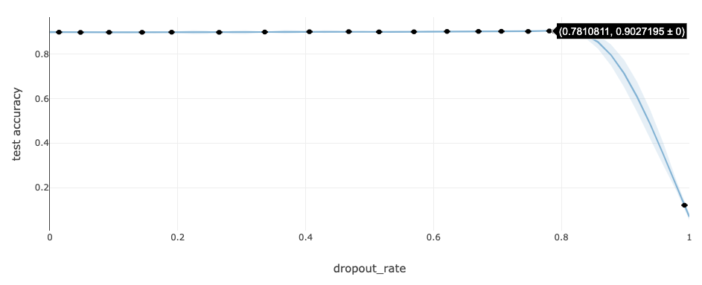
Ax to search for dropout rate
The best dropout rate found by Ax is 0.78108
The accuracy on the test set is improved from 89.62% to 90.27%

Slide 30

Future Work & Challenges
We plan to use Ax to optimize more hyperparameters, like learning rate, number of filters, filter size, number of neurons in the fully connected layer…
Ax prefers models with high variance, which means it tends to look for models that overfit the data
More hyperparameters are optimized, more experiments are needed for Bayesian Optimization algorithm to converge

Slide 31
What is AutoKeras?
AutoKeras is an open source software library for automated machine learning (AutoML) or Neural Architecture Search (NAS)
It is developed by DATA Lab at Texas A&M University
It use network morphism guided by Bayesian optimization to search the best neural network architecture
It’s more computation efficient compared with other NAS algorithms
NASNet by Google takes 48000 GPU hours, which is unaffordable

Slide 32
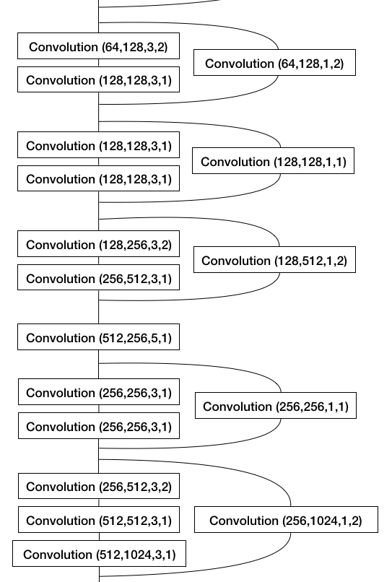
AutoKeras to Search for Neural Network Architectures
Architecture was found by AutoKeras after a 24-hour search
It is a variant of ResNet
Its accuracy on the test set is 90.22%

