Slide 1



Cov2GenX
An intelligent model for predicting mutation-resistant peptide candidates for Covid-19 vaccines
Center for Artificial Intelligence in Medicine & Imaging
Presented at the AIMI-HIAE COVID-19 Researchathon

Slide 2
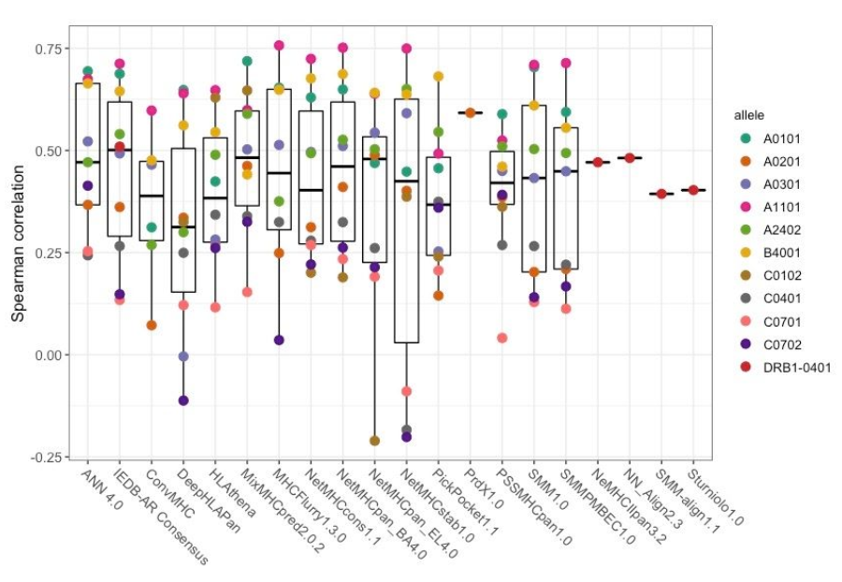

Problem
No peptide vaccine candidates
No mutation data inclusivity
No immunity profiling
Assumption that ‘one’ will fit all
1
2
3
4
Top 5 candidate vaccines currently under clinical trial are viral or nucleotide based
Vaccines are being developed with localized genomic data, excluding potential mutations which can reduce their efficacy and applicability
Differences in HLA-haplotyping amidst global populations can have a direct impact on the immunological response to the vaccine
Cov2GenX

Slide 3
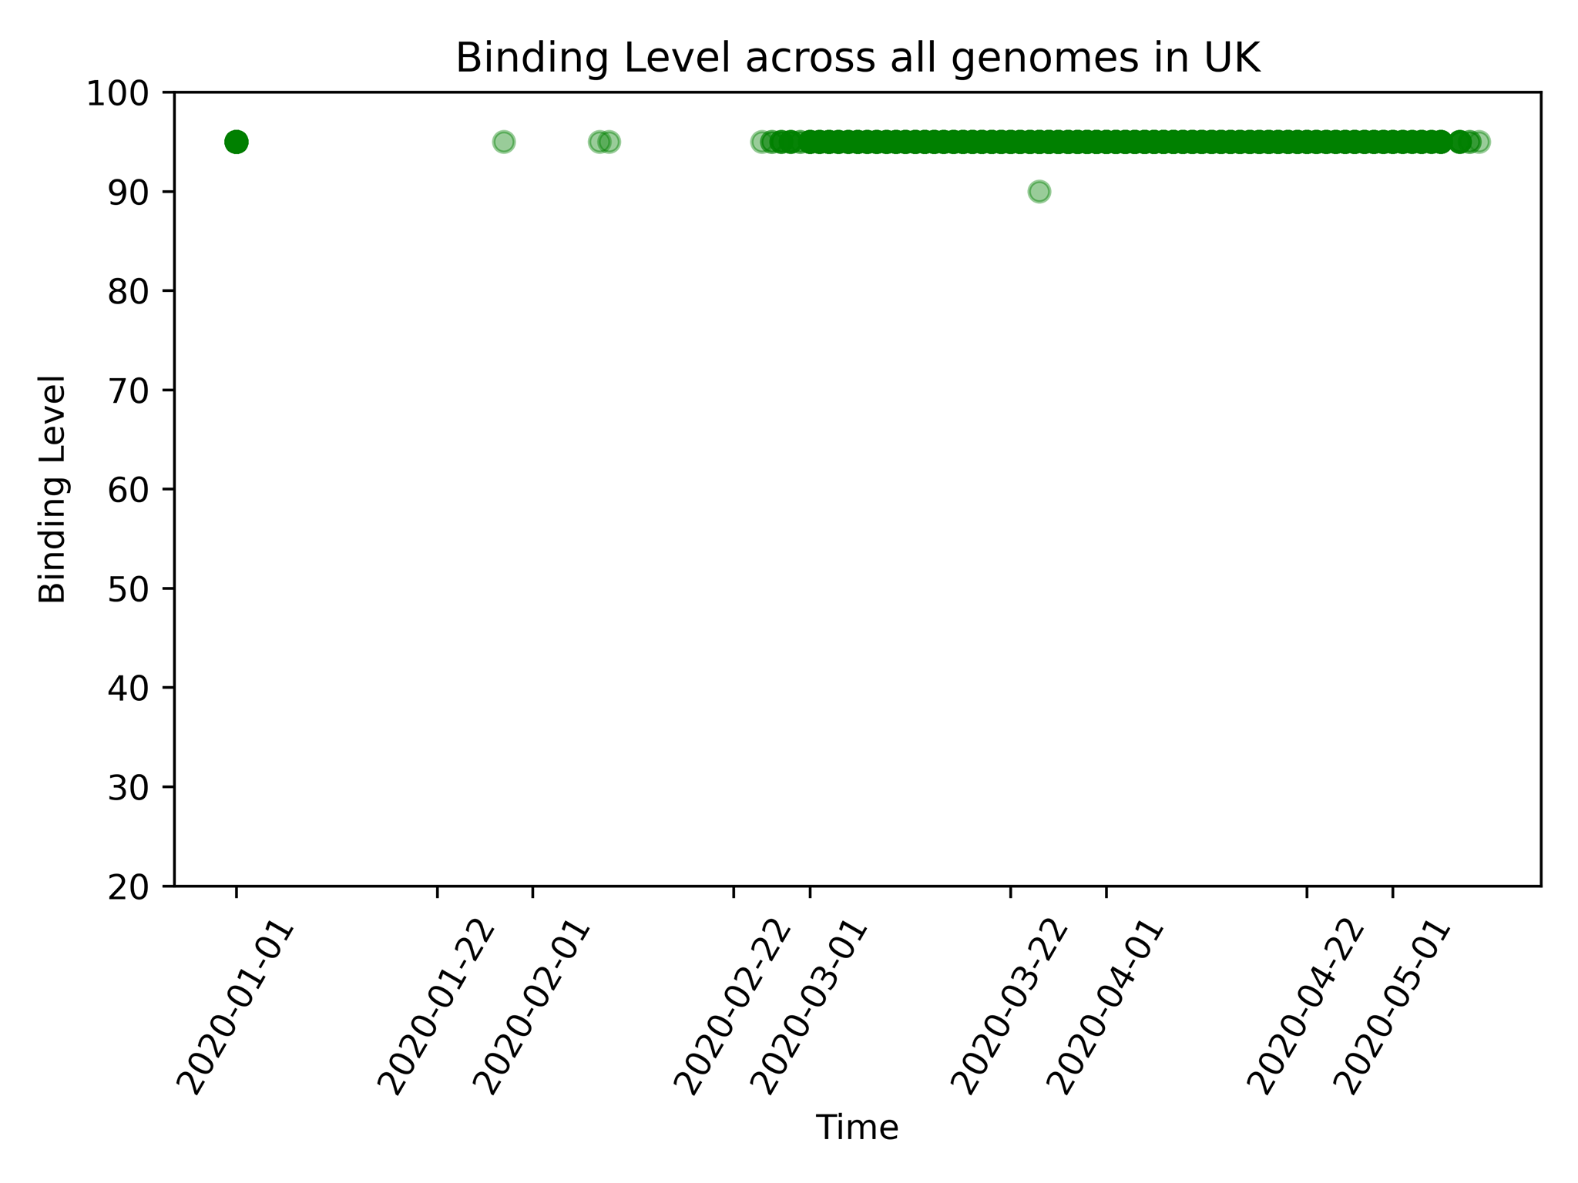

Slide 4
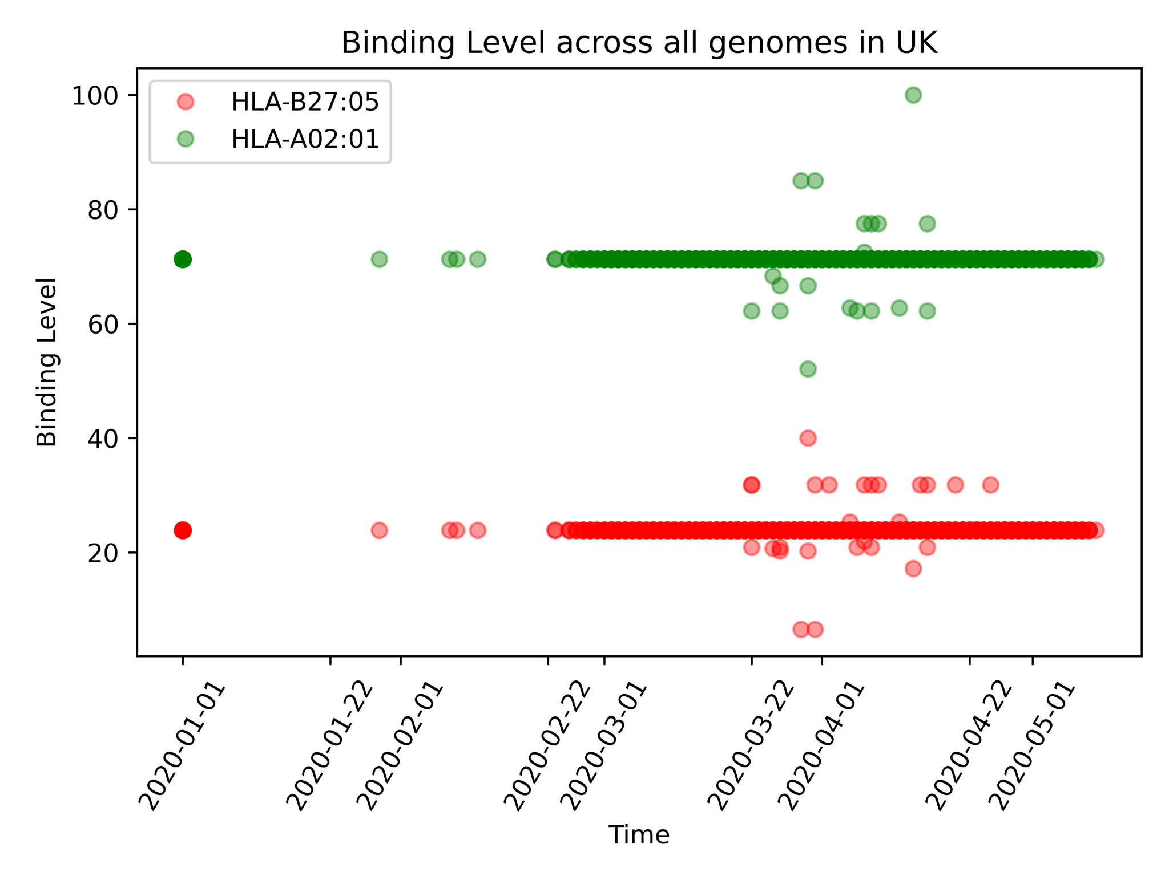

Slide 5
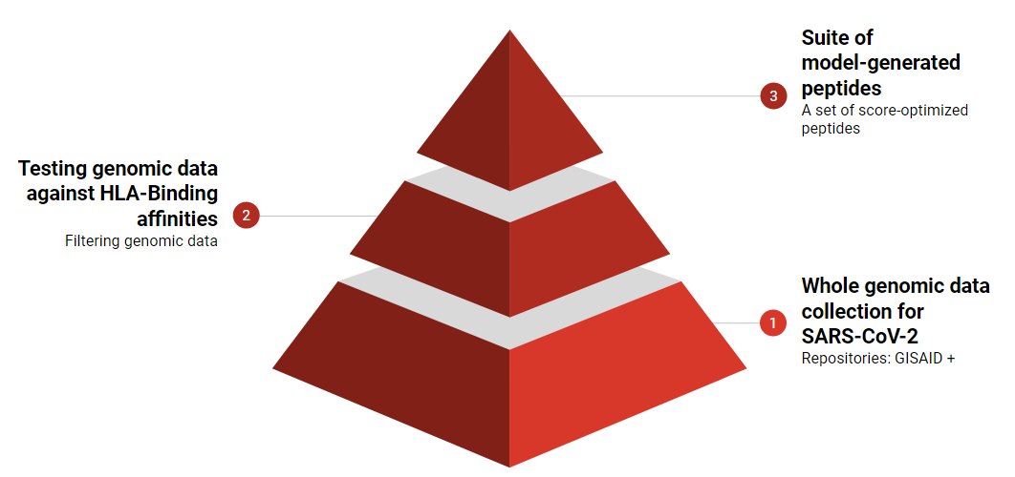
Solution
Curate pipeline to generate potential peptides for vaccine
Inclusion of large scale genomic mutation data for a robust set of mutation-resistant peptides
Inclusion of regionally derived HLA-haplotype data to categorize peptides based on race and ethnicity
Cov2GenX

Slide 6
Workflow pipeline
Collect HLA-haplotype and genomic data
Apply automated pipeline for peptide identification and scoring
HLA DB (143k)
netMHCpan (affinity)
ProtSA (ab avail)
SARS CoV-2 Genomes (18K)
NetChop (peptides)
peptides
Curate a robust dataset with HLA-specific peptide data
Train Gradient Boosted Decision Trees to generate mutation-aware vaccine suite
feature annotations
cov2genx peptide db (py dict)
SC2-MAP
Feature Sets
Cov2GenX

Slide 7
SC2-MAP Dataset
Features – per-peptide, multi-genome, multi-HLA
Peptide (individual amino acids, in order) [Categorical]
Position in protein [Integer]
Edit distance (number of mutations in the peptide) [Integer]
HLA (type of immunological response to the vaccine) [Categorical]
Location (city/country of sample collection) [Categorical]
Relative date of sample collection [Integer]
Labels
Mutation-aware binding score [Float]

Slide 8
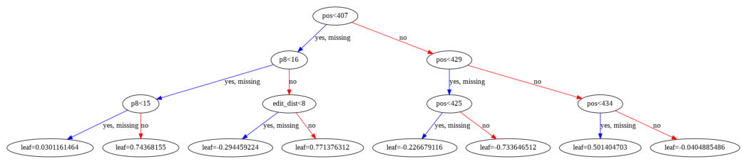
Results
Train set: Samples collected before 1 April 2020
Test set: Samples collected after 1 April 2020
Trained an ensemble of 100 XGBoost GBDTs to predict mutation-aware binding scores
Obtained a Regression NRMSE of 0.03399.
Performed the Chi-square test to reject the null hypothesis and ensure a goodness of fit

Slide 9
Why GBDTs over Neural Networks
Explainable AI (XAI) standpoint
Neural networks are black boxes
Government regulations prevent many uses in medical industry
In contrast, GBDTs allow
Trace decision path
Provide confidence and model interpretability
Provides estimate of feature importances
Debug and improve the model
Provide researchers insights on issues at hand (Location based mutations, etc)

Slide 10
Work done so far
Moving forward
Identified a niche problem
Generated a novel dataset (347,022,410 examples)
Processed and filtered the dataset
Trained Gradient Boosted Decision Trees
Incorporate solvent accessibility
Further train the model using a larger genome database
Compare rank-scored peptides vs. peer reviewed scores
In silico analysis of peptide suite for drug-likeness and ADMET

Slide 11
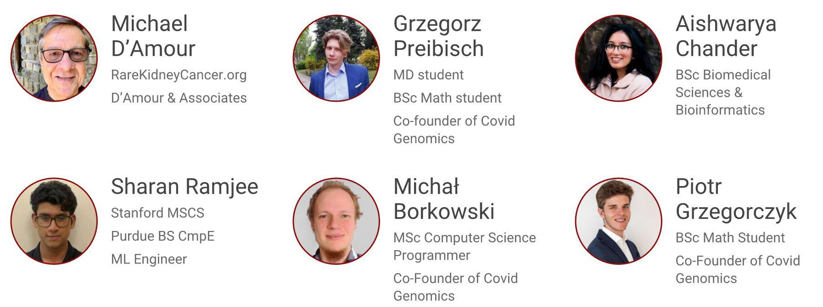

Meet the team
Cov2GenX

Slide 12
Questions?
Thank you.

Slide 13
References
Nguyen A, David JK, Maden SK, et al. Human leukocyte antigen susceptibility map for SARS-CoV-2. Journal of Virology. April 2020. doi:10.1128/jvi.00510-20
Prachar M, Justesen S, Steen-Jensen DB, et al. COVID-19 Vaccine Candidates: Prediction and Validation of 174 SARS-CoV-2 Epitopes. bioRxiv. March 2020. doi:10.1101/2020.03.20.000794
Kennedy RB, Ovsyannikova IG, Vierkant RA, Jacobson RM, Poland GA. Effect of human leukocyte antigen homozygosity on rubella vaccine–induced humoral and cell-mediated immune responses. Human Immunology. 2010;71(2):128-135. doi:10.1016/j.humimm.2009.11.002
‌Gartland AJ, Li S, McNevin J, et al. Analysis of HLA A*02 Association with Vaccine Efficacy in the RV144 HIV-1 Vaccine Trial. Journal of Virology. 2014;88(15):8242-8255. doi:10.1128/jvi.01164-14
Cov2GenX

