Slide 1

Department of Computer Science and Engineering
Senior Design Project — Review 2
Code: 20ECSW401 VII Sem Year: 2026-27
Project Title: AI-Powered Lung Disease Detection System
Screens chest X-rays and CT slices, explains every prediction, and refuses images it can't handle.
Team Details
Sl.no | Name | USN
1. | Sharan Pachapuri | 01FE23BCS027
2. | Sampad Gaonkar | 01FE23BCS024
3. | Vijet Nayak | 01FE22BCS324
Under the guidance of : Prof. Indira Bidari, Assistant Professor
Notes:
Introduce the team and guide. Review 2 covers the design of the system: requirements, architecture, design decisions, UML models, design patterns and APIs, detailed design (algorithms and pseudo code), and the implemented and tested modules.

Slide 2
Contents
1. System Requirements
2. Design Principles, Assumptions & Constraints
3. System Architecture
4. Design Decisions: Criteria-Based Selection
5. UML: Use Case & Class Diagrams
6. UML: Sequence & State (UX Flow)
7. Design Patterns & API Structure
8. Detailed Design: Algorithm Selection
9. Pseudo Code & Mathematical Models
10. Implementation, Integration & Testing
Notes:
Ten content slides, each mapped to a Review-2 rubric indicator (shown in orange), in the order the rubric lists them: requirements, architecture and design decisions, detailed design, then the implementation, testing and tools.

Slide 3
System Requirements
ID | Functional requirement: the system shall …
FR1 | Accept a chest X-ray or CT image (PNG/JPEG, ≤ 10 MB)
FR2 | Reject empty, corrupt, blank or colour images
FR3 | Reject non-scans and wrong or uncertain modality
FR4 | Reject images outside the training distribution (OOD)
FR5 | Classify X-ray (4 classes) and CT (3 classes) with confidence
FR6 | Crop chest X-rays to the lung fields (U-Net)
FR7 | Show a Grad-CAM heatmap for every prediction
FR8 | Write a non-diagnostic report (template if LLM is down)
FR9 | Answer questions through a scoped chat assistant
FR10 | Sign-up, email verification, login (email/Google), reset
FR11 | Save each user's scans and show the history
FR12 | Verify each model's validation metric at start-up
ID | Non-functional requirement
NFR1 | Performance: ≈1.3 s per prediction on a laptop
NFR2 | Correctness: serve exactly the models whose metrics are reported
NFR3 | Security: bcrypt passwords, signed 7-day JWT, rate limits
NFR4 | Usability: no manual needed; every rejection in plain English
NFR5 | Safety: never shown as a diagnosis; disclaimer on every result
NFR6 | Maintainability: one .env config file; automated test suite
From the literature review: prior work covers one modality, gives no explanation and never checks the input, which led to FR3–FR5 (input guards) and FR7–FR9 (explainability).
Notes:
Requirements come from the literature gap found in Review 1: existing systems handle one disease or modality, return a bare label, and accept any image. FR3–FR5 address input validity, FR7–FR9 explainability. NFR1 was measured: mean 1.26 s (X-ray) and 1.29 s (CT) end to end, including the report. Full list with use-case descriptions is in Chapter 2 of the report.

Slide 4
Design Principles, Assumptions & Constraints
Design principles and why we chose them
Assumptions
1
Refuse rather than guess
A plain classifier labels anything: a random photo scored 92% “X-ray”. Three gates and an OOD check give it a “none of the above”.
Frontal X-ray or axial CT slice of diagnostic quality
One 2D image (PNG/JPEG) per request
Users can use a web browser
A clinician makes the final decision
2
Explain every answer
Every result carries a Grad-CAM heatmap, all class probabilities, a low-confidence warning and a plain report.
3
Serve what was measured
Checkpoints store their validation metric and are re-scored at start-up; this caught one real data mismatch.
Constraints
Public data only: 19,217 X-ray, 10,036 CT images
Must run on a laptop CPU
Not a certified medical device
4
Transfer from relevant data
Chest-X-ray-pretrained DenseNet-121 and a class-weighted loss (TB is 3% of data) reach 96.5% validation accuracy.
5
Safety by construction
Prompts forbid diagnosis and treatment advice; the same disclaimer appears from the LLM or the template.
Notes:
Each principle is justified by something we measured or observed. The 92% figure: before the sanity gate existed, a random photograph was scored 92% 'xray' by the modality gate and also passed the OOD check. The start-up re-scoring caught a checkpoint trained on a different version of the data. Assumptions and constraints are in Section 3.4 of the report.

Slide 5
System Architecture (Three-Tier)
Client tier
Application tier — FastAPI back end
Client
React UI
Input checks
Size, blank, colour
Sanity gate
Is it a scan?
Modality gate
X-ray or CT?
Lung crop
U-Net, X-ray only
Result
Class, heatmap, report
Save scan
SQLite history
Gen AI report
Groq LLM + chatbot
Classifier
DenseNet + Grad-CAM
OOD detector
Like training data?
Rejection gate: if the check fails, the request stops here and the user is told why (HTTP 400 / 413 / 422)
Data tier: SQLite (users, tokens, scans) and a model store (6 checkpoints, OOD statistics)
External services: Groq LLM (report, chat), Gmail SMTP (emails), Google OAuth 2.0 (sign-in)
Notes:
Three tiers. Client: React 19 single-page app; every request goes through api.js. Application: FastAPI with 15 routes; the prediction route runs input checks, sanity gate, modality gate, U-Net crop (X-ray), OOD check, classifier with Grad-CAM, LLM report and saves the scan. Any red stage can stop the request with a plain-English reason (HTTP 400/413/422). Data: SQLite with three tables plus the model store. External: Groq, Gmail SMTP, Google OAuth. In public mode an ngrok tunnel serves the front end, which proxies /api to the back end on loopback, so the back end is never exposed directly.

Slide 6
Design Decisions: Criteria-Based Selection
Classifier backbone | Params | Accuracy on chest images (30%) | CPU cost (25%) | Chest-X-ray weights (25%) | Maintain-ability (20%) | Weighted score
VGG-16 | 138 M | 3 | 1 | 1 | 4 | 2.20
ResNet-50 | 25.6 M | 4 | 3 | 4 | 5 | 3.95
Inception-v3 | 23.8 M | 4 | 3 | 1 | 3 | 2.80
EfficientNet-B0 | 5.3 M | 4 | 5 | 1 | 4 | 3.50
DenseNet-121 (selected) | 8.0 M | 5 | 4 | 5 | 5 | 4.75
Other decisions, each tied to a quality criterion
Back-end framework
Database
Input gates
API routes
Maintainability
Reliability
Performance
Scalability
FastAPI over Flask/Django: request validation and API docs built in
SQLite over PostgreSQL: 3 tables, one host, no database server
ResNet-18 over DenseNet: a binary task needs a small, fast model
One route per modality: fixed schema each; new modality = new route
Method: weighted decision matrix: each criterion scored 1–5, score = Σ weight × rating.
Notes:
Formal decision-making tool: a weighted decision matrix. Ratings are our team's assessment from published evidence. Accuracy: CheXNet (DenseNet-121) is the reference chest X-ray model. CPU cost: parameter count, since serving runs on a laptop. Chest-X-ray weights: TorchXRayVision provides chest-pretrained DenseNet-121 (and ResNet-50) but not VGG, Inception or EfficientNet. Maintainability: torchvision support and a clean last convolutional block for Grad-CAM. DenseNet-121 scores 4.75 of 5. The four cards show the other architecture decisions and the quality attribute each one serves.

Slide 7
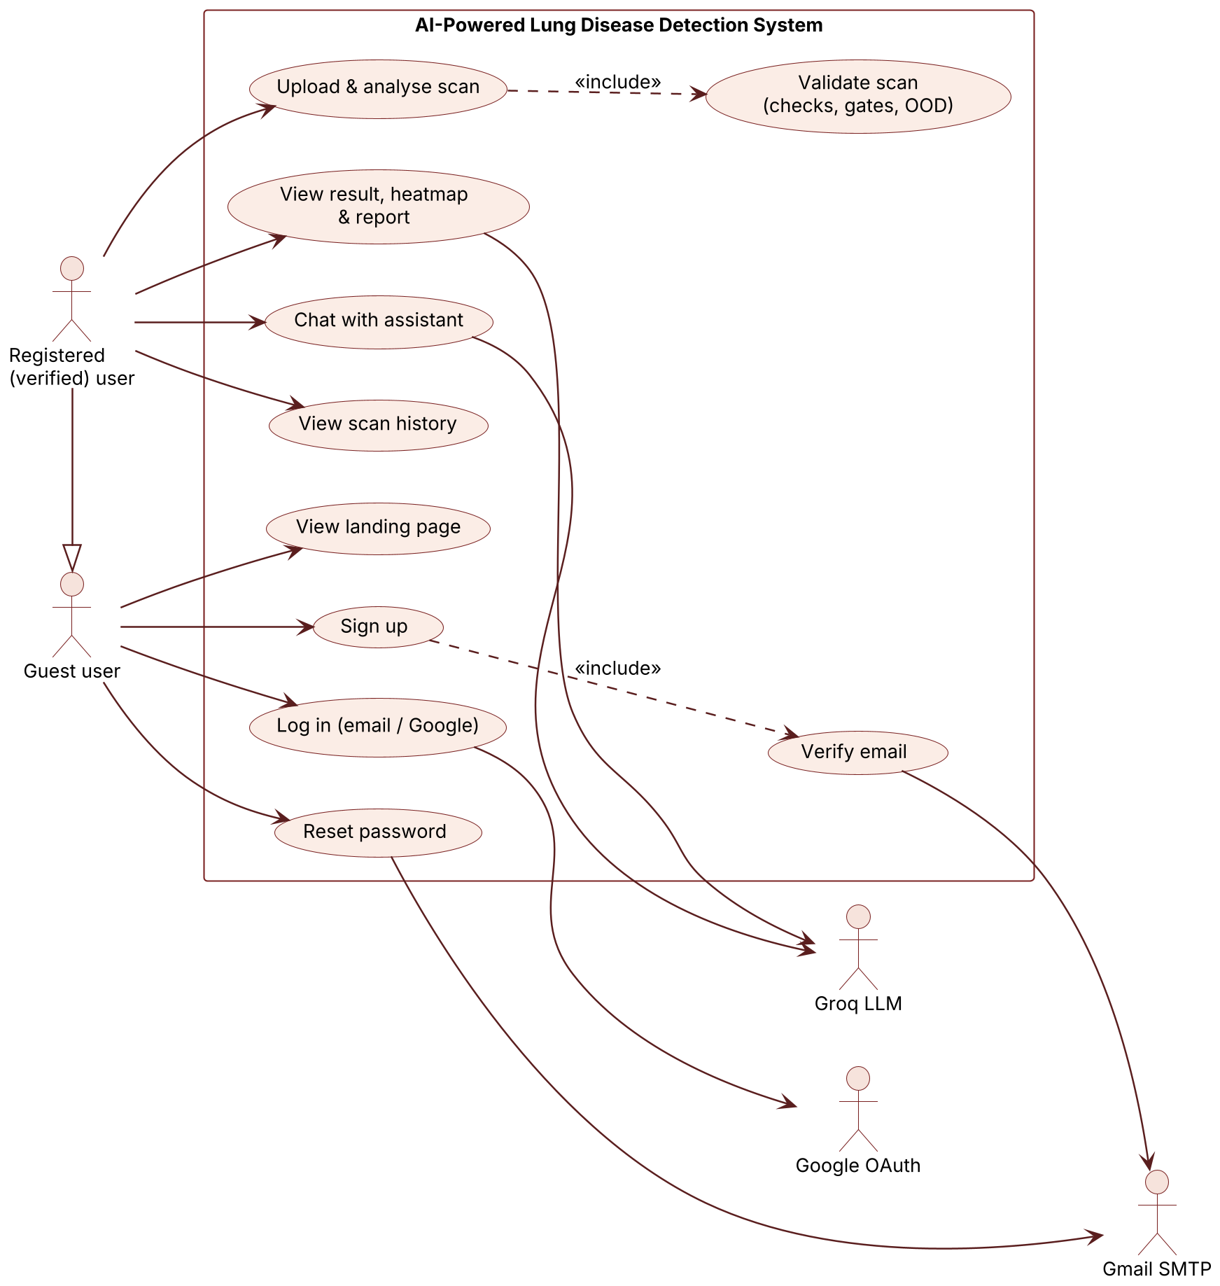
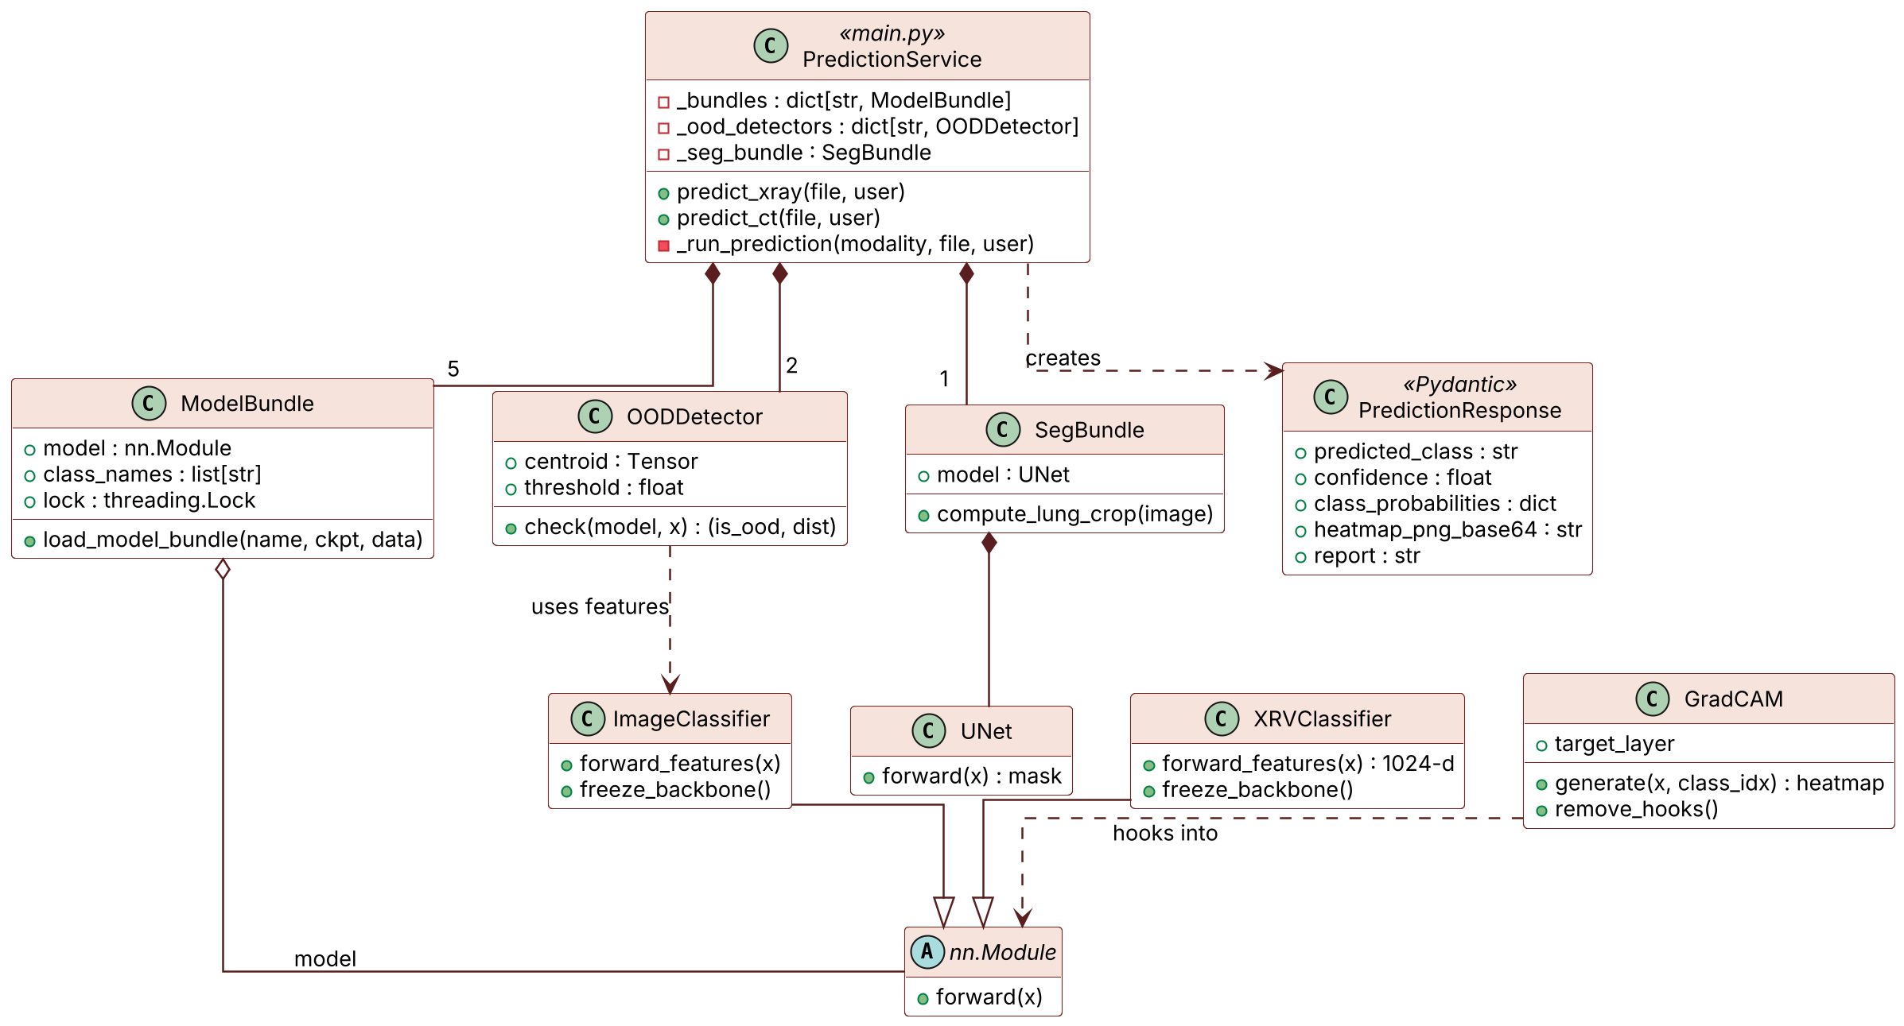
UML Modelling: Use Case & Class Diagrams
Class diagram of the back end (composition, inheritance, dependency)
Use case diagram: 2 actors, 3 external services
Notes:
Use case: a registered user inherits every guest use case; 'Upload & analyse scan' always includes 'Validate scan'; Groq, Gmail and Google OAuth are secondary actors. Class: PredictionService owns five ModelBundles (two sanity gates, the modality gate, two classifiers), two OOD detectors and one SegBundle wrapping the U-Net. ImageClassifier and XRVClassifier both inherit from PyTorch nn.Module; GradCAM hooks into the classifier; OODDetector uses the classifier's features. All diagrams were drawn in PlantUML.

Slide 8
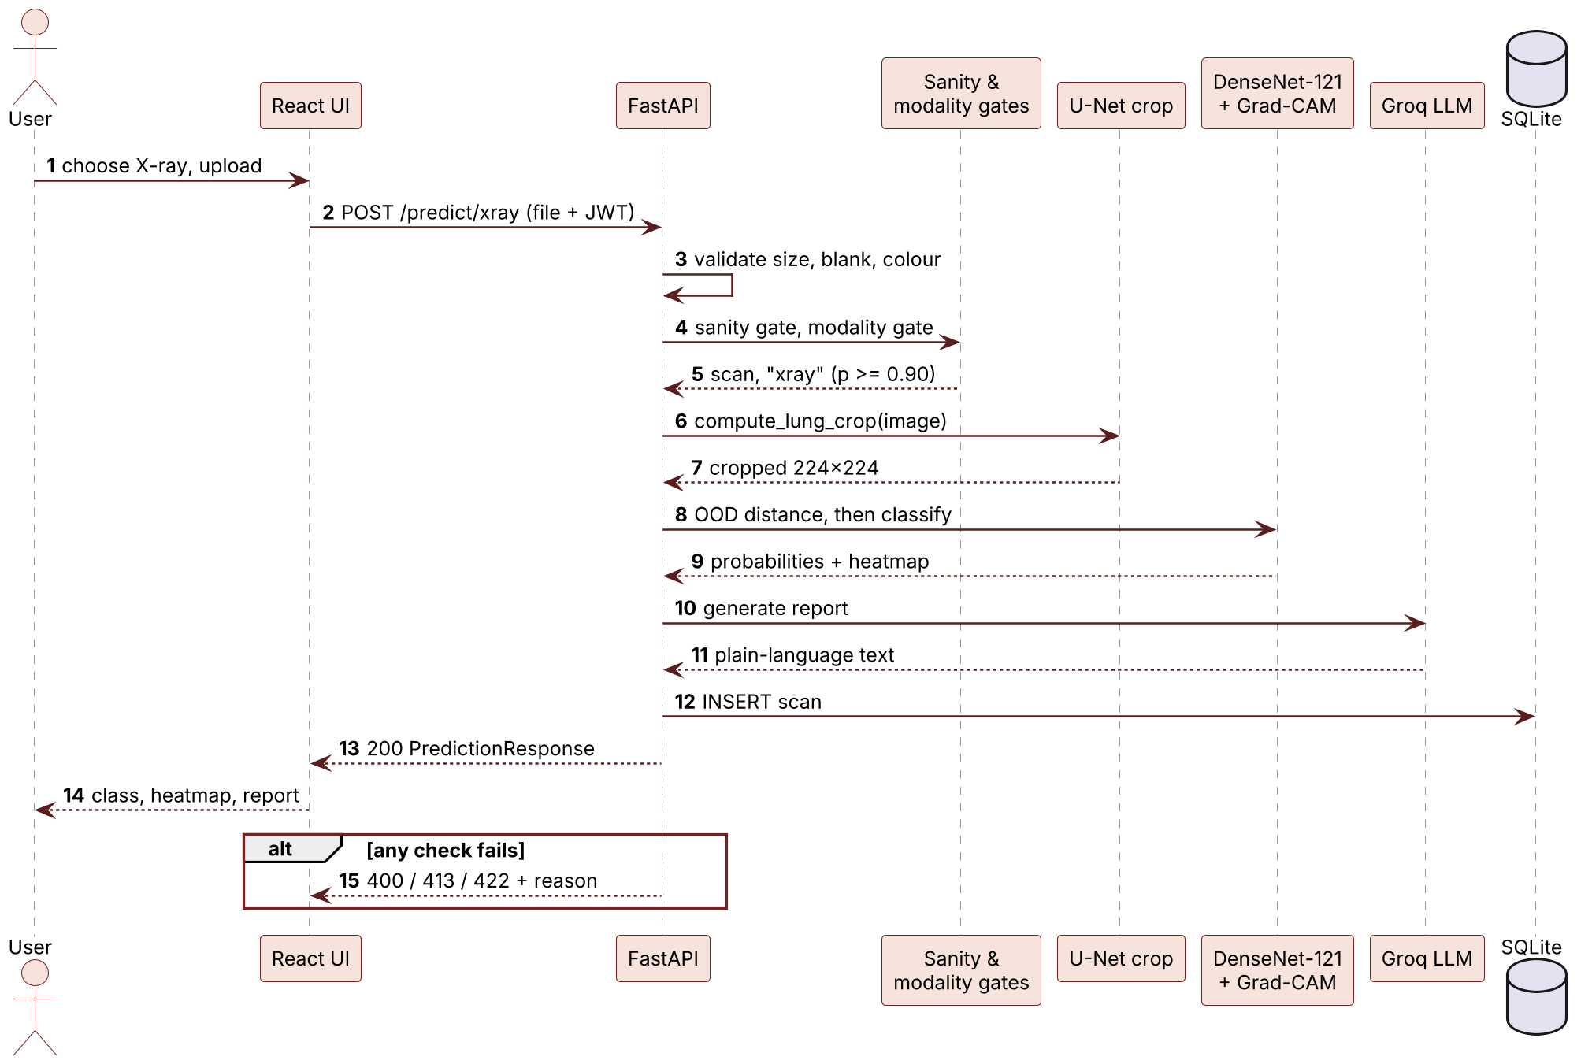
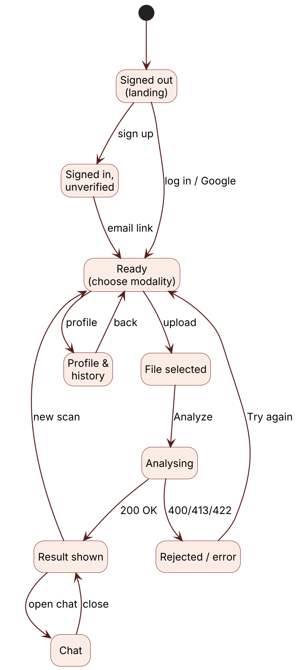
UML Modelling: Sequence & State (UX Flow)
UX design
One linear flow
Every rejection explained, with “Try again”
Progress checklist while analysing
Light / dark theme, works on phones
Sequence diagram: analysing a chest X-ray
State diagram of the UI
Notes:
Sequence: the UI posts the image with the session token; FastAPI validates it, calls the sanity and modality gates, crops the lungs, runs the OOD check and the classifier with Grad-CAM under one lock, asks the LLM for the report and stores the scan. If any check fails, the request stops there and the UI shows the reason. The state diagram is our UX model: signed out, unverified, ready, analysing, result or rejected, chat and history. A 401 at any point returns the user to signed out.

Slide 9
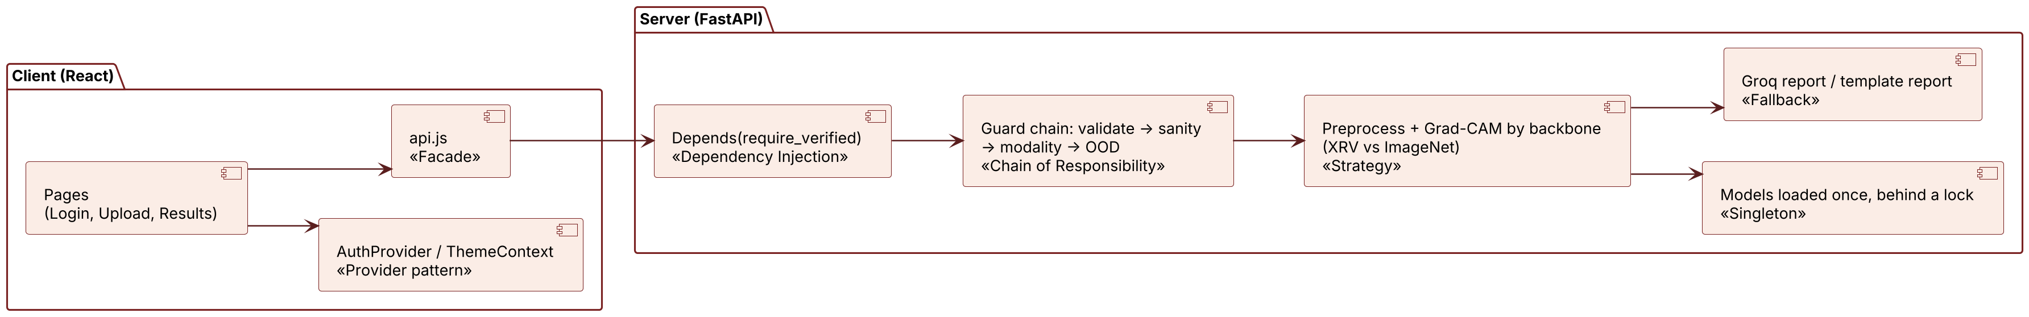
Design Patterns & API Structure
Pattern | Benefit in our system
Facade | One module owns URL, token and errors
Provider | Login and theme state shared with every page
Dependency Inj. | One verified-user check reused by protected routes
Chain of Resp. | Each guard can stop the request with its own reason
Strategy | X-ray/CT preprocessing swaps; same pipeline
Singleton | Six models loaded once, shared safely behind a lock
Fallback | A report is always returned, even if the LLM is down
Type | Interface | Used for
Web API | POST /predict/xray, /predict/ct | Analyse a scan
Web API | POST /chat | Chat assistant
Web API | /auth/* (9 routes) | Sign-up, login, reset
Web API | GET /scans/history, /health | History, status
Remote API | Groq (gpt-oss-120b) | Report and chat text
Remote API | Gmail SMTP, OAuth 2.0 | Email, Google sign-in
Library API | PyTorch, OpenCV | Models and images
Notes:
Top: where each pattern sits in the request path. Facade: frontend/src/api.js wraps every backend call and turns failures into one ApiError. Provider: AuthProvider and ThemeContext. Dependency injection: FastAPI Depends(require_verified_if_logged_in). Chain of responsibility: _run_prediction runs validation, sanity gate, modality gate and OOD in order; any stage can reject. Strategy: preprocessing and Grad-CAM are chosen by backbone (is_xrv_backbone). Singleton: models load once in _ensure_models_loaded under a lock. Fallback: report.generate_report returns a template if Groq fails. APIs: 15 REST routes defined with Pydantic schemas, three remote APIs, and library APIs for the models.

Slide 10
Detailed Design: Algorithm Selection
Module | Existing algorithms identified | Selected | Why selected
Disease classifier | VGG-16, ResNet-50, Inception-v3, EfficientNet-B0, DenseNet-121 | DenseNet-121 | Top weighted score (4.75); chest-X-ray weights; 8.0 M params
Lung segmentation | Otsu thresholding, FCN, SegNet, U-Net | U-Net | Skip connections keep lung borders; Dice 0.98 on validation
Scan & modality gates | Rule checks only, OOD check only, CNN binary classifier | ResNet-18 + rules | OOD alone let a CT slice through the X-ray route
OOD detection | Max-softmax, ODIN, Mahalanobis, energy score, centroid distance | Centroid L2, 99th pct | No retraining; Mahalanobis needs a 1024×1024 covariance, but CT has 829 images
Explainability | Saliency maps, LIME, SHAP, Grad-CAM | Grad-CAM | Class-specific, one backward pass; LIME/SHAP need hundreds of passes
CT leakage audit | Random split, patient-ID split, perceptual hash + SSIM | pHash + SSIM, union-find | No patient IDs in the data; random split gave a false 100%
Basis: every choice is checked against the constraints on Slide 4: laptop CPU, small single-source CT data.
Notes:
For each module we listed the standard alternatives and picked one against our constraints. Classifier: from the decision matrix. Segmentation: U-Net is the standard for biomedical segmentation with small data; reproduced Dice 0.983. Gates: the modality gate was added because a real CT slice passed the X-ray OOD check. OOD: maximum softmax probability is a weak signal for unfamiliar input (Hendrycks and Gimpel); Mahalanobis needs a full covariance that 829 CT images cannot estimate in 1024 dimensions, so we use Euclidean distance to the training-feature centroid with a 99th-percentile threshold. Explainability: Grad-CAM is fast enough to run on every request.

Slide 11
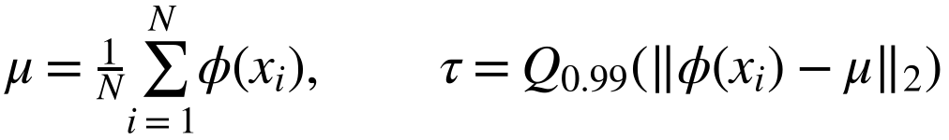
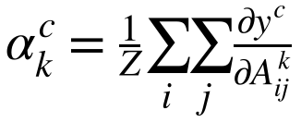
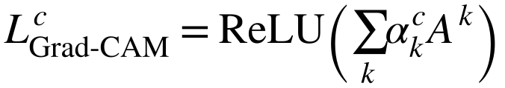

Pseudo Code & Mathematical Models
Algorithm 1: Predict(f, m, u)
Input : image file f, modality m ∈ {xray, ct}, user u
Output: class, confidence, probs, heatmap, report
or an HTTP error with a reason
1 if u signed in and not verified: return 403
2 img ← decode(f) // 413 if >10 MB, 400 if bad
3 if std(grey(img)) < 10 or colour > 20: return 400
4 x ← preprocess(img)
5 if SanityGate_m(x) ≠ scan: return 422
6 (m', p) ← ModalityGate(x)
7 if p < 0.90 or m' ≠ m: return 422
8 if m = xray: x ← preprocess(LungCrop(img))
9 lock classifier_m
10 if ‖φ(x) − μ_m‖ > τ_m: unlock; return 422
11 (probs, heatmap) ← Classifier_m(x) + Grad-CAM
12 unlock; warn if max(probs) < c_m
13 report ← LLM(m, probs) or template
14 if u signed in: save scan; return result
OOD detector (Module 5)
Grad-CAM (Module 6)
Class-weighted loss (Module 2)
Lung crop (Module 4)
fallback: 8% border crop if box <5% or >98% of image
Notes:
Algorithm 1 is the shared prediction pipeline for both routes, with inputs and outputs stated. The order matters: the sanity gate runs first because the modality gate has no 'neither' option; only images that pass both are lung-cropped; the OOD check and Grad-CAM run under one lock because Grad-CAM attaches hooks to the shared model. The report also gives pseudo code for training, the lung crop, the data audit and the start-up check. Right: the mathematical models behind the OOD detector, Grad-CAM, the class-weighted loss and the crop.

Slide 12
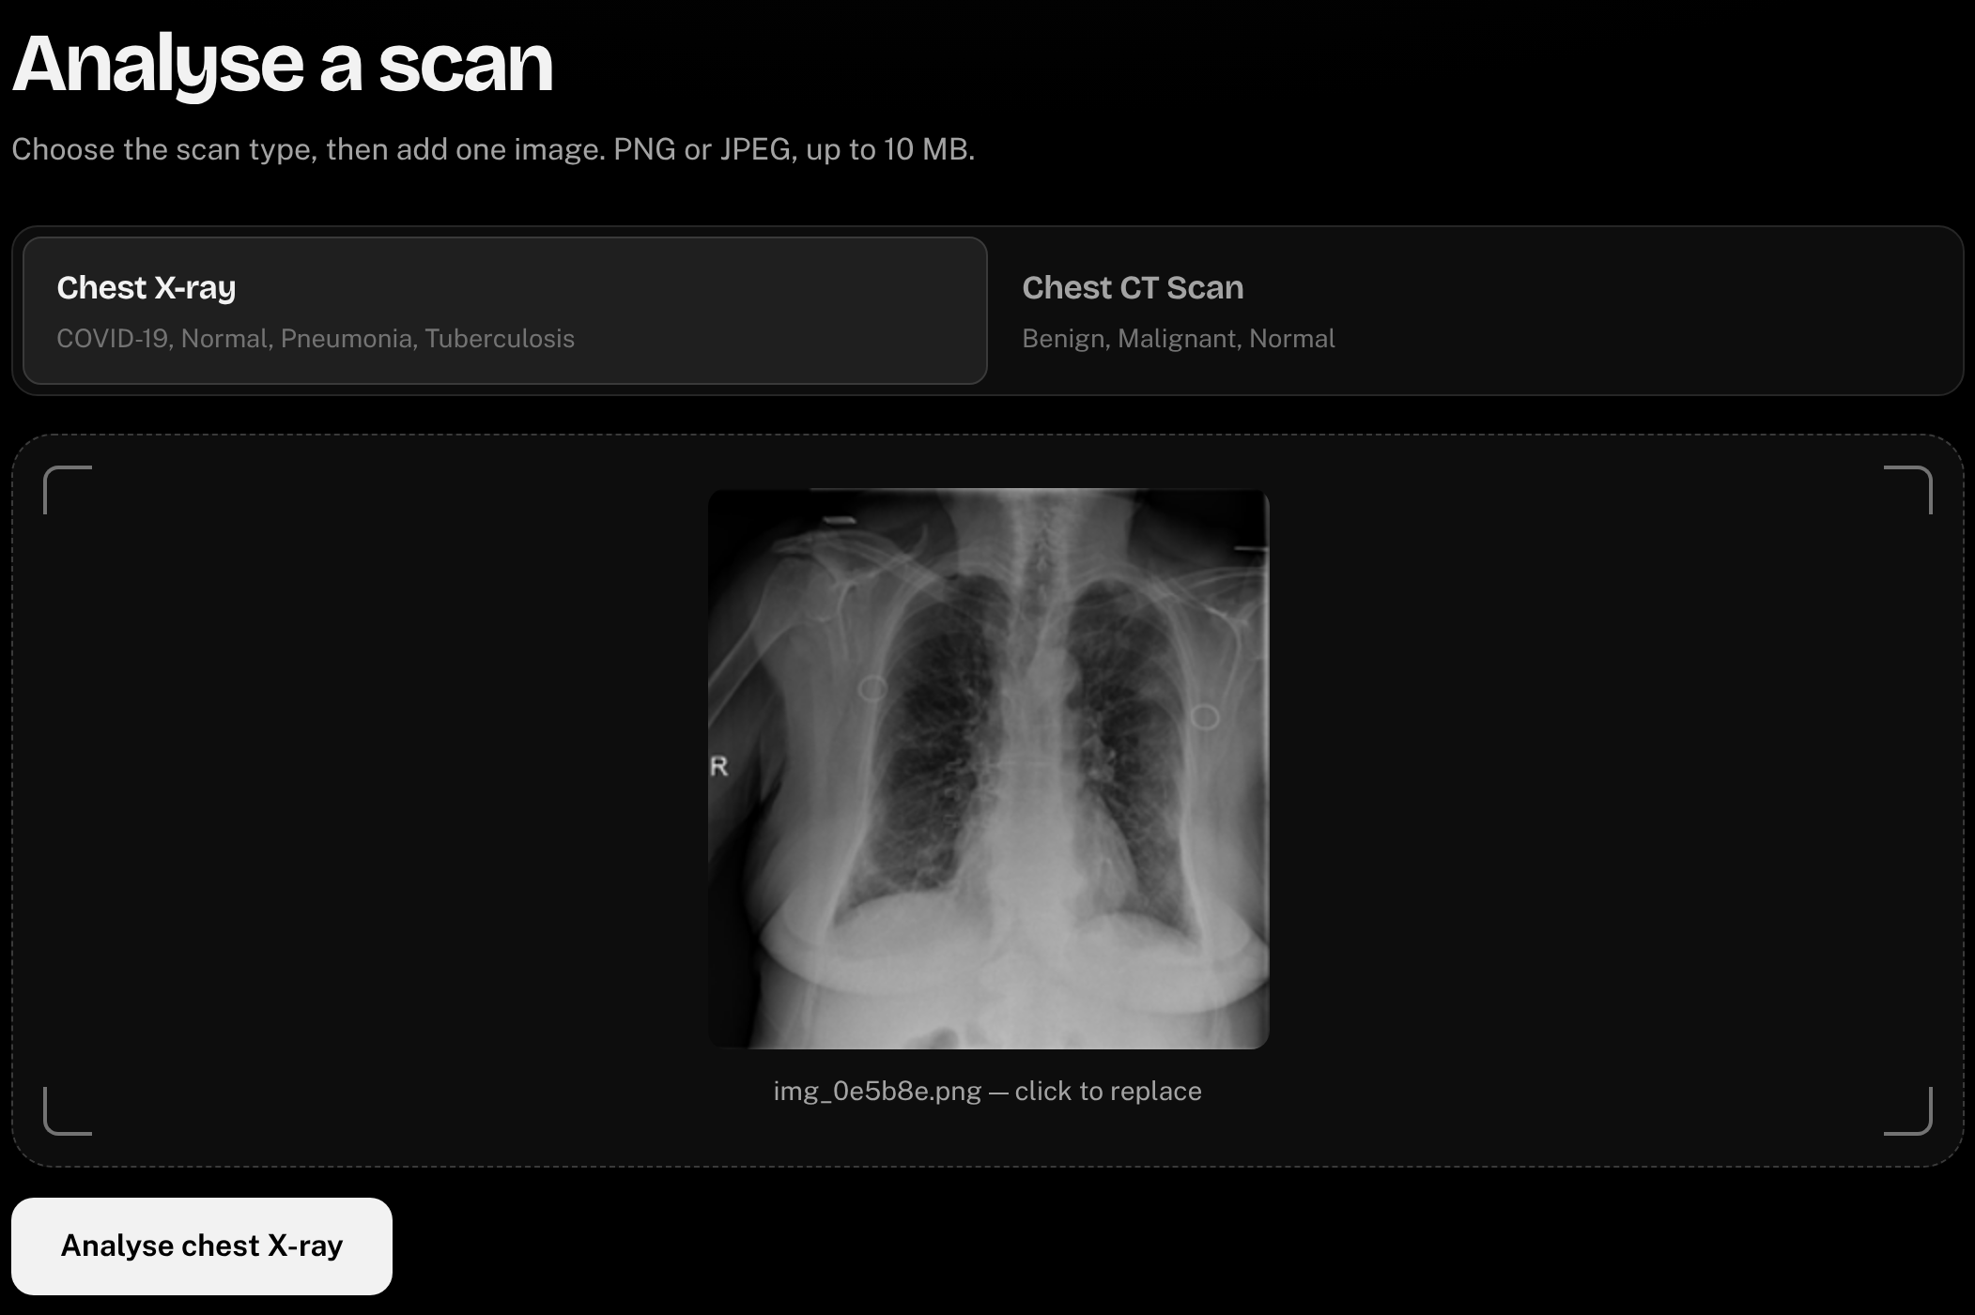
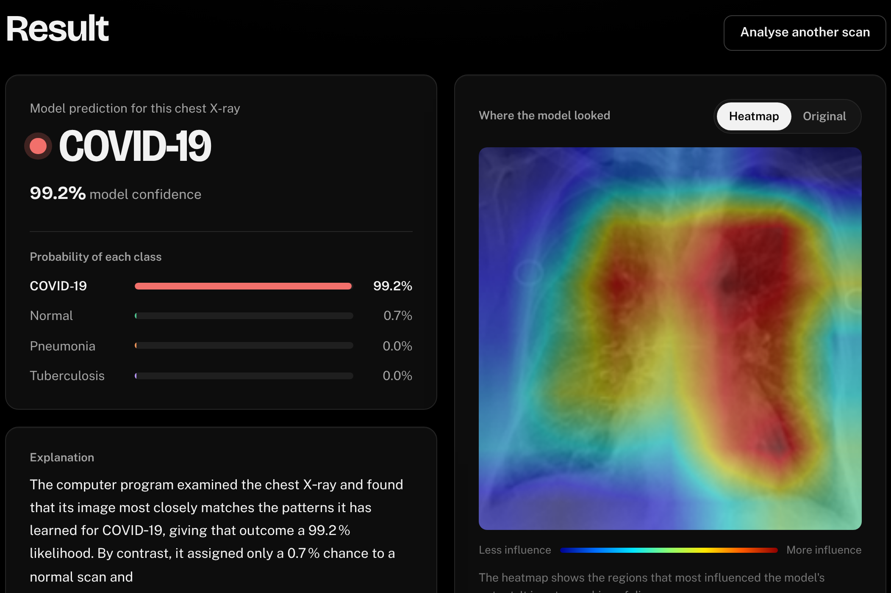
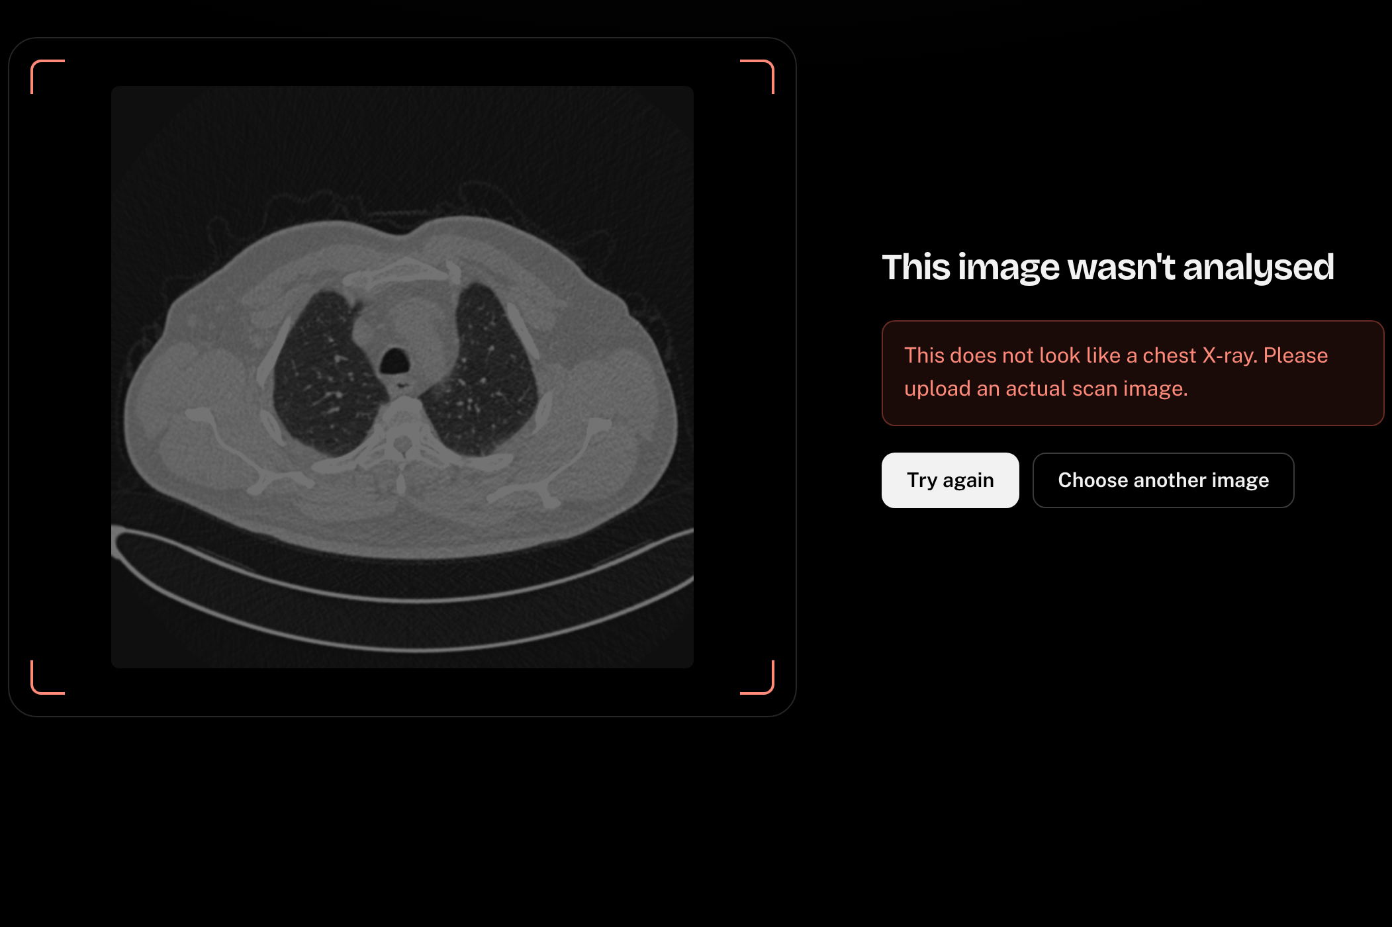
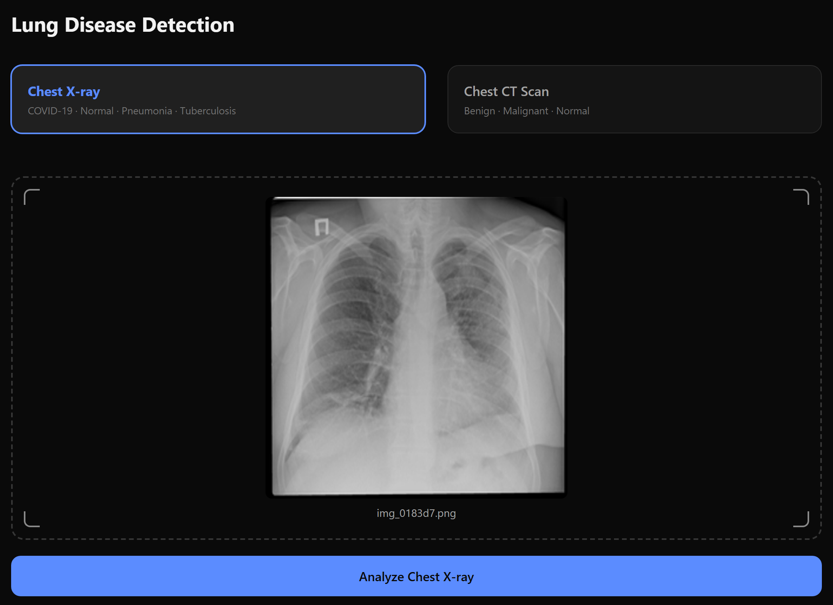
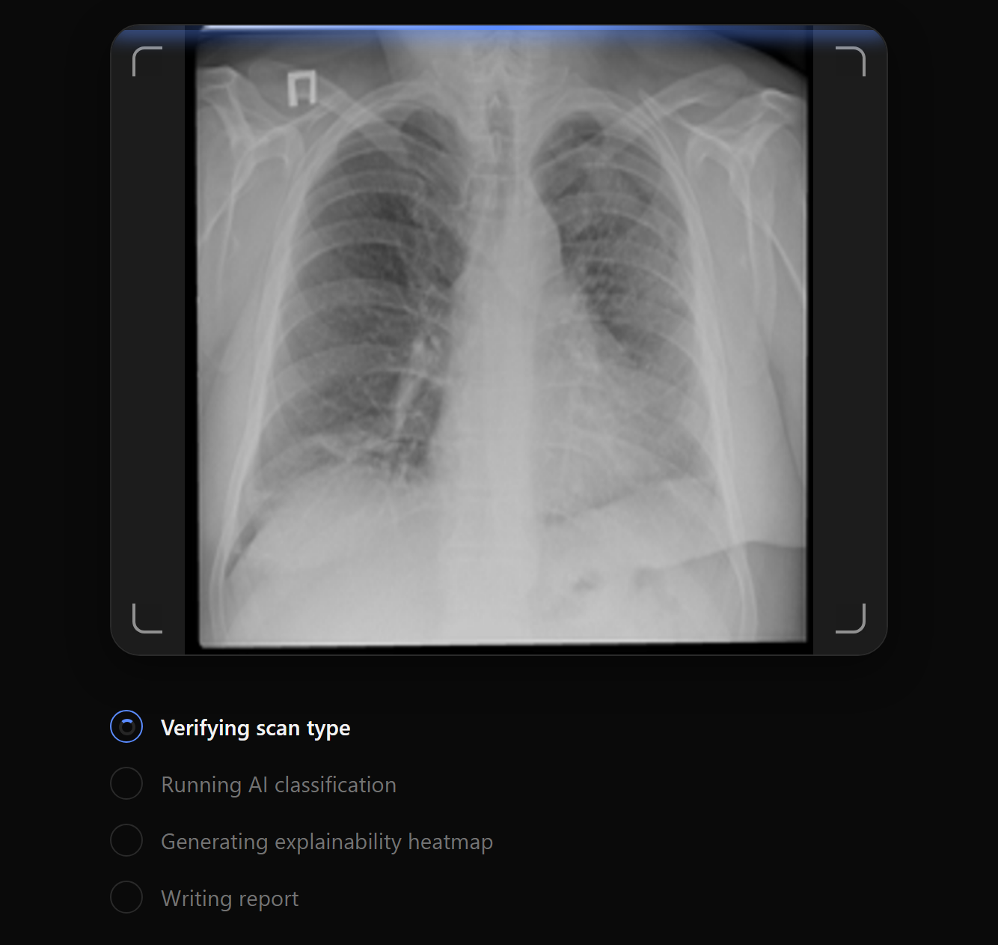
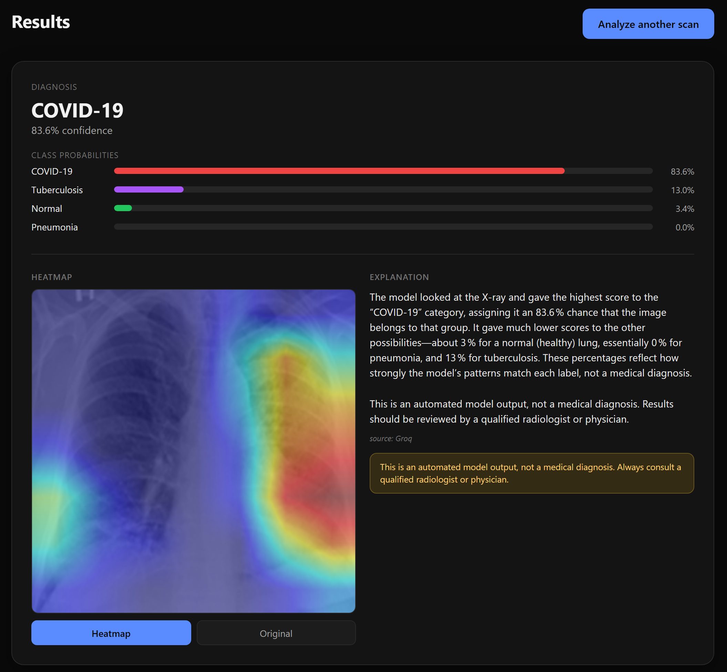
Implementation, Integration & Testing
1. Choose scan type and upload
2. Class, heatmap and explanation
3. Wrong scan type is refused
Modules built & integrated
Module testing
Tools used
All 12 designed modules work end to end (rubric asks 50–60%)
OOP model classes, procedural API routes
PEP 8 names, docstrings, type hints
pytest + httpx: 59 automated unit and API tests
Guardrail tests: photos, wrong scan type, blank, corrupt
183-image live end-to-end run; concurrency test
UML: PlantUML
Report: LaTeX (Overleaf)
IDE and version control: VS Code, Git
Training: PyTorch on Google Colab
Testing: pytest, httpx, Playwright
Notes:
Demo point: sign in, upload an X-ray, show the heatmap and report, ask the chatbot, then upload a photo to show a rejection. Implementation: data preparation and audit, classifier training, gates, U-Net crop, OOD detector, classification with Grad-CAM, report and chat, start-up check, authentication, rate limiting, front end and deployment are all built and connected. Testing: the backend suite in backend/tests covers authentication, prediction, every rejection path, chat limits and origin handling, with SMTP and Groq mocked. Tools: PlantUML for the UML models, LaTeX for the report, pytest for testing.

Slide 13
Thank You
AI-Powered Lung Disease Detection System
Under the guidance of : Prof. Indira Bidari · Assistant Professor
Sharan Pachapuri, Sampad Gaonkar, Vijet Nayak · B.E. CSE, 7th Semester
Notes:
Thank the panel and invite questions.

