Slide 1

Department of Computer Science and Engineering
Senior Design Project — Review 3
Code: 20ECSW401 VII Sem Year: 2026-27
Project Title: AI-Powered Lung Disease Detection System
Screens chest X-rays and CT slices, explains every prediction, and refuses images it can't handle.
Team Details
Sl.no | Name | USN
1. | Sharan Pachapuri | 01FE23BCS027
2. | Sampad Gaonkar | 01FE23BCS024
3. | Vijet Nayak | 01FE22BCS324
Under the guidance of : Prof. Indira Bidari, Assistant Professor
Notes:
Introduce the team and guide. Review 3 covers the complete working project and its demonstration, result analysis and comparison with existing systems, each member's contribution, the LaTeX report, and the IEEE paper draft.

Slide 2
Contents
1. Project Status
2. Test Cases for Every Module
3. Requirements Verification
4. Results: Internal vs External Accuracy
5. Comparison with Existing Systems
6. Project Contributions
Notes:
Six content slides in the order of the Review-3 expectations: the results (PI 12.2.2; the demo is shown live, outside the deck), individual contributions (PI 8.1.2), the report (PI 9.1.2) and the paper (PI 7.2.1).

Slide 3
Project Status: Complete and Deployed
12 / 12
81
96.5 / 99.0
AWS EC2
designed modules built and integrated
automated tests, all passing
% internal accuracy (X-ray / CT)
public HTTPS deployment (Docker + Caddy)
Review-3 expectations and where we stand
Demo of complete working project
Source code, live demo on all legitimate inputs, result analysis, comparison
Individual contributions
Modules implemented and presented by each member
1
2
Report in LaTeX
81-page report, Overleaf (pdfLaTeX), all figures and tables captioned
Paper draft
Submitted to Project Innovation Contest 2027 (Paper ID 178)
3
4
Notes:
Everything planned in Review 2 is built, integrated, tested and hosted. The four bottom cards are the four Review-3 expectations from the circular; the demo is done live, the others are covered later in the deck.

Slide 4
Test Cases for Every Module
Test file | Tests | Modules covered
test_predict.py | 13 | Gates, OOD, lung crop, classifier, Grad-CAM, history, 403 for unverified
test_auth.py | 13 | Sign-up, verification, login, reset, change password, JWT
test_public_origin.py | 21 | Allowed origins for links and Google sign-in, OAuth state tampering
test_serve.py | 15 | Single-origin hosting: front end at /, API at /api, SPA fallback
test_public_proxy.py | 12 | Real client IP behind the proxy, rate limits, chat caps
test_groq.py | 4 | LLM replies, report fallback when the LLM fails or is cut off
test_health.py | 3 | Start-up: all models loaded, /health status
Total | 81 | All pass (pytest, Python 3.12)
Integration testing
Full test split through the live API: 1,922 X-rays and 103 CT slices
Live HTTP: photos, screenshots, documents, blank, noise and corrupt files all refused correctly
12 concurrent requests = sequential results
Mean latency 1.26 s (X-ray), 1.29 s (CT)
Start-up check reproduces every model's validation metric
Notes:
81 pytest tests in seven files start the real application with all six models, a temporary database and mocked SMTP and Groq. Integration testing: the full test split (1,922 X-rays, 103 CT slices) was sent through the live API with every guard on; live HTTP guard tests; 12 concurrent predictions matched the sequential results exactly.

Slide 5
Requirements Verification
ID | Functional requirement | ✓
FR1–2 | Accept scans; reject empty, corrupt, blank, colour | ✓
FR3–4 | Reject non-scans, wrong modality, OOD images | ✓
FR5–6 | Classify X-ray (4) and CT (3); U-Net lung crop | ✓
FR7–9 | Grad-CAM, non-diagnostic report, chat | ✓
FR10–11 | Accounts, verification, Google sign-in, history | ✓
FR12 | Verify model metrics at start-up | ✓
ID | Non-functional requirement: result | ✓
NFR1 | Performance: 1.26 s / 1.29 s per request | ✓
NFR2 | Correctness: start-up check reproduces metrics | ✓
NFR3 | Security: bcrypt, signed JWT, rate limits | ✓
NFR4 | Usability: every rejection in plain English | ✓
NFR5 | Safety: disclaimer on every result | ✓
NFR6 | Maintainability: one .env; 81-test suite | ✓
Verified by: 81 automated tests, 15 acceptance tests on the running system (A01–A15), and the full test split through the live API. Hosted container skips the start-up check (no validation data on the server); it is run on the development machine.
Notes:
Every functional and non-functional requirement from Review 2 was checked, either by an automated test (T-numbers in Chapter 6 of the report) or by an acceptance test on the running system (A01–A15).

Slide 6
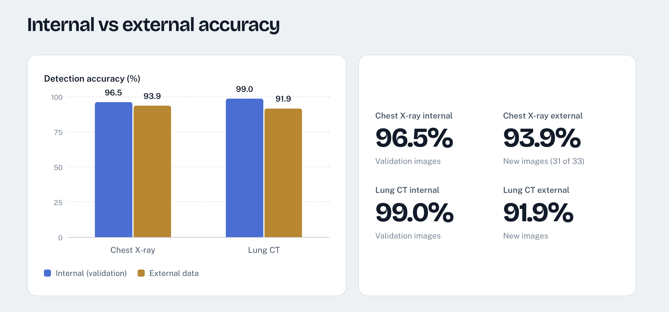
Results: Internal vs External Accuracy
Notes:
Accuracy on internal validation images and on new external images, as shown on the project website. Chest X-ray: 96.5% internal, 93.9% external (31 of 33 accepted images). Lung CT: 99.0% internal, 91.9% external.

Slide 7
Comparison with Existing Systems
System | Data / task | Reported result | Two modalities | Input guards | Leakage audit | External test
CheXNet (Rajpurkar 2017) | ChestX-ray14, pneumonia | F1 0.435 (radiologists 0.387) | No | No | – | No
Chowdhury et al. 2020 | X-ray, 3 classes | 97.9% accuracy | No | No | – | No
Mirugwe et al. 2025 | X-ray, TB vs Normal | 99.4% (VGG-16) | No | No | – | No
Benamara et al. 2025 | IQ-OTH/NCCD CT | 99.54% accuracy | No | No | No | No
This project | X-ray 4 classes + CT 3 classes | 96.5% / 99.0% internal; 93.9% / 91.9% external | Yes | Yes | Yes | Yes
Takeaway: our accuracy is in the same range as published work, and ours is the only system here that covers two modalities, refuses invalid inputs and was tested on external data.
Notes:
Published accuracies are in-distribution: tested on images from the same sources as training. On that basis our 96.57% and 98.06% are in the same range. What differs is the system: two modalities, input guards, a leakage audit, and an external test. The external test is what exposes the generalisation gap, which none of the compared studies measured.

Slide 8
Project Contributions
Module (Report Ch. 5.3) | Sharan Pachapuri | Sampad Gaonkar | Vijet Nayak
M1 Data Preparation and Audit | ✓
M2 Disease Classifier Training | ✓
M3 Sanity Gate and Modality Gate | ✓
M4 Lung Segmentation and Crop | ✓
M5 Out-of-Distribution Detector | ✓
M6 Classification and Grad-CAM | ✓ | ✓ | ✓
M7 Report Generation and Chat Assistant |  | ✓ | ✓
M8 Start-up Reproduction Check |  | ✓ | ✓
M9 Authentication, Sessions and Access Control |  | ✓ | ✓
M10 Rate Limiting and Error Handling |  | ✓ | ✓
M11 Front End |  | ✓ | ✓
M12 Deployment (AWS EC2, Docker, Caddy) | ✓
Initial project plan |  | ✓
Documentation: report, IEEE paper, PPT |  | ✓ | ✓
Testing, problem-solving and improvements | ✓ | ✓ | ✓
Notes:
Each member presents the tasks ticked against their name. Everyone shared problem-solving ideas, testing and improvements; the rubric (PI 8.1.2) marks every member individually.

Slide 9
Thank You
AI-Powered Lung Disease Detection System
Under the guidance of : Prof. Indira Bidari · Assistant Professor
Sharan Pachapuri, Sampad Gaonkar, Vijet Nayak · B.E. CSE, 7th Semester
Notes:
Thank the panel and invite questions.

