Slide 1

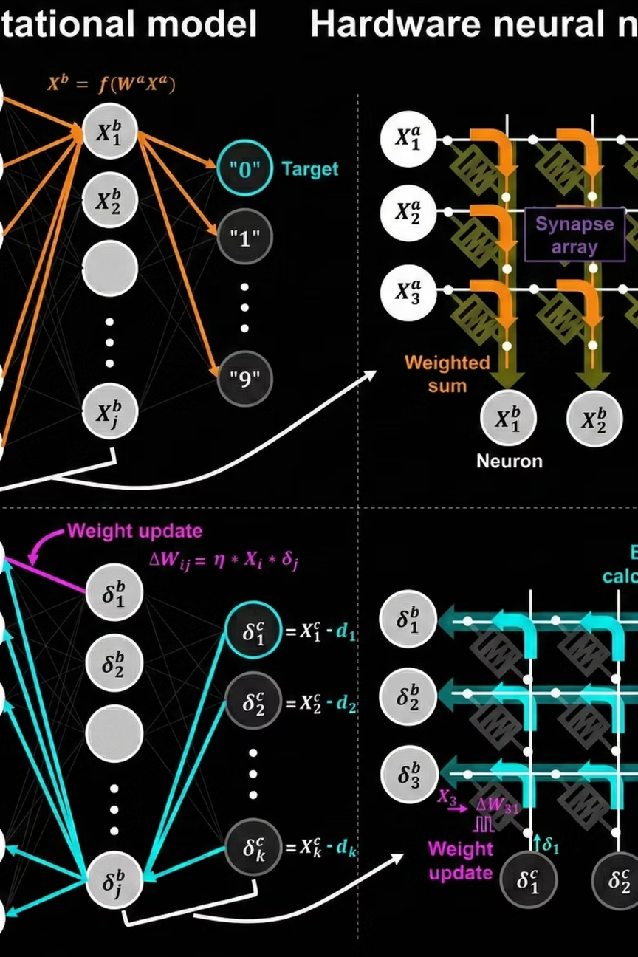
In-Memory Computing Accelerator for Energy-Efficient Matrix Computation
Breaking the Von Neumann Bottleneck with In-Memory Computing.
TEAM-CHAGGAN BYTES

Slide 2



PROBLEM
The Core Problem: Data Movement
Processor
Executes computations on data
High Latency
Frequent data transfers between memory and processor introduce significant access latency.
Memory access delays increasingly dominate total execution time.
High Energy Cost
Moving data consumes more energy than arithmetic operations.
In modern systems, data movement, ot computation is the primary energy bottleneck
Memory
Memory
Stores data for processing
Returns results and state
Current architectures suffer from the Von Neumann Bottleneck. Fetching weights from DRAM consumes 100x more energy than the computation itself.

Slide 3



INSIGHT
Processing-In-Memory (PIM)
Move Compute to Data, Not Data to Compute - OTP
Computation Inside Memory
Reduce Data Transfers
Improve Energy Efficiency
Eliminate unnecessary movement between memory and processor
We implemented a 2×2 PIM crossbar that performs PIM multiply accumulate (MAC), the core operation of neural networks
Lower power consumption by minimizing data movement

Slide 4
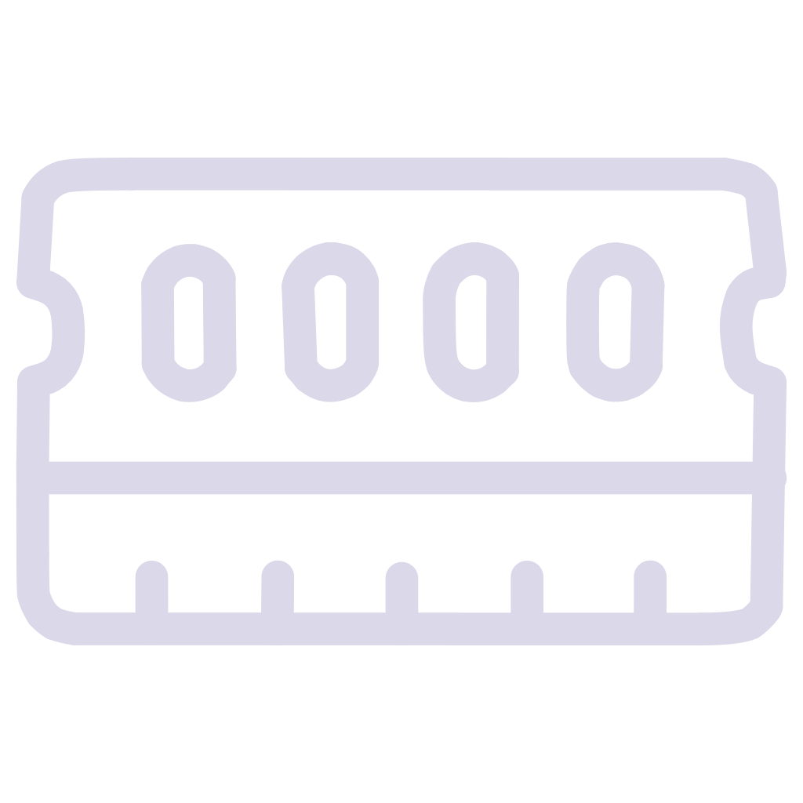



SOLUTION
PIM's Potential: Core Advantages
Processing-In-Memory (PIM) fundamentally reshapes how data is handled, moving computation closer to storage to resolve the traditional data movement bottleneck.
Computation Inside Memory
Arithmetic operations are executed directly where data is stored, minimizing the need for constant data transfers.
Reduced Data Transfers
Eliminates repeated and inefficient memory-processor communication, freeing up bandwidth.
Improved Energy Efficiency
Lower power consumption is achieved by minimizing costly off-chip and on-chip data movement, which traditionally consumes more energy than computation itself.
Higher Throughput
Enables massive parallel operations directly within memory arrays, significantly accelerating processing for data-intensive tasks.

Slide 5
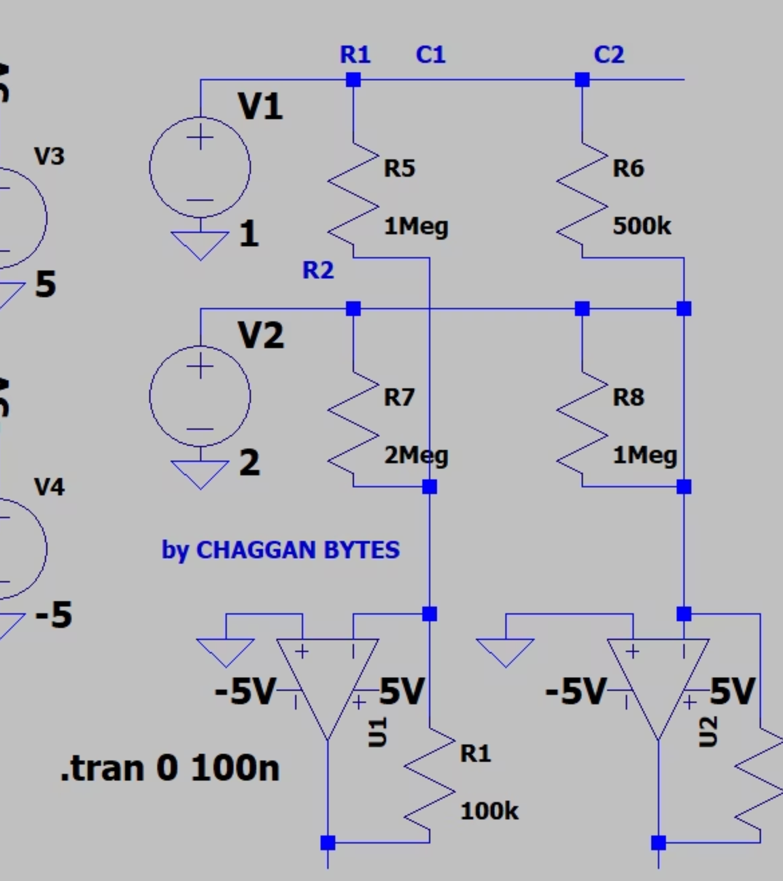


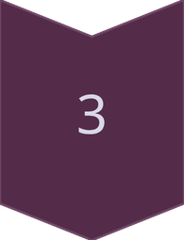
SOLUTION
Proposed Solution
PIM Module
A dedicated Processing-In-Memory architecture integrated with memory.
Matrix Operations
Matrix–vector multiplication (core operation for AI and DSP workloads).
Analog Computation
Computation implemented using a resistive crossbar array.

Slide 6
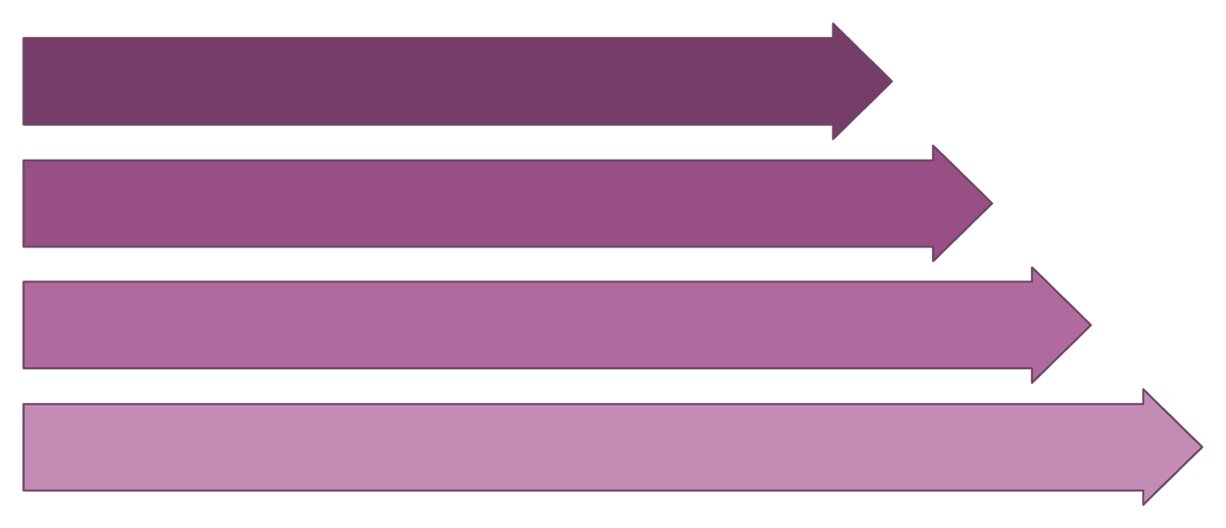
SOLUTION
How Computation Works
Apply Inputs
Store Weights
Multiply
Add
Inputs & Weights
Core Computation
Parallel Efficiency
Input signals are analog voltages, and matrix weights are stored as programmable resistances in the crossbar array.
Ohm's Law performs multiplication at each cross-point, while Kirchhoff's Law naturally sums currents for dot-product results.
The array's architecture enables simultaneous operation across all rows and columns, facilitating highly parallel computation.

Slide 7

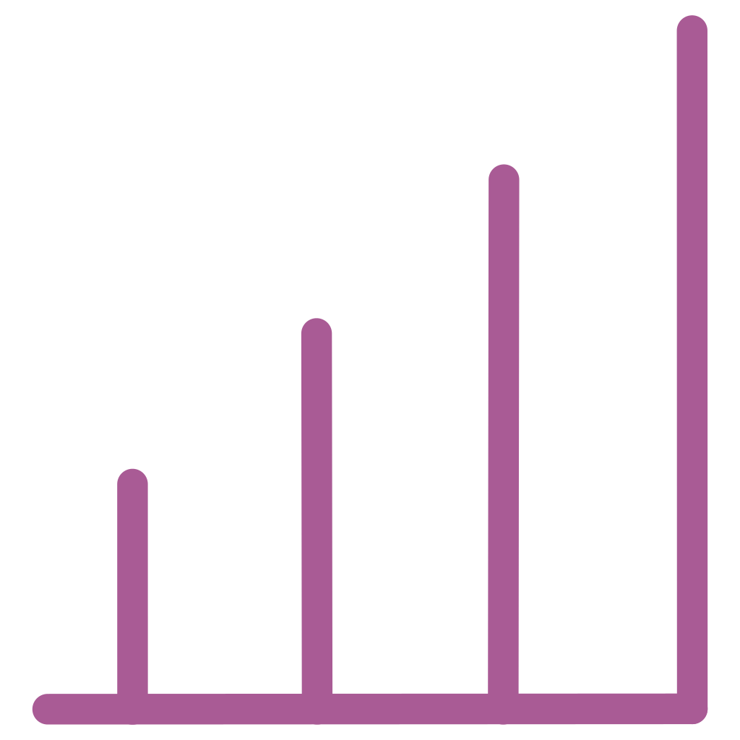

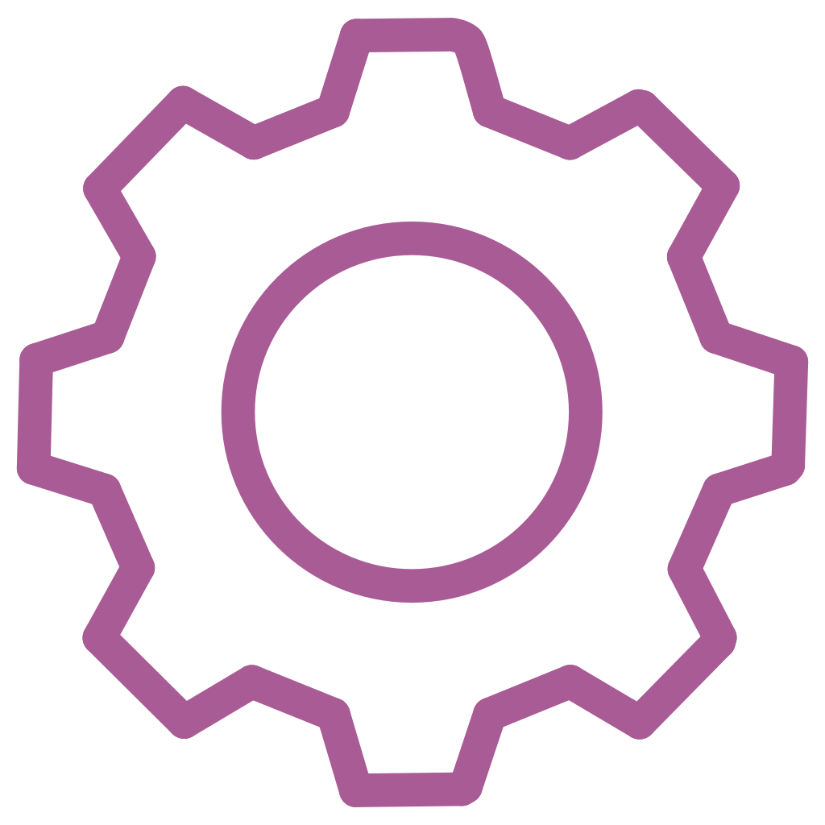
IMPACT
Why This Matters: Driving Future Innovation
AI & Edge Devices
Real-Time Signal Processing
PIM addresses the critical need for energy-efficient AI computation in resource-constrained edge environments, enabling advanced processing closer to the data source.
Achieve the high throughput and ultra-low latency required for demanding real-time applications such as radar, sonar, and advanced medical diagnostics.
Scalable Architecture
System-Level Efficiency
PIM offers a scalable and sustainable path forward for future data-centric computing architectures, overcoming the limitations of traditional Von Neumann systems.
Significantly reduces memory bandwidth pressure and enhances overall system efficiency, leading to faster processing and lower operational costs across various applications.

Slide 8
Current Status & Next Steps
Hackathon Scope
Future Work
Block-level architecture design
Scale Array Size
Crossbar concept validation
Increase crossbar dimensions
SPICE-based modeling in progress
Improve Accuracy
Feasibility demonstration
Optimize analog circuit design
Energy efficiency analysis
Hardware Integration
Full system implementation
This project explores a hardware-level solution to modern computing limitations.

