Slide 1
Introduction to Resilience4j A Java library for resilience patterns
Sharan B

Slide 2
Agenda
Netflix Hystrix
Resilience4j
Why Resilience4j?
Resilience4j Modules
Demo
Q/A
2

Slide 3
Netflix Hystrix
Netflix Hystrix is a library designed to handle fault tolerance and latency tolerance in distributed systems. It was originally developed by Netflix and open-sourced as part of their cloud architecture. Hystrix helps developers build resilient and fault-tolerant systems by providing mechanisms such as circuit breakers, fallbacks, and isolation of services.

Slide 4
Resilience4j
Resilience4j is an alternative lightweight fault-tolerant library for handling resilience and fault tolerance in distributed systems.
Inspired from Netflix Hystrix and designed for java8 and functional programming. It is built on top of functional language extension to java8, which does not have any other external library dependencies.
It provides several resilience patterns and features that help developers build robust and resilient applications.
Resilience4j is designed with simplicity and flexibility in mind, making it easy to integrate with existing code and libraries.

Slide 5
Why Resilience4j ?
Lightweight and Modular
Functional Programming Paradigm
Easy Integration
Configuration Flexibility
Event Notification
Prometheus Integration
Java 8+ Features and Reactive Compatibility
Actively Maintained
Open Source and License

Slide 6
Resilience4j Modules
Circuit Breaker
BulkHead
Rate Limiter
Time Limiter
Retry
Cache

Slide 7
Circuit Breaker Module
The circuit breaker is essentially a pattern that helps to prevent cascading failures in system
The circuit breaker pattern allow us to build a fault-tolerant and resilient system that can survive gracefully when key/remote services are either unavailable or have high latency.
Generally, It is widely used in distributed systems to handle faults in microservices or other networked components.
The circuit breaker is implemented via a finite state machine with three normal states: CLOSED, OPEN and HALF_OPEN and two special states DISABLED and FORCED_OPEN.

Slide 8
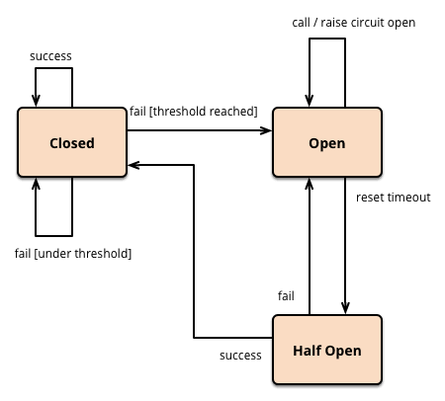
Circuit Breaker ..
The Circuit Breaker has three states,
CLOSED: The circuit is closed, and calls are allowed to pass through.
OPEN: The circuit is open, and calls are blocked, directing them to the fallback method.
HALF_OPEN: In this state, a limited number of calls are allowed to pass through to check if the downstream system has recovered.
The Circuit Breaker supports two more special states, DISABLED (always allow access) and FORCED_OPEN (always deny access). In these two states no Circuit Breaker events (apart from the state transition) are generated, and no metrics are recorded. The only way to exit from those states are to trigger a state transition or to reset the Circuit Breaker

Slide 9
Circuit Breaker ..
Transition between States:
The CircuitBreaker transitions between states based on the configured failure and volume thresholds.
When the failure threshold is exceeded, the circuit breaker transitions to the OPEN state.
After a cooldown period, the circuit breaker transitions to the HALF_OPEN state, allowing a limited number of calls to pass through.
If these calls succeed, the circuit breaker transitions back to the CLOSED state. Otherwise, it returns to the OPEN state.
Fallback Mechanism:
When the circuit is in the OPEN state, calls are directed to a fallback method or value.
You can provide a custom fallback method or use a default one provided by Resilience4j.
Event Listeners:
Resilience4j allows you to register event listeners to be notified of state changes, such as when the circuit breaker transitions between states.
The CircuitBreaker uses a sliding window to store and aggregate the outcome of calls. You can choose between a count-based sliding window and a time-based sliding window. The count-based sliding window aggregates the outcome of the last N calls. The time-based sliding window aggregates the outcome of the calls of the last N seconds.

Slide 10
Bulk Head..
The bulkhead pattern is a type of application design that is tolerant of failures.
When to use?
Apply the bulkhead pattern whenever you want to scale a service independent of other services.
Isolate resources used to consume a set of backend services.
Resilience4j provides two implementations of a bulkhead pattern that can be used to limit the number of concurrent execution:
SemaphoreBulkhead which uses Semaphores : Here we limit the no of concurrent requests to the services. Once the limit has been reached it starts rejecting the incoming requests.
FixedThreadPoolBulkhead which uses a bounded queue and a fixed thread pool : Here we isolate a set of thread pool from system resources. Use only this thread pool and waiting queue for the services. If both threadpool and waiting queue full then in that case The requests will get rejected with BulkHeadFullException

Slide 11
Ratelimiter..
RateLimiter pattern helps us to make our services highly available just by limiting the no of calls We could process in a specific window.
If the client exceeds this limit, further requests can be either be declined or processed in a later window or be services by allocating a smaller amount of resources or by providing by on best effort guarantees.
Rate limiting specified in terms of
Requests per Second(RPS)
Requests per Minute(RPM)
Requests per Hour(RPH)
There are two way to limit the Rate
Client-side rate limiting
- Resilience4j-ratelimiter
Server-side rate limiting
- Kong API Gateway
- Response API Filter

Slide 12
Timelimiter..
Here we set a limit on the amount of time we are willing to wait for an operation to complete
If the operation does not complete withing the time specified window, We want to be notified about it with a timeout error.
Resilience4j’s TimeLimiter can be used to set time limits(timeouts) on asynchronous operations.
Resilience4j Time limiter configurations,
timeoutDuration: 1s
cancelRunningFuture: false/true

Slide 13
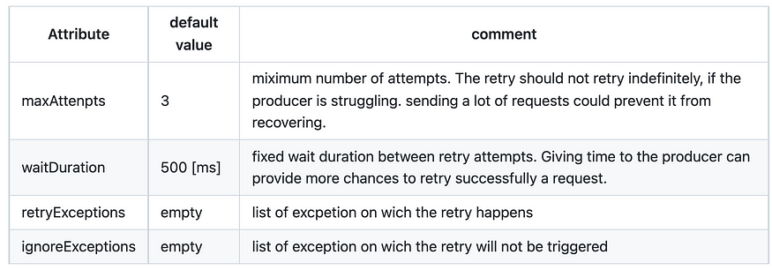
Retry..
The Retry patterns allows consumer to automatically retry a failed remote operations.
Its can be used whenever we assume that an unexpected response or no response for that matter, Can be fixed by sending the request again..
Retries can be useful in case of
Temporary network problems such as packet loss, loss of network connectivity, timeouts requests.
Internal errors of the target service, e.g. caused by an outage of a database.
No or slow responses due to a large number of requests for the target service.

Slide 14
Introduction to Resilience4j A Java library for resilience patterns
DEMO

Slide 15
Introduction to Resilience4j A Java library for resilience patterns
https://resilience4j.readme.io/v1.2.0/docs/circuitbreaker
QnA

